Slide 1

Meo Electric
Tagline here

Slide 2
Let’s talk about electric vehicles

Slide 3
The future of filling up
Combustion Engine Vehicles
Plug-in Electric Vehicles

Slide 4


Who we are
Meo is ___

Slide 5
Meo Electric offers personalised, all-inclusive electric vehicle charging solutions.
Graphic for consultation, sales, installation, monitoring

Slide 6






EVSE Market
Brand |  |  | (United States)
Hardware
Installation | Independent contractor | Independent contractor | Licensed installer
Monitoring/ Networking

Slide 7


EVSE Market
Brand |  |  | (United States)
Hardware
Installation | Independent contractor | Independent contractor | Licensed installer
Monitoring/ Networking

Slide 8
EVSE Market
Brand |  |  | (United States)
Hardware
Installation | Independent contractor | Independent contractor | Licensed installer
Monitoring/ Networking

Slide 9
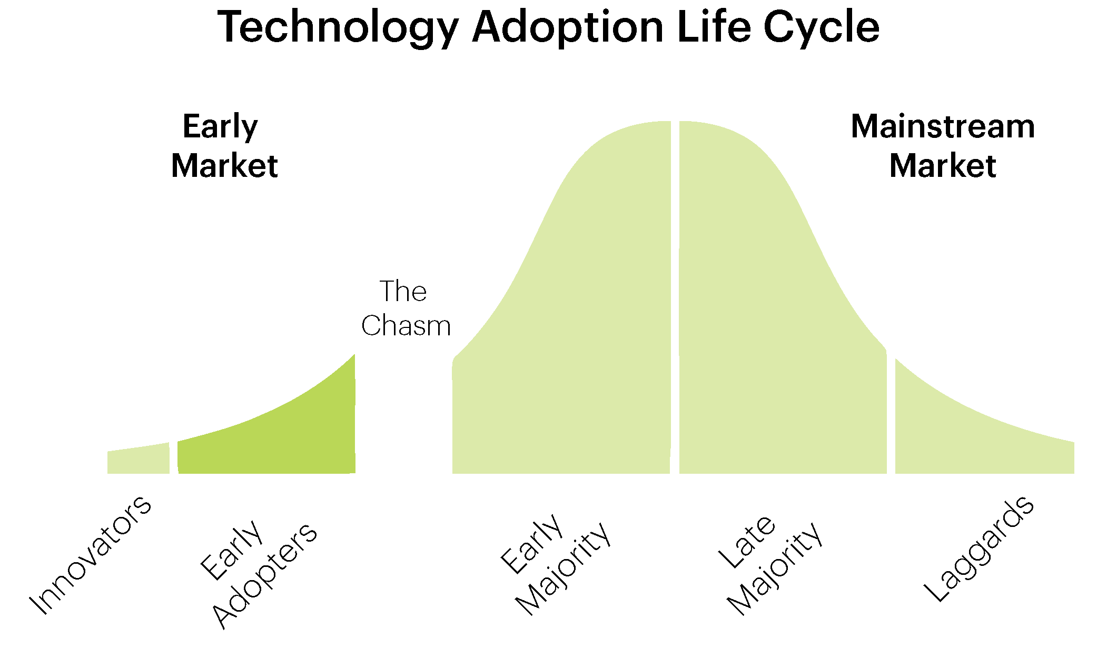
Who is buying EV chargers?

Slide 10
Market
Total addressable Canadian market for EV sales and installations to exceed $30 million in 2016

Slide 11
Target Market Criteria
Retailer with customer parking spaces
Interest in and budget for sustainability, green initiatives, and/or electric transport
Desire to boost in-store purchases, especially in response to competition from other retailers selling relatively homogeneous products
Lack of knowledge or will to deal directly with manufacturers and electricians

Slide 12
Marketing
Education over advertisement

Slide 13
Sale breakdown
Big-box store parking lot
4 SmartTWO pedestal 240 V charging stations
$23,800 total hardware MSRP + $8,000 total installation charge
30% gross margin for Meo Electric on $31,800 sale

Slide 14
Financial projection

Slide 15
Progress and status
AddEnergie Value-added Reseller

Slide 16
Why We’re here
Strategic mentors and partners
First customers and hires
Exposure through the Dobson Cup network
Education (sharing our mission!)

Slide 17


