Slide 1
PHITS
Multi-Purpose Particle and Heavy Ion Transport code System
Automated execution of PHITS by changing simulation conditions using script files
/phits/lecture/advanced/autorun
Dec 2024 revised
Title
Notes:
PHITS講習会 基礎実習

Slide 2
Purpose of This Lecture
Learn how to run multiple PHITS simulations at once by changing a certain parameter
For example…
Analysis of the energy dependence of nuclear reaction
Shielding calculation by changing the target thickness
Calculation of dose conversion coefficient for various irradiation geometries
Make script file by yourself,
or use “autorun.bat” or “autorun.sh” with icntl = 16
Purpose

Slide 3
Table of Contents
Make your own script files
Use “autorun.bat/sh”
Use [anatally] and ANOVA
Summary
Contents

Slide 4
What is script file?
A text file that consists of series of commands to be executed by command-line interpreter or terminal
Windows: Batch file (*.bat)
*Mac/Linux: Shell script (*.sh)
Grammars of batch file and shell script are similar but different
PHITS is executed by phits.bat or phits.sh in “phits/bin” folder
phits.bat
@echo off
title PHITS: %1
set PHITS_Single_EXE="C:\phits/bin/phits324_win.exe“
…
phits.sh
#!/bin/sh
OMP=1
# OMP = 0 -> OpenMP with default OMP_NUM_THREADS
…
If you want to run a different version of PHITS, you must change the executable file name in the script
*When you create a new shell script, you have to add executable status by “chmod u+x *.sh”

Slide 5
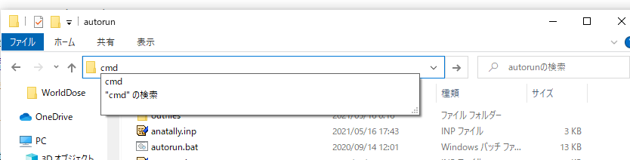
Exercise 1: Run a script file
Windows
Open “Explore” and move to “phits/utility/script/instruction”
Type “cmd” and press “enter” → terminal window is opened
Type “eachrun.bat” in the terminal window and press “enter”
Type “cmd” here
*Simply double-click “eachrun.bat” also works, but terminal window disappears after the execution
Mac
Open “Terminal” and move to “phits/utility/script/instruction”
Type “./eachrun.sh” or “eachrun.sh”
If you encounter “command not found”, type “chmod u+x *.sh” to add executable status for all .sh files and try again
To repeat the same command, press “↑” and “enter”*
*If you press “↑” twice, you can go back two-previous command

Slide 6
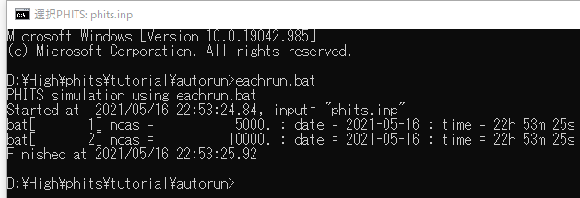
What is written in eachrun.bat?
eachrun.bat
*
eachrun.sh
echo PHITS simulation using eachrun.bat
echo set:c1[2.3] > density.inp
call phits.bat phits.inp
echo PHITS simulation using eachrun.sh
echo set:c1[2.3] > density.inp
phits.sh phits.inp
Role of each line
1st line: write “PHITS simulation using eachrun.bat” in the terminal
2nd line: write “set:c1[2.3]” into a file named “density.inp”
3rd line: execute PHITS with “phits.inp”
Important notices
“echo” means write the following message
“>” means “to the following file” (Overwrite if the file exists)
“call” is necessary for running another batch script in a batch script
Example of terminal Window
*To see a batch file, right click the file and “open with” a text editor or “Edit”

Slide 7
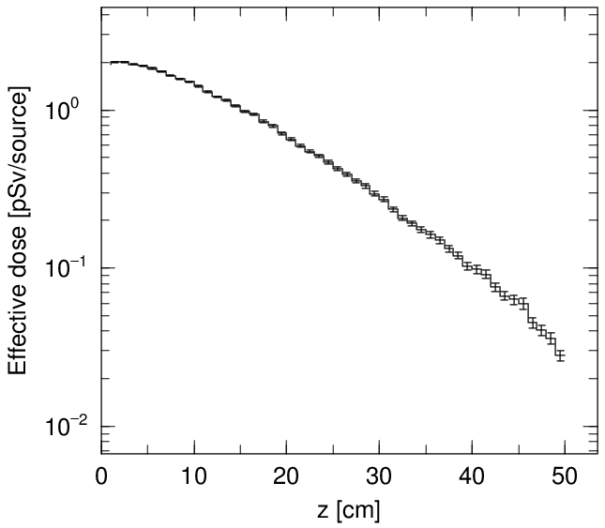
phits.inp
Basic setup
Source：
Geometry：
Tally：
20 MeV neutron at (0,0,-10) going to +z-axis
Cylindrical concrete with thickness of 50 cm and radius of 10 cm
[t-track] for calculating the effective dose using multiplier function
Important point
Density of concrete is specified by –c1, which is defined in density.inp
phits.inp
[ Cell ]
infl:{density.inp}
1 1 -c1 -10 101 -102
100 0 -999 #1
101 -1 999
…
track_rz.eps

Slide 8
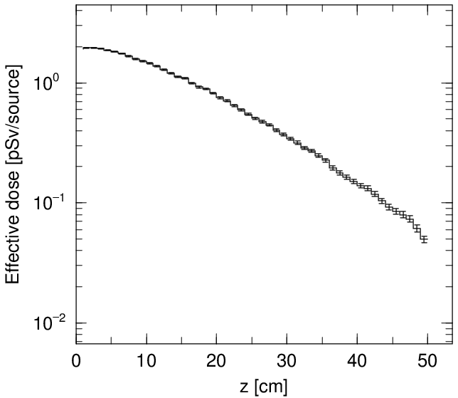
Exercise 2
Change the concrete density from 2.0 g/cm³ to 2.3 g/cm³
Open eachrun.bat/sh with text editor
Change c1 parameter written in density.inp from 2.0 to 2.3
Save eachrun.bat/sh
Execute eachrun.bat/sh (Press “↑” and “enter” in the terminal)
eachrun.bat
*
echo PHITS simulation using eachrun.bat
echo set:c1[2.3] > density.inp
call phits.bat phits.inp
0
↑
↑
eachrun.sh
↑
slightly increased
echo PHITS simulation using eachrun.sh
echo set:c1[2.3] > density.inp
phits.sh phits.inp
0
track_rz.eps
*To see a batch file, right click the file and “open with” a text editor

Slide 9
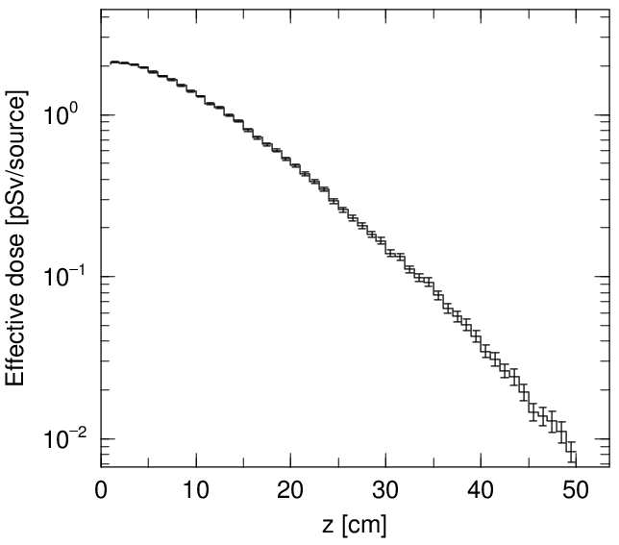
Exercise 3
Use variable in the script
Change “c1[2.0]” to “c1[%1]” for Windows, “c1[$1]” for Mac/Linux
Save eachrun.bat/sh
Type “eachrun.bat 3.0” for Windows, “./eachrun.sh 3.0” for Mac/Linux in the terminal
%1 indicates the 1st variable specified after eachrun.bat (separated by space)
eachrun.bat
echo PHITS simulation using eachrun.bat
echo set:c1[2.0] > density.inp
call phits.bat phits.inp
%1]
decreased
↓
↓
eachrun.sh
↓
echo PHITS simulation using eachrun.sh
echo set:c1[2.0] > density.inp
phits.sh phits.inp
$1]
track_rz.eps

Slide 10
Exercise 4
Automatically save output files by adding commands to “eachrun.bat/sh”
Add commands to “eachrun.bat” or “eachrun.sh” to make a new folder in “eachout” and copy all output files (*.out and *.eps) to the folder
Type “eachrun.bat 2.0” for Windows, “./eachrun.sh 2.0” for Mac/Linux in the terminal
Check eachout/2.0 folder by “explore” or “finder”
eachrun.bat
echo PHITS simulation using eachrun.bat
echo set:c1[%1] > density.inp
call phits.bat phits.inp
mkdir eachout\%1
copy *.out eachout\%1
copy *.eps eachout\%1
Tips
“*.out” means all files having the extension of “.out”
eachrun.sh
echo PHITS simulation using eachrun.sh
echo set:c1[$1] > density.inp
phits.sh phits.inp
mkdir -p eachout/$1
cp *.out eachout/$1
cp *.eps eachout/$1
Folder name should be separated by
\ (backslash) for batch file*
/ (slash) for shell script
“-p” after mkdir may not be necessary depending on your environment
*Backslash is something like in your keyboard

Slide 11

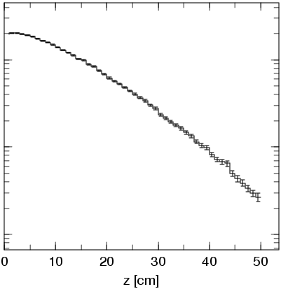
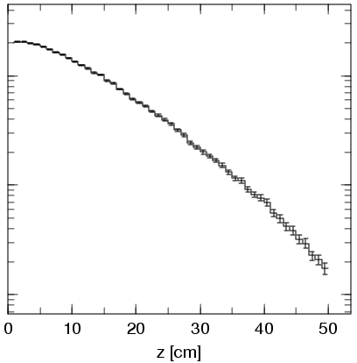
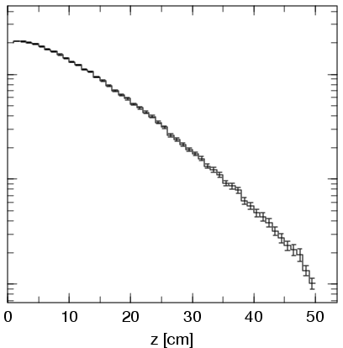
Exercise 5
Run PHITS with various conditions at once
Open “multirun.bat” for Windows, “multirun.sh” for Mac/Linux by text editor
Copy the 1st line and paste it by 4 times
Change the number from 2.0 to 2.2, 2.4, 2.6, & 2.8, respectively
Type “multirun.bat” for Windows, “./multirun.sh” for Mac/Linux in the terminal
Check the dependence of concrete density on the attenuation factor
multirun.bat
call eachrun.bat 2.0
call eachrun.bat 2.2
call eachrun.bat 2.4
call eachrun.bat 2.6
call eachrun.bat 2.8
multirun.sh
./eachrun.sh 2.0
./eachrun.sh 2.2
./eachrun.sh 2.4
./eachrun.sh 2.6
./eachrun.sh 2.8
2.0 g/cm³
2.2 g/cm³
2.4 g/cm³
2.6 g/cm³
2.8 g/cm³

Slide 12
Table of Contents
Make your own script files
Use “autorun.bat/sh”
Use [anatally] and ANOVA
Summary
Contents

Slide 13
“autorun.bat” & “autorun.sh” in PHITS
Execute PHITS for various conditions by automatically changing a parameter (ci)
Analyze the dependence of tally results on ci using [anatally] (optional)
How to use?
Make a PHITS input file (e.g. phits.inp) with variable ci
Set “icntl = 16” in the PHITS input file
Make a input file for autorun.bat/sh (e.g. autorun.inp) to specify how to change the variable
Run autorun.bat/sh with the input file
PHITS are iteratively executed until the simulations for all conditions are finished, and the results are moved to ‘1’, ‘2’, ‘3’ … folders in “outfiles”
Similar to “multirun.bat/sh”, but you can automatically change the parameter without the knowledge of batch file / shell script
Original script files are included in phits/bin folder

Slide 14
Exercise 6
Run autorun.bat /autorun.sh
Change “icntl = 16” in phits.inp (script mode)
Type “autorun.bat” for Windows, “./autorun.sh” for Mac/Linux in the terminal*
autorun.inp
phits.inp
file=phits.inp $ PHITS input file name
set:c1 $ Variable parameter
c-type=1 $ 1: data point, 2: linear, 3: log interpolation
nc=3 $ Number of data points
2.0 2.3 2.8
[ Parameters ]
icntl = 16
…
Run PHITS with “file=phits.inp“ by changing “set:c1” by “nc=3” times
The format of “c-type” is similar to that of the tally mesh
Calculated results for c1 = 2.0, 2.3 and 2.8 are moved to “1”, “2”, “3” folders in “outfiles”
Variable can be check by varfile.inp in each folder
*You can specify the input file name as the 1st variable (e.g. autorun.bat autorun.inp)

Slide 15
Exercise 7
Change autorun.inp
Change c1 from 2.0 to 2.8 by 0.2 step (nc = 5)
Use c-type = 2 ( linear interpolation)
Minimum & maximum values of c1 can be specified by cmin & cmax
Save “autorun.inp” and run “autorun.bat” or “autorun.sh” with autorun.inp
autorun.inp
file=phits.inp $ PHITS input file name
set:c1 $ Variable parameter
c-type=1 $ 1: data point, 2: linear, 3: log interpolation
nc=3 $ Number of data points
2.0 2.3 2.8
file=phits.inp $ PHITS input file name
set:c1 $ Variable parameter
c-type=2 $ 1: data point, 2: linear, 3: log interpolation
nc=5 $ Number of data points
cmin = 2.0
cmax = 2.8
Check the consistency between “outfiles/1” and “eachout/2.0”, … “outfiles/5” and “eachout/2.8”

Slide 16
Table of Contents
Make your own script files
Use “autorun.bat/sh”
Use [anatally] and ANOVA
Summary
Contents

Slide 17

What is [anatally] & ANOVA?
[anatally]: Special tally for analyzing multiple tally results based on ANOVA or user-defined function*.
ANOVA (ANalysis Of VAriance): A collection of statistical models for analyzing the differences among the means.
In PHITS, ANOVA is used for evaluating the systematic uncertainty associated with a certain variable (ci) in the input file
Doses at the end of concrete
ANOVA
c1 | Mean | r.err
2.0 | 4.98e-2 | 0.0636
2.2 | 3.56e-2 | 0.0754
2.4 | 2.67e-2 | 0.1051
2.6 | 1.74e-2 | 0.1215
2.8 | 1.02e-2 | 0.1245
$$u_{tot}^{2}\text{=} u_{syst}^{2}{+\frac{1}{N}u}_{stat}^{2}$$
Total uncertainty
(0.5553)
Statistical error
(0.0894)
Systematic uncertainty
(0.5481)
*defined in phits/src/usranatal.f. Compilation of PHITS is required when it is changed

Slide 18
Exercise 8
Activate anatally function
Delete “$” for the anatally subsection written in [t-track] of phits.inp
Save “phits.inp” and run “autorun.bat” or “autorun.sh” with autorun.inp
After finishing all simulations, “anatally.inp” is automatically created and executed by PHITS, and the results from ANOVA is output in a file specified by “sfile” parameter
phits.inp
[ T-track ]
…
angel = ymax(3.0) ymin(0.01)
$ anatally start $ Anatally subsection starts here
$ manatally = 1 $ Type of Anatally (0: user-defined, 1:ANOVA)
$ sfile=track_rz_anatally.out $ Anatally output file name
$ anatally end $ Anatally subsection ends here
→ Check “track_rz_anatally.eps”

Slide 19
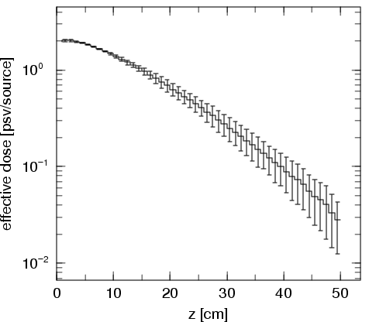
Answer 8
insensitive to the density
anatally.inp
[parameters]
icntl = 17
…
sensitive to the density
icntl=17 is for anatally
track_rz_anatally.out
x: z [cm]
y: effective dose [psv/source]
p: xlin ylog afac(0.8) form(0.9)
p: ymax(3.0) ymin(0.01)
h: n x y1(all ),hh0l ny21 dy1=[y1*y21]
# z-lower z-upper all r.err
0.0000E+00 1.0000E+00 1.9613E+00 0.0221 0.0210 0.0067
1.0000E+00 2.0000E+00 2.0248E+00 0.0230 0.0217 0.0077
…
track_rz_anatally.eps
Mean, total, systematic, statistical uncertainties
Only mean and total uncertainties are shown

Slide 20
Exercise 9
Try three-condition method
Simulations only for 3 conditions (mean & mean ± 1σ) are generally sufficient to evaluate the systematic uncertainty*
Evaluate the total uncertainty when the mean and uncertainty of the concrete density is known to be ρ = 2.3 ± 0.1 (g/cm³)
autorun.inp
file=phits.inp $ PHITS input file name
set:c1 $ Variable parameter
c-type=2 $ 1: data point, 2: linear, 3: log interpolation
nc=3 $ Number of data points
cmin = 2.2
cmax = 2.4
file=phits.inp $ PHITS input file name
set:c1 $ Variable parameter
c-type=2 $ 1: data point, 2: linear, 3: log interpolation
nc=5 $ Number of data points
cmin = 2.0
cmax = 2.8
*S. Hashimoto and T. Sato, J. Nucl. Sci. Technol. 56, 345 (2019)

Slide 21
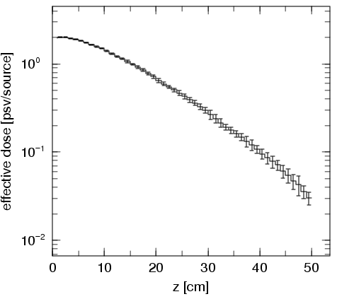
Answer 9
track_rz_anatally.eps
Total uncertainties including systematic uncertainties are not so significant

Slide 22
Table of Contents
Make your own script files
Use “autorun.bat/sh”
Use [anatally] and ANOVA
Summary
Contents

Slide 23
Summary
Script files can significantly reduce your effort on running PHITS simulations for a variety of conditions
As for the sample script files, you can select either the combination of “eachrun.bat/sh” and “multirun.bat/sh”, or “autorun.bat/sh”
“autorun.bat/sh” is useful particularly when the systematic uncertainties of a certain variable in PHITS input file must be evaluated

