Slide 1
PHITS
Multi-Purpose Particle and Heavy Ion Transport code System
Guidance for hands-on exercise
Neutron target
Aug. 2018 revised
title
Notes:
PHITS講習会 入門実習

Slide 2
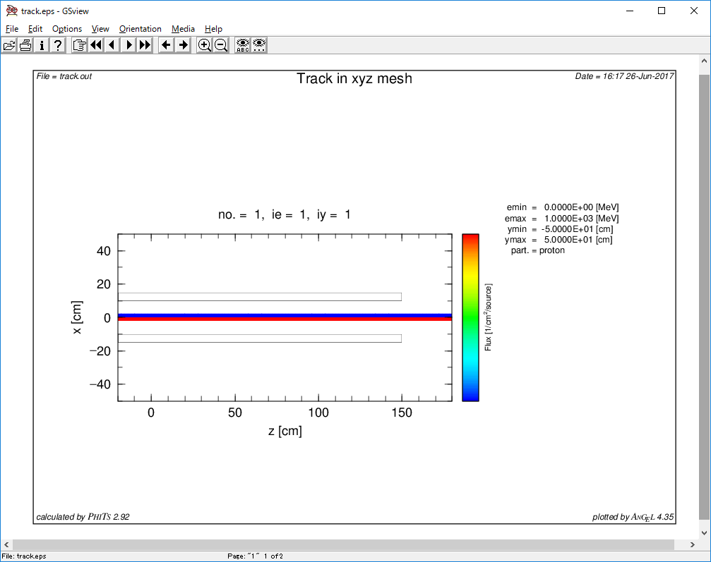
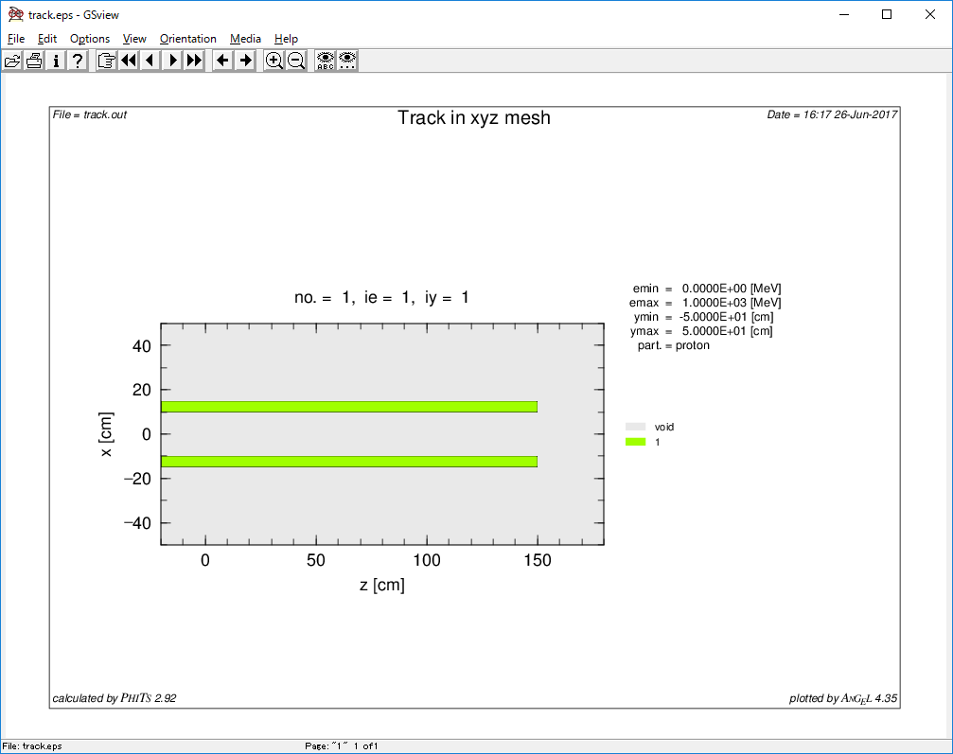
Step 1
Define a beam pipe made of 5 cm-thick Al
Define 10MeV proton beam
Beam goes through the beam pipe

Slide 3
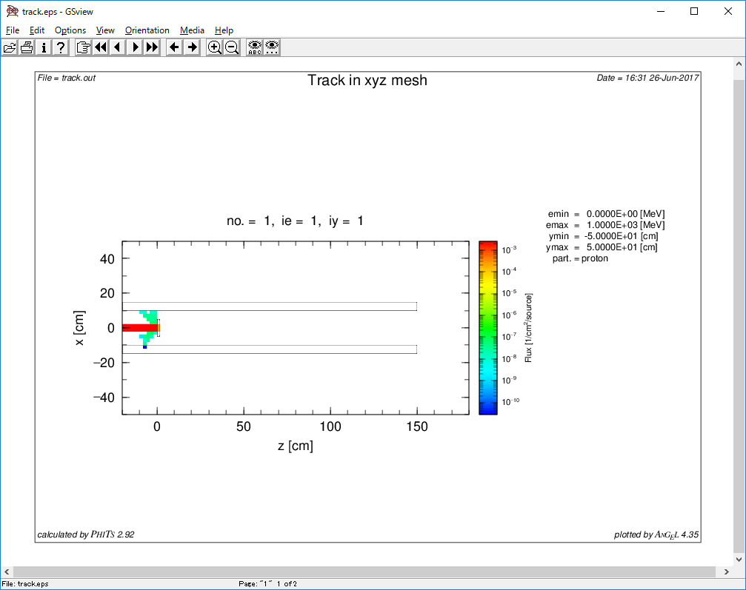
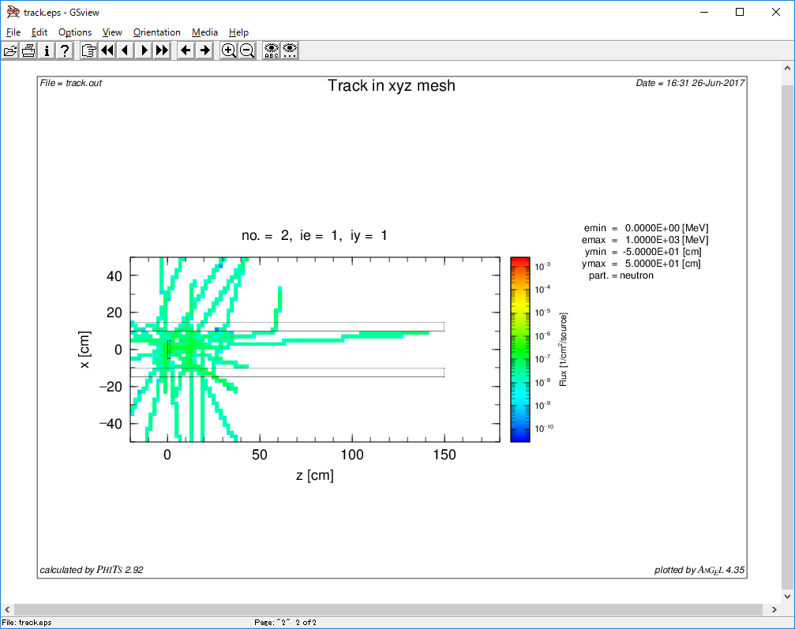
Step 2
Install a target station and generate neutrons
Full-stop length Li
Attention! : neutron cross section data and transport threshold
proton
neutron

Slide 4
Step 3
Install moderator, shield and reflector
Moderator : Outgoing neutron is thermalized
Neutrons are down scattered by H₂O
Shield : Stop neutrons exiting from target station
Neutron absorbing elements… Gd or B
Reflector : Reflect neutrons
Pb, Be, etc…

Slide 5
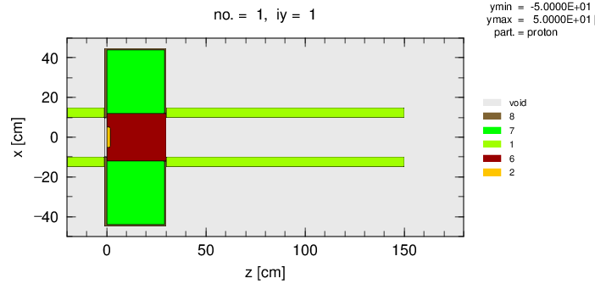
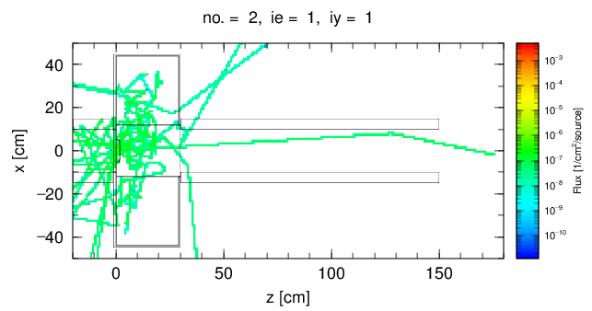
Be reflector
Beam pipe
B4C shielding
Moderator (H2O)

Slide 6
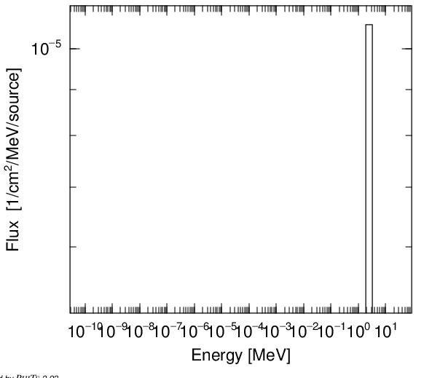
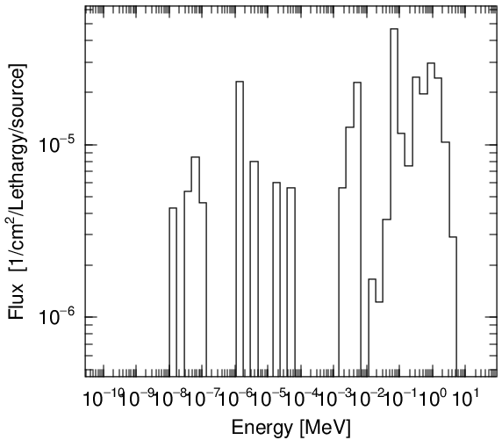
Step 4
Adjust neutron spectrum
Observe neutron spectrum
Take [T-Cross] sample from \phits\tallysample\t-cross\t-cross_reg.inp
Change moderator material, thickness, etc.
Increase maxcas if necessary

Slide 7
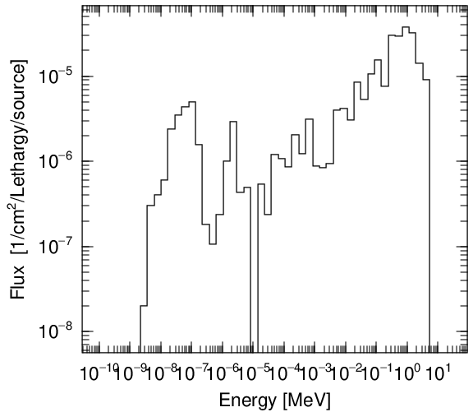
Step 5
Improve the statistical uncertainty
To see the energy spectrum shape
Split (slice) moderator and use [importance]
Splitting of reflector is also useful
= Make calculation faster
Find thermal neutron peak

Slide 8
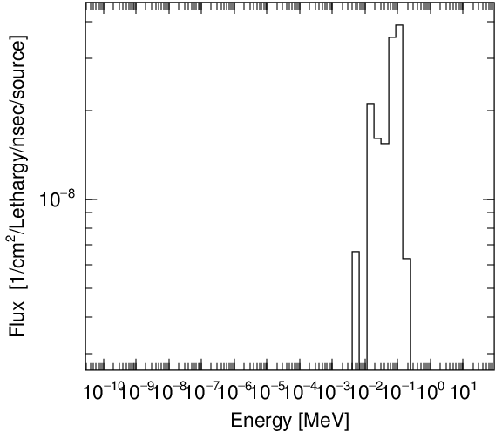
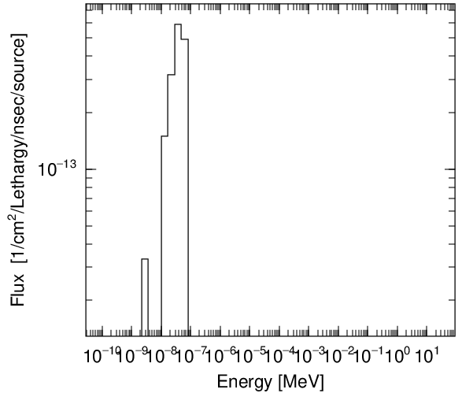
Step 6
Time and energy spectrum
Introduce “t-type”, “tmin”, “tmax”, and “nt” in [T-cross]
tmin ~ 10 ns
tmax ~ 10^7 ns (10ms)
Attention: unit of time is “ns” in PHITS
1.6ns – 2.1 ns
1.9ms – 2.5 ms

