Slide 1
PHITS
Multi-Purpose Particle and Heavy Ion Transport code System
Guidance for hands-on exercise
Detector
Aug. 2018 revised
title
Notes:
PHITS講習会 入門実習

Slide 2
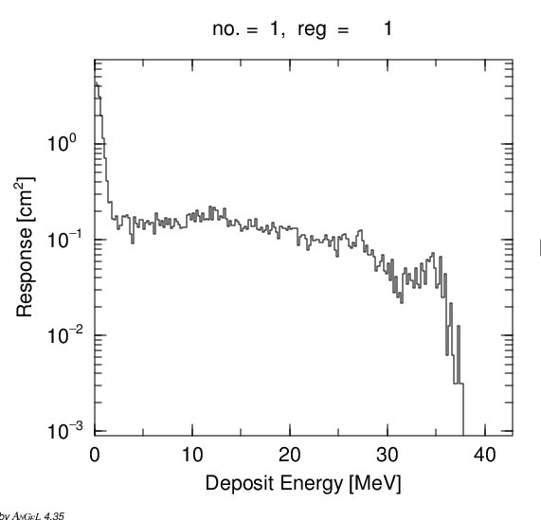
Step 0
start.inp is taken from \phits\recommendation\DetectorResponse\DetectorResponse.inp
Show the tally result

Slide 3
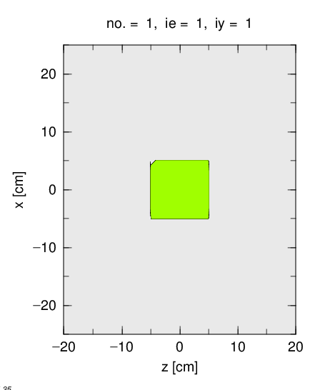
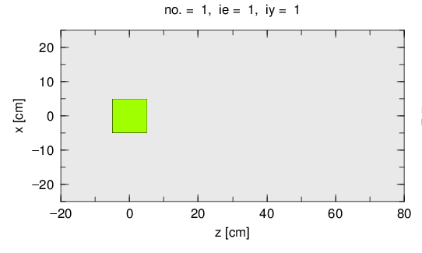
Step 1
Show the geometry
Take tally sample from \phits\tallysample\t-track\t-track.inp
Adjust the view range (in particular Z direction)

Slide 4
Step 2
Change following parameters and see results
Source neutron energy
emin(2) (e.g. emin(2) = 10 )
Change detector material
Neutron detector... He-3, U-235 (fission chamber), Li-6, Gd-155
Are they sensitive to 35 MeV neutrons?
Detector size (Attention: source is 10cm radius sphere)

Slide 5
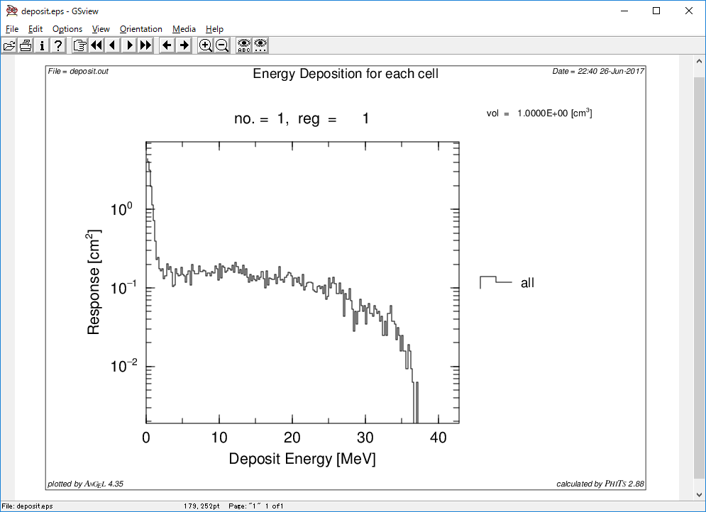
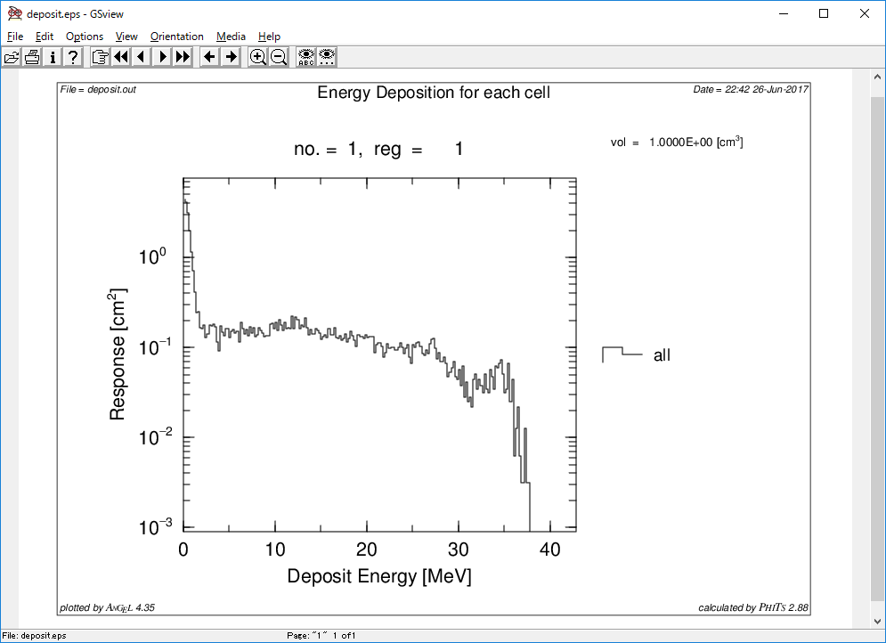
Left : emin(2) = 10
Right : emin(2) = 1.e-10
Why peak disappeared (hint: thermal neutron)

Slide 6
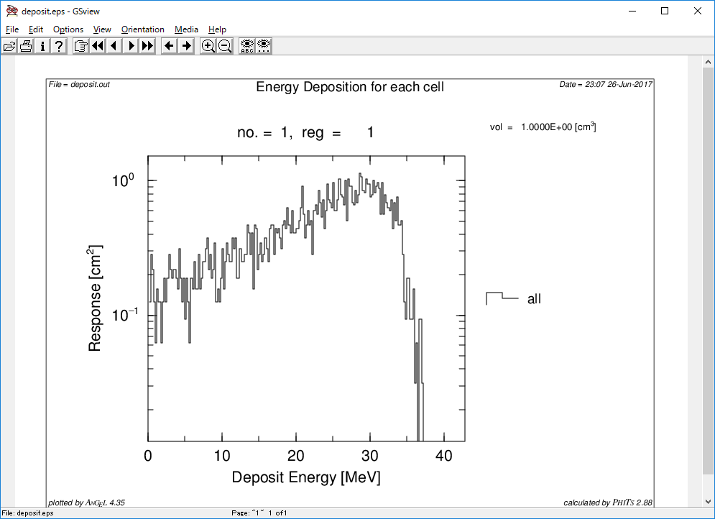
Step 3
Change neutron source -> photon source
Change detector type (NaI)
See the result

Slide 7
Step 4
Change following parameters and see results
Source gamma energy
If possible, generate efficiency calibration curve (absorption peak efficiency)
emin(12,13,14) (e.g. emin(12,13,14) = 10 )
Remember what the change was like when proj = neutron. Why so different?
Change detector material
Photon detector... Ge, BGO(BiGeO), etc
Are they sensitive to 35 MeV gammas?

Slide 8
Step 5
Let's make a Compton camera
Source is pencil beam
1 MeV gamma ray
Two Si detectors
Distance 140 cm (Y=100cm, Z =100cm)
One is downstream detector (Hint: RCC is useful)
Take [T-deposit2] tally sample from \phits\tallysample\t-deposit2\t-deposit2_reg.inp
Think how you can improve efficiency
What happens if you change energy
Attention! Do not use bias (improtance, weight)

Slide 9
