Slide 1

PHITS
Multi-Purpose Particle and Heavy Ion Transport code System
Guidance for hands-on exercise
Environmental radioactivity
Oct. 2024 revised
title
1

Slide 2
Computational approach to efficiently calculate dose contributions from widely distributed environmental radioactivity
f.g.: Dose evaluation inside a building standing on the ground contaminated by Cs-137
∼10m
Mean free path ~100m
hundreds meters
Only a few gammas reach the building among a tremendous number of initiated radiations
=> A large number of histories are required to achieve good statistics
How to compute efficiently ?

Slide 3
Semi-infinite ground
groundsource.inp
Geometry
Evaluation point (10cm radius sphere)
Air
200m
z
x
1m
200m
200m
Soil
50cm
set:c1[20000] $ World cylinder radius
set:c2[1.0] $ Density of soil g/cm3
...
[ Surface ]
10 sz 100.0 10.0 $ Detection volume
900 pz -50.0 $ Soil depth down to 50 cm
901 pz 0.0 $ Soil surface
902 pz 20000.0 $ Sky top up to 200 m
910 cz c1 $ World cylinder
[ Cell ]
10 1 -1.2e-3 -10 $ Detection volume
1 -1.2e-3 -910 901 -902 10 $ Air
2 -c2 -910 900 -901 $ Soil
900 -1 910:-900:902 $ Outer void

Slide 4
Semi-infinite ground (continue)
groundsource.inp
Source
Soil
set:c1[20000] $ World cylinder radius
set:c2[1.0] $ Density of soil g/cm3
...
[ Source ]
totfact = pi*c1*c1 $ per 1 Bq/cm2
s-type = 1
proj = photon
r0 = c1
z0 = -0.5/c2 $ 0.5g/cm2 depth
z1 = -0.5/c2 $ 0.5g/cm2
dir = all $ isotropic
e-type = 28 $ RI soource
ni = 1
137Cs 1.0 $ activity is 1 Bq
Uniform plane source in 0.5 g/cm² cumulative mass depth
Area
Distribute in depth even just after the incidence to account initial migration and ground roughness
Cs-137 in 1Bq/cm²
RI source setting
phits/lecture/advanced/sourceA

Slide 5
Semi-infinite ground (continue)
groundsource.inp
Tally
Evaluation point : Cell 10
Air
1m
Soil
[ T-track ]
file = dose.out
mesh = reg
reg = 10
...
multiplier = 1
part = photon
mat mset1
1 (1.0e-6*3600.0 -200)
Derive dose by computing the photon fluence in [T-Track] and multiplying the dose conversion coefficinety using “multiplier” function
phits/lecture/advanced/options
Ambient dose equivalent
Conversion coefficient (pSv cm²)
x 10⁻⁶*3600 => μSv/h

Slide 6
Step 1 (Semi-infinite ground)
Let’s execute PHITS with groundsource.inp
Then check
Fluence distribution in wide area (track.eps)
Fluence distribution around the target (track_inside.eps)
In addition, check
Dose value at the evaluation point (dose.out)

Slide 7
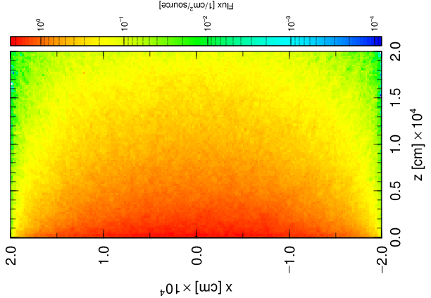
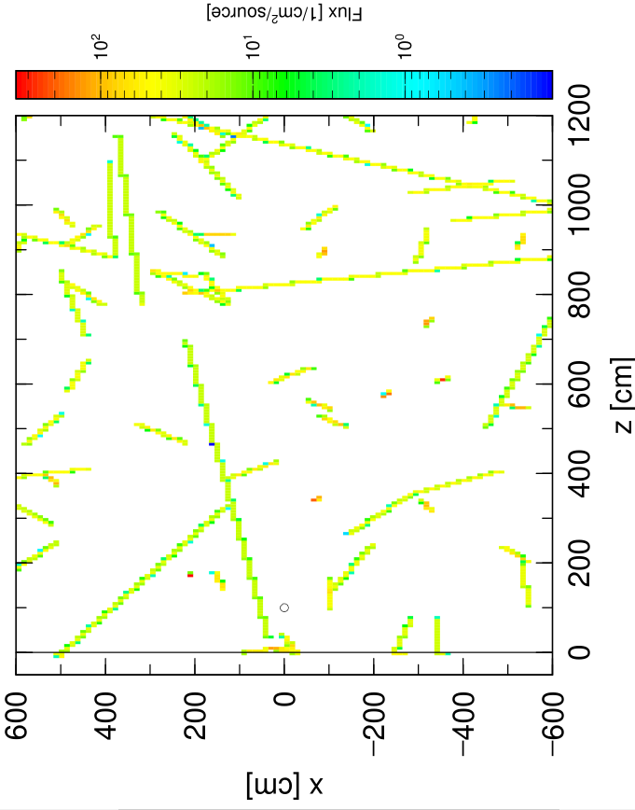
Step 1 (Semi-infinite ground) Result
maxcas=100,000
track.eps
# num reg volume all r.err
1 10 4.1888E+03 0.0000E+00 0.0000
dose.out (Line 38)
track_inside.eps
No gamma reaches to the evaluation point

Slide 8
Step 1 (Semi-infinite ground) Continued
Increase the histories 10 times (maxcas=1,000,000)
Then check
Fluence distribution in wide area (track.eps)
Fluence distribution around the target (track_inside.eps)
In addition, check
Dose value at the evaluation point (dose.out)

Slide 9
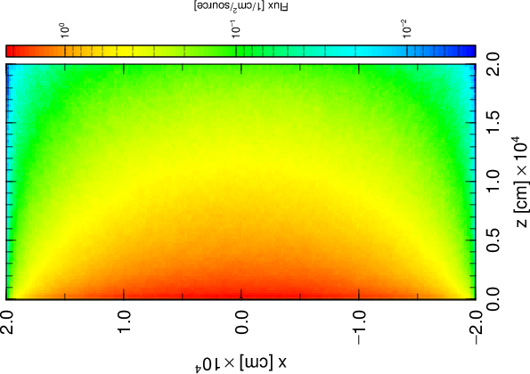
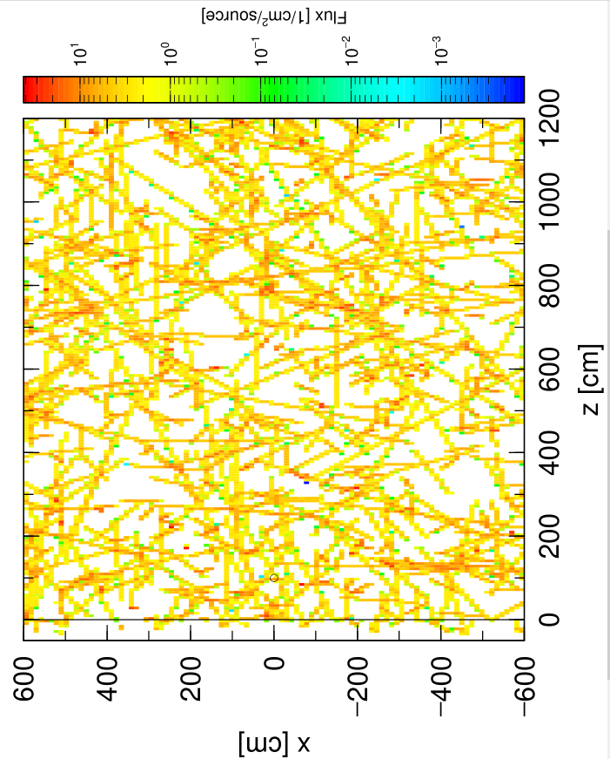
Step 1 (Semi-infinite ground) Result
maxcas=1,000,000
track.eps
# num reg volume all r.err
1 10 4.1888E+03 6.2302E-02 1.0000
track_inside.eps
dose.out (Line 38)
One gamma reaches the target => Needs much more histories

Slide 10
Calculation using reflection boundaries
Reflection boundary
Reflection boundary
Mirror image
Mirror image
Air
Mirror image
Mirror image
…
…
Transport
Soil
Infinite
Radiations reflected at the boundary = Independent radiations injected from mirror regions
Simulation only following radiations injected to the objective region from infinite radiation field => Very efficient

Slide 11
Step 2 (Reflection boundary)
Reflection boundary
set:c3[1000] $ Reflection box size xy
[ Surface ]
*101 px -0.5*c3
*102 px 0.5*c3
*103 py -0.5*c3
*104 py 0.5*c3
Add * in front of surface #
Geometry
Source
[ Cell ]
…
100 1 -1.2e-3 -910 901 -902 10 #(101 -102 103 -104)
101 1 -1.2e-3 101 -102 103 -104 901 -902 10
…
200 2 -c2 -910 900 -901 #(101 -102 103 -104)
201 2 -c2 101 -102 103 -104 900 -901
[ Source ] off
...
[ Source ]
totfact = c3*c3
s-type = 2
proj = photon
x0 = -0.5*c3
x1 = 0.5*c3
y0 = -0.5*c3
y1 = 0.5*c3
Remove “off”
Execute PHITS and check track_inside.eps and dose.out

Slide 12
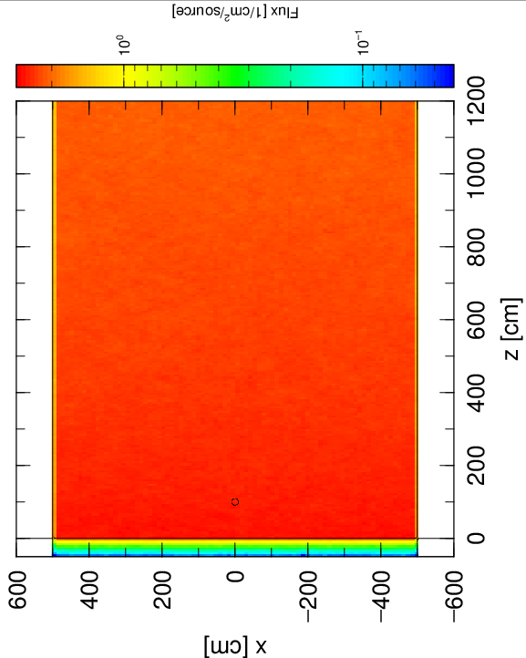
Step 2 (Reflection boundary) Result
# num reg volume all r.err
1 10 4.1888E+03 2.0340E-02 0.0648
dose.out (Line 38)
Statistics becomes much better even though calculation time becomes a bit longer
Statistics improves with narrower area
track_inside.eps

Slide 13
A building standing alone
Reflection boundary
Reflection boundary
ｚ
Buildings aligned in urban area ≠ A building standing alone
How to compute the situation of a building standing alone ?

Slide 14
A building standing alone (continued)
Two-step calculation
T. Furuta, RPD167(2015)392-398
1st step
2nd step
Reflection boundary
Reflection boundary
External source (Dump data)
Scoring box
+
Take a dump for radiations passing through surfaces of the scoring box
Internal source (Internal ground source)
Dump data = Radiations injected from infinite field

Slide 15
Step 3 (Obtain dump data)
Reflection boundary
Reflection boundary
Scoring box
set:c4[800] $ Scoring box size xy
set:c5[1000] $ Scoring box height
[ Surface ]
100 rpp -0.5*c4 0.5*c4 -0.5*c4 0.5*c4 -50 c5
...
[ Cell ]
...
100 1 -1.2e-3 -910 901 -902 10 #(101 -102 103 -104)
101 1 -1.2e-3 101 -102 103 -104 901 -902 10 100
102 1 -1.2e-3 -100 901 10
200 2 -c2 -910 900 -901 #(101 -102 103 -104)
201 2 -c2 101 -102 103 -104 900 -901 100
202 2 -c2 -100 -901
Remove “off”
[ T-cross ]
file = cross.out
mesh = reg
reg = 1
r-from r-to area
(101 201) (102 202) 1.0
output = current
unit = 1
axis = reg
dump = -8
1 2 3 4 5 6 7 8
Scoring box
Scoring box
Execute PHITS and check cross.out and cross_dmp.out

Slide 16
Step 3 (Obtain dump data) Result
cross.out (Line 29)
# num area all
1 1.0000E+00 2.2713E+06 0.0027
Number of photons per second injected to the scoring box from infinite field contaminated by Cs-137 in 1 Bq/cm2
cross_dmp.out
2.200000000000000D+01 4.349391048283195D+01 3.999999999997351D+02 … 2.200000000000000D+01 3.999999999990466D+02 2.453495348295788D+02 …
…
kf-code x y
1,022,972 gmma-ray data = Radiations scored by 1,000,000 histories

Slide 17
Step 4 (Dump data source)
Scoring box
[ Surface ]
…
101 px -0.5*c3
102 px 0.5*c3
103 py -0.5*c3
104 py 0.5*c3
Remove * to make them normal boundary
[ T-cross ] off
file = cross.out
…
[ T-product ]
file = source.out
output = source
mesh = xyz
x-type = 2
nx = 100
...
[ Source ] off
…
[ Source ]
totfact = 2.2713E+06
s-type = 17
file = cross_dmp.out
proj = photon
dump = -8
1 2 3 4 5 6 7 8
Copy [T-track] tally with
file=track_inside.out
and modify the contents in red frame
output=source to display source positions
Remove “off”
Execute PHITS and check source.eps

Slide 18
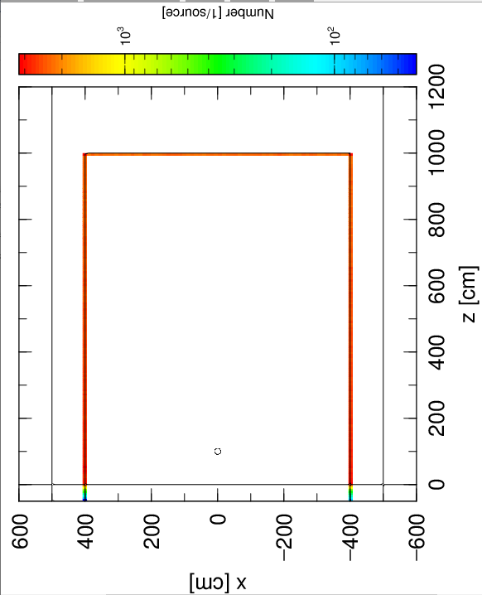
Step 4 (Dump data source) Result
source.eps
Source positions are shown along the scoring box

Slide 19
Step 5 (External source)
externalsource.inp
External source (Dump data)
Hut made by 2cm wooden walls
[ Surface ]
50 rpp -248.0 248.0 -248.0 248.0 2.0 498.0
51 rpp -250.0 250.0 -250.0 250.0 0.0 500.0
52 rpp -250.0 250.0 -250.0 250.0 -50.0 0.0
...
[ Cell ]
10 1 -1.2e-3 -10
11 1 -1.2e-3 10 -50
50 3 -0.64 50 -51
20 2 -c2 -910 900 -901 -52
100 1 -1.2e-3 -910 901 -902 51
200 2 -c2 -910 900 -901 52
900 -1 910:-900:902
[ Source ]
totfact = 2.2713E+06
s-type = 17
file = cross_dmp.out
proj = photon
dump = -8
1 2 3 4 5 6 7 8
Execute with externalsource.inp and then check track_inside1.eps and dose1.out

Slide 20
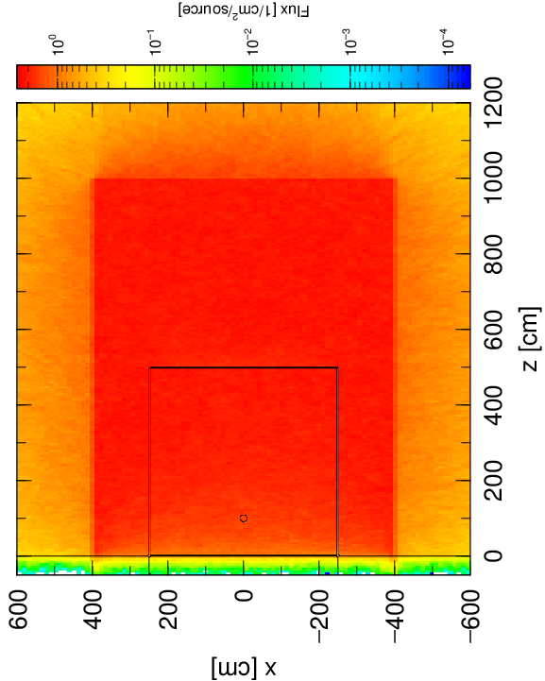
Step 5 (External source) Result
dose1.out (Line 38)
# num reg volume all r.err
1 10 4.1888E+03 1.0774E-02 0.0874
track_inside1.eps

Slide 21
Step 6 (Internal source)
internalsource.inp
Internal source (Internal ground source)
[ Surface ]
50 rpp -248.0 248.0 -248.0 248.0 2.0 498.0
51 rpp -250.0 250.0 -250.0 250.0 0.0 500.0
52 rpp -250.0 250.0 -250.0 250.0 -50.0 0.0
...
[ Cell ]
10 1 -1.2e-3 -10
11 1 -1.2e-3 10 -50
50 3 -0.64 50 -51
20 2 -c2 -910 900 -901 -52
100 1 -1.2e-3 -910 901 -902 51
200 2 -c2 -910 900 -901 52
900 -1 910:-900:902
[ Source ]
totfact = c4*c4-500*500
reg = 200
s-type = 2
proj = photon
x0 = -0.5*c4
x1 = 0.5*c4
y0 = -0.5*c4
y1 = 0.5*c4
…
Set source only in reg=200 to account no contamination beneath the hut
Execute with internalsource.inp and check track_inside2.eps and dose2.out

Slide 22
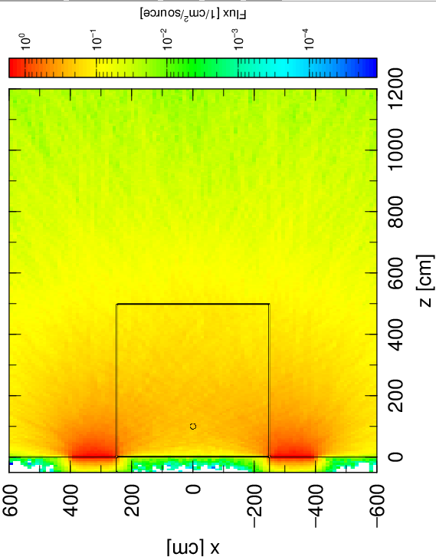
Step 6 (Internal source) Result
dose1.out (Line 38)
# num reg volume all r.err
1 10 4.1888E+03 2.0261E-03 0.1278
track_inside1.eps

Slide 23
Step 7 (Sumtally)
sumtally.inp
External source (Dump data)
Internal source (Internal ground source)
+
[ Parameter ]
icntl = 13
[ T-track ]
file = track_inside.out
…
sumtally start
isumtally = 2
nfile = 2
track_inside1.out 1.0
track_inside2.out 1.0
sfile = track_inside.out
sumfactor = 2.0
sumtally end…
Sumtally subsection
Average track_inside1.out and
track_inside2.out in 1:1
Setting of Sumtally
phits/lecture/utility/sumtally
Multiply 2 to obtain sum
Execute with sumtally.inp and check track_inside.eps

Slide 24
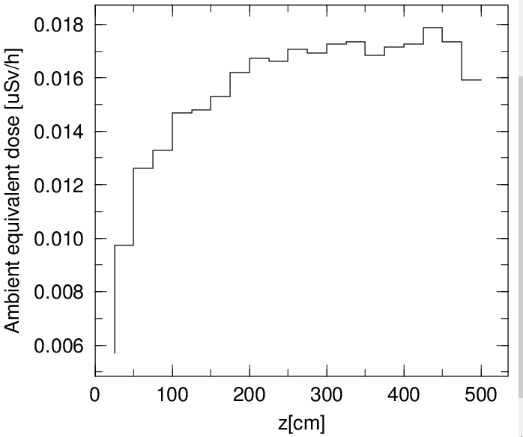
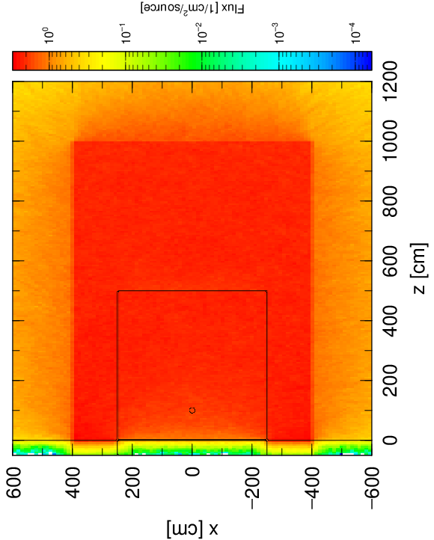
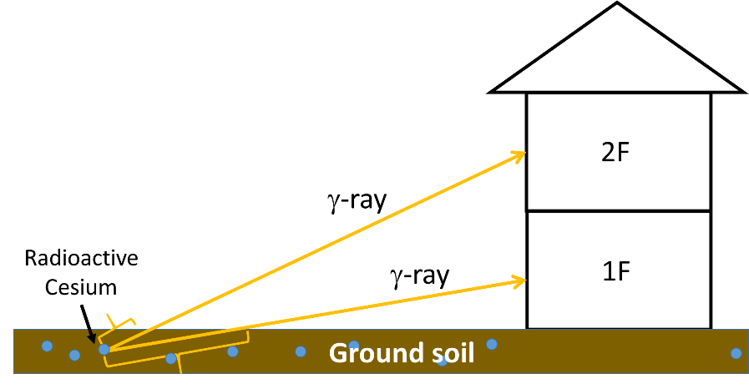
Step 7 (Sumtally) Result
Dose distribution in vertical direction in center (1x1m²)
vdose.eps
Dose increases with increasing height
=> Higher dose in 2nd floor
track_inside.eps
# num reg volume all r.err
1 10 4.1888E+03 1.2800E-02 0.0763
About a half of dose on infinite ground (2.0340E-02)
dose.out (Line 38)
Reason of the dose reduction ?

Slide 25
Step 8 (Shielding effect)
externalsource.inp
internalsource.inp
External source (Dump data)
Internal source (Internal ground source)
+
[ Cell ]
…
50 1 -1.2e-3 50 -51
…
Change wall material and density to air
Execute with externalsource.inp and internalsource.inp
and check dose1.out and dose2.out
Compare to dose inside hut (1.2800E-02μSv/h) and dose on infinite field (2.0340E-02μSv/h)

Slide 26
Step 8 (Shielding effect) Result
 | External source | Internal source | Total
1. Infinite field | - | - | 2.0340E-02
2. Inside hut | 1.0774E-02 | 2.0261E-03 | 1.2800E-02
3. No wall | 1.1288E-02 | 2.3418E-03 | 1.3630E-02
2. Inside hut
Reduction factor =
＝ 0.63
1. Infinite field
2. Inside hut
Shielding factor =
＝ 0.94
3. No wall
Main reason of dose reduction inside wooden house is not due to shielding effect of the wooden walls but no contamination beneath the house

Slide 27
Summary
Dose calculation in infinite radiation field required for dose evaluation for environmental radioactivity can be performed efficiently using two step calculation with reflection boundary
Two step calculation with reflection boundary
T. Furuta, Radiat. Prot. Dosim. 167(2015)392-398
Study of radiation dose reduction of buildings using this method
T. Furuta, J. Nucl Sci. Technol. 52(2015)897-904

