Slide 1

PHITS
Multi-Purpose Particle and Heavy Ion Transport code System
Guidance for hands-on exercise
Single Event Upset (SEU)
Feb. 2025 revised
1

Slide 2
Outline of this exercise
Tasks using semiconductor.inp
Step 1: Edit the geometry of semiconductor device
Step 2: Calculate ion-irradiation on semiconductor device
Step 3: Calculate SEU cross section
Step 4: Calculate dependence of SEU cross section
on the energy of incident radiation
Tasks using small-satellite.inp
Step 5: Set SEU cross section in [Multiplier] section
Step 6: Calculate SEU rate in small satellite
Step 7: Investigate the effect of thickening
small satellite wall on SEU rate
2

Slide 3
Open semiconductor.inp
Check the geometry by PHIG-3D and/or [T-Track] with icntl = 8
Direction of source projectiles
x
2.0 μm
Package layer (Epoxy, C₁₈H₁₉O₅)
ρ = 1.85 g/cm³
y
z
2.0 μm
Metal layer (Cu : SiO₂ = 3 : 1)
ρ = 5.69 g/cm³
* mol ratio
0.2 μm
500 μm
Insulation layer (SiO₂)
ρ = 2.65 g/cm³
0.1 μm
3.0 μm
STI (SiO₂)
ρ = 2.65 g/cm³
0.35 μm
z = 0 μm
0.25 μm
Silicon substrate (Si)
ρ = 2.329 g/cm³
500 μm
3

Slide 4
Step 1: Edit the geometry
Define the sensitive volume (cell 10) in the silicon substrate
[ S u r f a c e ]
21 px -0.05e-4
22 px 0.05e-4
23 py -0.10e-4
24 py 0.10e-4
4 pz 0.00e-4
6 pz 0.50e-4
Check the geometry by PHIG-3D and/or [T-Track]
Direction of source projectiles
x
2.0 μm
Package layer (Epoxy, C₁₈H₁₉O₅)
ρ = 1.85 g/cm³
y
z
2.0 μm
Metal layer (Cu : SiO₂ = 3 : 1)
ρ = 5.69 g/cm³
* mol ratio
0.2 μm
500 μm
Insulation layer (SiO₂)
ρ = 2.65 g/cm³
0.1 μm
3.0 μm
STI (SiO₂)
ρ = 2.65 g/cm³
0.35 μm
z = 0 μm
0.25 μm
Silicon substrate (Si)
ρ = 2.329 g/cm³
500 μm
0.5 μm
Sensitive volume (Si)
ρ = 2.329 g/cm³
4

Slide 5
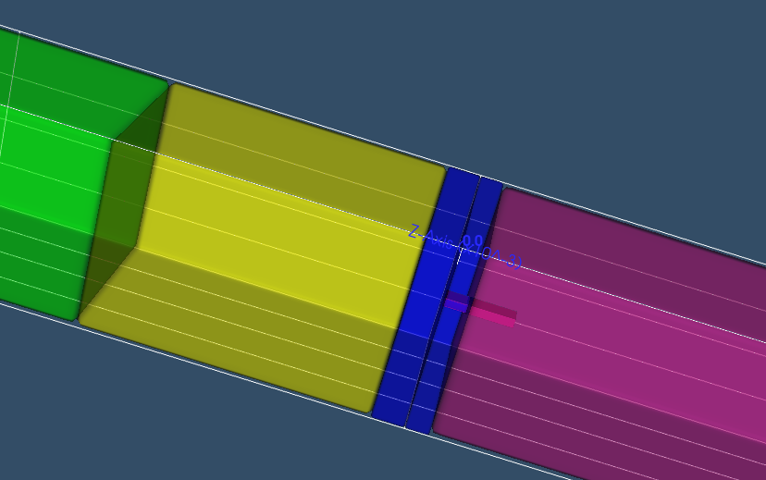
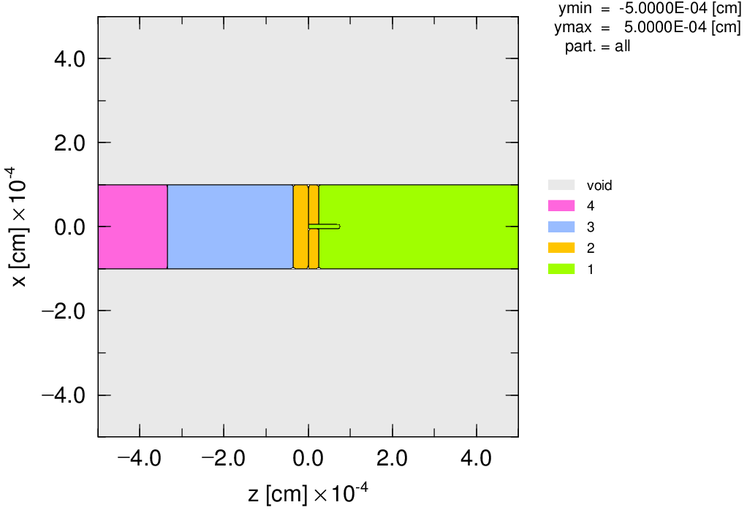
Sensitive volume
[ C e l l ]
…
5 1 -2.329 11 -12 13 -14 5 -7
#(21 -22 23 -24 5 -6)
10 1 -2.329 (21 -22 23 -24 4 -6)
Sensitive volume
5

Slide 6
Step 2: Calculation of ion-irradiation
Define [Source] section to irradiate ⁴He ions with the energy of 10MeV/n on the device from the package side uniformly and vertically
Change the parameter of [T-Deposit] section to score the variance of deposition energies in the sensitive volume (Cell 10) by individual history
Change “icntl=0”, run PHITS and check results
6

Slide 7
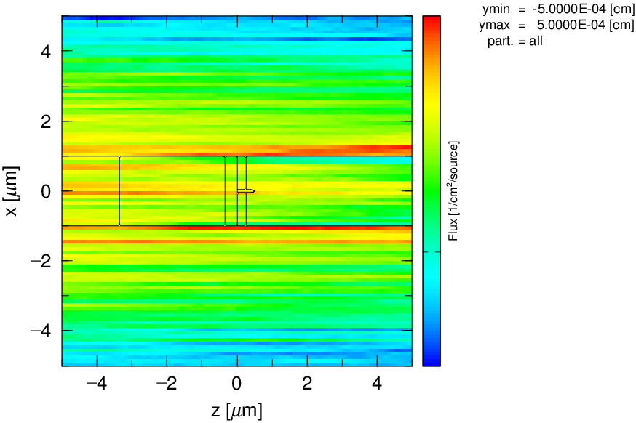
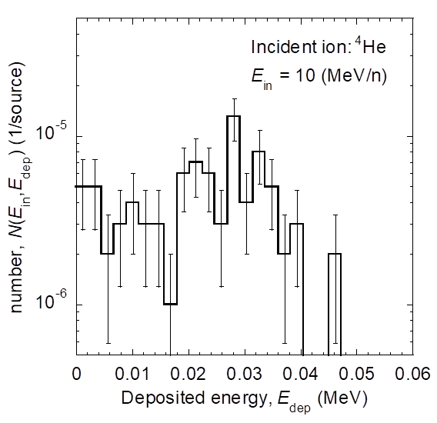
[ S o u r c e ]
s-type = 2
proj = 4He
e0 = 10.0
x0 = -1.0e-4
x1 = 1.0e-4
y0 = -1.0e-4
y1 = 1.0e-4
z0 = -1.0
z1 = -1.0
dir = 1.0
[ T – D e p o s i t ]
mesh = reg
reg = 10
e-type = 1
...
7

Slide 8
Step 3: Calculate SEU cross section
Calculate SEU cross sections
Open tdeposit_to_SEUCS_4He.xlsx and select the sheet of “10MeV”
Paste the result of [T-Deposit] on D ~ G columns
SEU cross sections and statistical errors for each critical charge are obtained in K ~ M columns
(*see next slide)
Note:
SEU is occurred when charges collected into sensitive node exceed threshold value (so-called critical charge, Q_{fit}).
[T-Deposit] outputs probability of events for each deposited energy.
Integral of probability from Q_{fit} corresponds to SEU cross section.
Q_{fit} depends on the condition of semiconductor device, so it is useful to calculate Integral of probability from Q_{fit} for each Q_{fit}.
Since PHITS cannot output such values, so external processing using such as Excel is necessary.

Slide 9
* How to paste each column data of
[T-Deposit] on D ~ G columns of excel file
(a)
Use “column selection (rectangle selection)” function of text editor, and copy & paste each column data
Notepad++: Hold down the Alt key and mouse drag
CotEditor: Hold down Option(Alt) key and mouse drag
(b)
Use “Convert Text to Columns Wizard” of Microsoft Excel
b-1.
Paste data on D column and keep highlighting D column
b-2.
Select the “Data” tab in the ribbon
b-3.
Select the “Text to Columns” in the “Data Tools” group
b-4.
Follow the “Convert Text to Columns Wizard”
(Ref.) https://support.microsoft.com/en-us/office/split-text-into-different-columns-with-the-convert-text-to-columns-wizard-30b14928-5550-41f5-97ca-7a3e9c363ed7
9

Slide 10
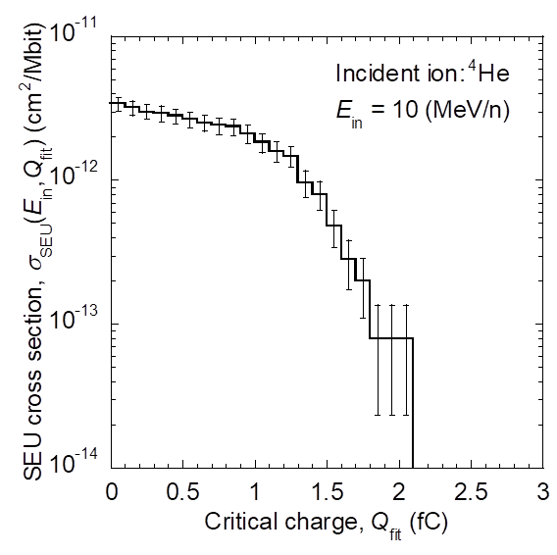
σ_{SEU}(E_{in,} Q_{fit}) : SEU cross section
E_{in} : Incident energy
Q_{fit} : Critical charge
A : Irradiation area
N_{in} : Number of irradiated particles
N_{bit} : Number of memory bit
N(E_{in}, q) : Number of event with
the corrected charge in [q, q+dq]
output of [T-Deposit]
10

Slide 11
Step 4: output dependence of SEU cross
sections on incident energy
Calculate SEU cross section for incident energies of 8, 25, 200, 2000 MeV/n
tdeposit_to_SEUCS_4He.xlsx has sheets of “8MeV”, “25MeV”, “200MeV”, “2000MeV” and “10000MeV” to calculate SEU cross section for each incident energy in the same way as the sheet of “10MeV”
11

Slide 12
12

Slide 13
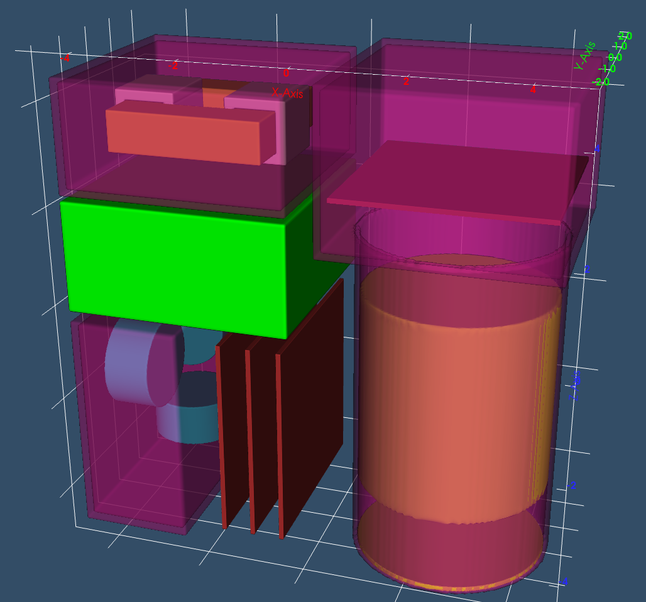
Open small-satellite.inp
Check the geometry by PHIG-3D and/or [T-Track] with icntl = 8
Transformer
Image sensor
Li-ion
battery
Attitude
control
system
Lens
Control boards
13

Slide 14
Step 5: Set [Multiplier] section
Set [Multiplier] section to use SEU cross section with the critical charge of 1.0 fC.
(Ref.) How to use multiplier: phits\lecture\advanced\option
When the value of critical charge is set in the cell B8 of the sheet of “SEU_CS”, SEU cross section for each incident energy is obtained in D ~ F columns
14

Slide 15
log-log interpolation
[ Multiplier ]
number = -200
interpolation = log
part = 4He
ne = 5
$ E_in (MeV/u), σ_SEU (cm2/bit)
8.0e+0 0.00e-0
1.0e+1 1.64e-12
2.5e+1 2.00e-13
2.0e+2 8.00e-13
2.0e+3 2.80e-13
Last data is applied when multiplier does not defined.
15

Slide 16
Step 6: Calculate SEU rate
Modify parameters of 2nd [T-Track] sections to output SEU rate of image sensor (cell 151) and control boards (cell 152, 153, 154)
Change “icntl=0”, run PHITS and check results
* If computational time is too long, please reduce maxcas and maxbch
16

Slide 17
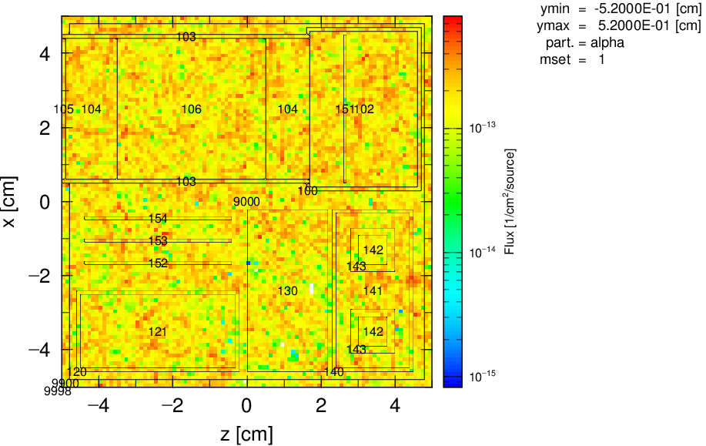
[ T - T r a c k ]
mesh = reg
reg = 151 152 153 154
volume
reg vol
151 4.0*4.0*0.1
152 4.0*4.0*0.1
153 4.0*4.0*0.1
154 4.0*4.0*0.1
e-type = 1
ne = 1
0.0 1.0e+6
unit = 1
axis = reg
file = ttrack-reg.out
part = 4He
gshow = 1
epsout = 1
multiplier = all
mat mset1
all (1 -200)
Parts | Cell ID | SEU rate (error/s/bit)
Image sensor | 151 | 1.780e-13
Control board 1 | 152 | 1.818e-13
Control board 2 | 153 | 2.056e-13
Control board 3 | 154 | 1.805e-13
SEU rate (err/s/bit)
17

Slide 18
Step 7: Investigate the effect of thickening
outer wall on SEU rate
Increase the thickness of small satellite wall and check the effect of SER rate
18

Slide 19
 |  | SEU rate (error/s/bit)
Parts | Cell ID | Wall thickness: 0.2 cm | Wall thickness: 1.2 cm
Image sensor | 151 | 1.780e-13 | 1.642e-13
Control board 1 | 152 | 1.818e-13 | 1.656e-13
Control board 2 | 153 | 2.056e-13 | 1.904e-13
Control board 3 | 154 | 1.805e-13 | 1.669e-13
Wall volume (cm³) | 76.1 | 584.1
Wall mass (kg) | 0.21 | 1.58
+ 1.37 kg
Mass of a 10 cm cube nanosatellite is approximately 1 kg
SEU rate is reduced only about 10% even though the mass of nanosatellite more than doubles

Slide 20
Additional exercise (1)
In the calculation of SEU cross section, turn off parameters of nspred and nedisp and check the result
(Please copy the excel file to compare the SEU cross section with the original setting）
20

Slide 21
Additional exercise (2)
Turn on the nspred and nedisp, and then extend the area of semiconductor device and check the SEU cross section
21

Slide 22
Additional exercise (3)
Calculate SEU cross section with the other incident energies to obtain smooth curve
Do step 1 ~ 6 for the other ions, and then discuss the main cause of SEUs in space
22

