Slide 1

PHITS
Multi-Purpose Particle and Heavy Ion Transport code System
Shielding exercise
August 2019 revised
title
Notes:
PHITS講習会 入門実習

Slide 2
Purpose of this exercise
Let us consider effective building material to shield high energy neutron using PHITS
？
High energy neutron
Dose assessment should be considered in effective dose
Contents
Notes:
「実習」 前の基本的な話から

Slide 3
What is effective dose ?
Physical quantities
Simulation
ICRU sphere
Quality factor [Q(L)]
Absorbed dose (Gy)
Fluence
Simulation
Human model (phantom)
Radiation weight factor [W_{R}]
Tissue weight factor [W_{T}]
Dose conversion coefficient (DCC)
Operational quantities
Protection quantities
Ambient dose equivalent (Sv)
Personal dose equivalent (Sv)
Effective dose (Sv)
Calibrate
Relate
Monitored quantities
Radiation health risk
Survey meters, Personal dosimeter
Cancer risk, Fatality rate
Use [T-track] instead of [T-deposit] to compute effective dose with DCC
Effective dose
Notes:
「実習」 前の基本的な話から

Slide 4
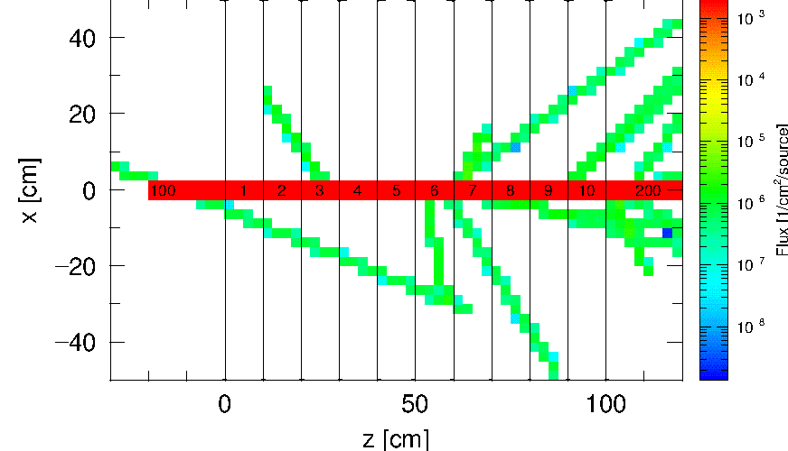
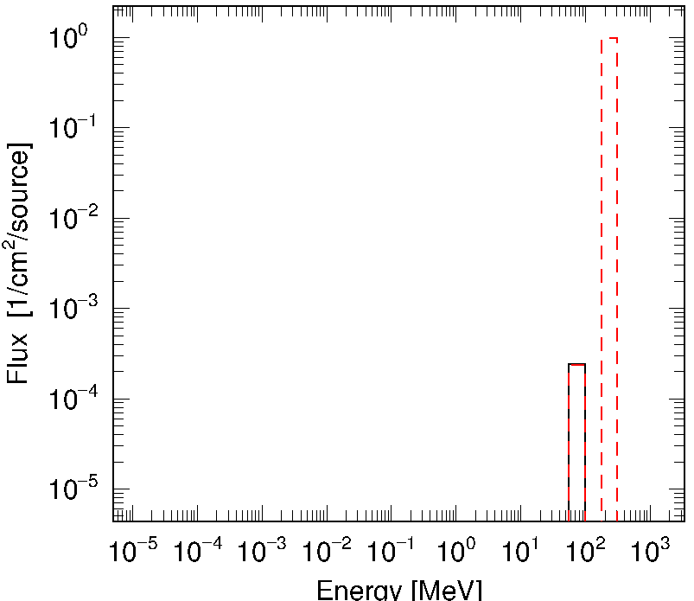
shield.inp
Basic setup
Projectile:
Geometry:
Tally:
200MeV proton (Pencil beam with radius 0.01cm)
10 aligning cylinders with radius of 50cm and 10cm thickness
(Air inside)
[t-track] Flux distribution (xz 2D, z 1D)
[t-cross] Energy spectrum at each surface of cylinders
10 cylinders
Proton flux
(1st page)
Cell 100
=> Cell 1
…
Proton
Neutron
200MeV
proton
Air
10cm
Geometry
trackXZ.eps
cross.eps
Check Input File

Slide 5
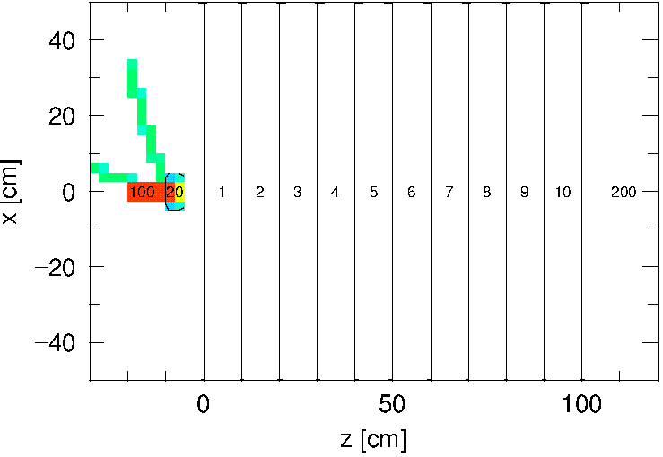
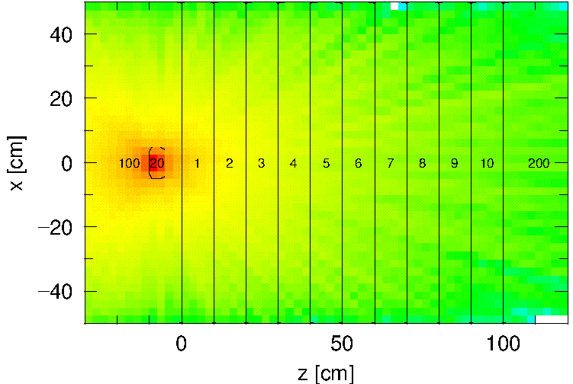
Step 1: Generate neutrons
Set tungsten target and generate neutrons by irradiating with proton beam
Cylinder (Cell 20) with thickness 5cm (z=-10 to -5) and radius 5cm centering Z axis
Tungsten is defined as (material #2) with density19.25g/cm³
Exclude target area from Cell 100
Proton flux
(1st page)
Neutron flux
(2nd page)
trackXZ.eps
Incident protons stop in the target
Neutrons generated by the collision with the target
Step 1

Slide 6
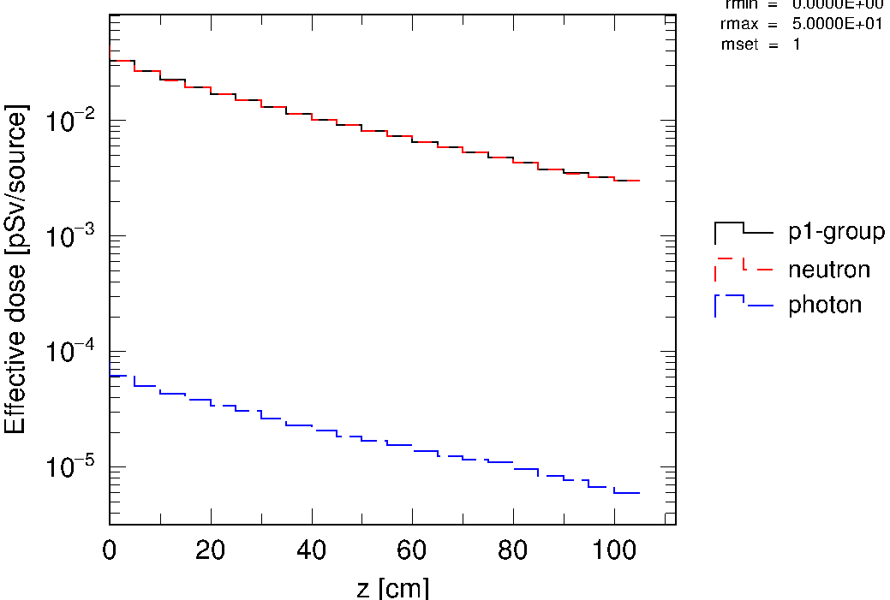
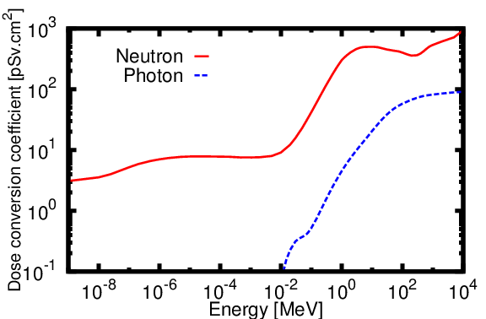
Step 2: Convert to effective dose
2nd
[ T - T r a c k ]
title = Track Z
...
y-txt = Effective dose [pSv/source]
multiplier = all
part = neutron photon
emax = 1000.0
mat mset1
all (1.0 -202)
Convert flux to effective dose using DCC at multiplier sections
Change title of y axis
Add multiplier subsection
Normalization factor
Multiplier # to use
DCC [ICRP116]
(Flux => effective dose) 1/cm² pSv
trackZ.eps
Neutron contribution is dominant
Step 2

Slide 7
Step 3: Adjust proton beam current
Calculate effective dose (Sv/h) for continuous beam current of 1μA
Hint
Effective dose was expressed in pSv/source by multiplying DCC
1A denotes 1 Coulomb of charged transmitted in 1 second
The electric charge of a proton is 1.6x10⁻¹⁹C
μ (micro) and p (pico) denotes 10⁻⁶ and 10⁻¹² respectively
# of protons consisting 1A current per sec is
1.0 / 1.6e-19 = 6.25e18 particles
# of protons consisting 1μA current per hour is
6.25e18 x 3600 x 1.0e-6 = 2.25e16 particles
Thus normalization factor to output in Sv/h is
2.25e16 x 1.0e-12 = 2.25e4
2nd
[ T - T r a c k ]
...
y-txt = Effective dose [pSv/source]
multiplier = all
part = photon
emax = 1000.0
mat mset1
all (1.0 -202)
[Sv/h]
2.25e4
At 100 to 105cm =>
6.8475E+01 Sv/h
84th line of trackZ.out
Step 3

Slide 8
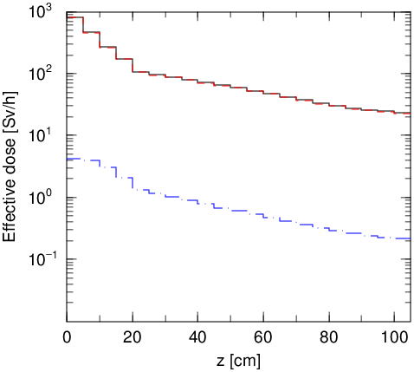
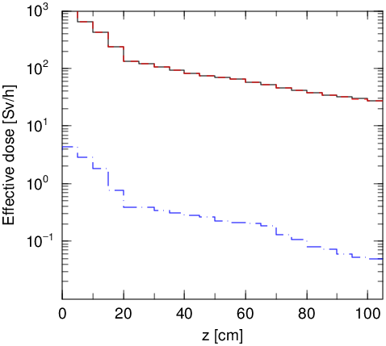
Step 4: Shield with wall
Change material of Cell 1 & 2 (20cm in total)
Add angel = ymin(1.0e-2) ymax(1.0e3) in 2nd [t-track] tally to make y axis scale uniform
Change gshow into 2 for 1st [t-track] tally to distinguish material easier
Concrete (MAT[3], 2.2g/cm³)
Iron (MAT[4], 7.7g/cm³)
2.2680E+01
2.5843E+01
trackZ.eps
Step 4

Slide 9
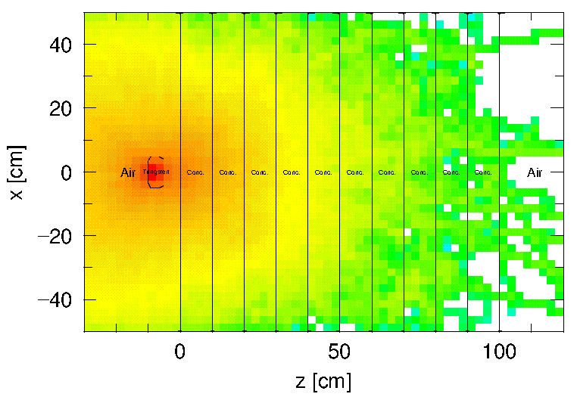
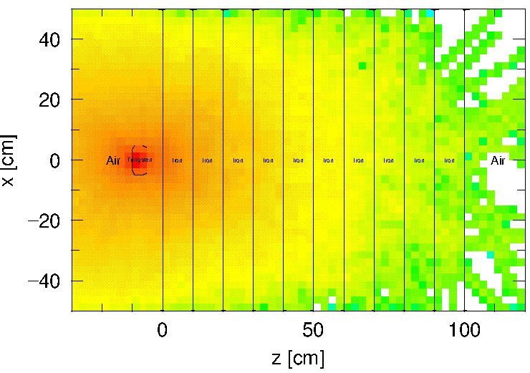
Step 5: Make the wall thicker
Change material of Cell 1, 2, …, 10 (100cm in total)
Concrete (MAT[3], 2.2g/cm³)
Iron (MAT[4], 7.7g/cm³)
TrackXZ.eps
Neutron deep-penetration calculation
=> Difficult to achieve sufficient statistical precision
Step 5

Slide 10
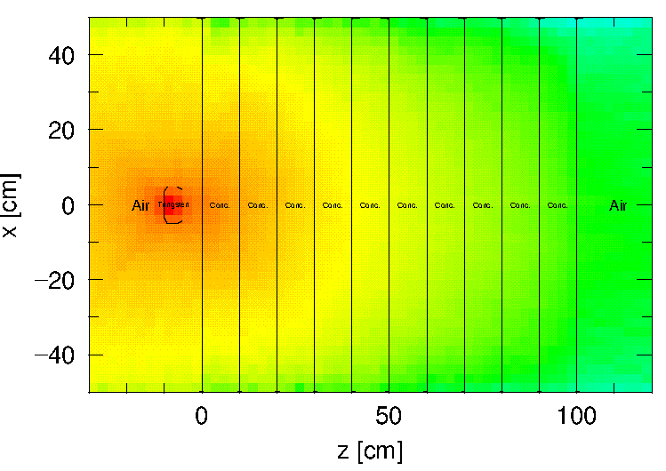
Step 6: Make neutrons reaching far edge
Set [Importance] to make neutrons reaching far edge
Concrete
[ I m p o r t a n c e ]
set: c1[1.0]
part = neutron photon
reg imp
100 c1**0
1 c1**1
2 c1**1
3 c1**2
4 c1**3
5 c1**4
6 c1**5
7 c1**6
8 c1**7
9 c1**8
10 c1**9
200 c1**9
Set more than 1.0
trackXZ.eps
If too large importance is set, calculation suddenly becomes very slow showing the following message
jbnk = 0, ibnk = 1
...
**** Warning: Too many secondary particles created ****
**** MAXBNK overflowed thus HDD is used 10 times ****
Effective dose at 100 to 105cm =>
2.6439E+00 Sv/h
1.6502E+00 Sv/h
for concrete
for iron
c1=2.0
Step 6

Slide 11
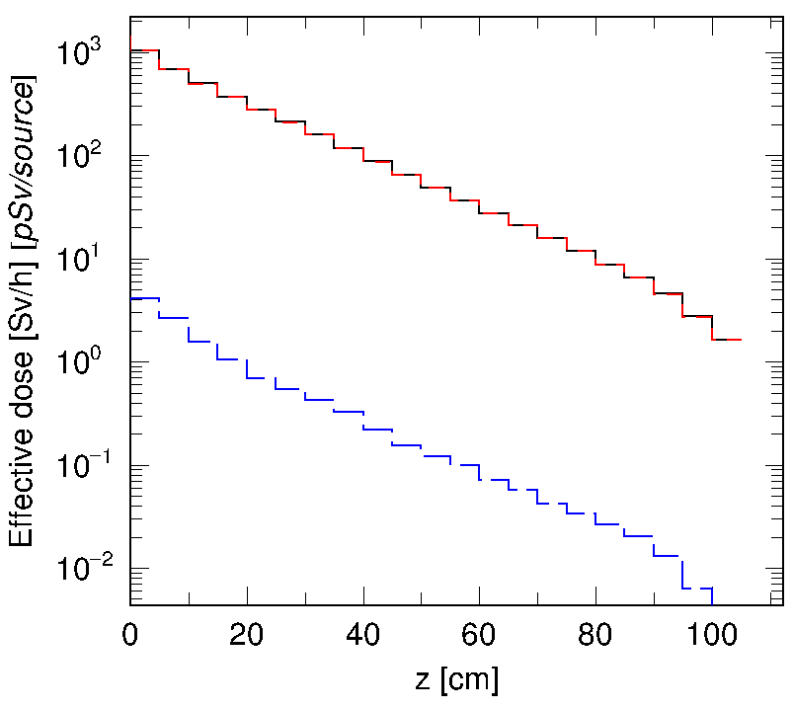
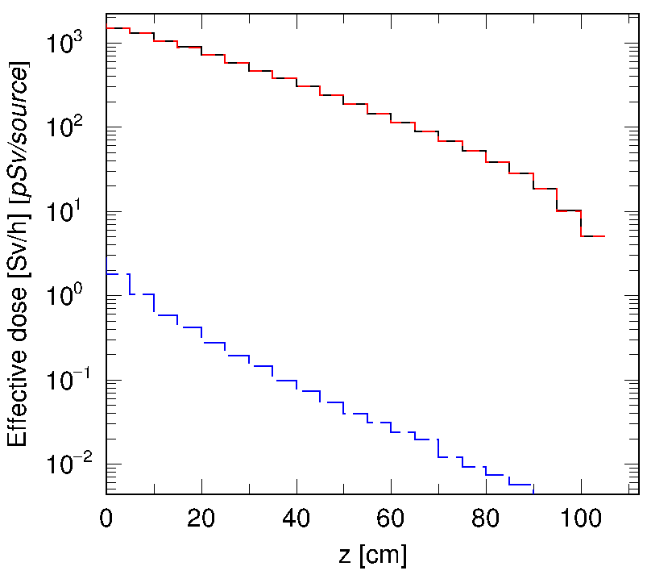
More shielded by denser material ?
Use lead (11.34g/cm³) instead of iron (7.7g/cm³)
Add lead as MAT[5] and use it for Cell 1, 2, …,10
[ M a t e r i a l ]
MAT[5] Pb 1.0
Iron (7.7g/cm³)
Lead (11.34g/cm³)
5.0811E+0
1.6502E+0
Shielding effect is smaller than iron
trackZ.eps
X-section (shielding effect) of high-energy neutron
X-section per nucleus
# of nucleus in unit volume
∝
×
Iron 2.01
Lead 1.91
∝ A^{2/3} × Density/A
Step 6

Slide 12
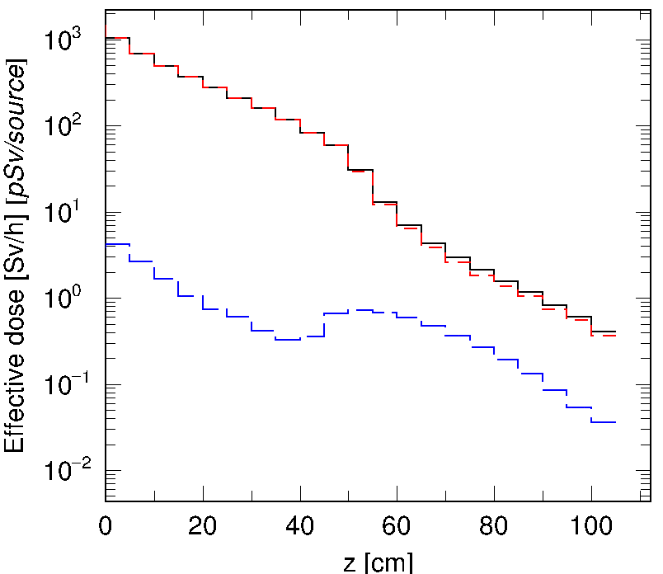
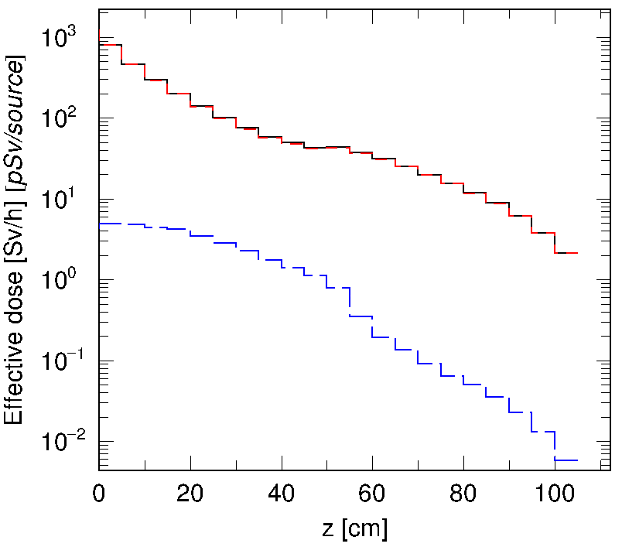
Step 7: Combine two materials
Set iron (MAT[4], 7.7g/cm³) for Cell 1, 2,…, 5
Set concrete (MAT[3], 2.2g/cm³) for Cell 6, 7,…, 8
Then compare the effective dose with the one for single material
Is there any difference if the positions of iron and concrete are exchanged ?
Concrete
Iron
Iron
Concrete
2.1888E+00
4.1126E-01
trackZ.eps
Step 7

Slide 13
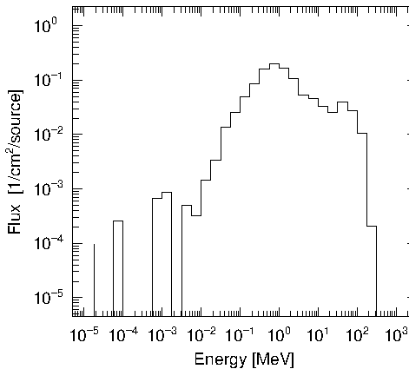
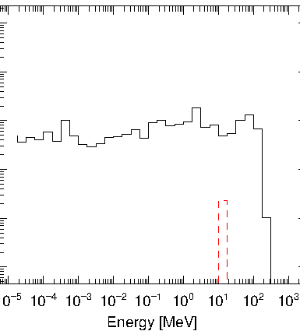
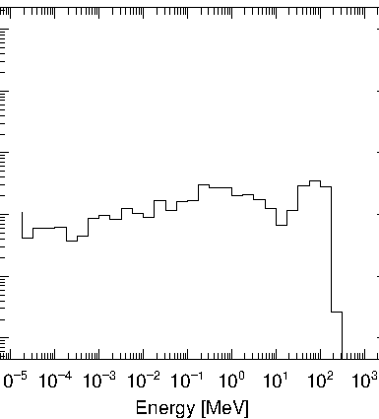
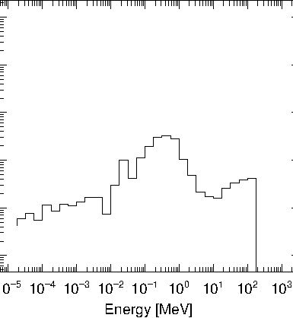
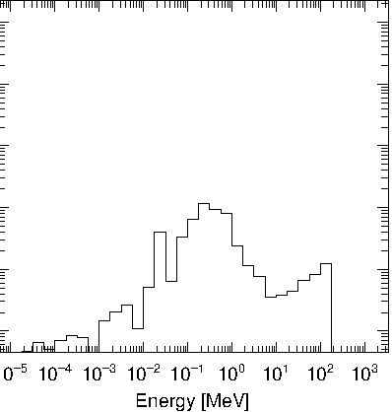
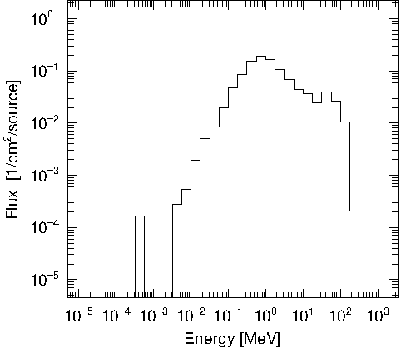
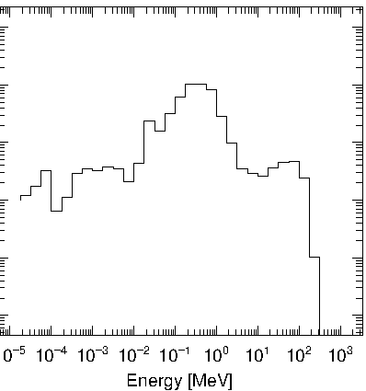
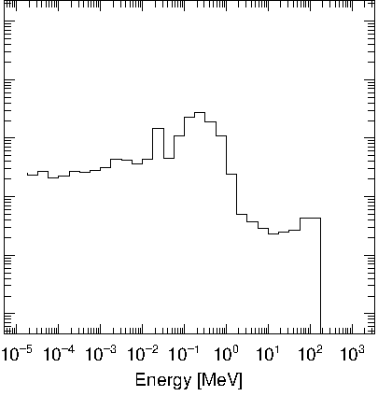
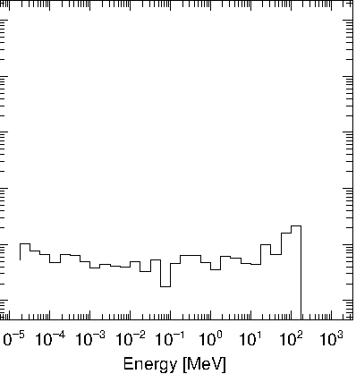
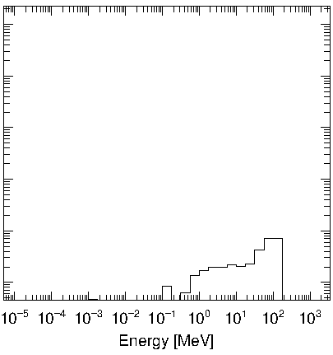
Spectrum of transmitted neutrons?
Air => Conc.
Conc. 20cm
Conc. => Iron
Iron 30cm
Iron => Air
cross.eps (Conc. => Iron)
Air => Iron
Iron 20cm
Iron => Conc.
Conc. 30cm
Conc. => Air
cross.eps (Iron => Conc.)
Neutrons can be shielded by degrading energy with iron (high density) and then stoping low-energy neutrons with concrete (containing hydrogen element)
Tally

Slide 14
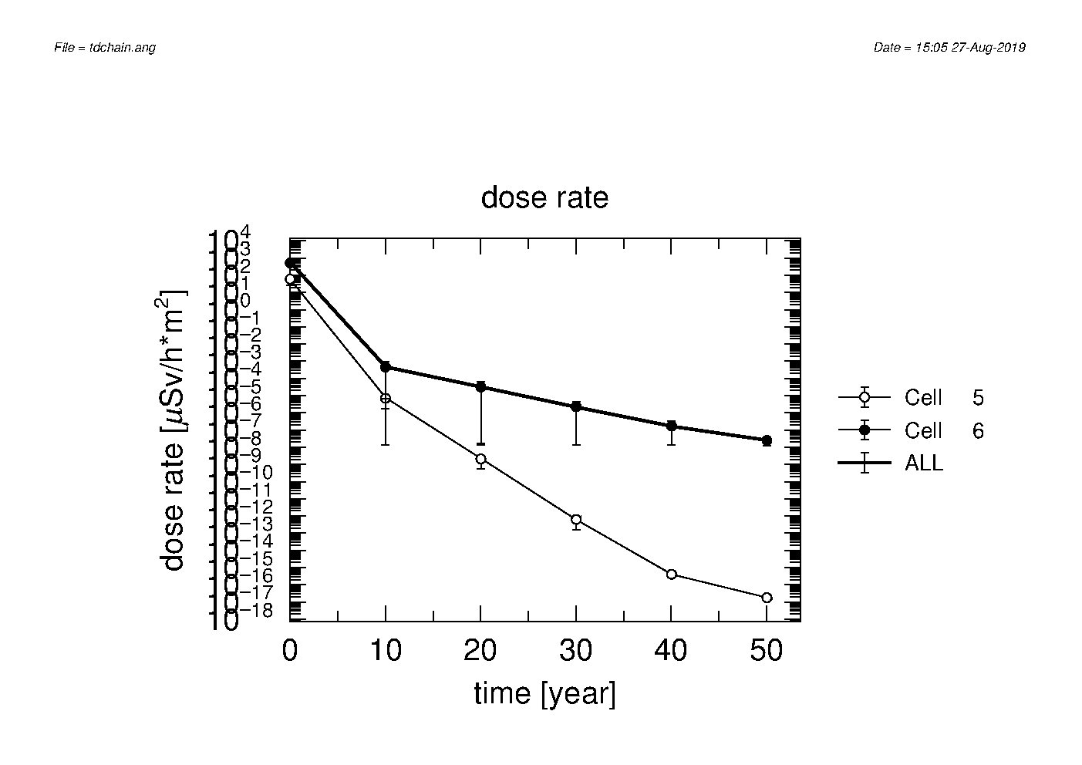
Step 8: Assess induced radiation of walls
Activate [t-dchain] tall and assess induced radiation activated by 1 hour irradiation up to 50 years later in 10-year step
Set iron for Cell 1, …, 5 and concrete for 6, …, 10
jmout = 1
e-mode = 0
Add to [parameters] section
Execute DCHAIN by using input “tdchain.out” obtained by PHITS
Remove “Off”
[ T - D C H A I N ]
$ must section for DCHAIN
title = Induced radiation
mesh = reg
reg = 5 6
file = tdchain.out
timeevo = 2
1.0 h 1.0
50.0 y 0.0
outtime = 6
1.0 h
10.0 y
20.0 y
30.0 y
40.0 y
50.0 y
$ beam current (nA)
set:c21[1000.0]
amp = c21*1.0e-9/1.602e-19
²⁶Al is dominant
Iron
Concrete
tdchain.eps (6th page)
Step 8

Slide 15
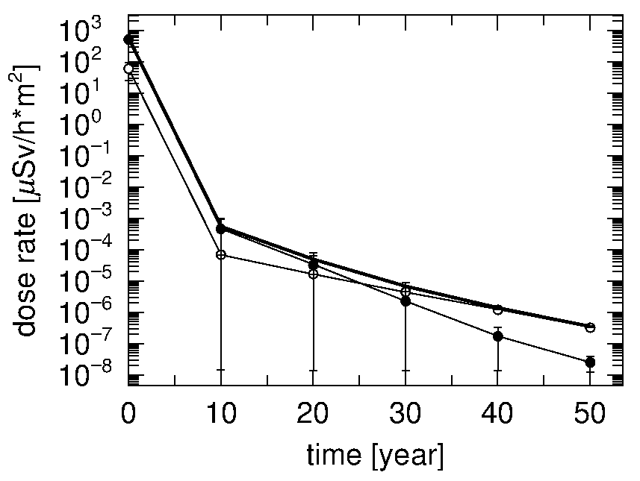
Influence of trace impurity
tdchain.out (around 61th line)
Add trace impurity (⁵⁹Co,1ppm) to iron wall (modify “tdchain.out”) and recalculate DCHAIN
!1)HRGCMM 2)IREGS 3)ITGNCLS ...
DUMMY001 5 5 2.4588E+08 ...
Fe-54 4.8545E-03
Fe-56 7.6206E-02
Fe-57 1.7599E-03
Fe-58 2.3421E-04
Co-59 1.0000E-06
# of elements
Impurity
Without impurity (⁵⁹Co)
With impurity (⁵⁹Co)
Concrete
Iron
Iron
Concrete
tdchain.eps（6th page）
After a few ten years ⁶⁰Co produced from trace impurity becomes dominant
Step 8

Slide 16
Summary
Effective dose can be calculated using [Multiplier] section and [T-track] tally
High-energy neutrons can be effectively shielded with high-density material (such as iron) followed by material containing hydrogen element
Consideration of trace impurities which may produce long-lived radionuclide is important for assessment of long-term induced radiation
Summary

Slide 17
Homework (Hard work!)
Let’s calculate induced radiation of the target (tungsten)
1 hour radiation with current beam setting and investigate at 1 day later
Compute effective dose at 1m distance from the target
Hints (work flow)
Do in order of PHITS => DCHAIN=> PHITS
1st PHITS
Modify [t-dchain] tally
Set volume of target in [volume] section
2nd PHITS
Copy [source] section from DCHAIN output (tdchain.pht)
Set rectangular source for tungsten target area
Replace wall with air and unset [importance]
Normalization factor of multiplier subsection in [t-track] should be
3600x1.0E-6=3.6E-3
Title of color bar can be changed by “z-txt = *** ”
Homework

Slide 18
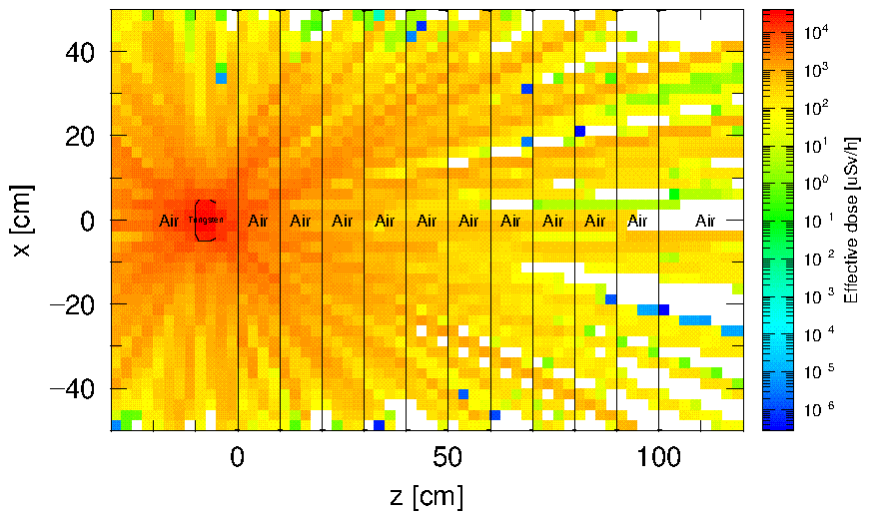
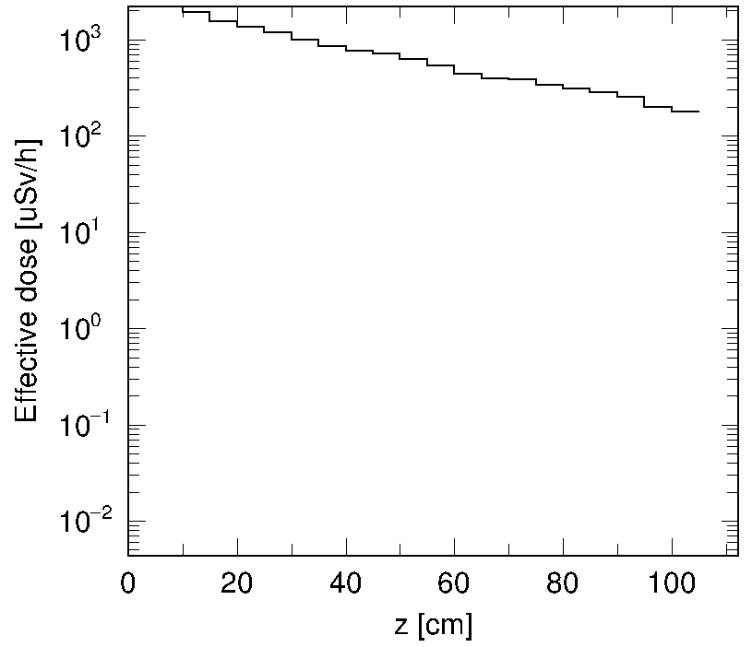
An answer (answer-step1.inp, answer-step2.inp)
trackZ.eps
trackXZ.eps
One order magnitude lower than the value of rough estimate by DCHAIN
(Line 1087 of tdchain.act)
total g-ray dose-rate 2.47988E+03 [uSv/h*m^2]
Effect of self-shielding by target itself
Homework

