Slide 1


Quick Guidance
phits/lecture/tutorial-en.pptx
(This file is also included in the installer)
Revised Apr. 2024

Slide 2
Table of Contents
Preparation for PHITS tutorial
Notes during PHITS tutorial
Remarks at the end of PHITS tutorial
Additional information for person who cannot attend PHITS tutorial
Table of contents

Slide 3
PHITS installation
Installers for Windows, Mac, and Linux are available
Windows: Move to “win” folder and double-click phits_setup_win.exe (see win/instruction-eng.pptx)*
Mac: Move to “mac” folder and right-click (or Ctrl+click) “PHITS_Installer.command” and select “open” from the shortcut menu (see mac/README-eng.pdf)
Linux: Move to “linux” folder and see README-eng.txt
Important notice
Approximately 10 GB disk space is required.
Please do not change the path (folder name) to install PHITS from its default setting (e.g. c:/ for Windows).
If you have an older version of PHITS, please make a backup of your edited files and install the new version in the same folder (overwrite installation is recommended).
*phits_setup_win.exe is occasionally quarantined by anti-virus software. In that case, please restore it by yourself

Slide 4
Confirmation of Installation
When installation is completed, open
/phits/lecture/basic/lec01/
folder and execute PHITS with an input file lec01.inp
How to run PHITS
Windows: Select an input file -> Right click -> Send to* -> Select PHITS
Mac: Drag & drop in input file to a blue PHITS icon in the dock
Linux: type “phits.sh lec01.inp” in your console
Please see instruction files in each folder in more detail
*In Windows 11, “SEND TO” command is behind “Show More Options”.

Slide 5
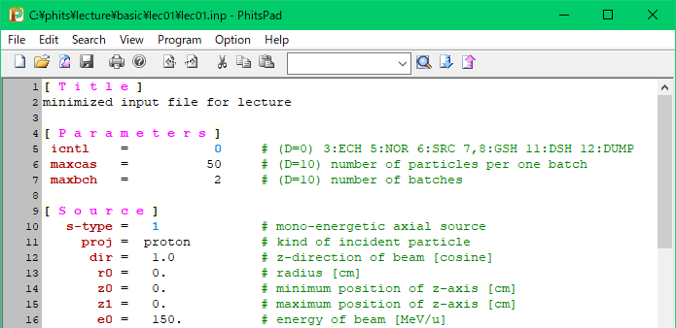
Confirmation of Installation using Text Editor
Open lec01.inp with PHITS-Pad or NotePad++
Select “PHITS” option in “Program” (PHITS-Pad) or “Run” (NotePad++) in the menu bar.
Here!
Please see instruction files in each folder if it does not work

Slide 6
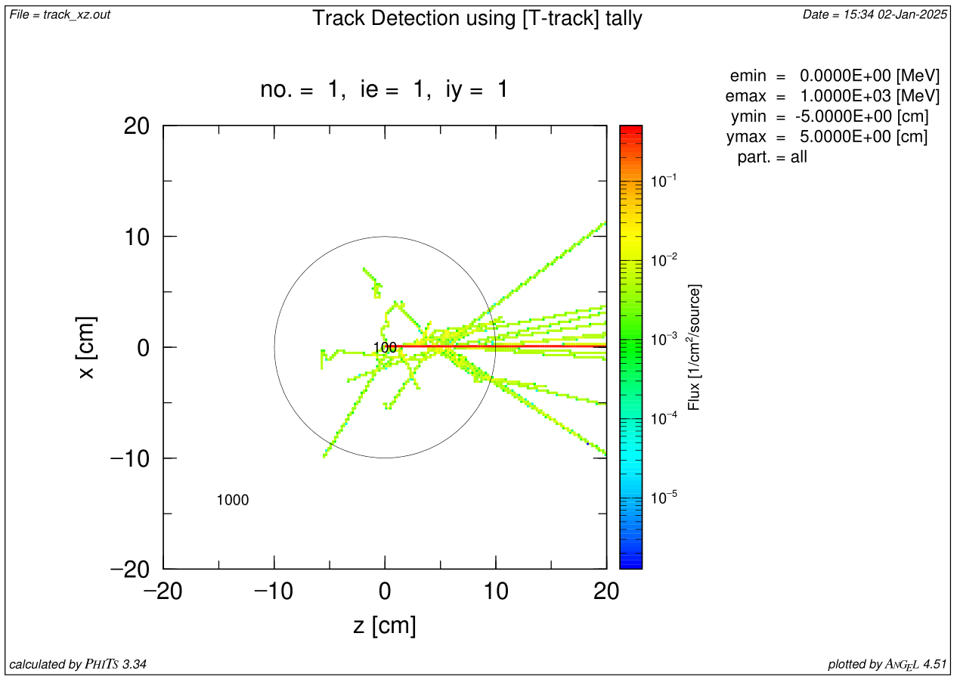
Check PHITS simulation results
When PHITS execution is finished, output files phits.out, track_xz.out, track_xz.eps, track_xz_err.out, track_xz_err.eps, batch.out are created. Open track_xz.eps and check whether eps file is shown or not.
track_xz.eps
If you cannot see this figure, please install software for opening EPS file by referring the instruction files in each folder

Slide 7
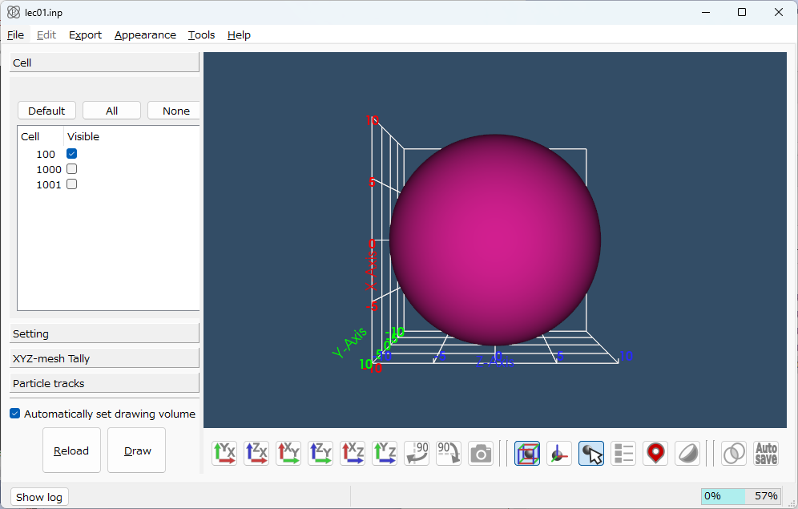
Confirmation of Geometry Viewer: PHIG-3D
How to run PHIG-3D (similar to PHITS itself)
In the folder of “/phits/lecture/basic/lec01”
Windows: Right-click lec01.inp and select “SEND TO”→ ”PHIG-3D”*
Mac: Drag lec01.inp & drop into the icon of ”PHIG-3D”
Linux: Type “phig3d.sh lec01.inp” in your console
Draw button
After pressing “Draw” button, you can see this picture
Please see instruction files in each folder if it does not work
*You can also run PHIG-3D via PHITS-Pad or NotePad++

Slide 8



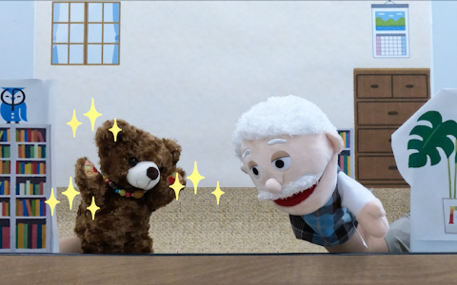
Preparation with YouTube (Not mandatory)
Promotion Movie
https://www.youtube.com/watch?v=G6-XTIctRgA
Basic lecture (with machine voice)
https://www.youtube.com/playlist?list=PLe8Wrr-sE8vy-ygWoAqWVrvK89PfxUFYO
Monte Carlo simulation with dice! (in Japanese)
https://www.youtube.com/watch?v=9_bs6g0n3Hg
PHITS introduction by puppet Rakugo (in Japanese)
https://www.youtube.com/watch?v=1WeaFPRXHWI&t=331s

Slide 9
Table of Contents
Preparation for PHITS tutorial
Notes during PHITS tutorial
Remarks at the end of PHITS tutorial
Additional information for person who cannot attend PHITS tutorial
Table of contents

Slide 10
Electricity supply of laptops
During the course, please be sure that AC electricity is supplied to your laptop. Otherwise, power saving mode setup will be applied depending on the OS setup. In that case you may suffer from CPU power limitation.
Installation folder name
You should not move or rename “phits” folder after the installation finished for both Windows and Mac. You can freely change input file and folder names, but you should not use “blank” in the name
Tutorial contents
Basic course is designed for beginners of Monte Carlo particle transport simulation. If you have experienced with other codes such as GEANT4 and MCNP, you can move forward by yourself and ask any questions regardless of the tutorial progresses.

Slide 11
Table of Contents
Preparation for PHITS tutorial
Notes during PHITS tutorial
Remarks at the end of PHITS tutorial
Additional information for person who cannot attend PHITS tutorial
Table of contents

Slide 12
PHITS folder structure
In the /phits/ folder, following folders are included
/bin/ ------ Shell scripts and exe files of PHITS
/data/ ------ Data files used by PHITS
/dchain-sp/ ------ Programs related to “DCHAIN-SP”
/document/ ------ ppt files on recent updates
/lecture/ ------ Lecture notes
/manual/ ------ Manuals for PHITS and ANGEL
/phig3d/ ------ Files related to geometry visualizing software PHIG-3D
/recommendation/ ------ Sample inputs for various purpose
/sample/ ------ Sample inputs for benchmark, surface, & tally
/src/ ------ PHITS source files in FORTRAN
/utility/ ------ Useful scripts and external programs
/XS/ ------ Nuclear/Atomic cross section data library
Folder tree
Notes:
マニュアルは辞書的に使ってください。

Slide 13
Utility folder
/animation/ ------ Conversion of PHITS results into GIF animation
/FLUENT/ ------ PHITS-FLUENT coupling analysis
/icru90/ ------ ICRU90 stopping power
/magmap/ ------ Magnetic field map
/ParaView/ ------ 3D-visualization application
/PSFC4PHITS/ ------ Phase Space File Converter for PHITS
/RTphits/ ------ Radio Therapy package based on PHITS
/script/ ------ Script for successively executing PHITS
/ShieldingDistribution/ ------ Shielding thickness calculation
/SimpleGEO/ ------ GUI application for making 3D-geometry
/sumtally/ ------ Function for summing up two (or more) tally results
/SuperMC/ ------ Conversion of CAD files to PHITS format
/TetraGEOM/ ------ Tetrahedron geometry
/usrtally/ ------ Sample program of User defined tally [t-userdefined]
Utility folder
Notes:
マニュアルは辞書的に使ってください。

Slide 14
PHITS code license
PHITS is exclusively licensed to individual and secondary distribution is not permitted.
If you change your affiliation, you have to get PHITS license again by submitting application form via PHITS website
You can install PHITS to your own computer or to your personnel account in a shared computer. Please be careful to avoid the leakage of PHITS to unsubscribed people.
License

Slide 15
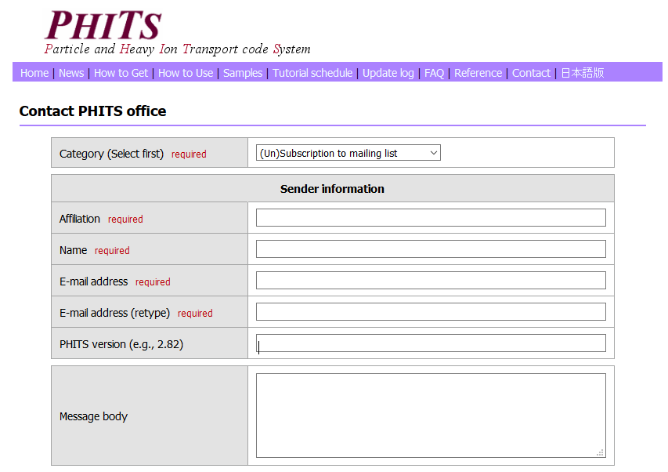
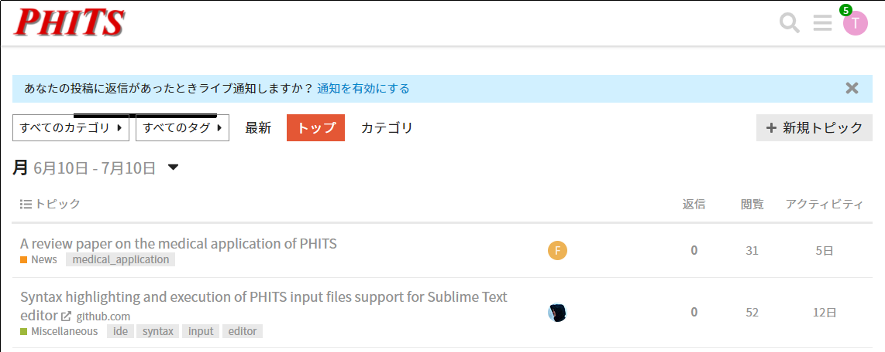
Question and Update Announcement
You can ask questions via PHITS forum or contact page of PHITS website, but please refer manual and FAQ before sending questions.
The information on PHITS update and PHITS course are announced through the PHITS mailing list. If you do not wish to receive Email from us, please unsubscribe your address using contact page of PHITS website
Please also check PHITS Facebook page and promotional video
https://meteor.nucl.kyushu-u.ac.jp/phitsforum/
https://phits.jaea.go.jp/contact/edit/en

Slide 16
Concluding Remark
You may think that you can do computer simulation anytime you want, in different from experiment
However, it is very difficult to remember how to use a simulation code after a certain blank period
Therefore, we strongly recommend starting a certain study using PHITS within a week from now, otherwise, the chance to forget everything you have learned in this tutorial will become quite high
We do hope that PHITS will be useful in your research
PHITS Development Team

Slide 17
Table of Contents
Preparation for PHITS tutorial
Notes during PHITS tutorial
Remarks at the end of PHITS tutorial
Additional information for person who cannot attend PHITS tutorial
Table of contents

Slide 18
Recommended Lecture Notes
In the beginner course, basic/lec01, basic/lec02, basic/lec03, exercise/range and exercise/snowman in the phits/lecture folder will be conducted. We recommend to follow these lectures when you start to learn PHITS. YouTube video are available for these lectures, though they are not always the latest version.
In the intermediate course, the main topics are the complex source definition (sourceA), variance reduction techniques (variance-reduction), useful functions (options), and automatic execution using script (autorun) in the phits/lecture/advanced folder. In addition, purpose-specific lectures are held on cosmic-ray transport (cosmicray), induced-activity calculation (DCHAIN1), detector-response simulation (detector), and shielding calculation (shielding) in the same folder, and BNCT and X-ray therapy dose calculations (BNCT & XrayTherapy) in the phits/lecture/therapy folder. You can find your own relevant items in these folders for your reference.

Slide 19
Use of Sample Files
The most difficult issue in the parameter setting is the determination of whether the EGS mode, the event generator mode, and JENDL-5 should be used or not. If you cannot determine those parameters by yourself, please read phits/recommendation/readme-eng.doc and copy & paste the [parameters] section of the input file that is most relevant to your calculation condition.
Tallies are rather difficult to define because they have a variety of parameters. So, we recommend finding the sample input file of the tally that you need to set up from phits/sample/tally folder and copying the tally to your input file.
In addition to tallies, there are several sample input files useful for various purposes such as complicated source definitions and the medial physics simulations using ICRP human phantoms in both voxel and mesh format.

