Slide 1
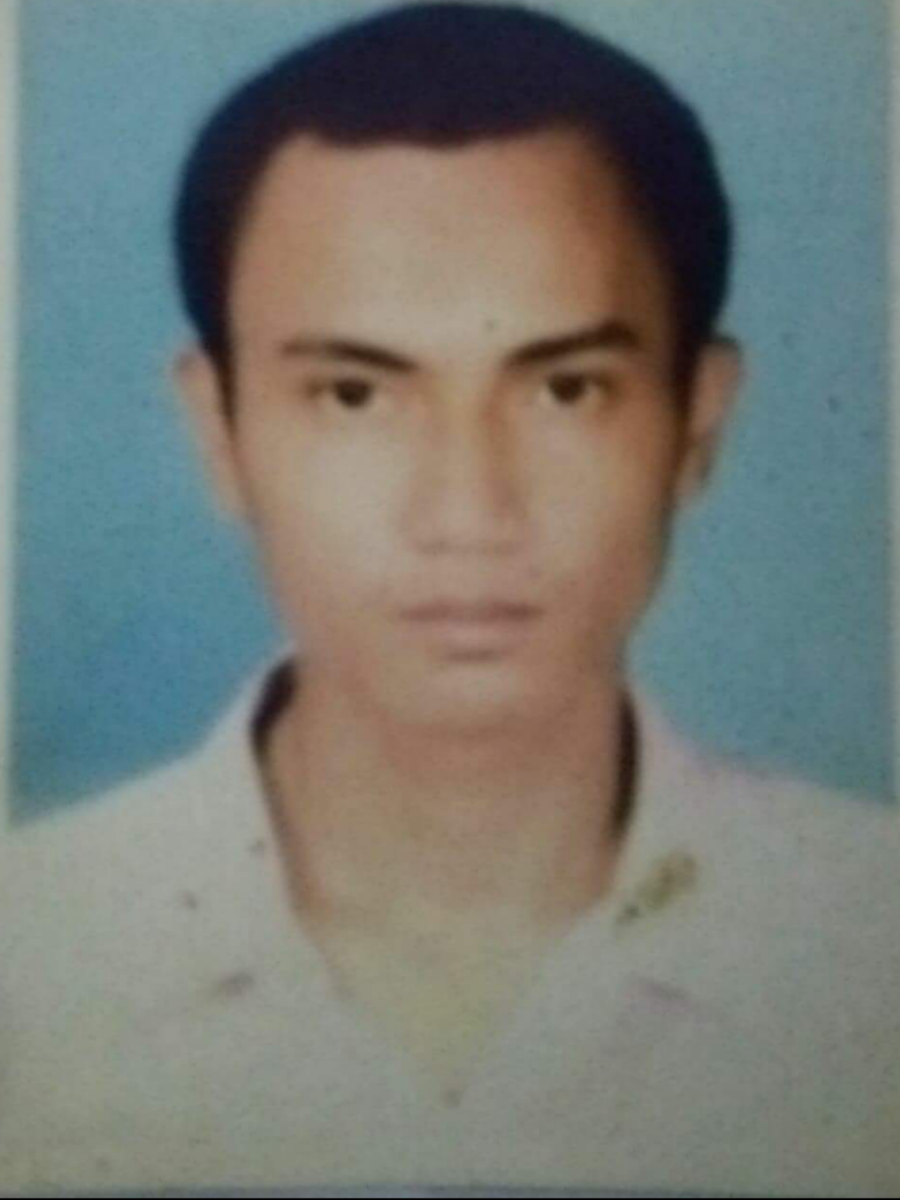






WORK EXPERIENCE
Asiasoft Nusantara
Mar 2001 - May 2008 · 7 yrs 3 mos
Greater Jakarta Area, Indonesia
Software DeveloperSoftware Developer
http://Elog.idhttp://Elog.id Mar 2018 - Jul 2018 · 5 mos
Greater Jakarta Area, Indonesia
fullstack web developer
Aris Priyanto
Application DeveloperApplication Developer
turangga aksa mahadana
Jun 2019 - Nov 2019 · 6 mos
081284123979
aris.22002.priyanto@gmail.com
Jakarta, 05 April 1981
Jl. Kebon Mangga no 40 rt 02/rw 02 kebon manga 4 cipulir kebayoran lama 12230 Jakarta selatan
front end developer
Vuejs
Triklin Rekatama · Full-time
Nov 2019 - Jun 2020 · 8 mos
Jakarta Metropolitan Area
WorkerWorker
PT. Intidata Anugrah Pratama ·
Contract Jan 2021 - Mar 2021 · 3 mos
Jakarta, Indonesia
selesai
SKILL
React Js
Laravel
Vue JS MongoDb
Json
MySQL
SQL Server Code Igniter
Python
PHP
Javascript CSS
Bootstrap
Full Stack Engineer
Freelance
P.T Digital Taruna Indonesia
Jun 2020 - May 2021 · 1 yr
Jakarta Metropolitan Area
Frontend Developer
Contract
VueJs
Majapahit Teknologi
· Contract May 2021 - Sep 2021 · 5 mos
Jakarta, Indonesia
Frontend Developer
VueJs
ON-TRUCKS · Full-time
Jan 2022 - Present · 5 mos
Jakarta, Indonesia
Aris-Priyanto

Slide 2

EDUCATIONAL BACKGROUND
Sedang Berkuliah di E-Campus Sekolah Tinggi Teknologi Informasi NIIT
Universitas BudiLuhur- jakarta Bachelor of Computer (S.Kom.),
Ilmu Komputer - Major
IPK : 3.04 , 2000 – Dropped Out
Smu Walisongo Jepara
1997 – 2000
SMP Negeri 48 Jakarta | 1994 - 1997
SD Negeri Cipulir 03 Jaksel | 1989 - 1994
Training Record
• Dasar Kotlin
• Java Programming
• Website Design
• Mahir web modern Reactjs
• React The Complete Guide
• PHP untuk Pemula

Slide 3
Project
2018
Nama aplikasi : Intern Koni Kota Tangerang Selatan
Tahun selesai : 2018
Jenis Aplikasi : Aplikasi Payroll,absensi dan web
Teknologi : PHP, CSS, JS, MySqli, Linux, JQuery
Deskripsi. : Apps for Intern KONI Kota Tangerang Selatan such as Payroll, attendance System, and Web
2. 2019
Nama Aplikasi : PT Telkom IBSS
Tahun selesai : 2020
Jenis Aplikasi : Web app
Teknologi : Java, Linux Server, Axios, Code Igniter, PostMan, Json, TOAD, VueJs BootStrap.
Deskripsi : Apps For Client (intergrated Buisness Solution System)
3. 2021
Nama Aplikasi : OSS Ministry Of Investment
Tahun Selesai : 2021
Jenis Aplikasi : Web app
Teknologi : NodeJS, Docker, AWS, Vuejs, Axios, PostMan, Json,Vuetify, Vuex, TypeScript, microservice
Deskripsi : An application that integrates Submission for Investing and permit completed that’s covers all about tax, permit, etc etc.

