Slide 1
A. P. Athanasiou, C. N. Raftopoulos,
E. D. Thanos, G. V. Kritharellis,
N. D. Tselikas, I. E. Foukarakis, A. C. Boucouvalas
Towards Privacy Aware Target Advertising
PCI 2012 - 16th Panhellenic Conference on Informatics
October 5 - 7, 2012 University of Piraeus, Greece

Slide 2
Online Advertising
A form of promotion that uses the internet and world wide web to deliver marketing messages to attract customers
Examples of online advertising
  Search engines results pages
  Banner advertisments
  Blogs
  Social networking advertising
  Interstitial advertisments
  Advertising network
  Email marketing
  Pop-up ads

Slide 3
Target Advertising
Ad targeting refers to the practice of advertisers attempting to reach a specific consumer audience
Researches have shown that targeted advertising secure an average of 2.7 times more profit per ad as non-targeted advertising
Targeting Methods
  Contextual targeting
  Behavioral targeting
  Geo-Targeting / Local advertising

Slide 4
Advantages of Online Advertising
Immediate publishing of information and content that is not limited by geography or time
Efficiency of the advertisements
Internet advertising is targeted
Good conversion tracking
Low-cost
World wide range
Multimedia tools – more effective ads
Consumer is few-clicks away from buying the advertised product

Slide 5


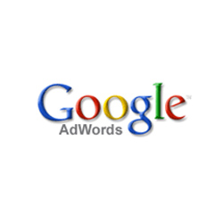
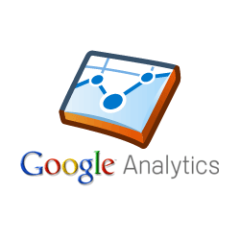

Significance of online advertising
Corporations such as Google, Facebook, Yahoo, AOL main revenue was derived from online advertising.
Google changed online advertising by introducing new approaches

Slide 6
Privacy issues
Target advertising is based on users’ personal information
  Monitoring
  Tracking
  Analyzing
Users’ Data
The use of online advertising has implications on the privacy and anonymity of users
Privacy advocates have expressed grave concerns about its potential abuses and threats

Slide 7
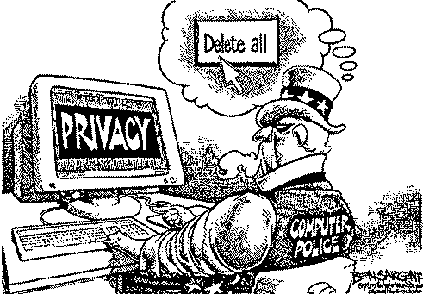
Privacy
The ability of an individual or group to seclude themselves or information about themselves and thereby reveal themselves selectively
  Privacy is a fundamental human right recognized in the UN Declaration of Human Rights, the International Convenant on Civil and Political Rights and in many other international and regional treaties

Slide 8
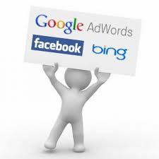

Efficiency vs. Privacy
Obviously, there is a controversy between privacy awareness and targeted advertising
vs.

Slide 9
Our Framework
It’s an alternative framework enabling targeted advertising while, at the same time, privacy issues are seriously taken into consideration
Proposes an architecture where the advertising server constitutes as a separate entity
Renders “abstract” the personal data collected from users by classifying them into a general category concealing this way all the sensitive personal information from the advertising authority

Slide 10
Testing the framework
In order to test our system we implemented a chat system
The proposed framework mediates between chat and advertisement servers
It then actually :
  “filters” the text content coming from chat end users
  removes any personal and/or private information
  provides the end user with the appropriate advertisement

Slide 11
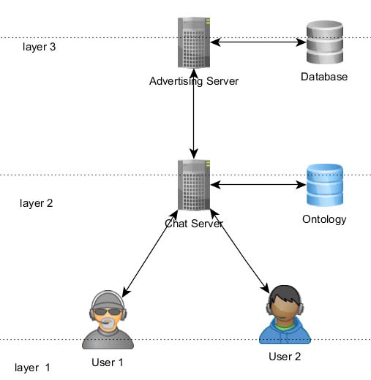
System Architecture
This system consists of three layers:
  Layer 1 (the end users of a chat application)
  Layer 2 (the “mediator”, that consists of the chat server and the proposed framework
  Layer 3 (the advertising server)

Slide 12
Web Ontology Language
The OWL Web Ontology Language is designed for use by applications that need to process the content of information instead of just presenting information to humans
We created an ontology, in order to:
  organise the target-vocabulary efficiently
  enable the abstraction of data collected

Slide 13
Disease Ontology
In order to test the system we decided to choose a specific advertising field
We chose the medicine field specifically because:
personal health data is of vital importance
privacy is a major factor when it comes to health issues
The ontology is an effort to unify the structure of the human disease knowledge based on existing research on the medical ontologies’ field

Slide 14
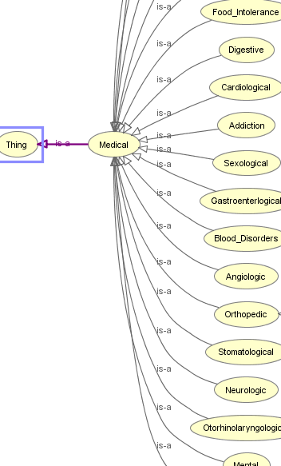
Disease Ontology structure
Each super-class represents a large category of health disorders and contains as members a list with significant number of diseases and symptoms
Similar ontologies could be created for several other fields, in order to expand the current database while preserving its structure

Slide 15
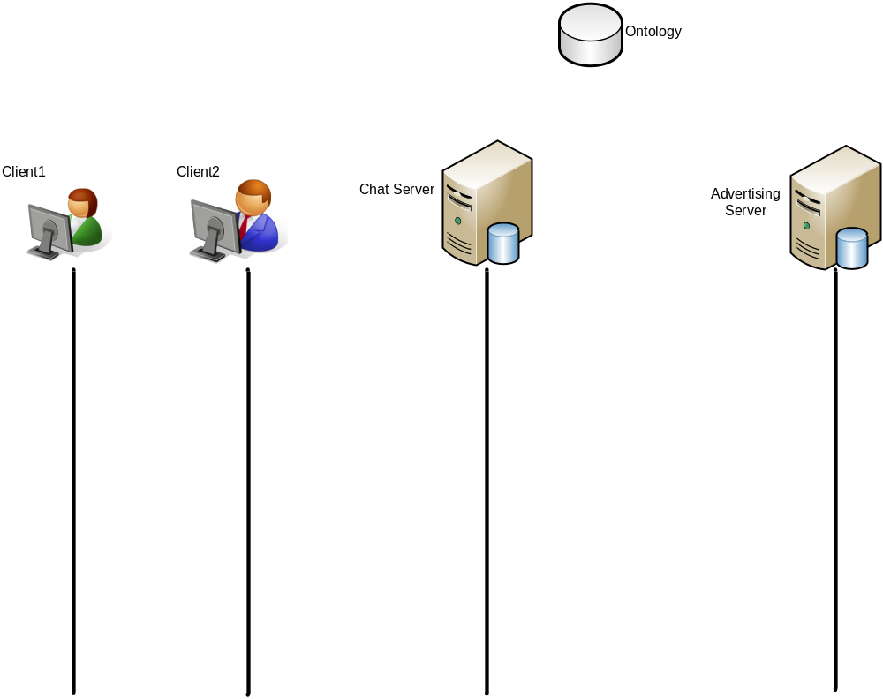
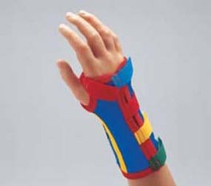
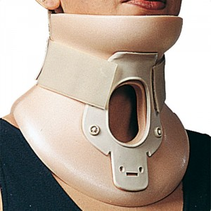
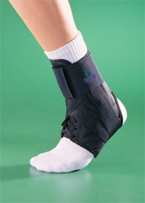
Use Case Scenario
“Yesterday I dislocated my ankle”
Orthopedic
“Yesterday I dislocated my ankle”
“Yesterday I dislocated my ankle”
Orthopedic
(ad1, ad2, ad3)
ad3
ad3

