Slide 1
flexDoc
Quick-start Manual – Draft

Slide 2
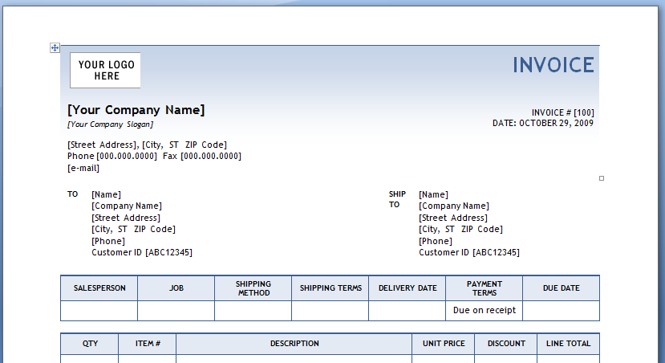
Create the template
Create the template as if you’re creating the desired output document

Slide 3
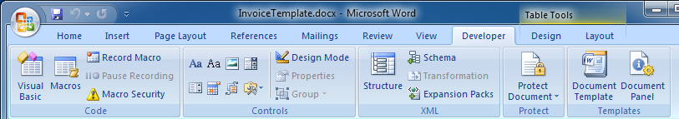
Enable the Developer-tab
Check this blog for details on how to enable it.

Slide 4
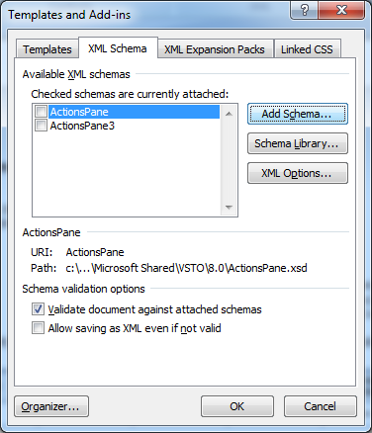
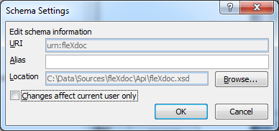
Enable fleXdoc
Add the XML-schema for the fleXdoc placeholders from the Developer-tab:
Click ‘Schema’
Click ‘Add schema’ and select fleXdoc.xsd*
Enable the Structure-pane
* Can be found in the fleXdoc installation folder

Slide 5
fleXdoc Elements
Small tags in the template that:
Render data: ValueOf
Render an image: ImgOf
Iterate through sets of data: ForEach
Import another template: ImportTemplate
XPath is used to query the data-XML
Online Element Reference Guide: http://flexdoc.codeplex.com

Slide 6
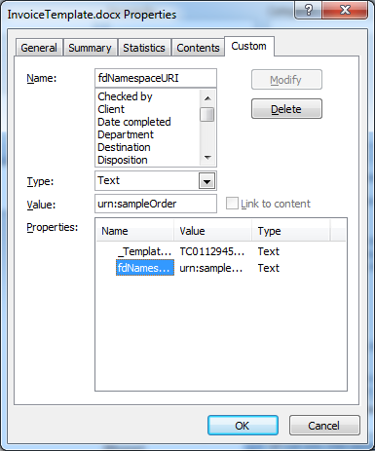
Configure data namespace
Add a custom document property fdNamespaceURI:
This namespace-URI is used by fleXdoc to query the data-XML. You can refer to it by using default namespace-prefix ‘d’.

Slide 7
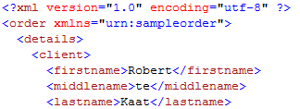
Using a context-node
Nest ValueOf-elements inside a UseContext-element: then you can use xpath-queries relative to the context-node that is selected by the UseContext-element
Set the context-node to the ‘client’-element*: /d:order/d:details/d:client
* ‘d’ is the default namespace-prefix used by fleXdoc

Slide 8
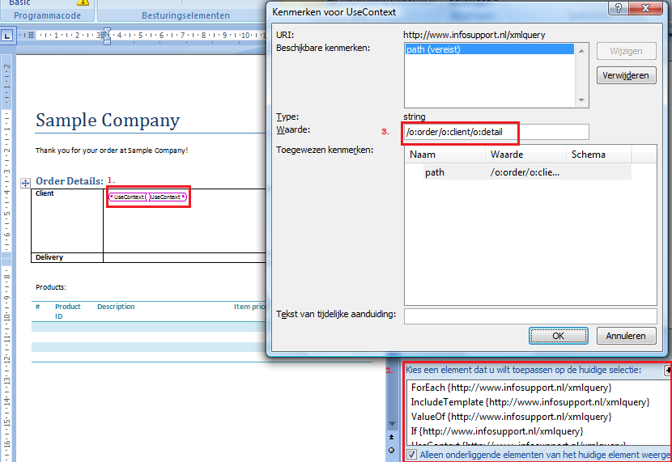
Adding the UseContext
Select the position in the document
Add the UseContext from the Structure-pane
Set the path-property

Slide 9
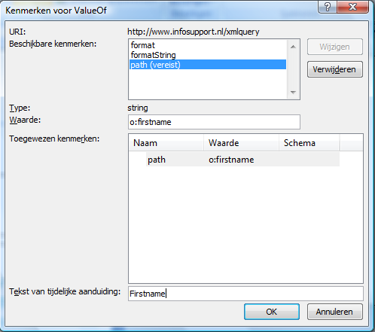
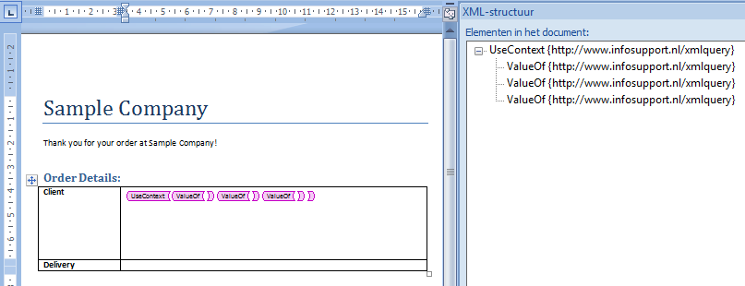
Adding the ValueOf
In the same way add the ValueOf-elements inside the UseContext-element, set their path-properties and set the value for temporary display

