Slide 1
Lab session#6: Sorting
Kamil Salakhiev

Slide 2
Sorting algorithms
Simple sorting algorithms:
Bubble sort
Insertions sort
Selection sort
Complex sorting algorithms:
Quick sort
Heap sort

Slide 3
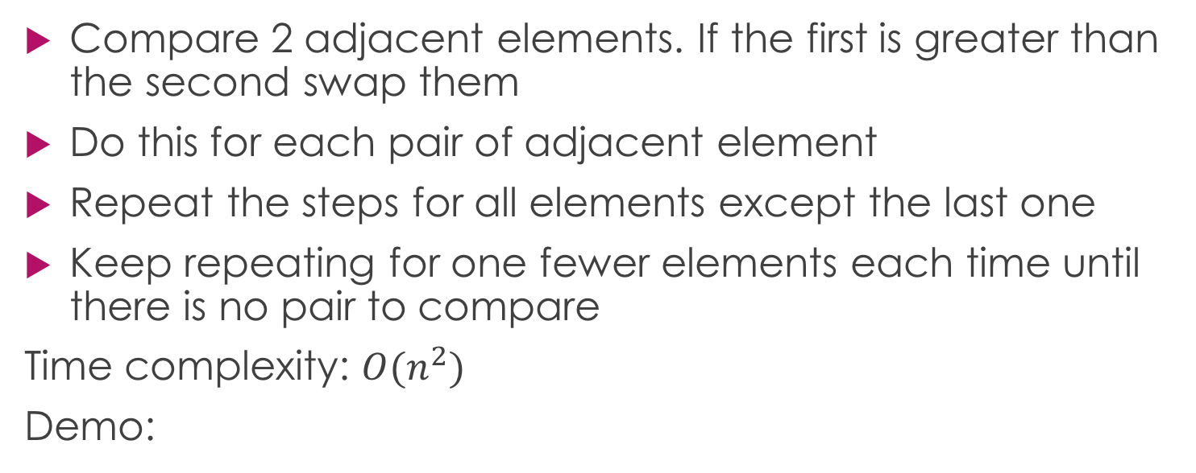
Bubble sort
Compare 2 adjacent elements. If the first is greater than the second swap them
Do this for each pair of adjacent element
Repeat the steps for all elements except the last one
Keep repeating for one fewer elements each time until there is no pair to compare
Time complexity: $O(n^{2})$
Demo:

Slide 4
QUICKSORT

