Slide 1
New York Taxi
Aris Fernando

Slide 2
Brief Information
All material all available in google shared drive : https://drive.google.com/drive/folders/1YqZ1ob1wsreCNQB6Fnpw_5iTTFepNydO?usp=sharing
All codes are in default anaconda environment, except for several lib such -
Library Used for EDA : matplotlib.pyplot, plotly.offline & plotly.graph_objs
Library Used for Predicting Model : lightgbm. Why another gbm? Explained later

Slide 3
Data Sources
There are 2 (two) main Data Sources, bulk file which contain trip ---- detail information.
Relationship among those two sources are 1 …… 1 ( 1 to 1) relationship
Trip fare data:
medallion, hack_license, vendor_id, pickup_datetime, payment_type,
fare_amount, surcharge,
mta_tax, tip_amount, tolls_amount, total_amount
Trip detail data:
medallion, hack_license, vendor_id, rate_code, store_and_fwd_flag, pickup_datetime,
dropoff_datetime, passenger_count, trip_time_in_secs, trip_distance, pickup_longitude, pickup_latitude,
dropoff_longitude, dropoff_latitude

Slide 4
Data Prep & Wrangling
Before doing EDA & Extrapolation information from dataset, joined those two sources into single dataframe as the relationship is 1 to 1 already.
After that, then check for general statistic information for a little sanity checking.

Slide 5
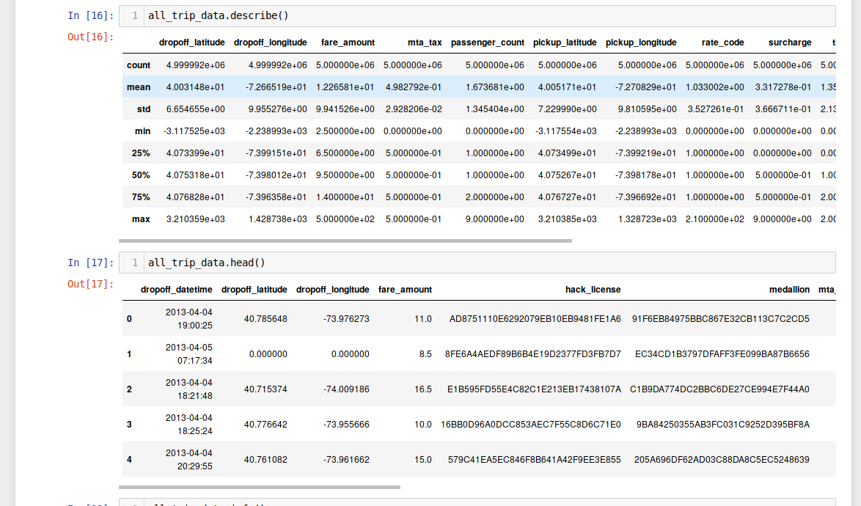

Slide 6
Understanding context of data
This is generally transportation trip information. We need to understand context of data so we will aware of the boundary or invalid information that are exist in our data set. ( I need times to understand this as a lot of observation location are already out of this world )
New York Longitudinal & Latitudinal
longitude = -74.0063889
latitude = 40.7141667

Slide 7
What we have here
Our dataset are consist of observation of Taxi Trip information in one month. Basically the data are logged from Taxi Meter application. We can group the information provided by :
Location Pickup & Drop-off
Time Pickup & Drop-off
Trip Duration
Taxi Trip Fare
Total Passenger
Trip Distance (point to point)
Application Log status
License Information
Vendor Information

Slide 8
EDA
Disclaimer 1 : Data Wrangling & EDA are both cyclical iteration process, we could back to Data Wrangling then go again to EDA to review our changes of Dataframe structure.
Disclaimer 2 : We have overloaded of information here. Not dropping several variables could be potential to be future cheating / information leakage in our data train later. ( I just realized this in a hard way as never processing trip information before )
Disclaimer 3 : Having only one month data for training is not a good practice as our train data will be bias on this month only
Notes:
I can not process a huge of data since I don’t have the access to production environment to digest a lot of month and perform randomization there for better data training.

Slide 9
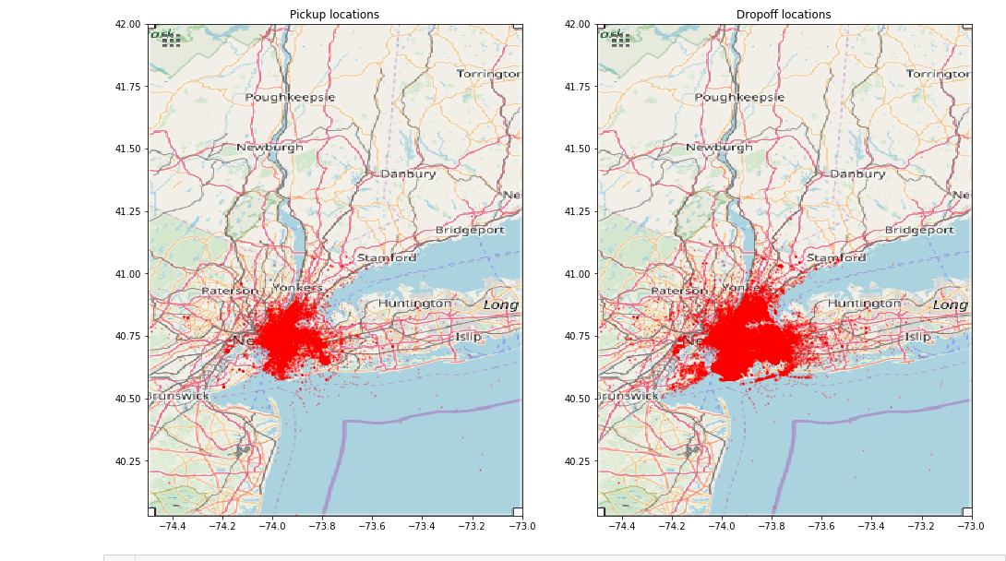
How is the trip data spread on the map

Slide 10
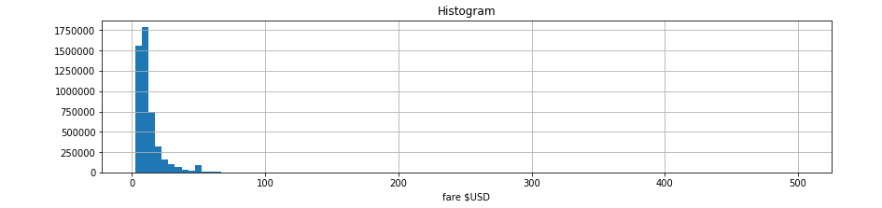
Plotting the obvious - fare distribution
Let’s plot the fare distribution among our data set.
Heavily right - positive skewed. This is power law / exponential distribution. Take a look at the fare bin difference

Slide 11
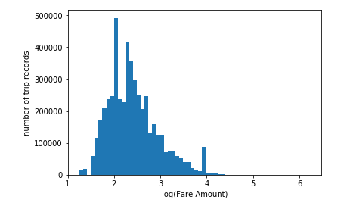
Plotting the obvious - log(fare) distribution
Many outlier or invalid observation detected. Let us take a look for another variable distribution : Hour
Notes:
Apply log transformation to fare amount ( Assign new column ) before we investigate further about outlier.

Slide 12
Answering - Question Set 1
What are the top 5 busiest hours of the day?
What are the top 10 busiest locations of the city?
Which trip has the highest standard deviation of travel time?
Which trip has most consistent fares?

Slide 13
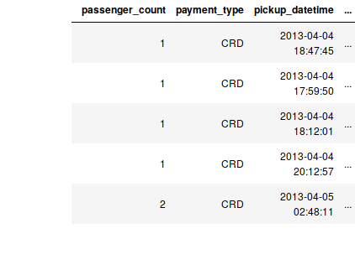
Answering [a] - Hour Distribution
We have field pickup_datetime to
Extract hour information for each
trip.

Slide 14
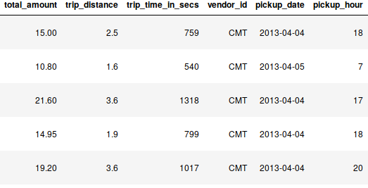
Answering [a] - Hour Distribution
After extracting hour data from
pickup_datetime, we could
Plot the hour distribution for
All trip observation data.

Slide 15
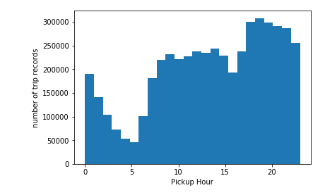
Answering [a] - Hour Distribution
Busy hour spiked from 6AM to 12 AM. Second peak hour is spiked from 16PM to 19PM. After 20PM, the peak goes down until next morning at 5AM.

Slide 16
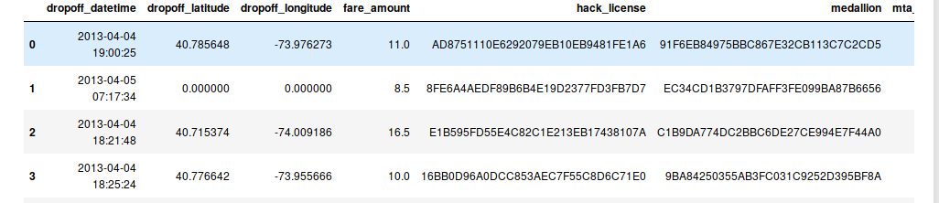
How to measure the traffic density per location?
All we have is longitudinal & latitudinal coordinates
We need coordinates dictionary for our cluster coordinate guidance
Cluster the location (pickup - dropoff) based on the coordinates dictionary
Use the heatmap plotting with our new label (location - after clustering) to determine which location have the highest density traffic

Slide 17
Coordinate Location Dictionary
Neighborhood Coordinate Dictionary :
Cluster each pick-up & drop-off location based on this coordinates
-74.0019368351 | Chelsea
-73.837549761 | Queens
-73.7854240738 | JFK
-73.9810421975 | Midtown-North-West
-73.9862336241 | East Village
-73.971273324 | Midtown-North-East
-73.9866739677 | Brooklyn-parkslope
-73.8690098118 | LaGuardia
Notes:
More coordinates on notebook. Sources : https://www.gps-coordinates.net/ & https://www.openstreetmap.org

Slide 18
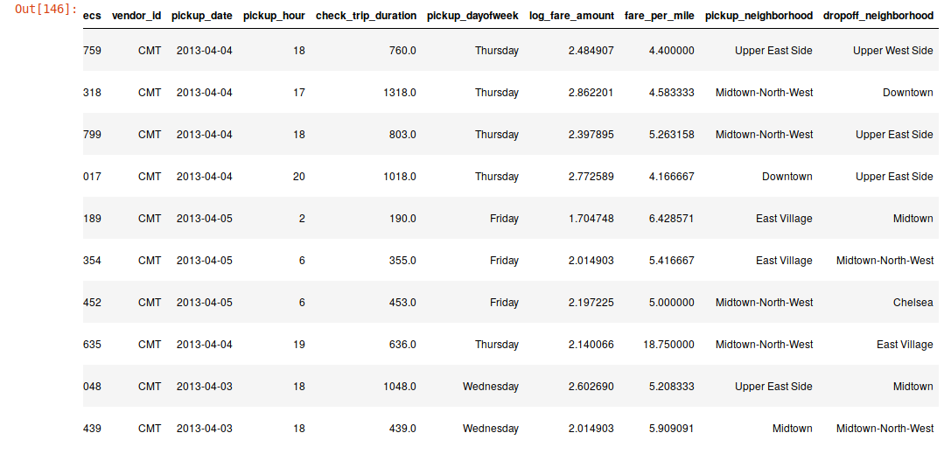
Neighborhood Set
Notes:
After clustered each observation data using KMeans

Slide 19
Plot Neighborhood interaction using heatmap to measure the density per location
Plotly packages;
Plotly.offline for init and showing the plotting,
Plotly.graph_objs to setup the layout dimension on heatmap

Slide 20
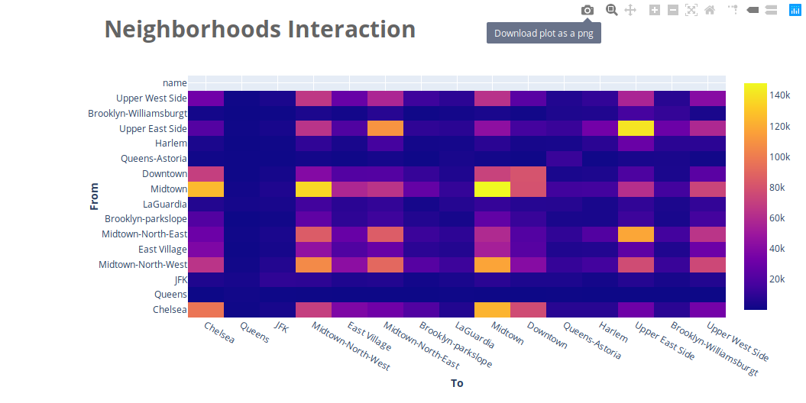
Answering [b] - Top busiest 10 location

Slide 21
Answering [b] - Top busiest 10 location
The most density based on inbound - outbound traffic per location, which are :
Midtown - Midtown
Upper East Side - Upper East side
Midtown North West - Midtown
Chelsea - Midtown
Midtown - Chelsea
Upper East Side - Midtown North East
Midtown - Midtown North West
Chelsea - Chelsea

Slide 22
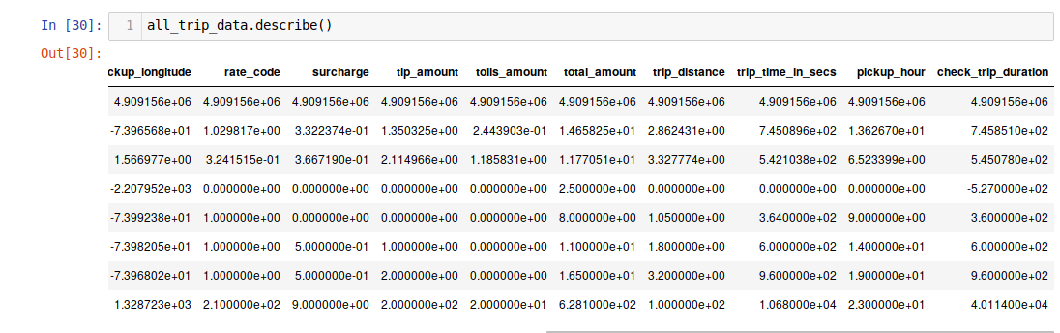
Check Statistic value of Trip Time
Recalculate all trip time by subtracting drop-off time to pick-up time, found a lot of negative (invalid data). This is causing our std dev is bias to negative.

Slide 23
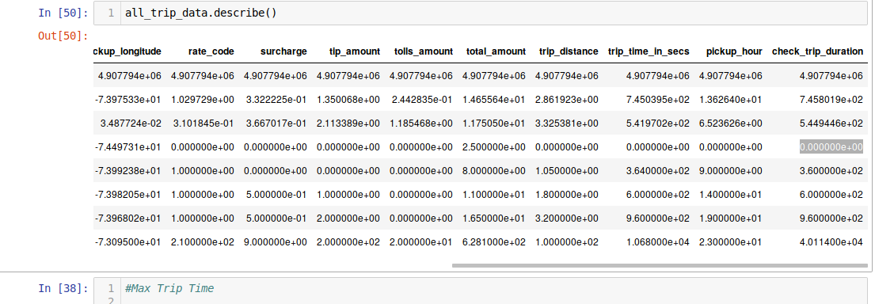
Perform Sanity Checking & Normalizing Trip Time
Minus trip travel is already gone. Let’s check the distribution.

Slide 24
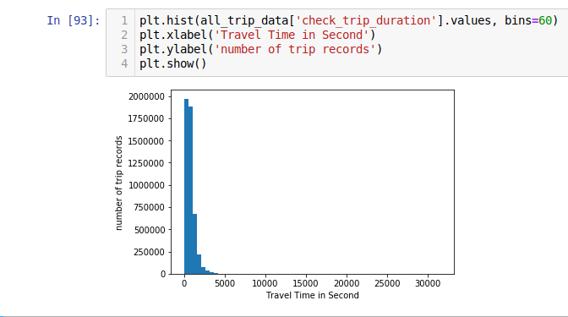
Normalizing Trip Time
Variance in Travel Time in
second are very high, we need
To standardizing the number as
time in second are too much of
Granular data.

Slide 25
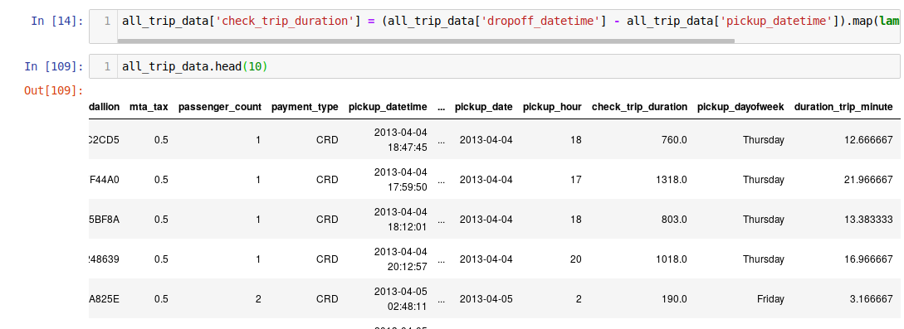
Normalizing Trip Time
Check the dispersion number of trip_minute by plotting the distribution again

Slide 26
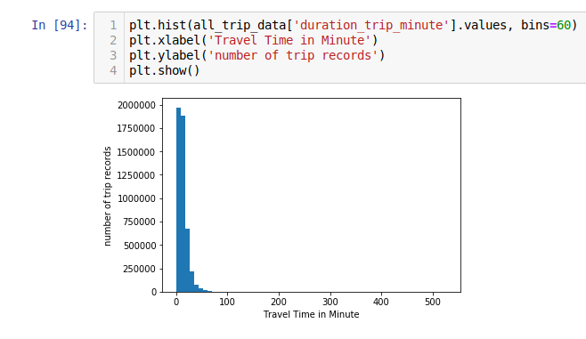
Normalizing Trip Time
Dispersion among travel time is indeed reduced but still heavily spread below 100 minute. Log-power distributed. Let’s apply log transformation to trip_travel_minute

Slide 27
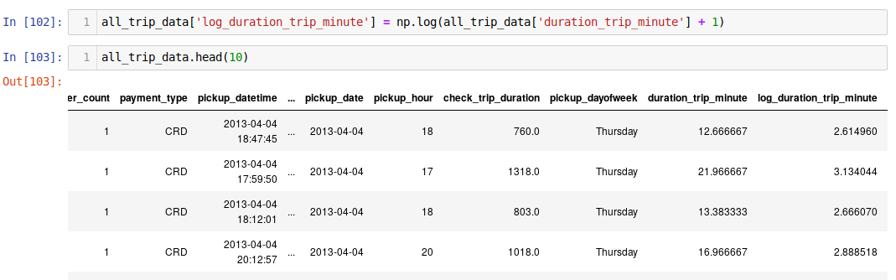
Normalizing Trip Time

Slide 28
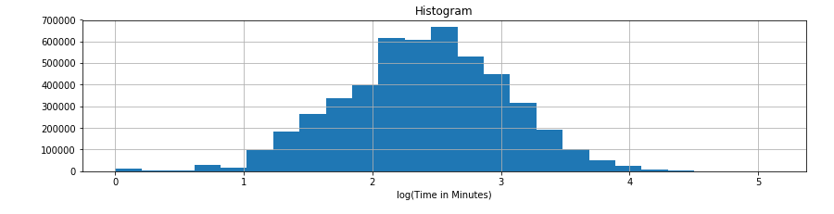
Answering [c] - Use log (minute) instead of second
Plot the log(traveltime_minute) distribution

Slide 29
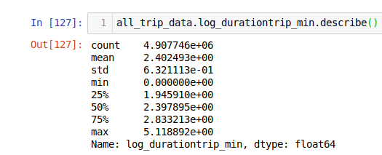
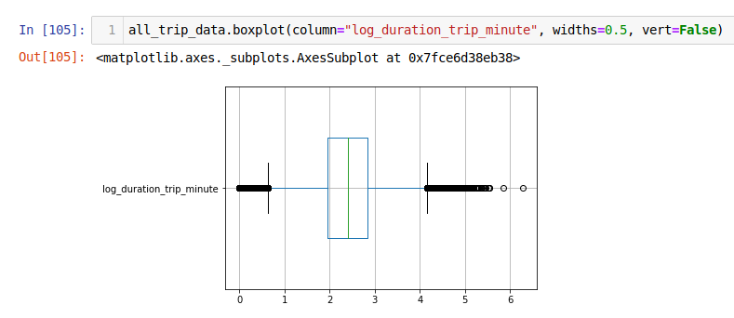
Answering [c] - Trip with the highest sd of travel time
Trip with the furthest from stddev value based on log(trip minute) Time.
There are a lot of short trip travel time and very long travel trip (above 4 log_trip_inminute

Slide 30
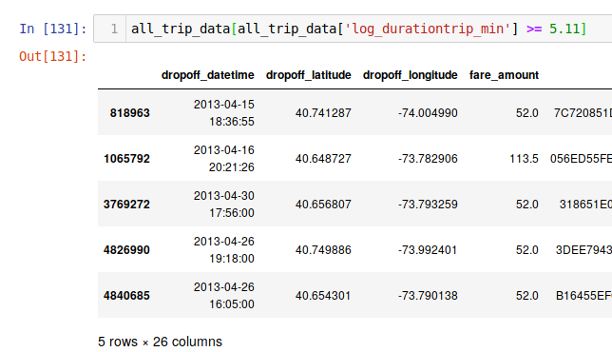
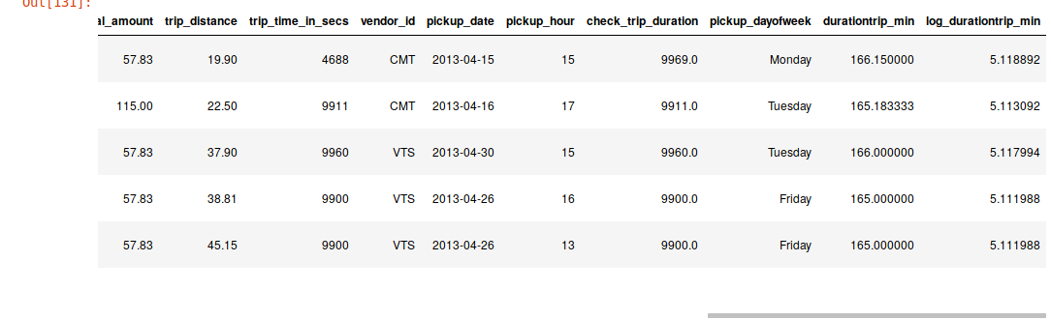
Answering [c] - Trip with the highest sd of travel time
Notes:
These 5 Observation data could be outlier.

Slide 31
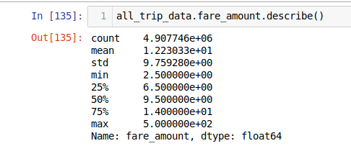
[d] - Trip with most consistent fare
Trip that fall in SD range based on the fare amount variable
Minimum fare amount is 2.5, it is fit with the constraint of taxi booking as 2.5 is the cancellation fee for Taxi in New York

Slide 32
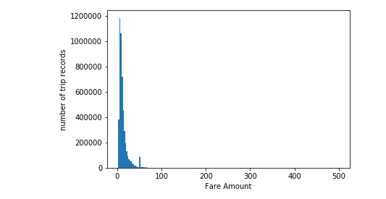
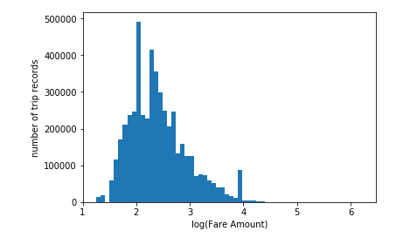
Answering [d] - Trip with most consistent fare

Slide 33
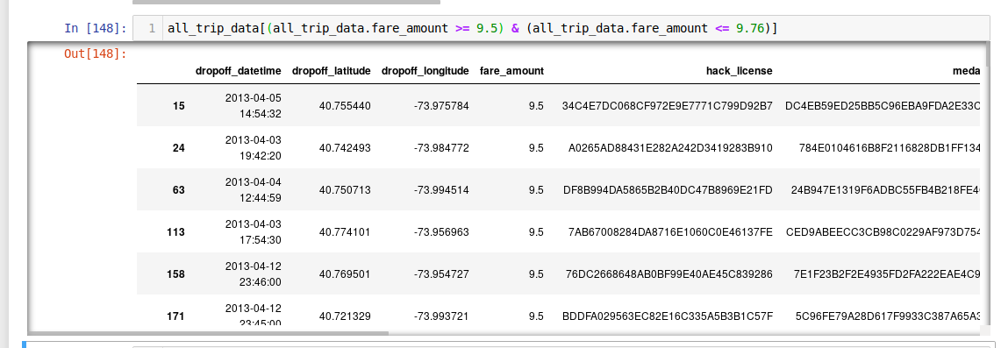
Answering [d] - Trip with most consistent fare

Slide 34
Question Set 2
In what trips can you confidently use respective means as measures of central tendency to estimate fare, time taken
How will you build a model to predict fare and tip amount with the given data?
If you were a taxi driver, how would you maximize your earnings in a day?
If you were a taxi driver, how would you minimize your work time while retaining the average wages earned by a typical taxi in the dataset?
If you run a taxi company with 10 taxis, how would you maximize your earnings?
Recode modelling script into Pyspark

Slide 35
Central Tendency
Central tendency is a number which represents the center of a distribution. This can be represented in mean, mode, or median.
But,

Slide 36


Slide 37
If the distribution is not normal or skewed data -
Both mean and mode will not be representable as the tendency since mean value will bias toward the outlier. Let us check distribution of each variable.
Median is safe measurement for central tendency even though distributions are skewed.

Slide 38
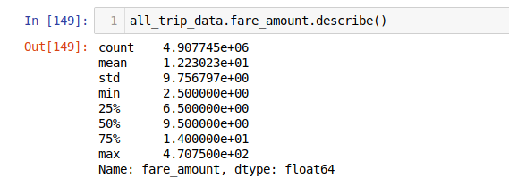
Answering [a] - Central Tendency Fare
Trip with Fare on range 9.5

Slide 39
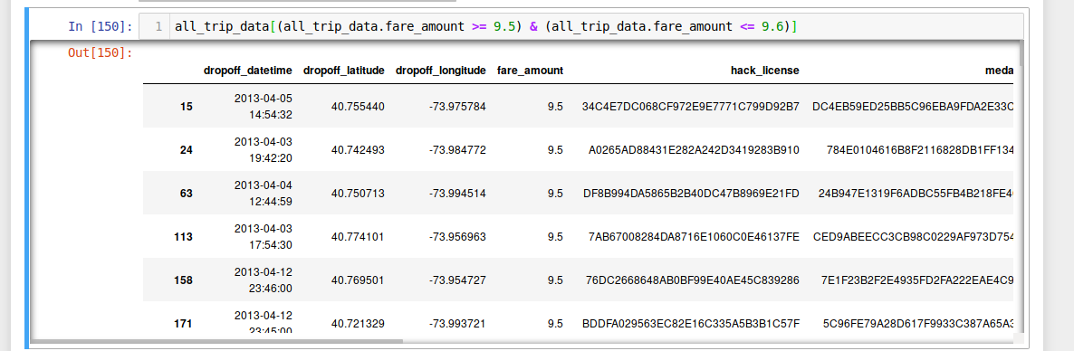
Answering [a] Central Tendency Fare

Slide 40
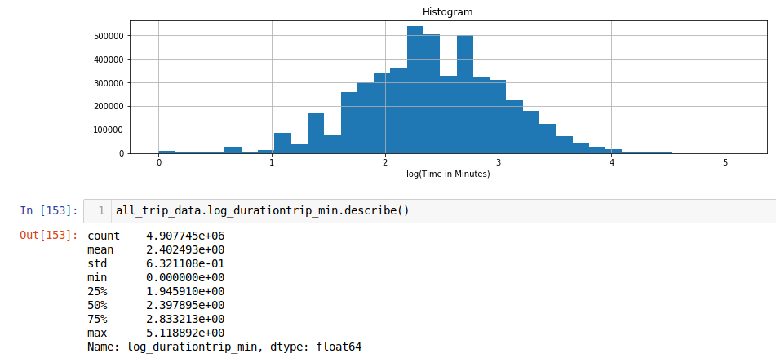
Answering [a] - Central Tendency Trip Travel Time

Slide 41
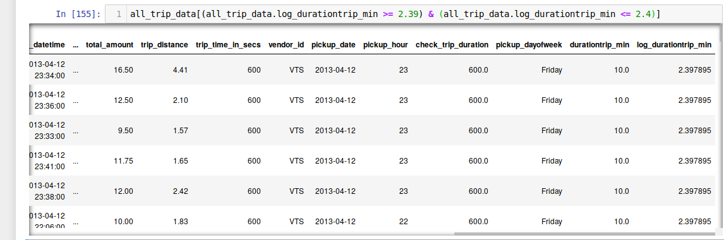
Answering [a] - Central Tendency Trip Travel Time

Slide 42
Build the model to predict fare amount
This is regression problem as the target variable is amount variable. There are 3 main things that need to be do :
Investigate Variable
Model Selection for this problem set
Train & Test the model
Report on Model Importance

Slide 43
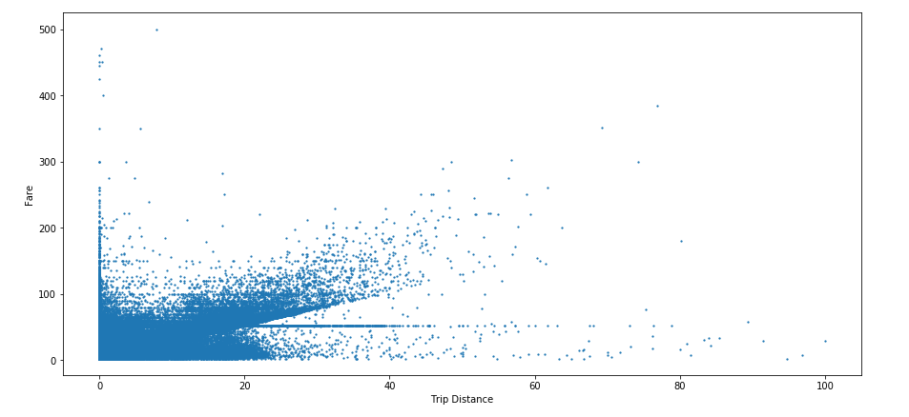
Investigate Variable - Extrapolate Information
Does the distance affecting the fares? Test our hypothesis

Slide 44
Investigate Variable - Extrapolate Information
Generally the longer the distance is the more expensive the fare, but there are few trips that cost less even though the distance is longer.
There are a lot of short trips that cost more than 100 $ below 20 miles distance. This potentially could describe us some rules for the taxi pricing.

Slide 45
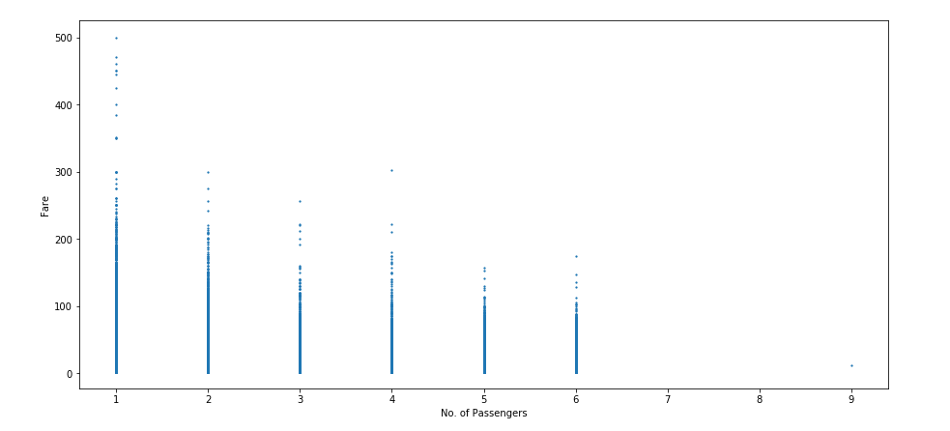
Investigate Variable - Extrapolate Information
Does the count of passengers affecting the fares? Test our hypothesis

Slide 46
Investigate Variable - Extrapolate Information
Does the count of passengers affecting the fares? It is clearly not as even the most expensive fares are those with one (1) passenger only.

Slide 47
Investigate Variable - Extrapolate Information
How about other certain famous location based on our findings from answering the busiest location. Note that busiest location does not always mean the most expensive fares, but we will take the approach with that.
How about the airport? Let’s take a look at which airport available on NY
After long finding ( I don’t aware of famous location until last minute ), let’s compare the trip based from nearest airport location
jfk = (-73.7822222222, 40.6441666667)
Newark Airport = (-74.175, 40.69)
LaGuardia Airport = (-73.87, 40.77)

Slide 48
Investigate Variable - Extrapolate Information
First, we need to measure the distance of each trip observation to our predefined location. There are several type of distance measurement for this : haversince, law of cosins, and another.
After calculating the distance, we can plot the fare amount toward distance to the predefined location (airports or many famous location)

Slide 49
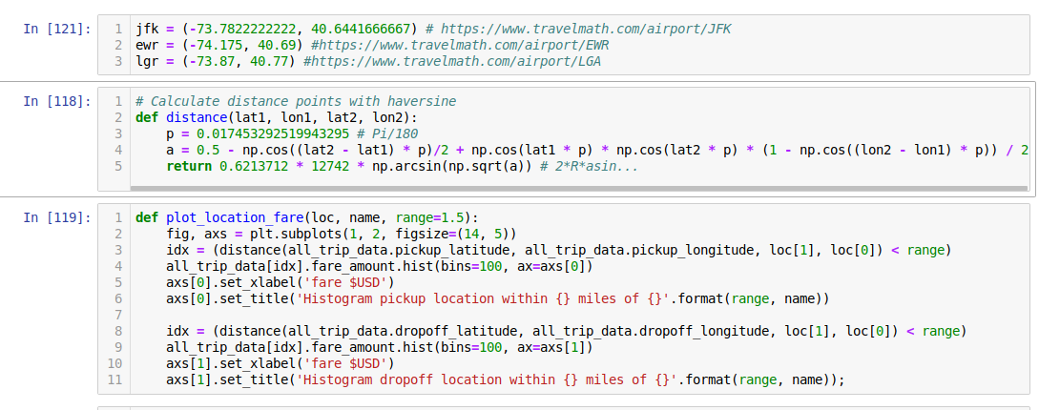
Investigate Variable - Extrapolate Information

Slide 50
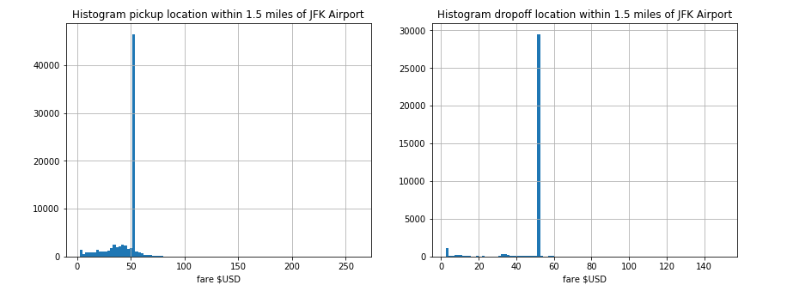
Investigate Variable - Extrapolate Information

Slide 51
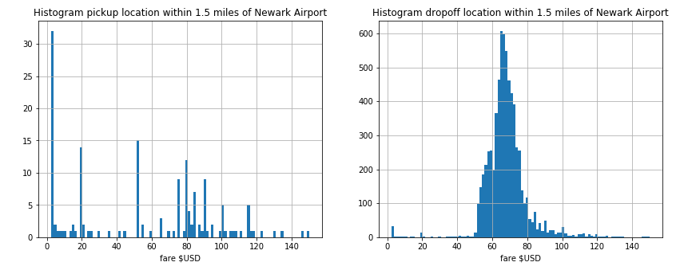
Investigate Variable - Extrapolate Information
Notes:
It is a very good start. Continue to compare from another Airport

Slide 52
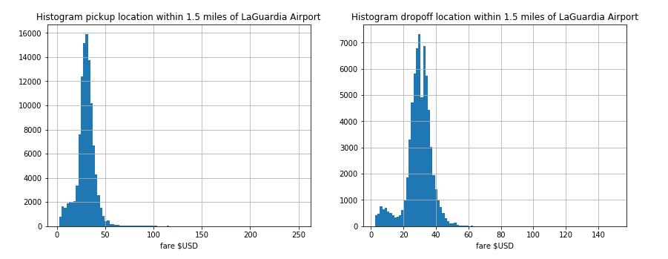
Investigate Variable - Extrapolate Information

Slide 53
Investigate Variable - Extrapolate Information
Finally!
It is indeed that famous location like airport affecting the fare taxi pricing. Note that.
That we can say there are certain minimum amount no matter how long the distance if we take trips from that location, regardless the passenger.
At this point, I think that is only feature engineered that I could thought of from longitude-latitude pickup and dropoff location.

Slide 54
Model Selection
Based on our EDA previously, clearly some variable are not regressing positively with the fare pricing. It means that linear regression will not work well with some pre-rules based pricing in this case.
There is no risk that we should mitigate for taxi pricing model like LGD (Loss Given Default) on Default Credit Risk modelling, we have much reason to be able to use non Linear model.
We left with NN or Tree Based Model. I am choosing Tree Based model as this pricing have some rule-based criteria.

Slide 55
Model Selection
With Tree based model, we may not need to standardizing the variable value.
I have less time to do the modelling, so will feature engineer-ed the location predictor variable and let the model learn the rule with high iteration modelling.

Slide 56
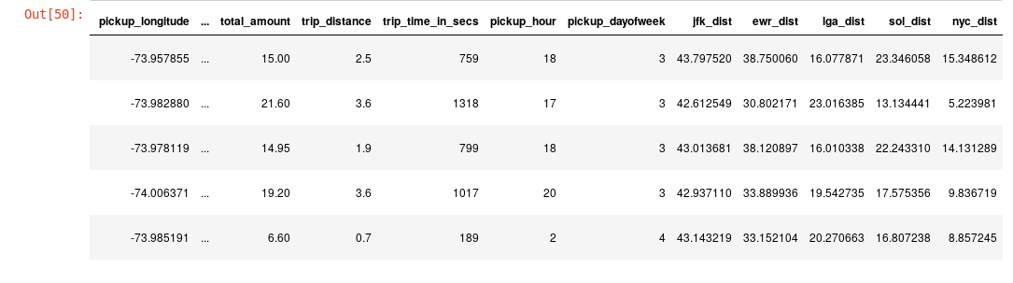
Feature Engineering

Slide 57
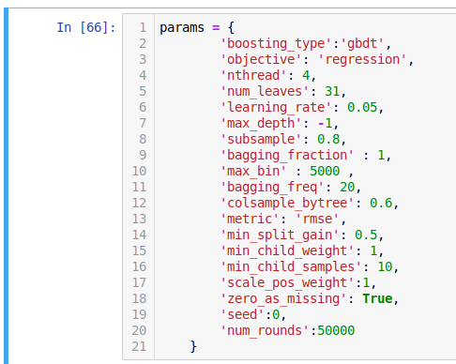
Train and Test the Model
Train Test ratio is 0.25, Iterate 5 times.
Use rmse metrics as this is a regression problem. Could be implement CV here but I don’t have enough time to do a lot of hyperparam optimization with Cross Validation with a lot of iteration.

Slide 58
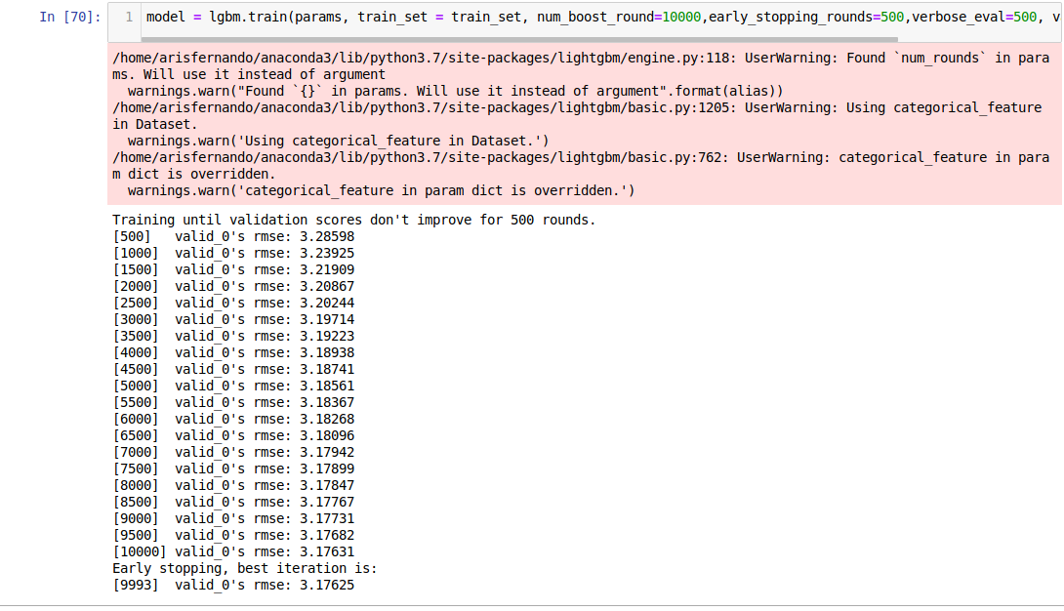
Answering [b] - Train and Test the Model
Notes:
Best rmse : 3.17 Can be improved to 2.9 if we could able to select the training data better.

Slide 59
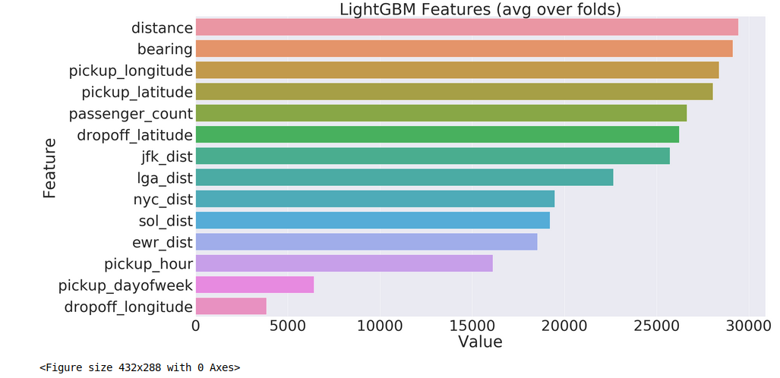
Feature Importance after Training

Slide 60
Train and Test the Model
Rmse is on 3.17.
What could be improved to increase the performance?
Randomizing the data & select better data. Remember garbage in garbage out
Later on I found that we could use the trip direction as FE variable too
Weather data from public information could able to help us to determine the density location
We can not able to determine the vehicles’ speed in the trip.
Geo clustered for all city location.
Bayesian optimization after training. Again we face time constraint here.

Slide 61
Maximize Earning in a Day
EDA - Deep Analyze when is the right time to gain maximum fare per distance

Slide 62
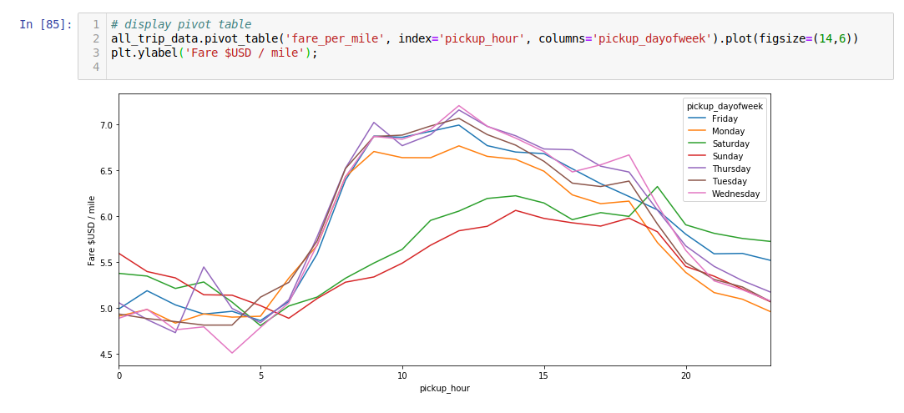
Answering [c] - Maximize Earning in a Day

Slide 63
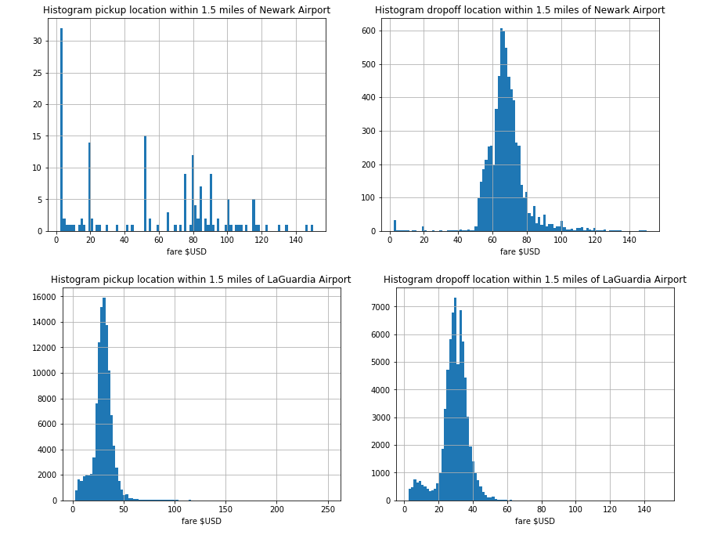
Answering [c] - Maximize Earning in a Day

Slide 64
Answering [c] - Maximize Earning in a Day
Information Taken :
Start the trip from morning 7AM to 10AM as the fare/mile amount is spiking up everyday.
Trips inbound - outbound airports are generally larger amount rather than normal trip that depends on the distance.

Slide 65
Minimizing time work while retaining good amount of fee
From fare/mile information we conclude that to maximize your earning - there are only certain hour to do this. That concludes us do the full trips on that hour 7$ per miles, which 40% better on another hour with 5$ per miles.
If driver don’t want to pick up airport location, there are same-city location that have the highest pick up in chronological order :
Midtown
Upper East Side
Chelsea

Slide 66
10 taxis, how would you maximize your earnings?
Stay in top 3 city because the trips are the busiest and most of them are local trips. Based on prediction test that taking location near airport or those 3 city

Slide 67
Thank You
Aris Fernando
arisffernando@gmail.com

