Slide 1

Leveraging Web Scraping to Extract and Analyze Key Company Insights
Arish Manasia

Slide 2
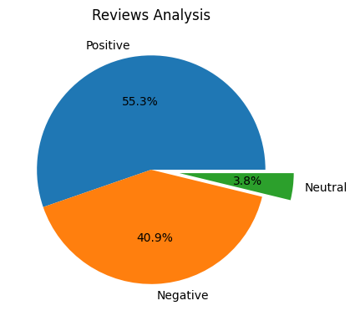
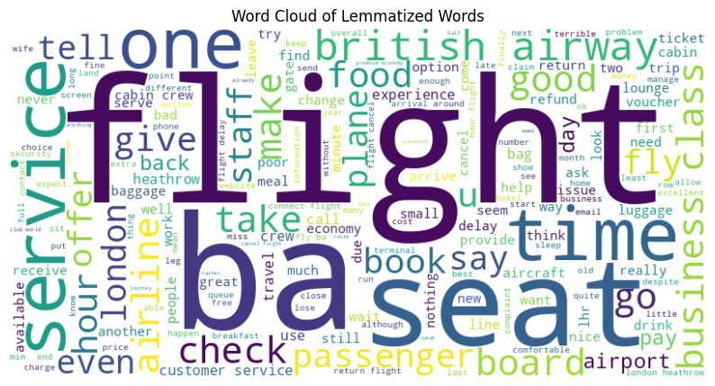
INSIGHTS FROM CUSTOMER REVIEWS
From cleaning 1000 reviews given by the customers, we obtained
Positive Reviews - 553
Negative Reviews - 409
Neutral Reviews – 38

