Slide 1

Predicting customer buying behavior
Arish Manasia

Slide 2
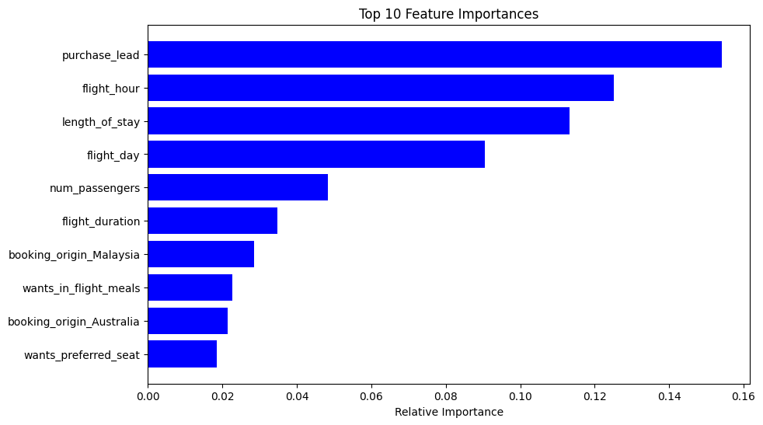
predictive model to understand factors that influence buying behavior
We have trained the data set with Random forest classifier model, Logistic Regression and SVM.
Random Forest Accuracy: 85.10
Logistic Regression Accuracy: 85.29
SVM Accuracy: 85.22
The Diagram to the right side shows top 10 Feature which influence Customer buying behavior.

