Slide 1
Welcome To My Presentation

Slide 2
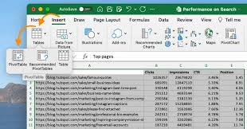
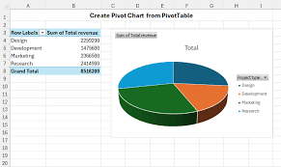
Pivot Table
Make a project about your department in excel

Slide 3
Utpal
Soyeb
Apon

