Slide 1

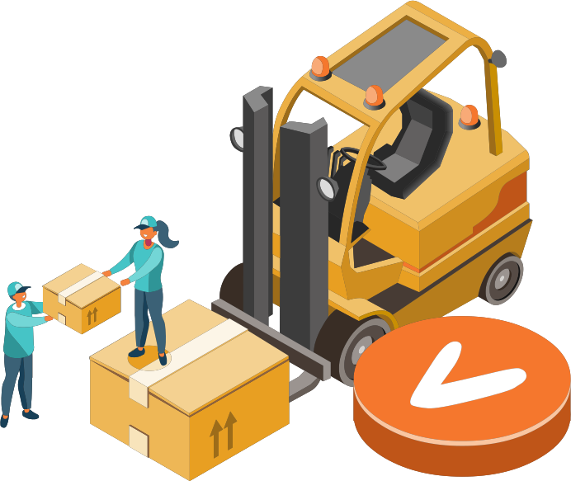

THE SMART WAREHOUSE EXECUTION SYSTEM FOR AGV COORDINATION (WES)
SEP490_G4
Lecturer: TamNT122

Slide 2

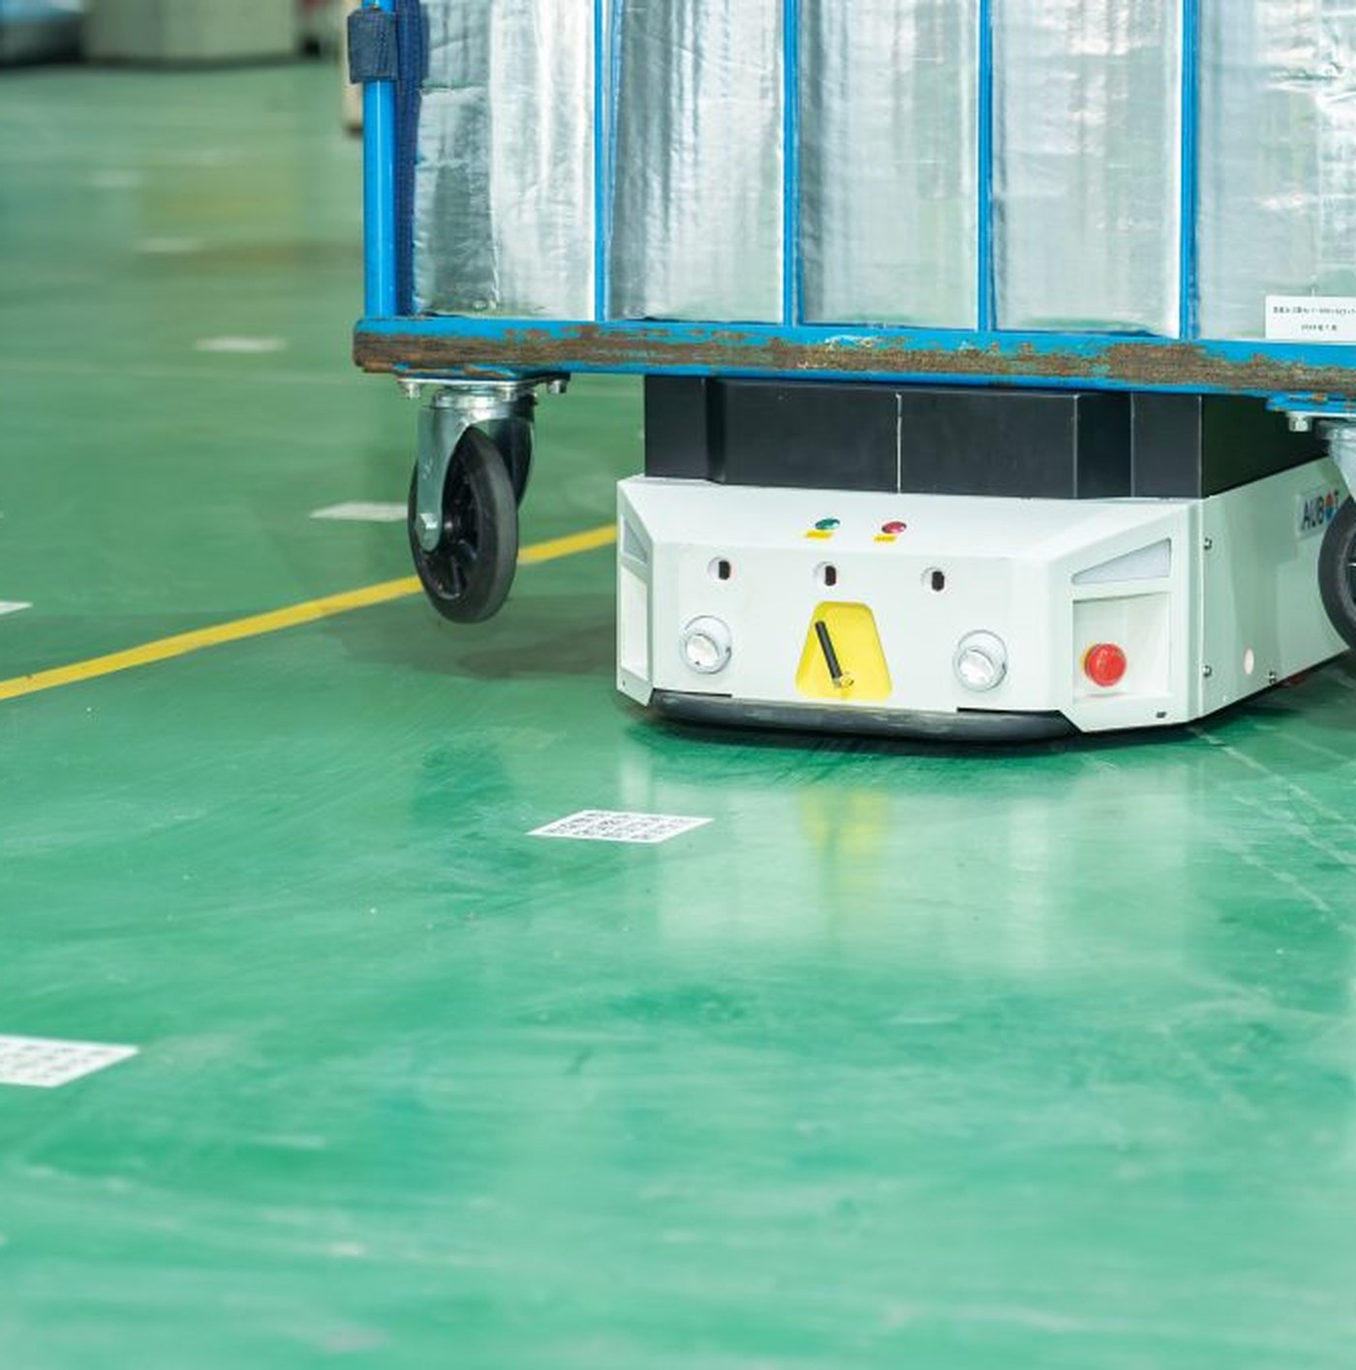
AGV & WAREHOUSE AUTOMATION
1
Vehicles that follow a QR grid
AGVs move along a grid of QR codes stuck to the warehouse floor. Each code is a point on the map; the vehicle reads the code beneath itself to know where it is.
2
Replacing manual handling
Pushing carts, dragging pallets, moving loads between areas — work people used to do by hand.
3
A new problem appears
Decisions that used to live in an operator’s head now need software to make them: what runs first, which vehicle takes it, which way it goes.

Slide 3
AGV LOGISTICS
IN VIETNAM
Viettel Post
Phenikaa-X
Aubot
Vietnam’s first robot sorting complex (Jan 2024): 1.4 million parcels a day, 60% lower labour cost. By Oct 2024 it ran 300 self-built AGVs.
A 1,000 kg AMR deployed into the Samsung Thai Nguyen plant (Apr 2024), integrated over VDA5050 — the same standard this project uses.
More than 300 AGVs deployed, the T500 and B300 lines. Customers include Sumitomo, NITORI and BEING Holdings.

Slide 4

ONE LAYER,
ONE RESPONSIBILITY
WMS
WES
FMS
AGV
Runs stock and orders. Knows what has to reach which area, but not when or by which vehicle. Outside the scope of this project.
What runs first? Which vehicle takes it? Which exact cell inside the destination area? This is the system we built.
Which route? Who enters a cell first? Physical routing and path allocation. Built on our fork of openTCS.
Carries out movement commands. B300 vehicles, driven over MQTT using the VDA5050 standard.

Slide 5
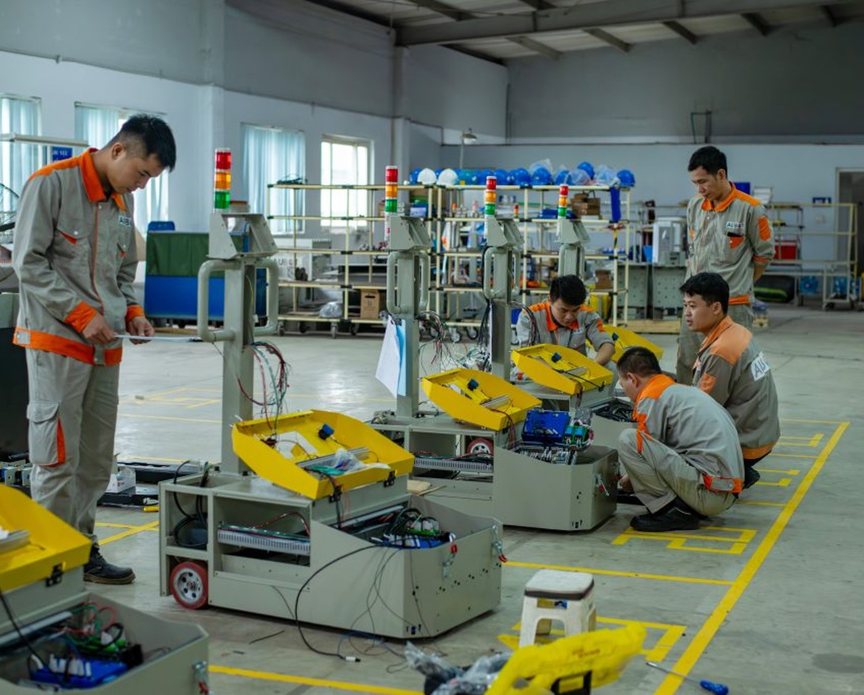
AUBOT & PROJECT SCOPE
The project runs on the live fleet-management system of Aubot, a Vietnamese AGV company operating the B300 line. Every figure in this talk comes from real operating data, not from assumptions.
1
The WES layer: business rules, dispatch, vehicle assignment.
2
Changes inside the routing layer of the FMS.
3
Out of scope: stock management, hardware, firmware.

Slide 6
NEARLY HALF THE ORDERS NEVER ARRIVE
On the busiest day: 44.2% of orders never completed, and on average 309 seconds passed before a vehicle was assigned. Every order did get a vehicle — the failures happen after assignment, not because the system could not assign.
Charging orders
89.5%
Parking orders
56.2%
All orders
44.2%
Transport orders
6.3%
All of that 44% comes from charging and parking — but most of it is deliberate withdrawal: an idle vehicle on its way to charge gets recalled because a load arrives. The number measures churn in the idle-vehicle lifecycle, not failure. Those three symptoms give the project its three problems:
1
Assignment
2
Fleet-wide routing
3
Idle-vehicle lifecycle
Long waits, and no way to tell a legitimate block from a slow dispatcher.
Crowding causes gridlock; failures pile into the two busiest hours of the day.
Sent away and recalled over and over, burning distance that creates no value.

Slide 7
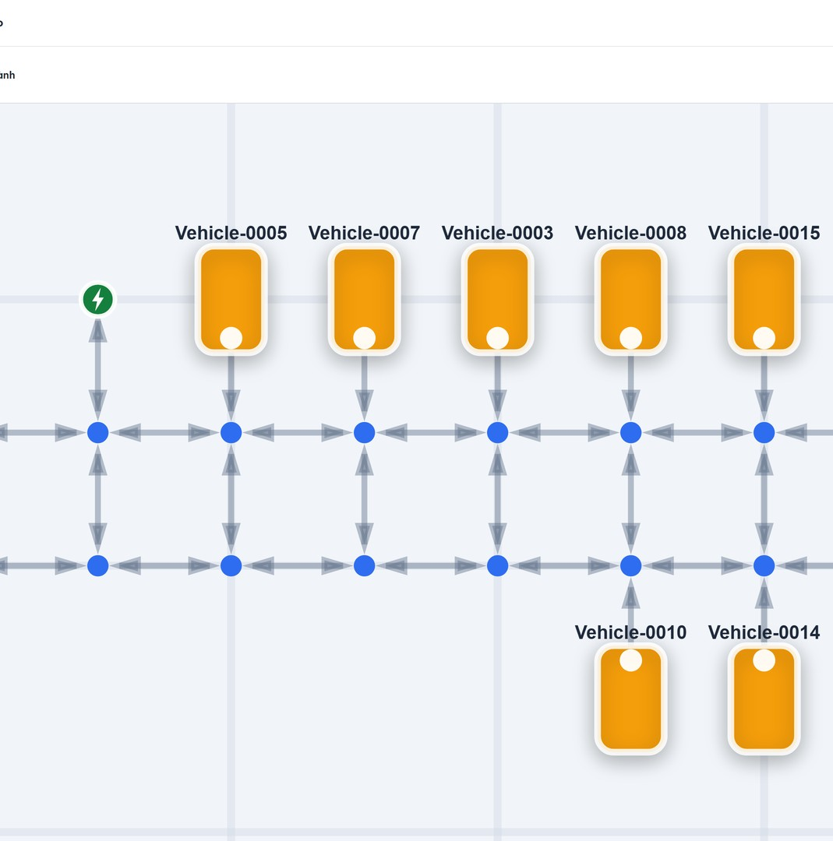
WES PICKS THE VEHICLE,
FMS PICKS THE ROUTE
1
WES decides
Takes in the load, creates the order, decides what runs first, picks the exact drop-off cell inside the destination area, and picks which vehicle does which job.
2
FMS executes
Computes routes, prevents collisions, allocates cells. openTCS normally picks the vehicle itself — we took that back, because picking needs business data the FMS lacks.
3
Talking to the vehicles
The open VDA5050 standard over MQTT, so no lock-in to one vendor. The comm adapter handles what is specific to the B300: command constraints, state normalisation, QR-orientation compensation, three speed tiers.

Slide 8
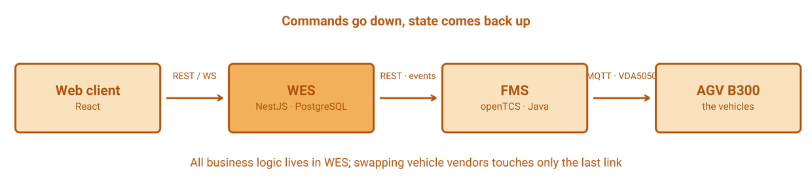
SYSTEM ARCHITECTURE
Block or recall
Lost localisation
Continuous reconciliation
When a lane stops being safe, the system reads how much of the path has already been granted to the vehicle. If it is already inside the lane, no further load is accepted; if not, the vehicle is called back out.
Recovery is per leg: still on the way to pick up, hand the job to another vehicle; entering the lane, reissue; already unloaded, reissue only the retreat. The load is never dropped twice.
Correctness never depends on a single event. Every cycle rebuilds state from the layer below, so a lost notification heals itself on the next pass.

Slide 9
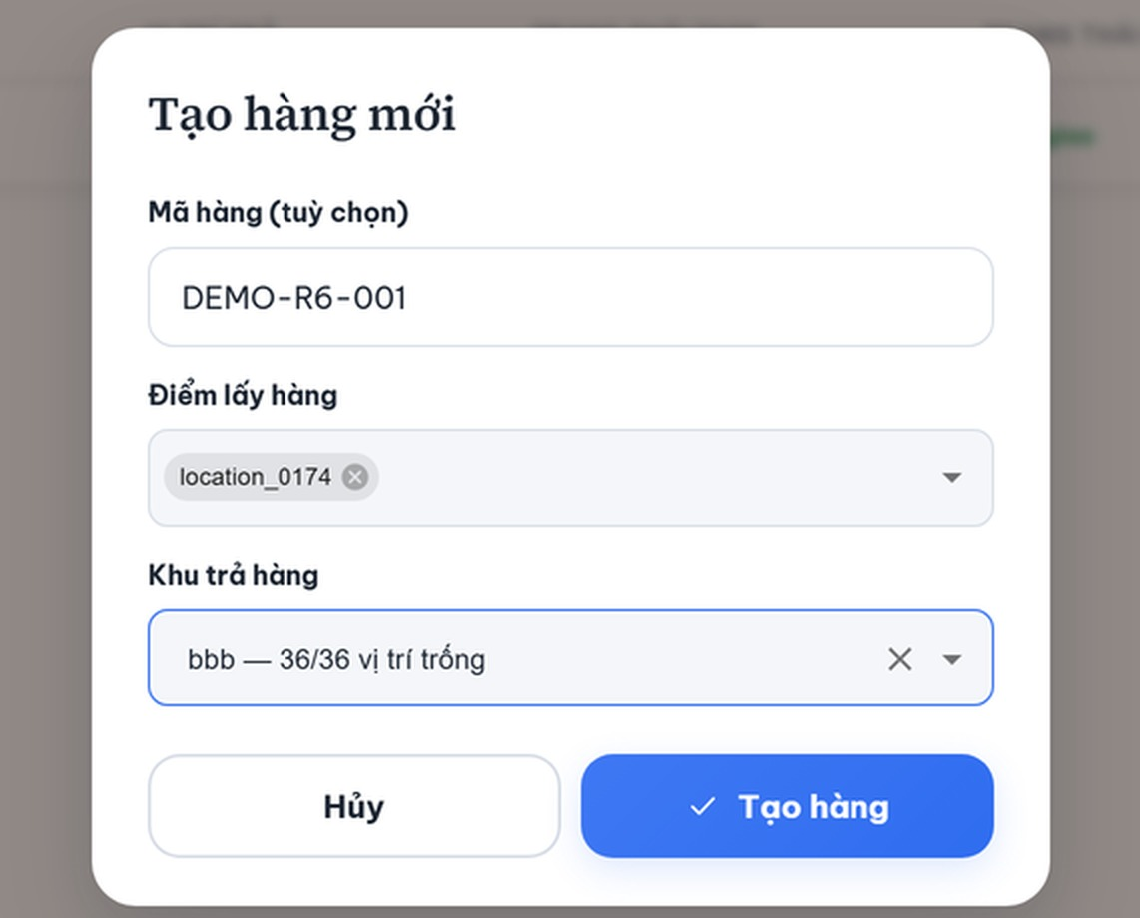
THE LIFE OF ONE TRANSPORT REQUEST
The minimum input is just two things: where the load is now, and which area it must reach. WES splits that request into three legs, and each leg ends at a real business milestone.
1
Drive to the pickup point and lift the load.
2
Move to the head of the drop-off lane.
3
Set the load down, then back out of the cell.

Slide 10
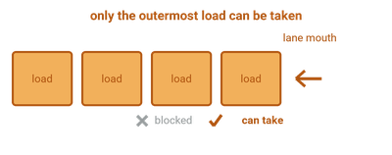
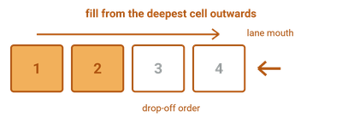
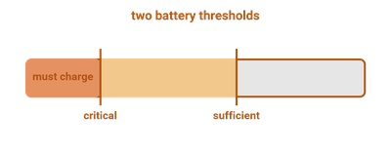
THE RULES
OF THE WAREHOUSE
Picking up
Dropping off
Charge & park
Only the outermost load can be taken. Anything behind it waits until that one is gone.
Fill from the deepest cell outwards, so a later load never blocks an earlier one and the vehicle can still back out.
A full battery is not enough to leave the charger — there has to be work waiting. Charging outranks parking.

Slide 11
DISPATCH CYCLE
Six steps, in order
Only WES sees the loads
The cell is chosen last
Rebuild the parking-claim ledger · reconcile legs in flight · decide which orders are cleared to run · assign vehicles · consider charging · consider parking. Sequential, coalesced on a 1.5-second beat, and never two cycles at once.
The routing layer only sees a static map: it does not know which cell currently holds a load, which was just claimed, or which package is blocking another. Whatever knows those things has to be the business layer — that is why this layer exists.
The exact drop-off cell cannot be decided when the order is created: between creation and arrival, other vehicles keep filling that area. It is committed just before the vehicle enters the lane, and locked per area so two vehicles never aim at the same one.
The two algorithms that follow only work once these six steps are right.

Slide 12
THE ASSIGNMENT PROBLEM
Two questions, kept apart
The cost matrix
Three kinds of cell
Is this order cleared to run at all — answered by the layered pickup rule; if not, it sits in a blocked state with the reason recorded. Among the orders that are cleared, which vehicle takes which — that is the assignment problem.
Each cycle builds a matrix with as many orders as there are idle vehicles. A cell holds the empty distance the vehicle must drive to the pickup point, multiplied by that vehicle’s own battery factor. Distance is measured on the real map, not as the crow flies.
Matchable, route unknown, and unreachable. Ordered lexicographically: maximise matched pairs first, then minimise unknown ones, and only then minimise total distance.
Cost is a product, not a sum — that is what makes each vehicle’s own battery factor bite.

Slide 13
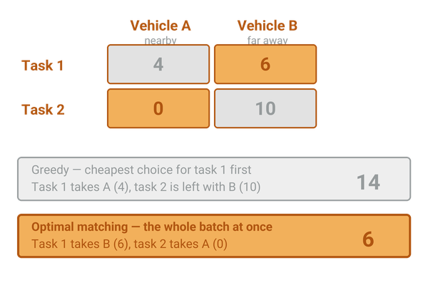
THE HUNGARIAN ALGORITHM
Greedy decides one order at a time and cannot take it back.
The Hungarian algorithm solves minimum-cost one-to-one matching optimally across the whole batch, in polynomial time. For a fleet of a few dozen it runs in under a millisecond.
Two properties matter as much as optimality: the same input must give the same result, and the result must not depend on how fast the machine is.
Every cycle solves both matchings on the same matrix: the system executes one and records what the other would have chosen, so any decision can be traced back.
Optimal matching looks at the whole batch at once, so a cheap first choice never spoils a later order.

Slide 14
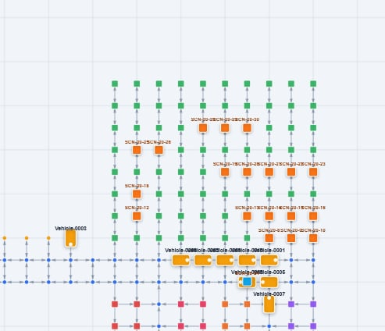
WHY NOT SHORTEST PATH
PER VEHICLE
Dijkstra answers beautifully for one vehicle: the shortest way from here to there.
But it is called separately for each vehicle, and no call knows about the others. Every vehicle aims for the shortest path, so every vehicle pours into the same corridor.
The result is local gridlock: vehicles queue at the mouth of a lane — and a storage lane is where the map splits in two, so there is no way around.
Once the queue closes into a ring of mutual waiting, no vehicle has broken a rule and no vehicle can get out on its own.

Slide 15
THE COORDINATION SOLVER:
PIBT · LaCAM · ADG
PIBT — pushing
LaCAM — search tree
ADG — execution order
At each step the higher-priority vehicle picks its cell first; a vehicle that loses its spot inherits priority and pushes the blocker aside. Very fast and it scales, but on its own it gives no guarantee of finding a solution when things get tangled.
Wraps PIBT in a search tree whose nodes are whole-fleet configurations. PIBT proposes the next move and constraints are added only when genuinely needed, which keeps the speed without losing solutions.
The plan becomes a set of ordering relations: a vehicle may only continue once the one ahead has cleared a given point. That graph is what gets enforced while the vehicles are actually moving, by refusing cells to anyone arriving early.
PIBT proposes moves · LaCAM guarantees a solution is found · ADG keeps the order on the floor

Slide 16
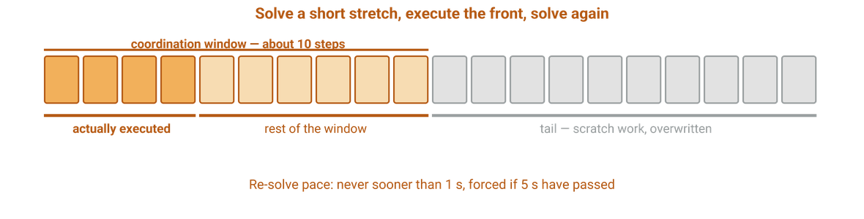
ONE-SHOT OR LIFELONG:
WHICH PROBLEM IS THIS REALLY
One-shot MAPF
Each vehicle has exactly one fixed goal. Solve once for the whole fleet, run it out, done. This is the textbook form.
Here the goals will not hold still
Loads are deleted, new loads arrive, and the matching runs again every cycle — if a better vehicle-order pair appears, it changes. A vehicle’s goal can change before it ever gets there.
So we do not solve once and finish; we solve coordination inside a short window and repeat — that is RHCR.

Slide 17
FUTURE
WORK
Waiting points
Look-ahead assignment
Upgrade to LLLG
Instead of sending an idle vehicle all the way back to the depot and calling it out again minutes later, let it wait near the pickup area. If another vehicle needs to pass, it yields and returns. That removes a round trip that creates no value.
Assignment is myopic today — it only matches vehicles that are already idle, so one finishing in a few seconds never appears in the matrix. The direction: include soon-to-be-free vehicles and switch the cost unit from metres to seconds.
LaCAM is a one-shot solver being called repeatedly here. LLLG is built for the lifelong problem: it carries collision predictions from the previous round into the next and adds local guidance for each vehicle. The paper reports throughput gains of 30–81%.
Three different layers: where idle vehicles wait, how far ahead assignment looks, and the routing core itself.

Slide 18
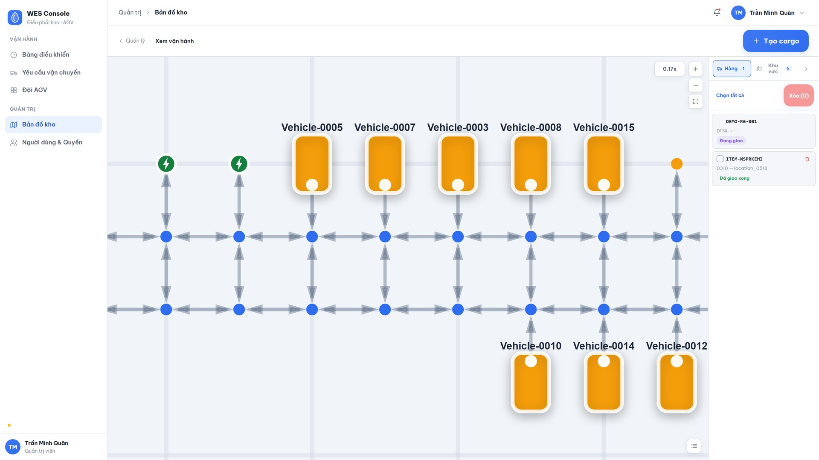
DEMO
▶
Click the image to watch the recorded run

Slide 19
RESULTS
AND CONCLUSION
What runs
What we measured
What is not done
A complete dispatch layer running on a real fleet over an open standard. Twenty-two of thirty-three background functions cross-checked against the source. The test suite is larger than the product itself, and each regression test is named after the day the incident actually happened.
Parking orders generated per package fell from roughly nineteen to roughly zero point two. The solver now stops on work done rather than on the clock: the same input gives the same result, and the deadlock suite went from three of six to six of six.
Assignment is still myopic, seeing only vehicles that are already idle. The solver’s theoretical guarantee does not hold on a map with this many one-way segments. The idle-vehicle lifecycle still oscillates.
All three problems raised at the start have working answers — and where the work is unfinished, we know exactly where it stops.

Slide 20
QUESTIONS?
Thank you for your attention.
SEP490_G4
Lecturer: TamNT122

