Slide 1
TECHSTORE
Analysis, design, implementation and control of order management application

Slide 2
With the application the user will be able to:
To be informed about the products of the store
To choose the category of the product he wants
It will be possible to update the database
There will be a list of products that are in short supply and that need to be ordered
It will be possible to track sales statistics

Slide 3
METHODOLOGY ICONIX
Use Cases Diagram
Robustness Diagram
Sequence Diagram
Class Diagram

Slide 4
STAGES OF ICONIX
Requirement Analysis
Initial Design
Final Design

Slide 5
SYSTEM ANALYSIS
Two basic methodologies:
USE CASES
USER STORIES

Slide 6
USE CASE
OPERATING REQUIREMENT == USE CASE
MAIN SCENARIO-Main flow
ALTERNATIVE SCENARIOS-Secondary flows

Slide 7
USE CASES OF THE SYSTEM
USER LOGIN
CHECK AVAILABILITY
UPDATE DATABASE
CHOOSE CATEGORY
CHOOSE PRODUCT
CREATE SALELIST
CREATE ORDERLIST
SHOW STATISTICS

Slide 8
USER STORY
USER STORY [CHARACTERISTIC OF THE SYSTEM]
As a [type of user]
I want to [perform some task]
so that I can [achieve some goal]

Slide 9
CHARACTERISTICS OF THE USER STORY
Independence: must be completed autonomously
Negotiable: should only describe the substance of the operation
Essential: to have some value for the end user
Valuable: it must be able to be valued
Small: must be completed in a short time
Tested: it must be possible to confirm its completion

Slide 10
USE CASE vs USER STORY
User stories are easy to be evaluated
User stories give the opportunity to differentiate them
Use cases usually include details regarding the user interface with the application
The use cases are mainly used in the implementation of design with the waterfall model

Slide 11
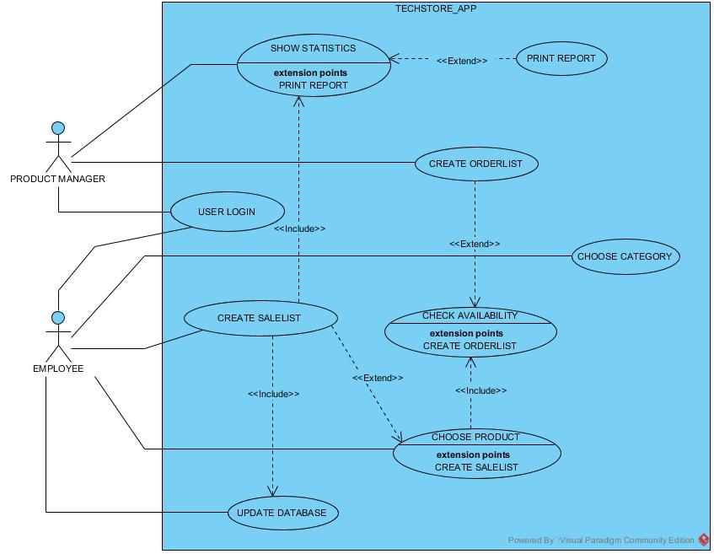
USE CASES DIAGRAM

Slide 12
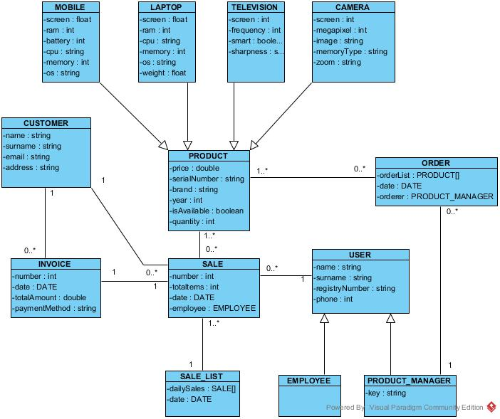
ENTITY RELATIONSHIP DIAGRAM

Slide 13
DESIGN OF THE SYSTEM
Main Principles: where are the principles on which all the next level standards are based
Principles: immerse a little deeper into the concepts and give more specific references
Design Patterns: more detailed and closer to the programming languages
heuristics: more detailed and specialized design formulas
guidelines: Guidelines

Slide 14
GRASP
The controller
The information Expert
The creator
Low coupling
High cohesion
Indirection
Polymorphism
Pure fabrication
Protected variations

Slide 15
DESIGN PATTERNS
Creational patterns: deal with creating objects in a system
Structural patterns: simplify the design by optimizing the correlations between the system components
Behavioral patterns: share the role and responsibility of each class of the system

Slide 16
GRASP PATTERNS vs GoF PATTERNS
The essential difference is in the degree of their abstraction
GoF patterns base their description and role on the fundamental principles of GRASP patterns

Slide 17
ROBUSTNESS DIAGRAM
Controls the reuse between use cases
Provides an interface between the user’s and the designer’s perspective
It is easier to interpret and study
Checks their logic and completeness of the use case
Helps and encourages the use of the MVC model
Assists in the design of architectural stratification

Slide 18
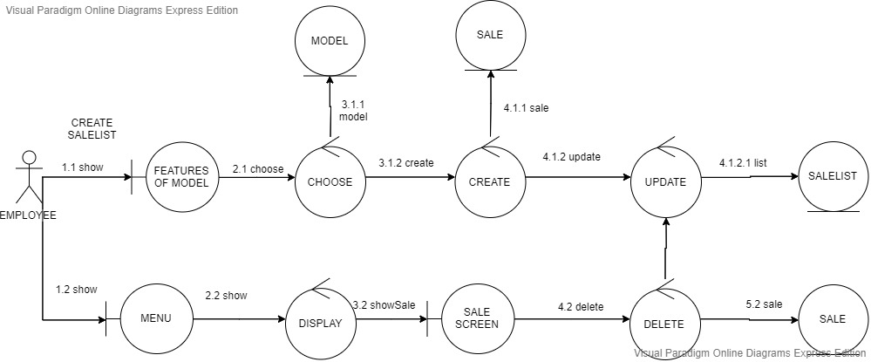
USE CASE CREATE SALELIST

Slide 19
SEQUENCE DIAGRAM
It marks the beginning of the design phase of a system
Processing of conclusions and data of Robustness diagram
Focuses on the interaction of objects
Time sequence of communication of the objects of the system
The flow of system logic is visualized and evaluated

Slide 20
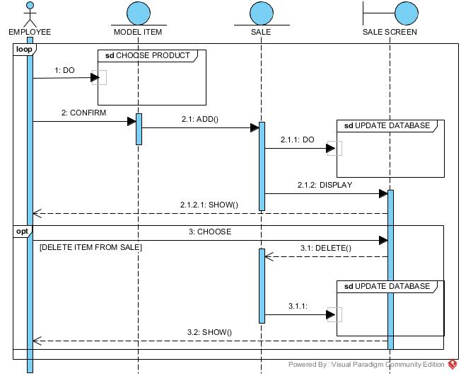
ΠΕΡΙΠΤΩΣΗ ΧΡΗΣΗΣ CREATE SALELIST

Slide 21
CLASS DIAGRAM(1)
Describes the types of system objects
Records the functions of classes
Describes the relationships of the objects
Points out the limitations of object correlations

Slide 22
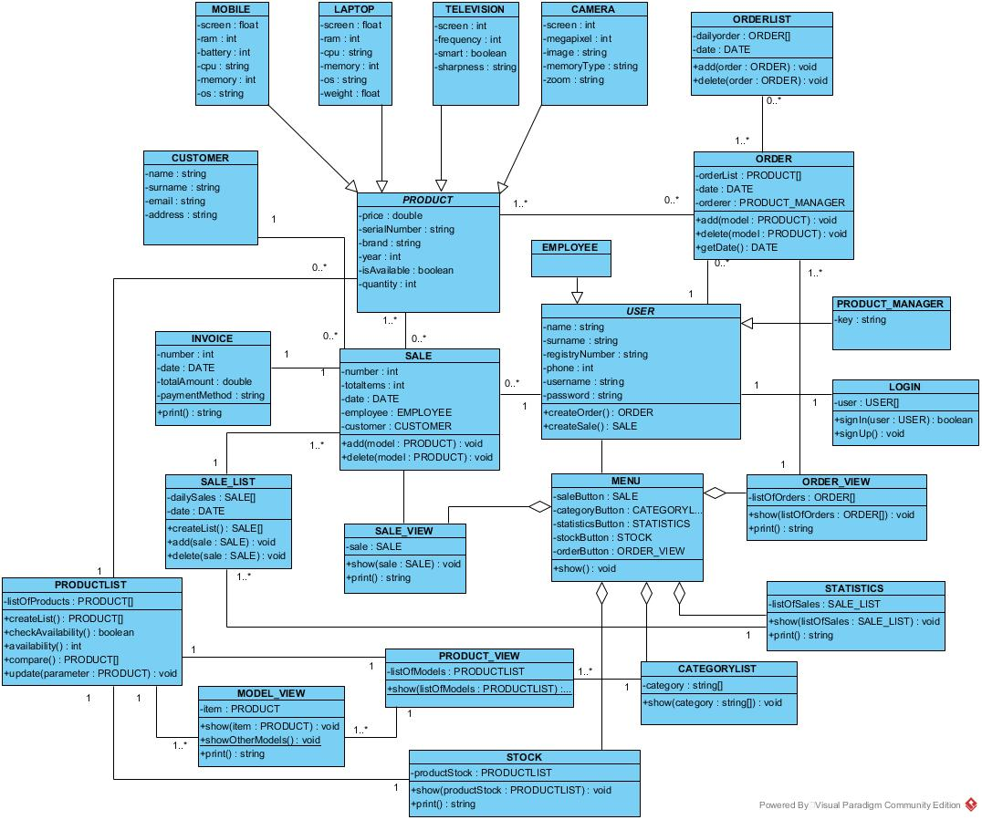
CLASS DIAGRAM(2)

Slide 23
IMPLEMENTATION OF THE SYSTEM
MVC ARCHITECTURE
MODEL
VIEW
CONTROLLER

Slide 24
SOFTWARE TOOLS
MAVEN→ built the program
HIBERNATE →connect with the database MySQL
JUNIT →test the code
COBERTURA →analyze the testing of the code
SWING →create the user’s interface

Slide 25
THANK YOU FOR YOUR ATTENTION

