Slide 1

Web Service
Aris Setyawan
Arissetyawan.campus@gmail.com
Mobile: +6285221807780
Profile: https://www.linkedin.com/in/arisan

Slide 2
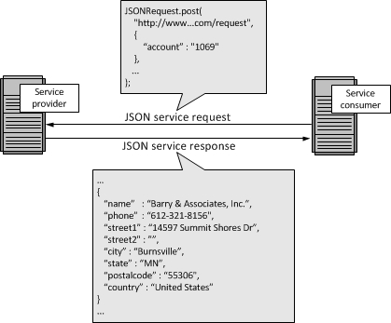
W/S Architecture

Slide 3
Web Service
The API is like an artist performing on stage, and its users are the audience
Facebook, Google, Github, Netflix and few other tech giants have given a chance to the developers and products to consume their data through APIs, and became a platform for them
We will consume facebook API in the next chance we meet (insyaAllah)
Introduction
To Know
Let's Play

Slide 4
To Know
Terminologies
API endpoint
HTTP methods (verbs)
HTTP response status codes
Field name casing convention
Searching, sorting, filtering and pagination
Versioning
Introduction
To Know
Let's Play
Discussion

Slide 5
(1) Terminologies
Resource eg. company
Collections eg. companies
URL eg. /companies/3
Introduction
To Know
Let's Play

Slide 6
(2) API endpoint
method GET path /companies should get the list of all companies
method GET path /companies/34 should get the detail of company 34
method DELETE path /companies/34 should delete company 34
method PUT path /companies/34 should update company 34
Clue: The paths should contain the plural form of resources and the HTTP method should define the kind of action to be performed on the resource
Introduction
To Know
Let's Play

Slide 7
(3) HTTP methods (verbs)
GET
POST
DELETE
PUT
Introduction
To Know
Let's Play

Slide 8
(4) HTTP response status codes
200 Ok for GET, PUT or POST.
201 Created for instance is created
204 No Content eg. DELETE
400 Bad Request
401 Denied
Introduction
To Know
Let's Play

Slide 9
(5) Field name casing convention
We can follow any casing convention, but make sure it is consistent across the application. If the request body or response type is JSON then please follow camelCase to maintain the consistency. No strict rules, but keep consistent.
{
"company":
  {
  "id": 4,
  "name" : "Mukidi bin Salman",
  "address": "Jl. Damai bahagia No. 1, Pemalang"
  "secondAddress": "Jl. Jalan saja No. 1, Bandung"
  }
}
Introduction
To Know
Let's Play

Slide 10
(6) Searching, sorting, filtering and pagination
Searching
GET /companies?keyword=Makmur
Sorting
GET /companies?field=name&order=desc
Filtering
GET /companies?region=Central Java
Pagination
GET /companies?page=3
Introduction
To Know
Let's Play

Slide 11
(7) Versioning
Http://api.domain.com/v1/companies/2
Http://api.domain.com/v2/companies/2
Introduction
To Know
Let's Play

Slide 12
Let's Play
Apiary.io
RESTful
HTTP Poster
Introduction
To Know
Let's Play

Slide 13
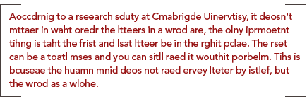
Thanks !
Door Price: Read this fast without any mistake :)

