Slide 1
Bachelor Thesis: Thermodynamic Uncertainty Relation in Superconducting Circuits

Slide 2
Motivation
This thesis focused on overdamped superconducting circuits
Josephson junction (JJ) is the core component of superconducting circuits
In overdamped limit: highly stable voltage-frequency locking → applications in metrology, e.g. voltage standards
Maintaining precision of current and voltage under thermal noise is of central importance
Precision is limited by thermal noise: Thermodynamic uncertainty relation (TUR) places a universal bound on precision in terms of entropy production
Notes:
Overdamped limit: resistive effects dominate over capacitative
….
These decives basically define what a Volt is, and therefore set a reference for gauging other instruments and machinery
…..
For those applications, its of central importance to maintain precision despite thermal fluctuations, which essentially are the limiting factor for precision in superconducting circuits
TUR quantifies this limitation: places a universal …
This makes the TUR a powerful theoretical tool for understanding the effect of thermal noise on superconducting circuits
→ examine the TUR more closely

Slide 3
Struture
Noise in Superconducting Circuits
Josephson Junction
General Circuit Description
Thermodynamic Uncertainty Relation
Constraints on Precision
Analytical Results of this Thesis
Impact of special Energy-Phase Relations
Josepson Junction
Sawtooth Potential
Notes:
This presentation is structured as follows…
….
From there, we are going to derive a more general description of the type of circuit we examine in this thesis
…
After that, we will examine the TUR more closely, and see how precision is constrained
…
Finally, we will study the TUR for some systems of technological importance, and see how their unique dynamics affect noise

Slide 4
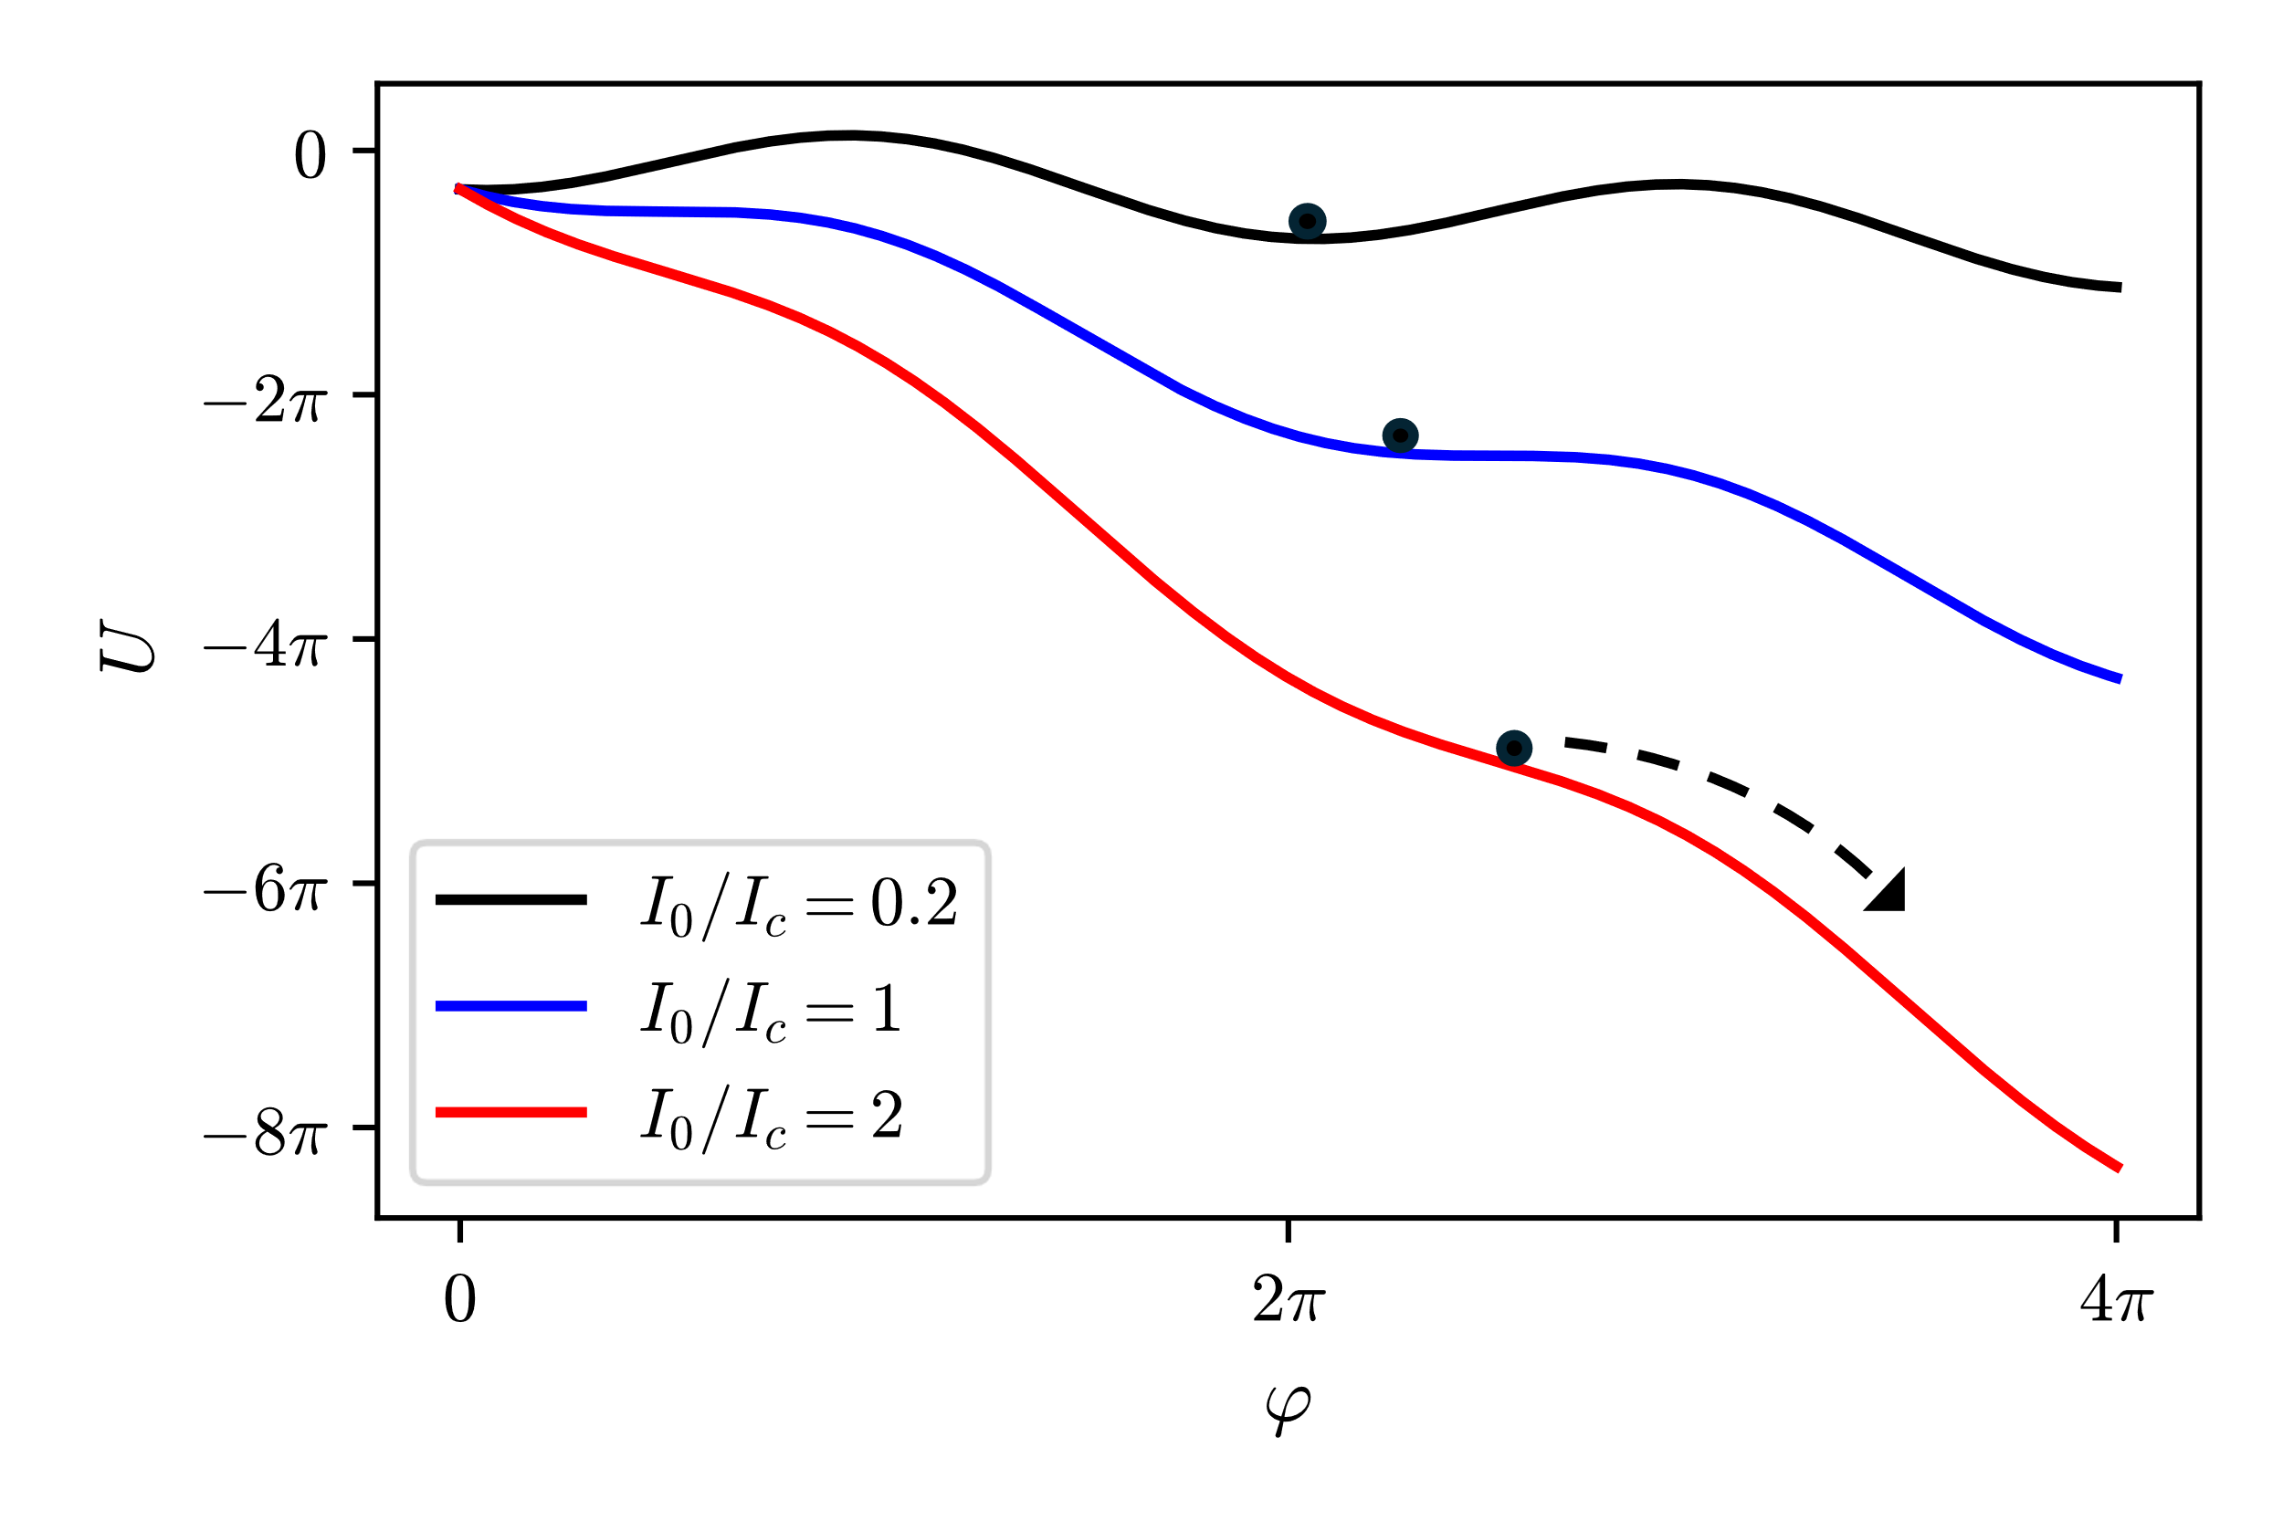
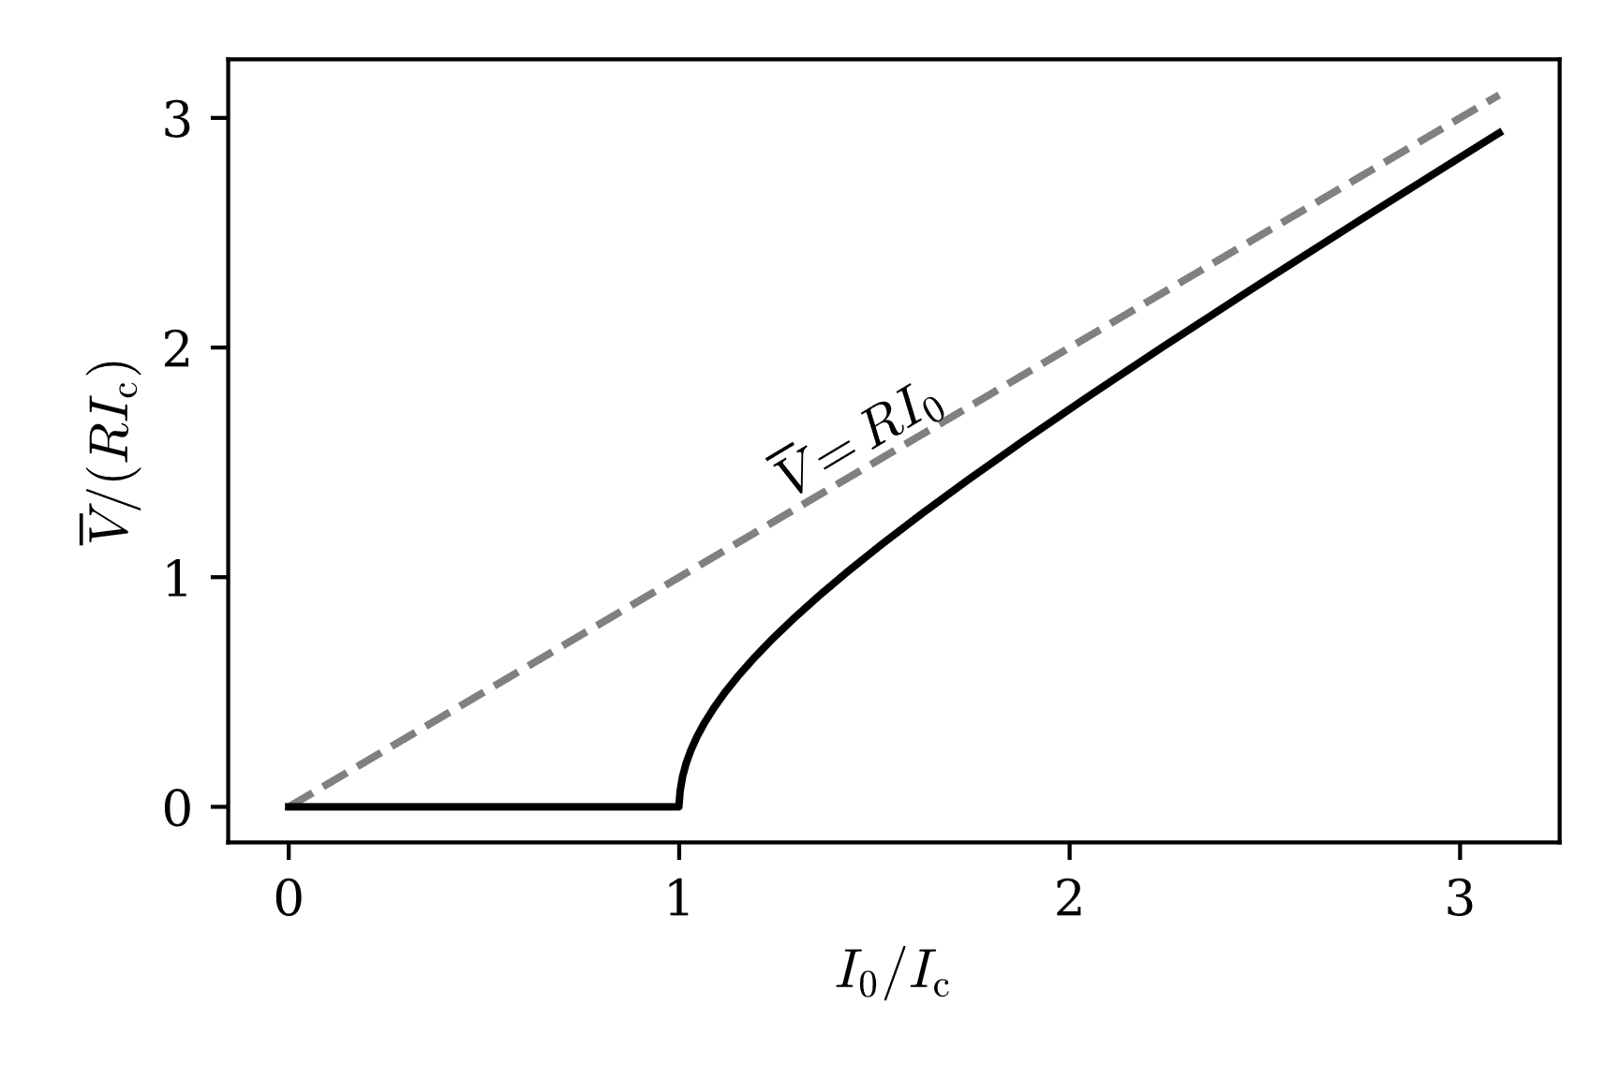




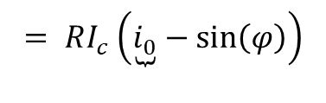
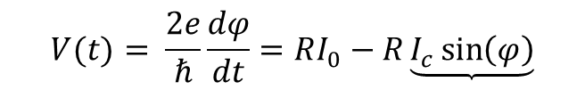

Noise in Superconducting Circuits
Josephson Junction
Circuit description (overdamped limit):
Deterministic description is inconsistent with statistical physics
Thermal fluctuations arise due to resistance $R$
Equipartition theorem:
$$V(t)= \frac{2e}{ℏ}\frac{dφ}{dt}=RI_{0}−R\underbrace{I_{c}\sin\left(φ\right)}$$
$$= RI_{c}\left(\underbrace{i_{0}}−\sin\left(φ\right)\right)$$
Current-Phase Relation
$$I_{0}/I_{c}$$
$$\frac{2e}{ℏ}\frac{dφ}{dt}=−RI_{c}\frac{dU}{dφ} U\left(φ\right)={−i}_{0}φ−cos⁡(φ)$$
$$+ B\underbrace{ξ(t)}$$
Gaussian white noise
$$\left\langle E\right\rangle = \frac{k_{B}T}{2}$$
→ $B= \sqrt{2Rk_{B}T}$
Notes:
In the overdamped limit, JJ is described by ….
Components … V, e, h, t, phi, R, I_0, I_c, Current-phase relation…
Factor out RI_c → Via a potential (tilted periodic potential)
→ Resembles Newtons second law , with the exception that the particle has no momentum
However, when particle is at rest: no energy (inconsistent with statistical physics)
Add gaussian white noise → overdamped Langevin equation
Noise strength consistent with equipartition theorem

Slide 5


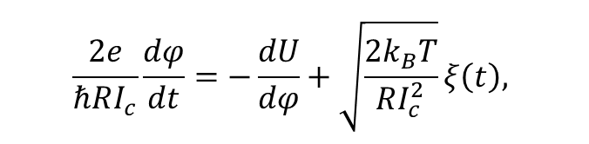
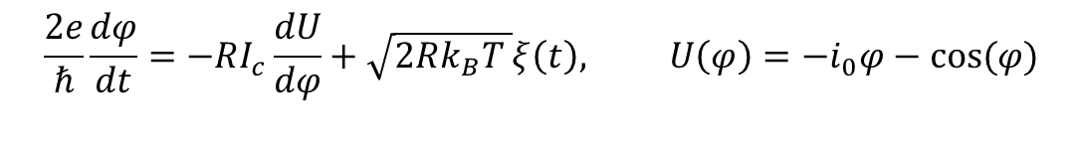
Noise in Superconducting Circuits
General Circuit Description
$$\frac{2e}{ℏRI_{c}}\frac{dφ}{dt}=−\frac{dU}{dφ}+\sqrt{\frac{2k_{B}T}{RI_{c}^{2}}}ξ\left(t\right),$$
$$\frac{2e}{ℏ}\frac{dφ}{dt}=−RI_{c}\frac{dU}{dφ}+\sqrt{2Rk_{B}T }ξ\left(t\right), U\left(φ\right)={−i}_{0}φ−cos⁡(φ)$$
Josephson junction:
$$t→τ$$
General circuit description:
$$\frac{dφ}{dτ}=−\frac{dU}{dφ}+ \sqrt{2D} ξ\left(τ\right)$$
$$, U\left(φ\right)={−i}_{0}φ+\underbrace{P\left(φ\right)}, P\left(φ\right)=P(φ+L)$$
Energy-Phase Relation (EPR)
Notes:
Rearrange overdamped langevin equation of the JJ
Define dimensionless time
Now for arbitrary Energy-Phase relations

Slide 6
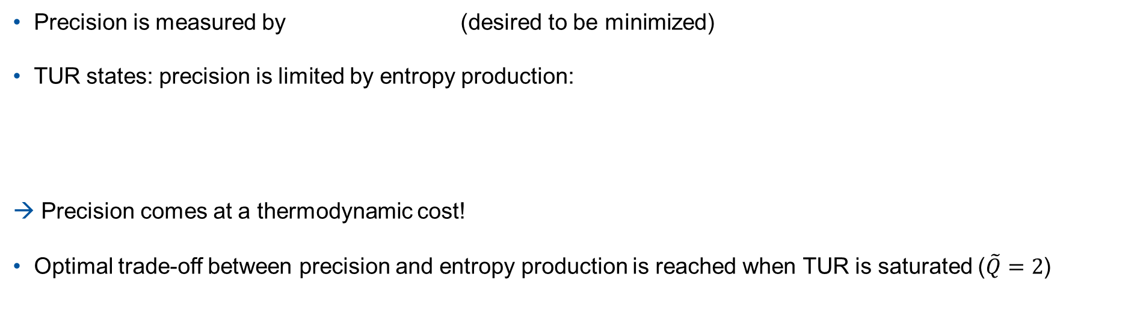
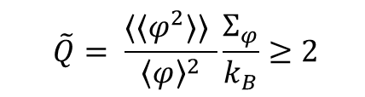

Thermodynamic Uncertainty Relation (TUR)
Constraints on precision
$$CV_{φ}^{2}=\frac{⟨⟨φ^{2}⟩⟩ }{{\left\langle φ\right\rangle }^{2}}$$
Precision is measured by (desired to be minimized)
TUR states: precision is limited by entropy production:
Precision comes at a thermodynamic cost!
Optimal trade-off between precision and entropy production is reached when TUR is saturated ($\tilde{Q}=2$)
$$\tilde{Q}= \frac{⟨⟨φ^{2}⟩⟩ }{{\left\langle φ\right\rangle }^{2}}\frac{Σ_{φ}}{k_{B}}≥2$$
Notes:
How do we measure precision of a circuit?
Constraints on precision
Optimal tradeoff reached when?

Slide 7
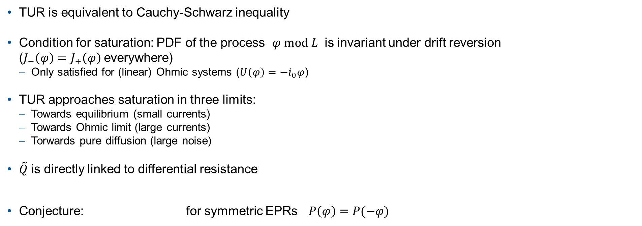
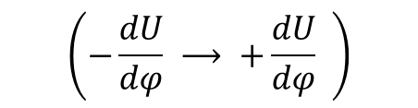
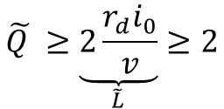

Thermodynamic Uncertainty Relation (TUR)
Analytical results of this thesis
TUR is equivalent to Cauchy-Schwarz inequality
Condition for saturation: PDF of the process $φ mod L$ is invariant under drift reversion
($J_{−}\left(φ\right)=J_{+}\left(φ\right)$everywhere)
Only satisfied for (linear) Ohmic systems ($U\left(φ\right)=−i_{0}φ$)
TUR approaches saturation in three limits:
Towards equilibrium (small currents)
Towards Ohmic limit (large currents)
Torwards pure diffusion (large noise)
$\tilde{Q}$ is directly linked to differential resistance
Conjecture: for symmetric EPRs $P\left(φ\right)=P(−φ)$
$$\left(−\frac{dU}{dφ} ⟶ +\frac{dU}{dφ} \right)$$
$$r_{d}= \frac{dv}{di_{0}}\sim \left\langle J_{− }, J_{+}\right\rangle$$
$$\tilde{Q }≥\underset{\tilde{L}}{\underbrace{2\frac{r_{d}i_{0}}{v}}}≥2$$
Notes:
Condition for saturation: PDF circle (see figure)

Slide 8
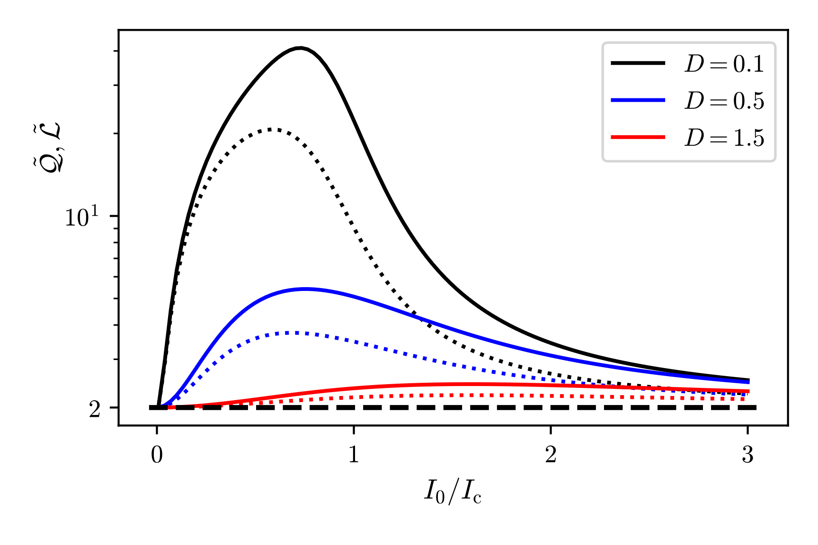
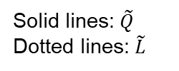
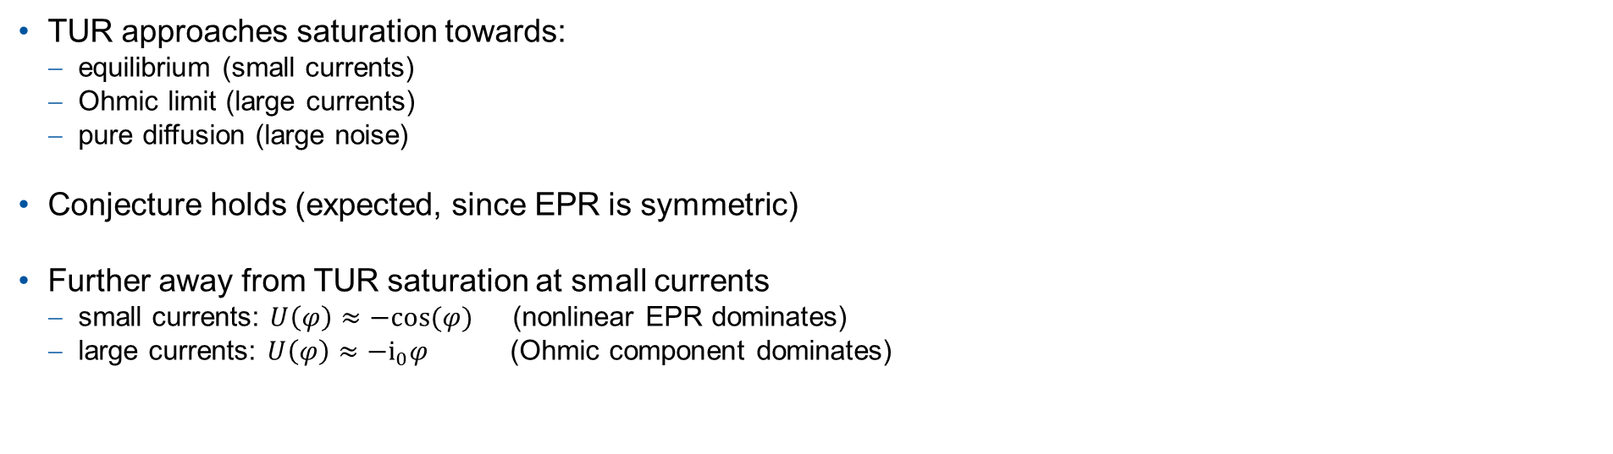
Impact of Special Energy-Phase Relations
Josephson Junction
TUR approaches saturation towards:
equilibrium (small currents)
Ohmic limit (large currents)
pure diffusion (large noise)
Conjecture holds (expected, since EPR is symmetric)
Further away from TUR saturation at small currents
small currents: $U\left(φ\right)≈−cos⁡(φ)$ (nonlinear EPR dominates)
large currents: $U\left(φ\right)≈−i_{0}φ$ (Ohmic component dominates)
Solid lines: $\tilde{Q}$ Dotted lines: $\tilde{L}$

Slide 9
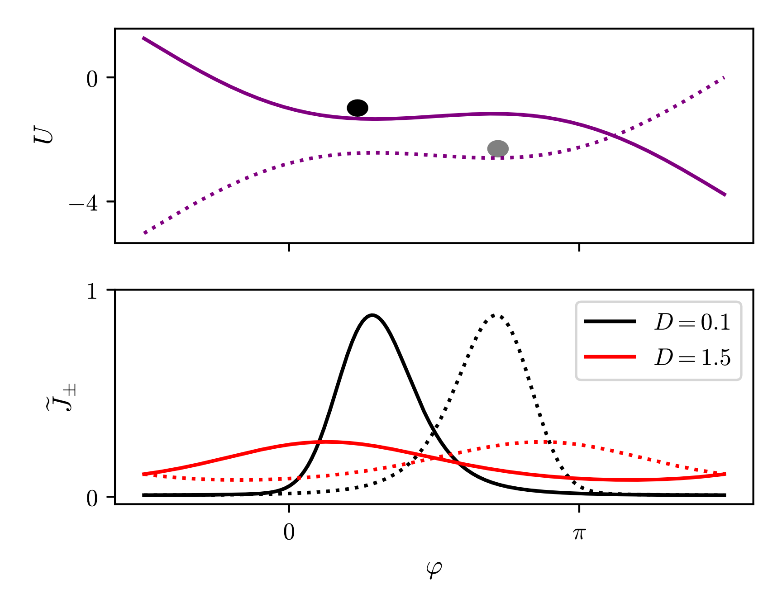

Impact of Special Energy-Phase Relations
$$I_{0}/I_{c}=0.8$$
Josephson Junction
PDF accumulates inside local minima
Large discrepancy between PDF of the forward-
and drift-reversed process
→ Strong breaking of saturation
Solid lines: forward process, Dotted lines: drift-reversed process

Slide 10
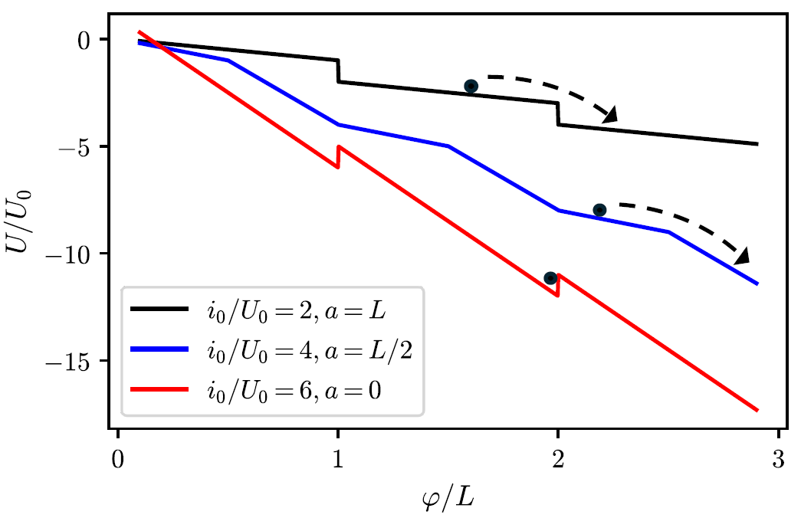
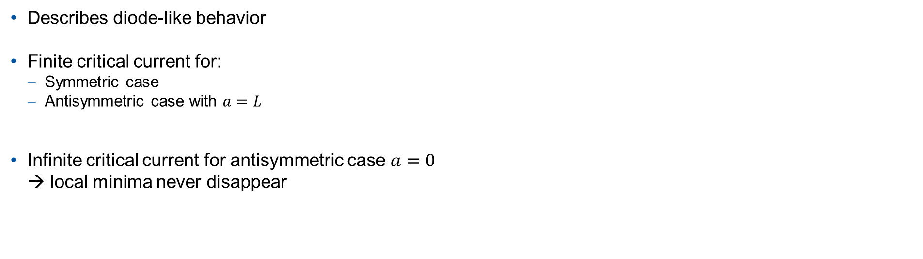
Impact of Special Energy-Phase Relations
Sawtooth Potential
Describes diode-like behavior
Finite critical current for:
Symmetric case
Antisymmetric case with $a=L$
Infinite critical current for antisymmetric case $a=0$
→ local minima never disappear

Slide 11
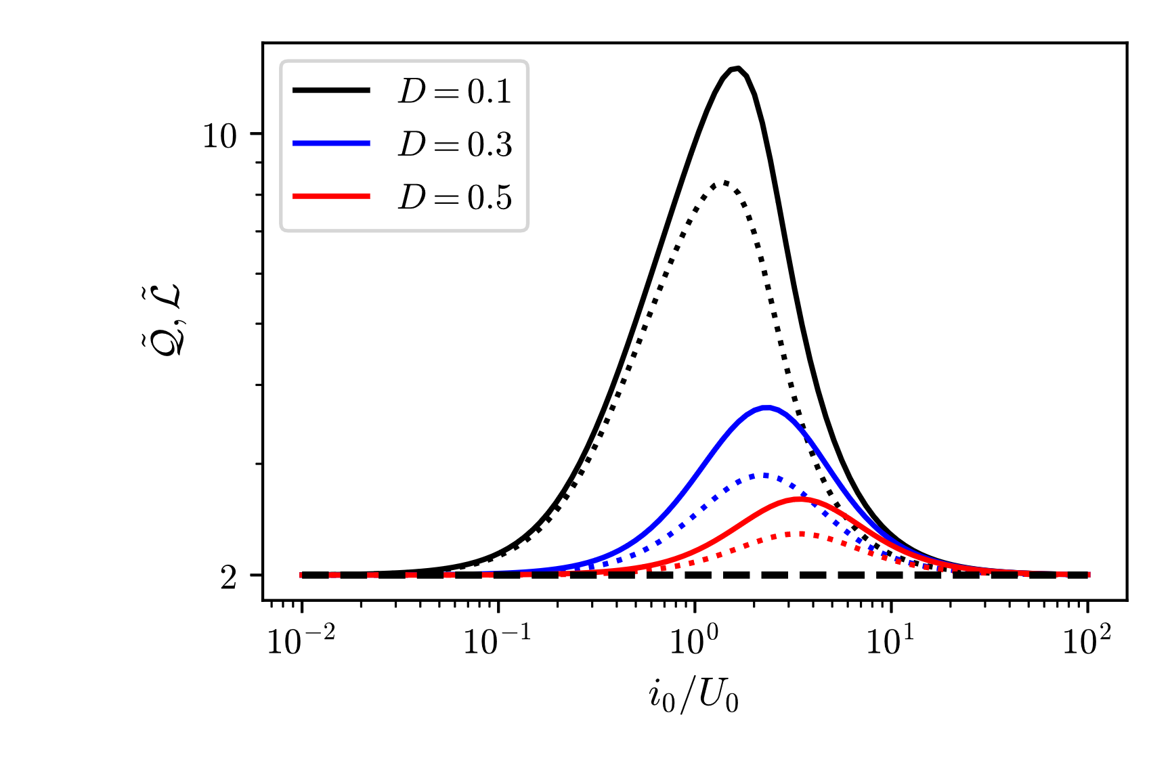
Impact of Special Energy-Phase Relations
Symmetric Sawtooth Potential
Same ovservations as for the Josephson Junction
Conjecture holds (expected, since EPR is symmetric)
Solid lines: $\tilde{Q}$ Dotted lines: $\tilde{L}$

Slide 12
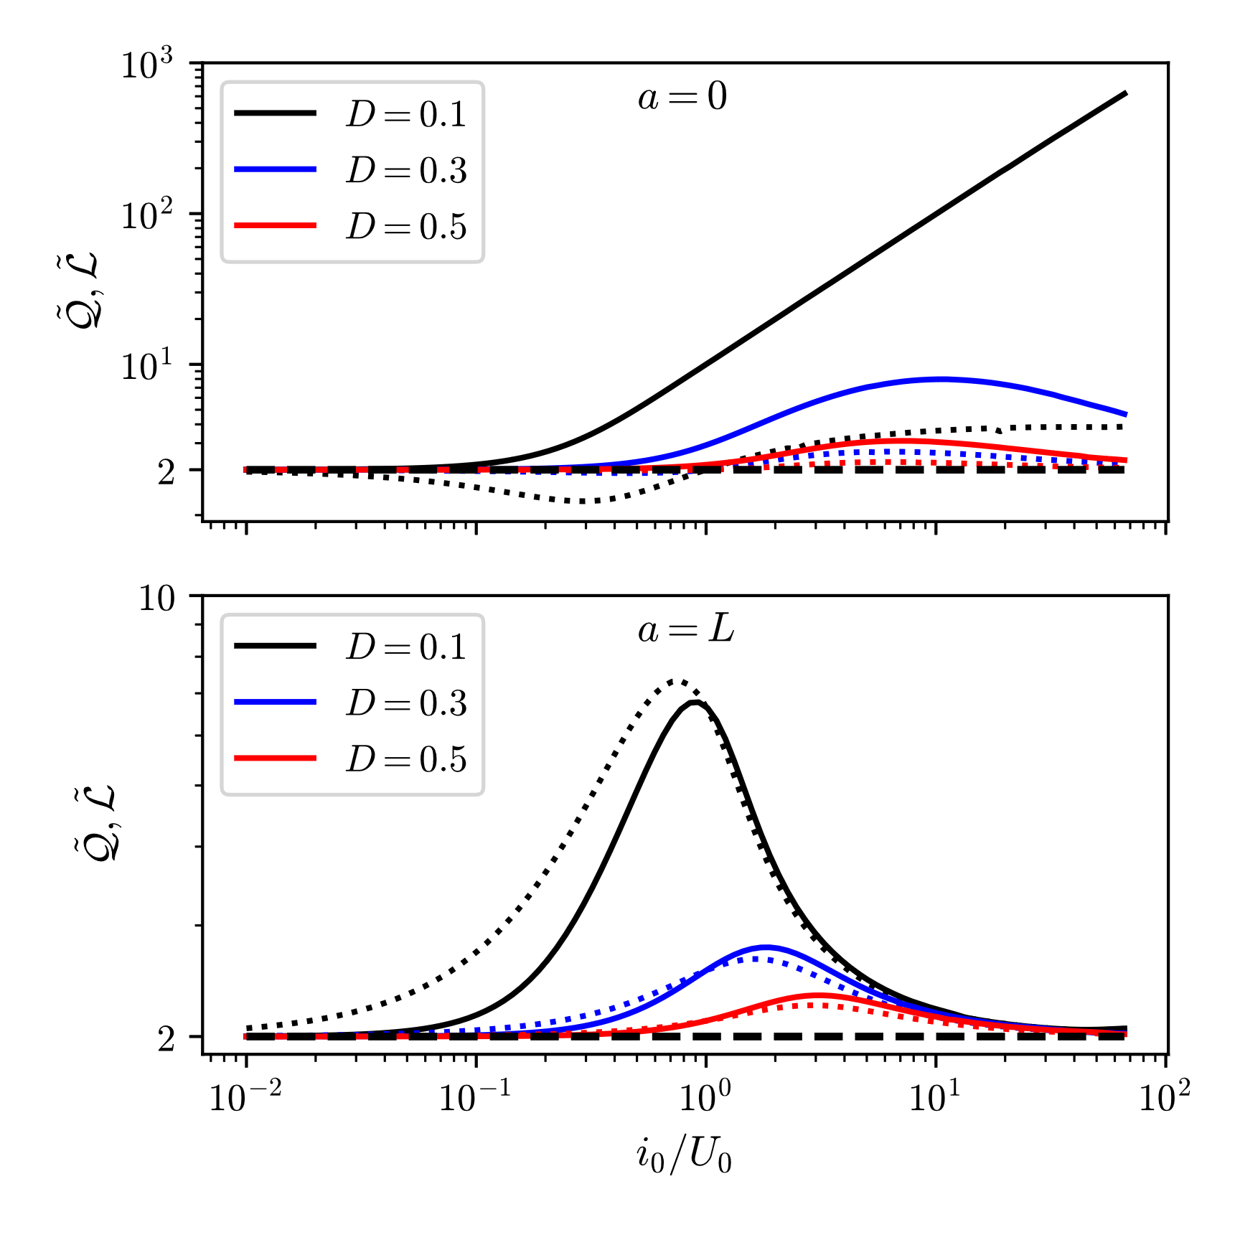
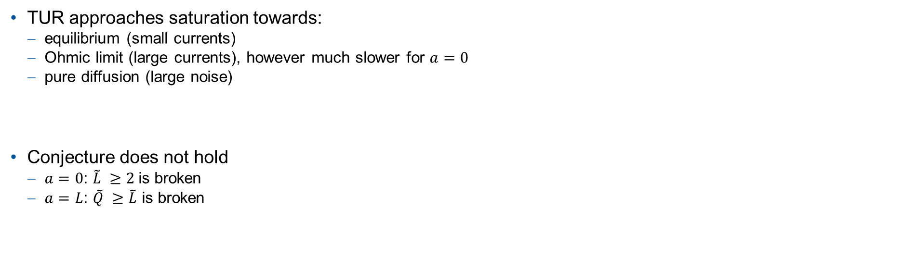

Impact of Special Energy-Phase Relations
Antisymmetric Sawtooth Potential
TUR approaches saturation towards:
equilibrium (small currents)
Ohmic limit (large currents), however much slower for $a=0$
pure diffusion (large noise)
Conjecture does not hold
$a=0$: $\tilde{L} ≥2$is broken
$a=L$: $\tilde{Q} ≥\tilde{L}$ is broken
Solid lines: $\tilde{Q}$ Dotted lines: $\tilde{L}$

Slide 13
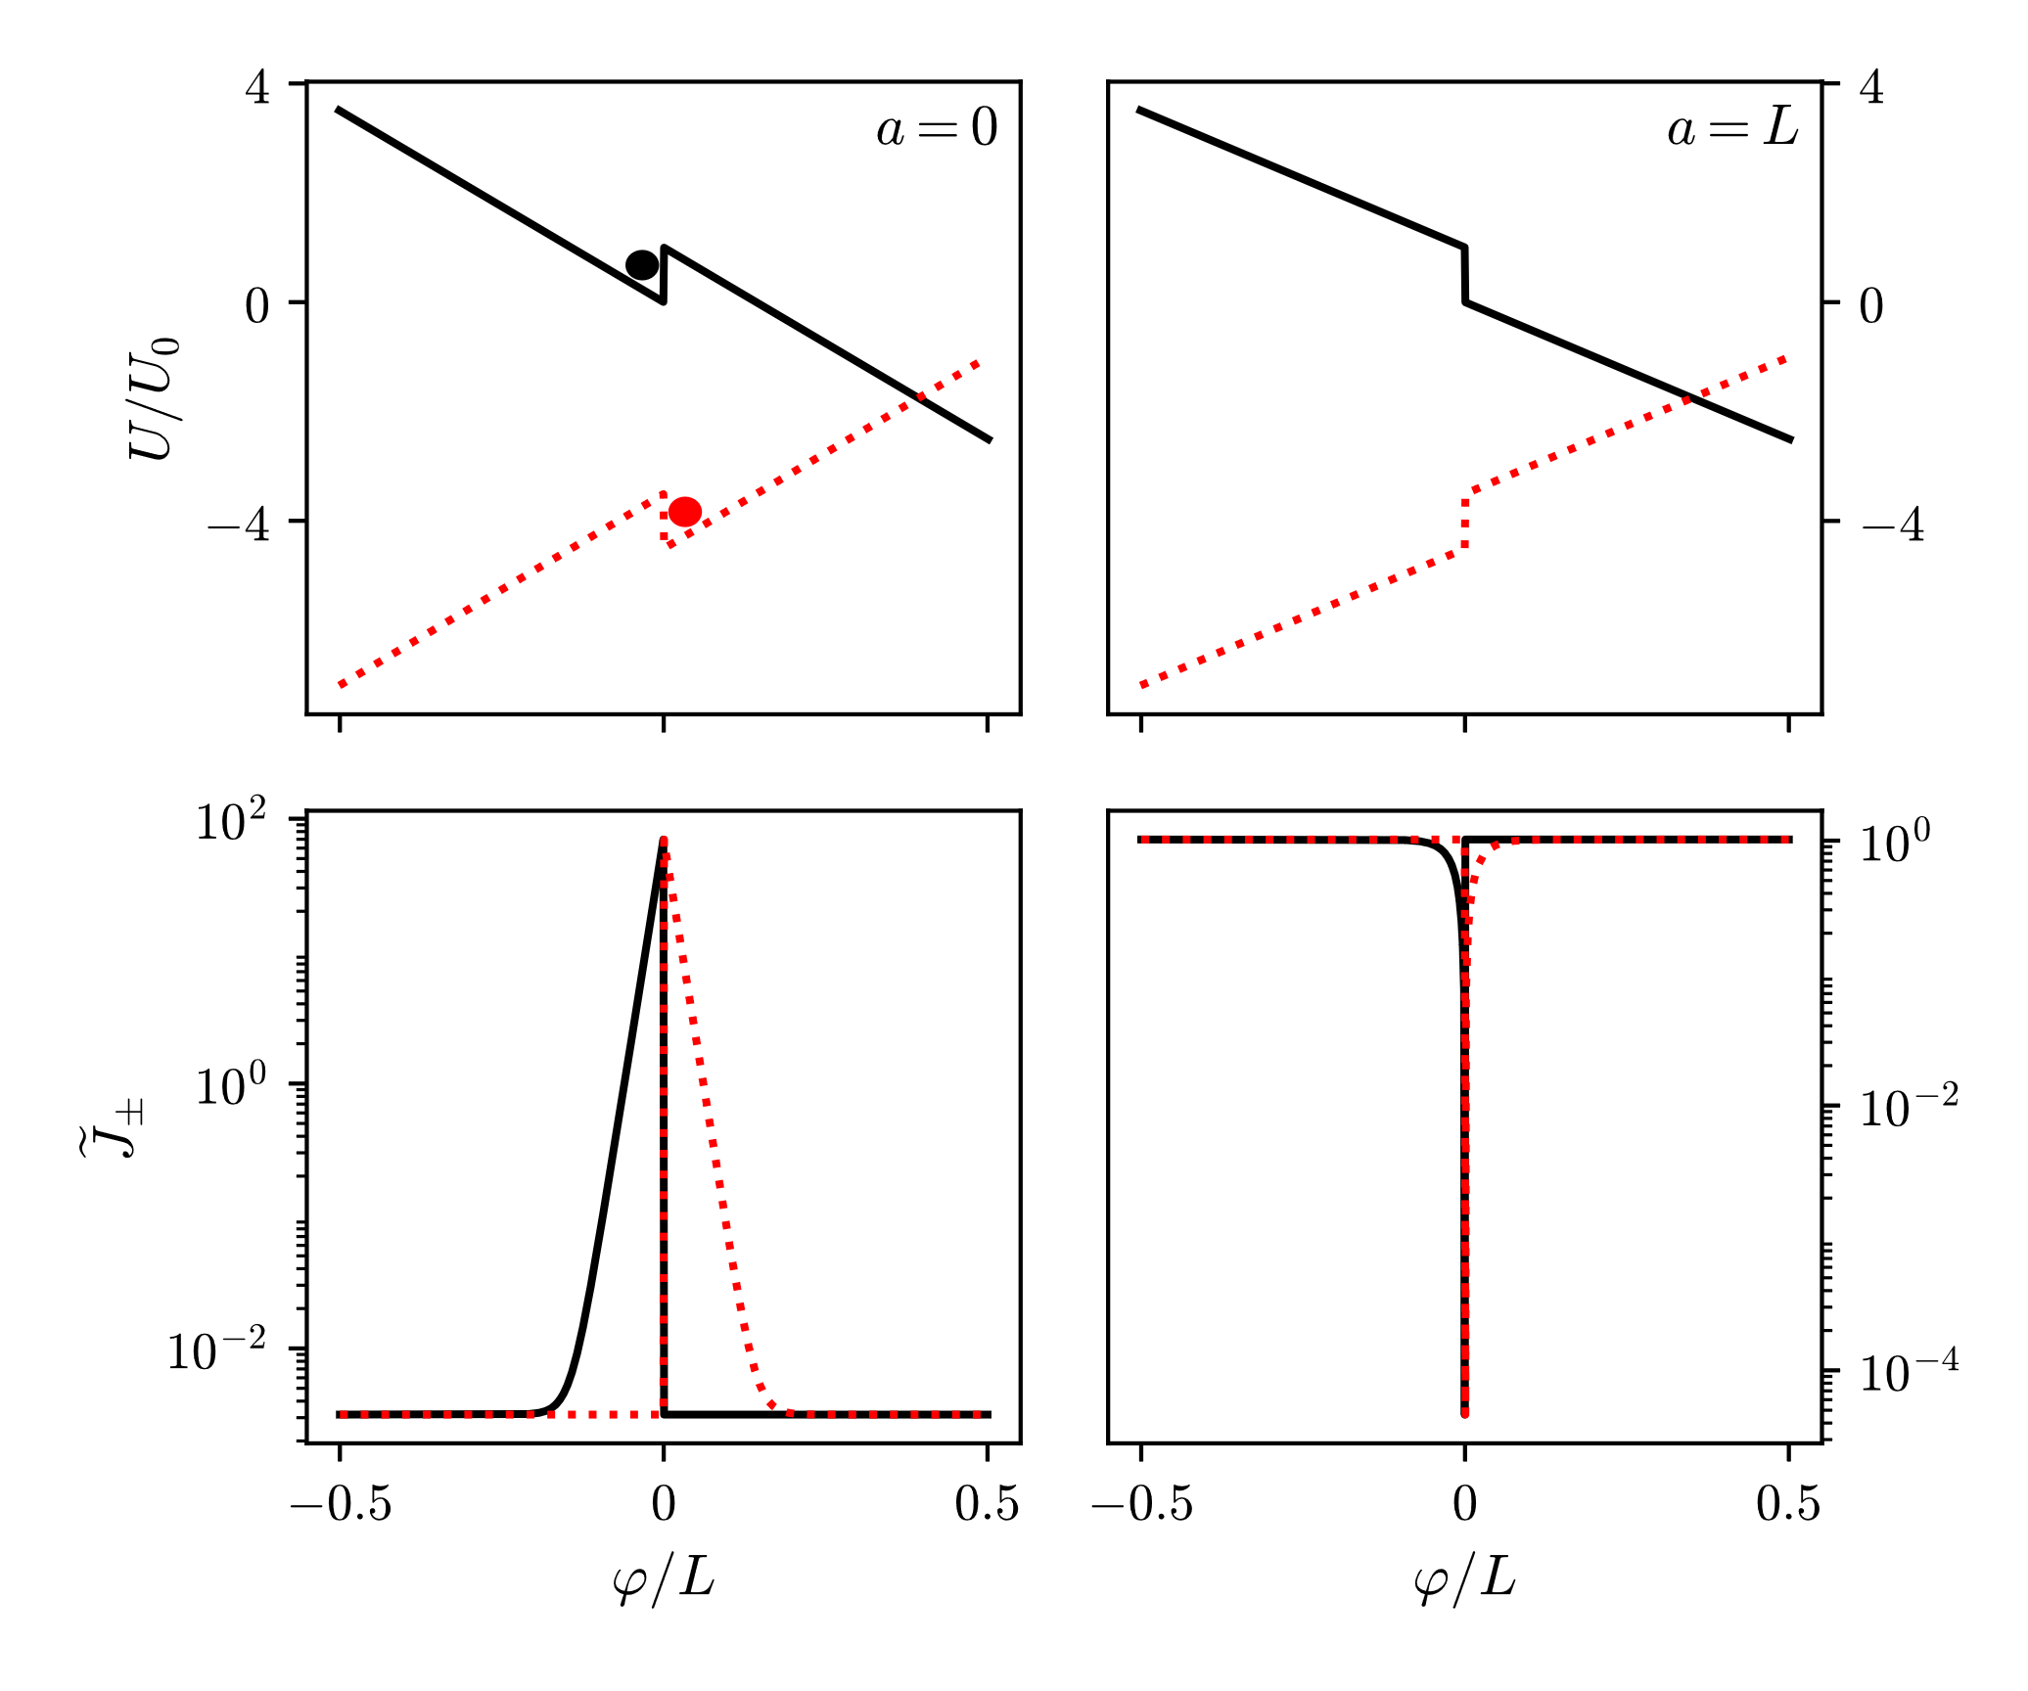


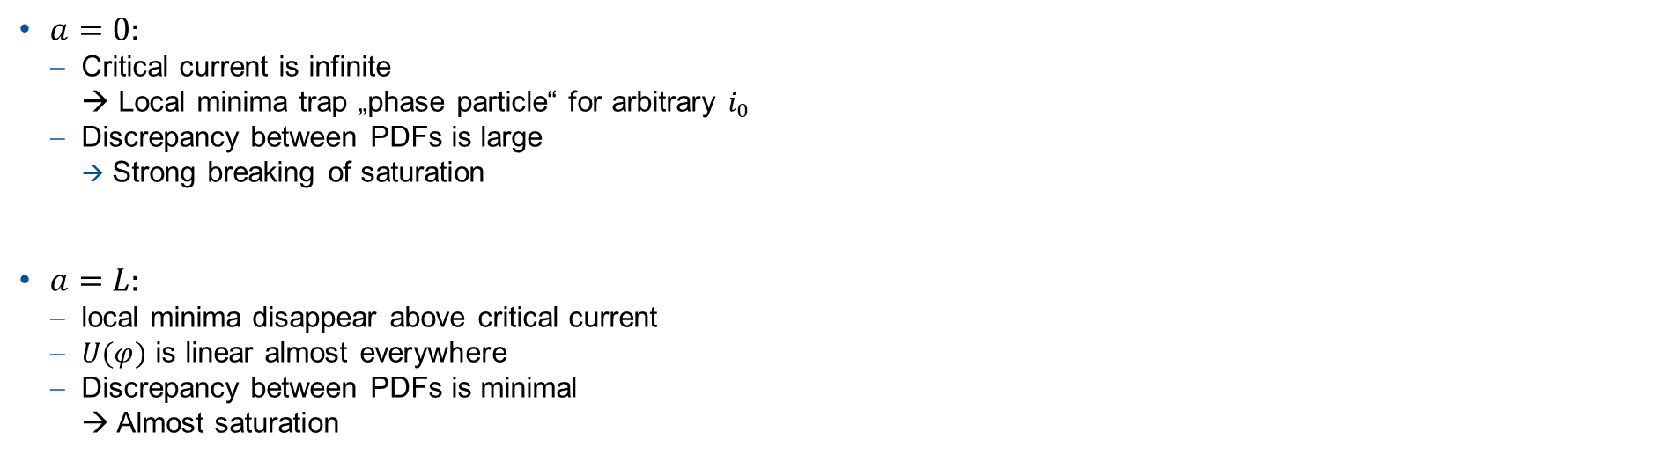
Impact of Special Energy-Phase Relations
$$i_{0}/U_{0}=6,$$
$D/U_{0}=0.1$
Antisymmetric Sawtooth Potential
$a=0:$
Critical current is infinite
→ Local minima trap „phase particle“ for arbitrary $i_{0}$
Discrepancy between PDFs is large
Strong breaking of saturation
$a=L:$
local minima disappear above critical current
$U(φ)$ is linear almost everywhere
Discrepancy between PDFs is minimal
→ Almost saturation
Solid lines: forward process, Dotted lines: drift-reversed process

Slide 14
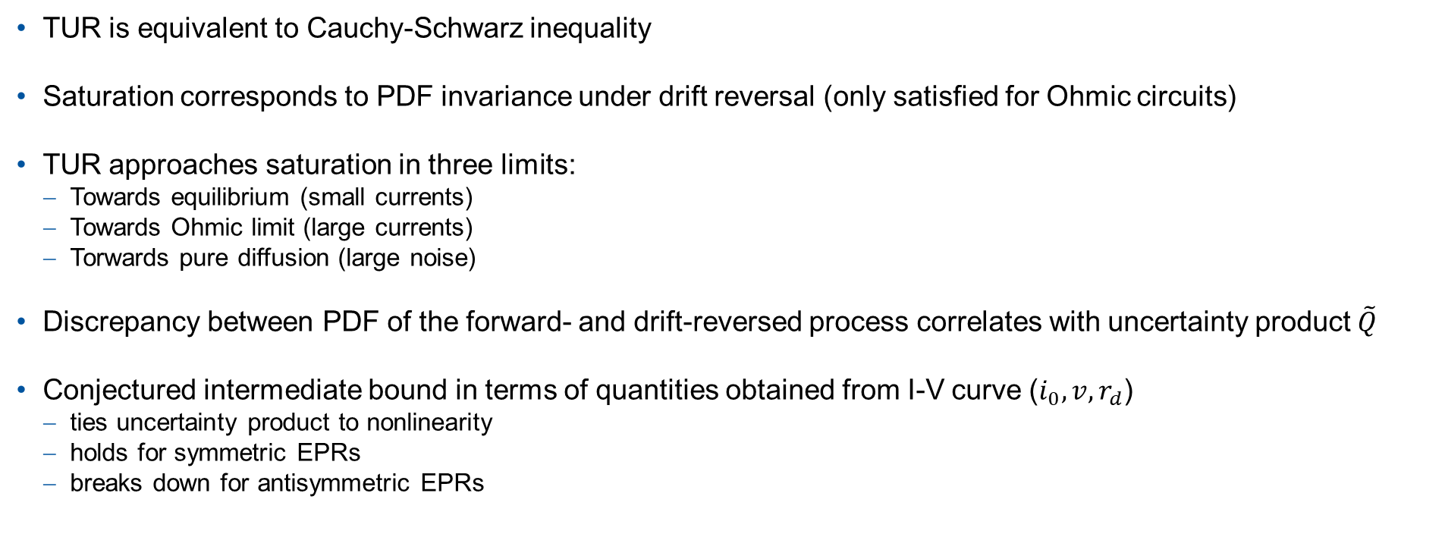
Summary and Outlook
TUR is equivalent to Cauchy-Schwarz inequality
Saturation corresponds to PDF invariance under drift reversal (only satisfied for Ohmic circuits)
TUR approaches saturation in three limits:
Towards equilibrium (small currents)
Towards Ohmic limit (large currents)
Torwards pure diffusion (large noise)
Discrepancy between PDF of the forward- and drift-reversed process correlates with uncertainty product $\tilde{Q}$
Conjectured intermediate bound in terms of quantities obtained from I-V curve (${i_{0}, v, r}_{d}$)
ties uncertainty product to nonlinearity
holds for symmetric EPRs
breaks down for antisymmetric EPRs
Notes:
Conjectured intermediate bound would allow a more tractable estimate of noise in our circuit, since all the quantities are accessible via the I-V curve

