Slide 1
CHICKENPLUSPLUS (Food Ordering System)
Submitted by:
ABRIAN, Azarel Jediael
BUENAVENTURA, Aristotle C.
LEONEN, Justine

Slide 2







CHICKENPLUSPLUS
Introduction
Significance of the study
Problem of the study
Flowchart
Objective of the study
Conclusion

Slide 3
Introduction
A restaurant menu is more than just a list of food with prices. It also represents the theme and concept of a restaurant.
A well designed and planned menu can motivate customers and even employees for a responsible service and can lead to customer satisfaction.
The menu is considered as the heart of any restaurant.

Slide 4
Problem
Inconvenience of customers.
Customers tend to lose their patience in regards to long queues
Time consuming and customers are pressured.
Hassle in writing the order of the customer.
Discrepancy in customers’ orders.
Lack of manpower.
Slow transaction.
Virus could transmit through money and person to person.

Slide 5
Objectives
To design a user-friendly and interactive interface, that showcases the available products a restaurant sells.
To design a simple and effective menu plan and design that allows the users to navigate easily through the program.
To provide more convenience for users that wish for easier accessibility to purchasing restaurant products.

Slide 6
Significance
Chicken++ was developed because of the pandemic, it will help lessen contact with other people.
Less stress for the customer because they are not pressured to order their food.
It was developed to help small businesses to innovate and join the online food ordering system.
It is a key step in helping restaurants and other establishments to become more accessible to everyone during this pandemic.
6

Slide 7
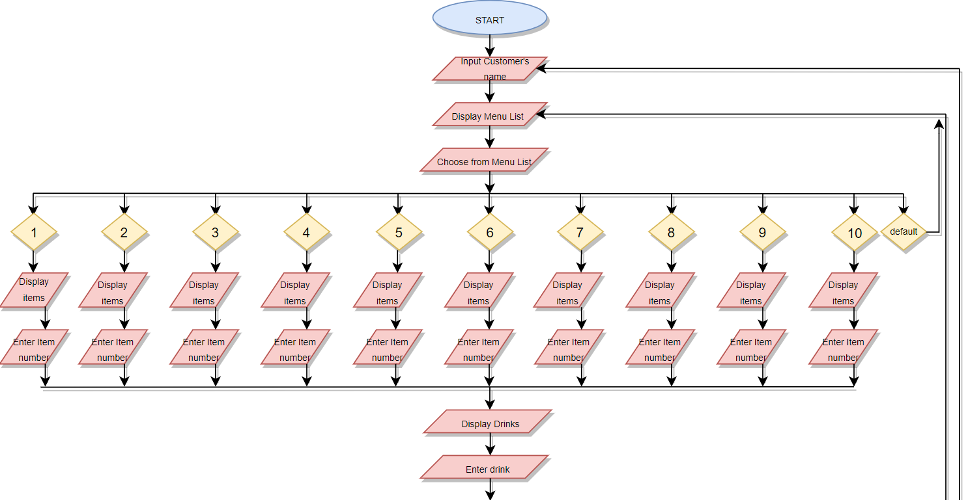
Flowchart

Slide 8
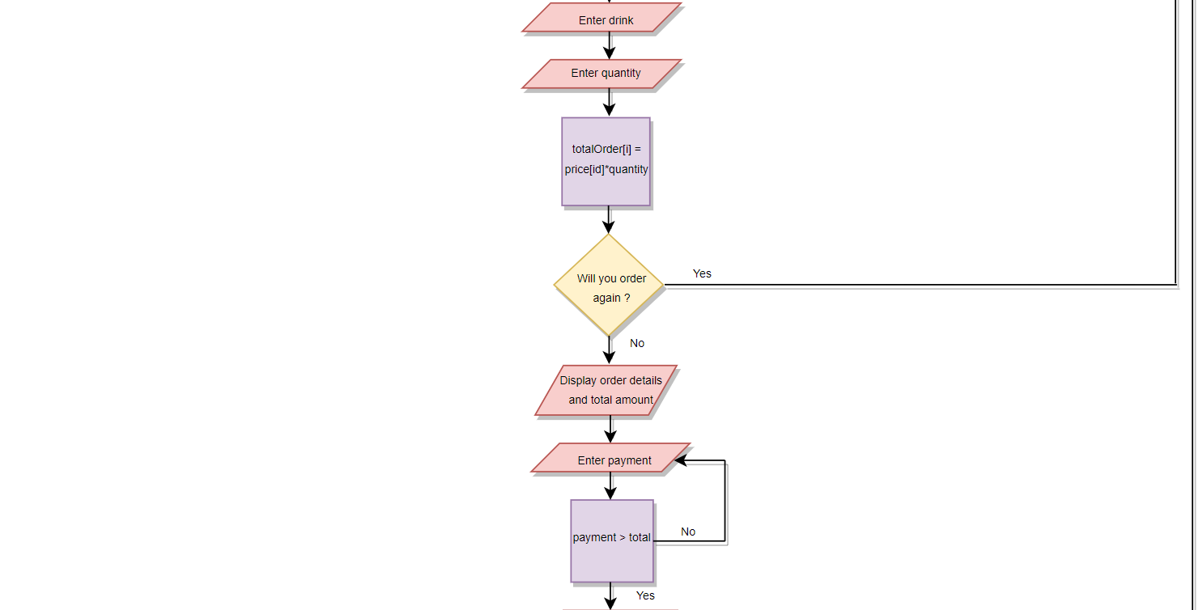
Flowchart

Slide 9

Flowchart

Slide 10
Conclusion
Chicken++ has achieved all the objectives, and demonstrated that automation will be the future of online ordering system.
The program has made online purchasing or selling more accessible for everyone.
It can be easily integrated and easily modified to fit the given establishment’s product.
It will make the food ordering online more convenient for both parties
It was made with the intention of being easily accessible and understood by everyone, the UI is very easily understandable so that anyone of any age can use it.

Slide 11
Thank You

