Slide 1
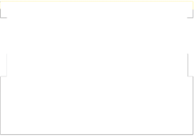

TECHNOLOGICAL INSTITUTE OF THE PHILIPPINES
College of Information Technology Education
Control Structures:
Conditional Statements
Notes:
https://tinyurl.com/ql583l2

Slide 2
Objectives:
At the end of the lesson, the students should be able to:
1. Apply the syntax and design sequential and selection statement;
2. Formulate a solution with decision making capabilities using appropriate control structures;

Slide 3
Objectives:
3. Compare the different types of Selection Control structures in problem solving; and
4. Create a program using Selection Control structures in C++ Programming Language.

Slide 4
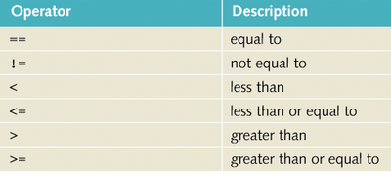
Relational Operators
The expressions which determine
  Selection
  Repetition are usually comparisons
Comparisons are done with relational operators
Beware of mistaking the assignment = for the equality ==

Slide 5
Logical (Boolean) Operators
The && operator (logical and)
  If both operands are true, the result is true
  If either or both operands is false, the comparison is false
The || operator (logical or)
  If either or both of the operands are true, the comparison is true
  The comparison is false only if both operands are false
The ! operator (logical not)
  The not operator reverses the logical value of the one operand

Slide 6
Short Circuit Evaluation
Evaluate this
(x != 0) && (1.0 / x < 0.25)
x = 10.0
(10.0 != 0) && (1.0 / 10.0 < 0.25)
= 1 && (0.1 < 0.25)
= 1 && 1
= 1

Slide 7
Short Circuit Evaluation
Evaluate this
(x != 0) && (1.0 / x < 0.25)
x = 0
(0 != 0) && (1.0 / 0 < 0.25)
= 0 && error
= 0 && error
= 0

Slide 8
Short Circuit Evaluation
Evaluate this
(x != 0) && (1.0 / x < 0.25)
If the first condition is false, the program could crash when it tried to divide by zero
  but if the first condition is false, the whole expression is false
  no need to go on
When C++ evaluates an expression, realizes that fact and does not even make the second comparison
Called "short circuit" evaluation

Slide 9
3 Control Structures
Sequence structure
  Programs executed sequentially by default
Selection structures
  if, if/else, switch
Repetition structures
  while, do/while, for

Slide 10
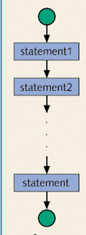
Control Structures
Statements can be
executed in sequence
One right after the other
No deviation from the
specified sequence

Slide 11
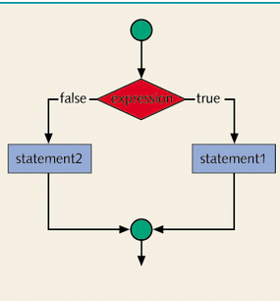
Control Structures
A selection structure
can be used
Which statement
is executed is
selected by
whether the
expression is true
or false

Slide 12
Conditional Statement
It checks certain conditions (Boolean expressions) before executing certain statements.
Condition – Selection – Decision
Expression – Condition
Statement – any programming statement

Slide 13
Conditional Statements
The Selection control structures allow one set of statement to be executed if a condition is true and another set of actions to be executed if a condition is false.

Slide 14
Conditional Statement
Single Selection Statement
“To be or not to be, that is the question.”
Or in terms of the single selection statement, we should rephrase it to
“To execute or not to execute, that is the question.”

Slide 15
Conditional Statement
Single Selection Statement
In C++, the if statement is used for single selection.
The statement will be executed if and only if the expression evaluates to true.

Slide 16
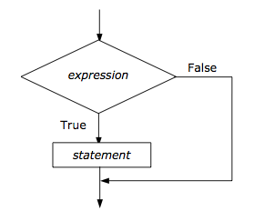
Single Selection Statement
SYNTAX:
  if(expression)
  {
  statement/s;
  }

Slide 17
Single Selection Statement
Write a program segment that asks for an item price from the user and displays the string “Expensive!” if the price is greater than or equal to 1000.

Slide 18

Flowchart
Write a program segment that asks for an item price from the user and displays the string “Expensive!” if the price is greater than or equal to 1000.
START
START
INITIALIZE item_price
READ item_price
IF item_price >= 1000
WRITE ("Expensive!")
END IF
END
item_price
GET(item_price)
item_price >=1000
Yes
No
PRINT(“Expensive!”)
END

Slide 19

Pseudocode
Write a program segment that asks for an item price from the user and displays the string “Expensive!” if the price is greater than or equal to 1000.
START
START
INITIALIZE item_price
READ item_price
IF item_price >= 1000
WRITE ("Expensive!")
END IF
END
item_price
GET(item_price)
item_price >=1000
Yes
No
PRINT(“Expensive!”)
END

Slide 20

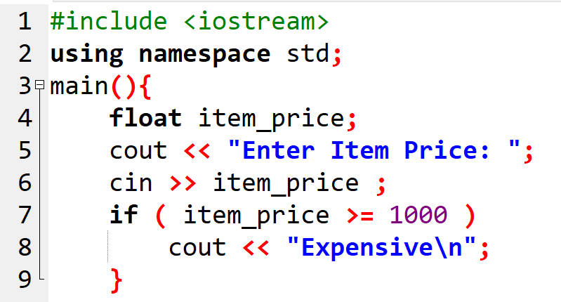
Source code
Write a program segment that asks for an item price from the user and displays the string “Expensive!” if the price is greater than or equal to 1000.
START
INITIALIZE item_price
READ item_price
IF item_price >= 1000
WRITE ("Expensive!")
END IF
END

Slide 21
Compound Statements
If more than one statement needs to be executed, these statements must be enclosed within braces ({}).
These statements are called compound statements.

Slide 22
Single Selection Statement
Write a program segment that asks for an item price from the user and displays the strings “Expensive!” and “Can’t Afford” if the price is greater than or equal to 1000.

Slide 23
Flowchart
Write a program segment that asks for an item price from the user and displays the strings “Expensive!” and “Can’t Afford” if the price is greater than or equal to 1000.
START
START
INITIALIZE item_price
READ item_price
IF item_price >= 1000
WRITE (“Expensive!”)
WRITE (“Can’t Afford”)
END IF
END
item_price
GET(item_price)
item_price >=1000
Yes
PRINT(“Expensive!”)
No
PRINT(“Can’t Afford”)
END

Slide 24

Pseudocode
Write a program segment that asks for an item price from the user and displays the strings “Expensive!” and “Can’t Afford” if the price is greater than or equal to 1000.
START
START
INITIALIZE item_price
READ item_price
IF item_price >= 1000
WRITE (“Expensive!”)
WRITE (“Can’t Afford”)
END IF
END
item_price
GET (item_price)
item_price >=1000
Yes
PRINT(“Expensive!”)
No
PRINT(“Can’t Afford”)
END

Slide 25

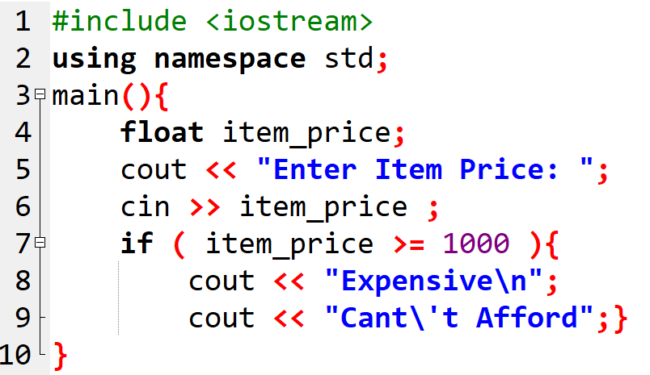
Source code
Write a program segment that asks for an item price from the user and displays the strings “Expensive!” and “Can’t Afford” if the price is greater than or equal to 1000.
START
INITIALIZE item_price
READ item_price
IF item_price >= 1000
WRITE (“Expensive!”)
WRITE (“Can’t Afford”)
END IF
END

Slide 26
Multiple Selection Statements
Selection statements are branching mechanisms in programming languages.
These branching mechanisms allow us to choose among alternatives.
In C++, the if-else and the switch statements facilitate the branching.

Slide 27
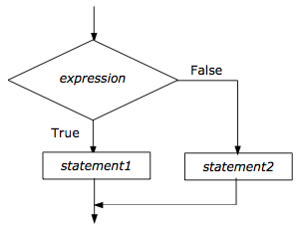
The if-else Statement
SYNTAX:
if (expression){
Statement/s;}
else {
Statement/s;}

Slide 28
Example:
Create a program that will ask for a grade from the user and display the strings “Congratulations!” and “You passed.” if the grade is greater than or equal to 50 and displays “Sorry…” and “You failed.” if otherwise.

Slide 29

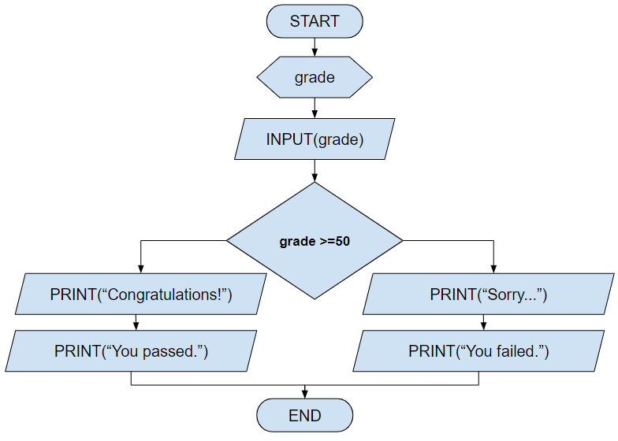
Flowchart
Create a program that will ask for a grade from the user and display the strings “Congratulations!” and “You passed.” if the grade is greater than or equal to 50 and displays “Sorry…” and “You failed.” if otherwise.
Yes
No

Slide 30

Pseudocode
Create a program that will ask for a grade from the user and display the strings “Congratulations!” and “You passed.” if the grade is greater than or equal to 50 and displays “Sorry…” and “You failed.” if otherwise.
START
INITIALIZE grade
READ grade
IF grade >= 50
WRITE ("Congratulations!")
WRITE (“You passed")
ELSE
WRITE (“Sorry…”)
WRITE ("You failed. ")
END IF
END

Slide 31

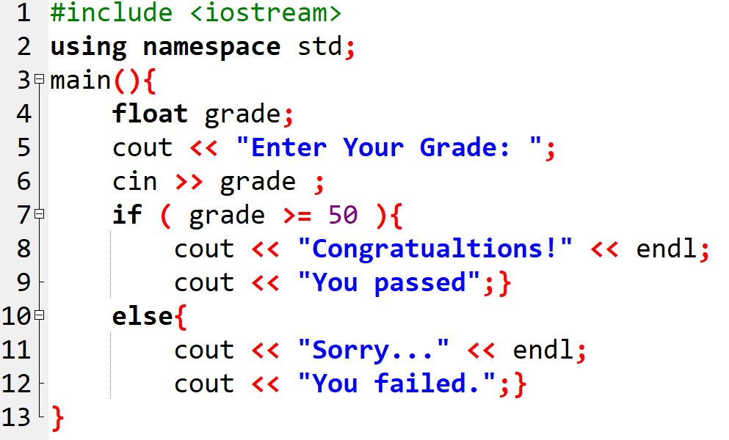
Source Code
Create a program that will ask for a grade from the user and display the strings “Congratulations!” and “You passed.” if the grade is greater than or equal to 50 and displays “Sorry…” and “You failed.” if otherwise.

Slide 32
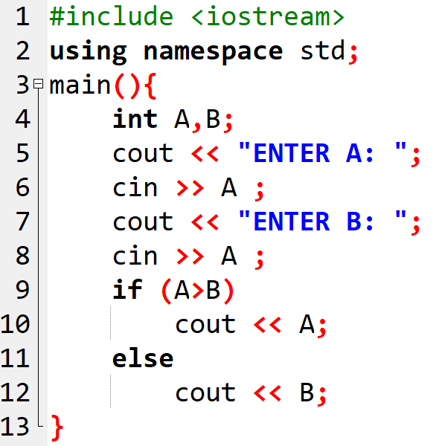
Example
START
INITIALIZE A,B
READ A,B
IF A > B
WRITE(A)
ELSE
WRITE(B)
END IF
END
B

Slide 33
More Example
Create a pseudocode that identify if a an input number is an odd or even number. Print "ODD" for odd number, print "EVEN" for even number.

Slide 34
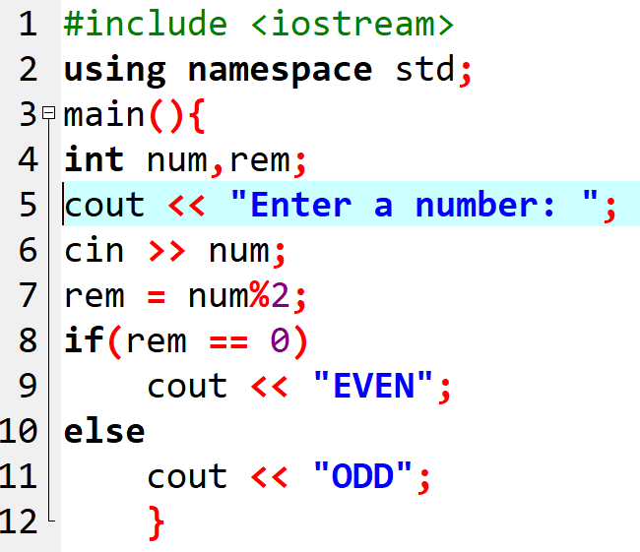
Create a pseudocode that identify if a an input number is an odd or even number. Print "ODD" for odd number, print "EVEN" for even number.
START
INITIALIZE num, rem
READ num
COMPUTE
rem := num%2
IF rem == 0
WRITE "EVEN"
ELSE
WRITE "ODD"
END IF
END

Slide 35
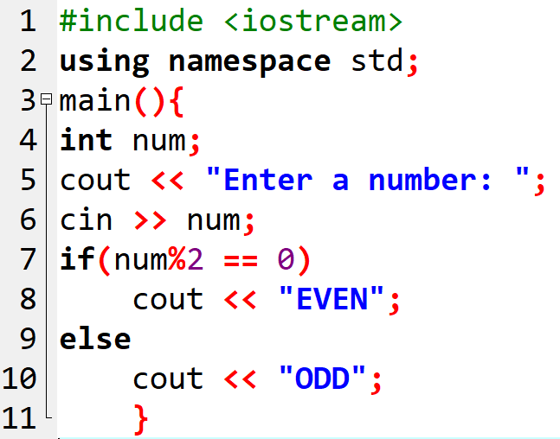
Create a pseudocode that identify if a an input number is an odd or even number. Print "ODD" for odd number, print "EVEN" for even number.
START
INITIALIZE num
READ num
IF num%2 == 0
WRITE("EVEN")
ELSE
WRITE("ODD")
END IF
END

Slide 36
Transform the given pseudocode to a source code.
START
INITIALIZE num
READ num
IF num > 0
WRITE("POSITIVE")
ELSE
WRITE("NEGATIVE")
END IF
END

Slide 37
Start solving these problems until 4:20 PM. On your computer, write a program for the following problems. Display appropriate messages for each scenario.
1. Create a program that will ask a number from the user then display the corresponding string value based on the table below:
Number String Output
1 Freshman
2 Sophomore
3 Junior
4 Senior
Other numbers Out Of Bound
2. Create a program that will determine if a number is divisible by 3.
3. Create a program that will determine if a number is a perfect square.
4. Create a program that will ask the user to enter a string. If the string input is the same with the magic word, display "You got it right...", "Try again later…” otherwise. Magic word is "ITE001A-WeGotABET".

Slide 38
Review
The Selection control structures allows one set of statement to be executed if a condition is true and another set of actions to be executed if a condition is false.

Slide 39
Review: Types of Selection Control Structures
Simple If Statement
Syntax:
if (expression)
<statement if condition is true>

Slide 40
Review: Types of Selection Control Structures
if–else Statement
Syntax:
if (expression)
<statement if condition is true>
else
<statement if condition is false>

Slide 41
Review: Types of Selection Control Structures
if-else-if-else Statement
Syntax:
if (expression)
<statement if condition is true>
else if (expression)
<statement if condition is true>
……
else
<statement if condition is false>

Slide 42
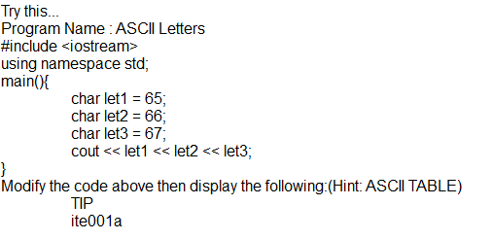

Slide 43
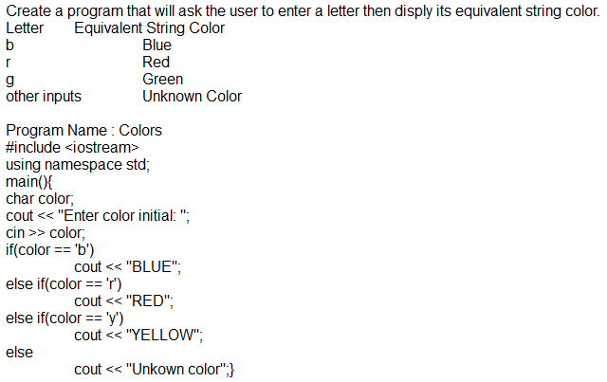

Slide 44
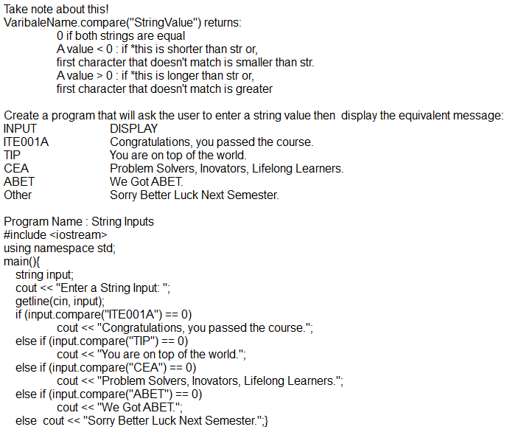

Slide 45
Nested If Statement: Syntax 1
if (expression1)
if (expression2)
statement1;

Slide 46
Nested If Statement: Syntax 2
if (expression1)
if (expression2)
statement1;
else
statement2;

Slide 47
Nested If Statement: Syntax 3
if (expression1)
if (expression2)
statement1;
else
statement2;
else
if(expression3)
statement3;
else
statement4;

Slide 48
Nested If Statement: Syntax 4
if (expression1)
statement1;
else
if(expression2)
statement2;
else
statement3;

Slide 49
Nested If Statement: Syntax 5
if (expression1)
if (expression2)
statement1;
else
if(expression3)
statement2;
else
statement3;

Slide 50
Nested If Statement: Syntax 6
if (expression1)
if (expression2)
if (expression3)
statement1;

Slide 51
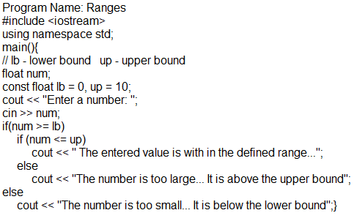

Slide 52
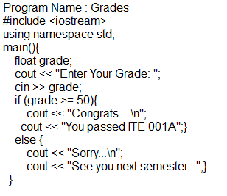

Slide 53
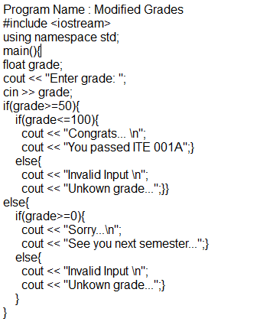

Slide 54
Using Logical Operators
Simplifies the conditional statement
Used when two or more needs to be satisfied
You can have combinations of these operators(i.e. Logical Operators) with other types of operators(i.e. Relational, Equality, Arithmetic Operators)

Slide 55
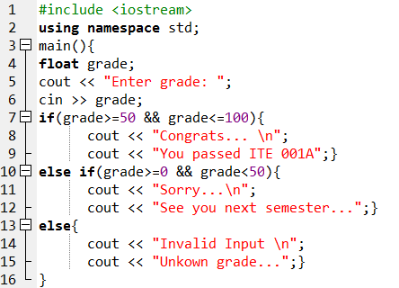
Notes:
#include <iostream>
using namespace std;
main(){
float grade;
cout << "Enter grade: ";
cin >> grade;
if(grade>=50 && grade<=100){
cout << "Congrats... \n";
cout << "You passed ITE 001A";}
else if(grade>=0 && grade<50){
cout << "Sorry...\n";
cout << "See you next semester...";}
else {
cout << "Invalid Input \n";
cout << "Unkown grade...";}
}

Slide 56
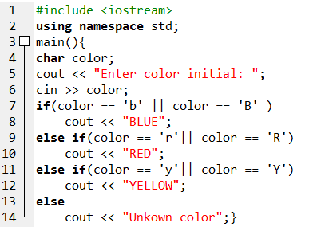
Notes:
#include <iostream>
using namespace std;
main(){
char color;
cout << "Enter color initial: ";
cin >> color;
if(color == 'b' || color == 'B' )
cout << "BLUE";
else if(color == 'r'|| color == 'R')
cout << "RED";
else if(color == 'y'|| color == 'Y')
cout << "YELLOW";
else
cout << "Unkown color";}

Slide 57
Switch Structure
It is useful if there are a lot of alternatives to choose from.
However, switch statements can only check equality relationships.

Slide 58
Switch Structure
Switch - Case
- Test variable for multiple values
- Series of case labels and optional default case
switch ( expression ) {
case value1: statement1; break;
case value2: statement2; break;
case valueN: statement3; break;
default: statement4;
}

Slide 59
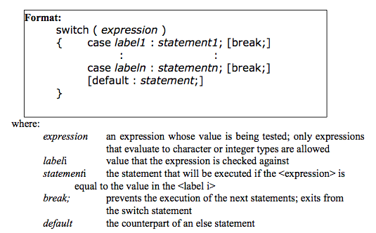
Switch Structure

Slide 60
true
case a
case a action(s)
break
false
true
case b
case b action(s)
break
false
.
.
.
true
case z
case z action(s)
break
false
default action(s)

Slide 61
Switch Structure
switch ( expression ) {
case value1: // taken if variable == value1
statements; break; // necessary to exit switch
case value2:
case value3: // taken if variable == value2 or == value3
statements; break;
default: // taken if variable matches no other cases
statements;
}

Slide 62
if-else if-else vs switch-case
  if (rank == 11)
  cout << "Jack";
  else if (rank == 12)
  cout << "Queen";
  else if (rank == 13;
  cout << "King";
  else if (rank == 1)
  cout << "Ace";
  else
  cout << rank;
switch (rank){
case 11: cout << "Jack"; break;
case 12:
cout << "Queen"; break;
case 13:
cout << "King"; break;
case 1: cout << "Ace";
break;
default: cout << rank; }

Slide 63
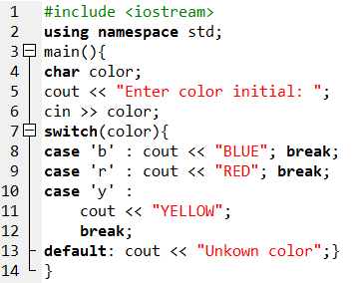
Notes:
#include <iostream>
using namespace std;
main(){
char color;
cout << "Enter color initial: ";
cin >> color;
switch(color){
case 'b' : cout << "BLUE"; break;
case 'r' : cout << "RED"; break;
case 'y' :
cout << "YELLOW";
break;
default: cout << "Unkown color";}
}

Slide 64
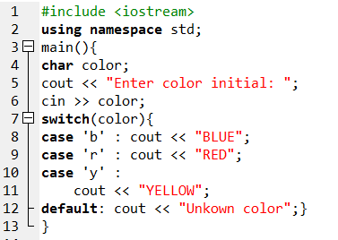
Remove all break;

Slide 65
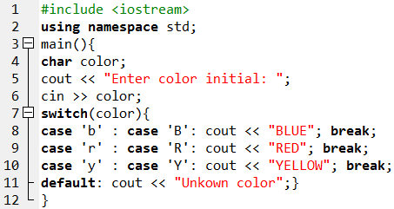
Notes:
#include <iostream>
using namespace std;
main(){
char color;
cout << "Enter color initial: ";
cin >> color;
switch(color){
case 'b' : case 'B': cout << "BLUE"; break;
case 'r' : case 'R': cout << "RED"; break;
case 'y' : case 'Y': cout << "YELLOW"; break;
default: cout << "Unkown color";}
}

Slide 66
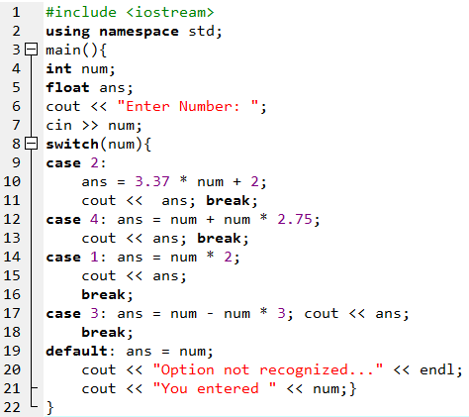
Notes:
#include <iostream>
using namespace std;
main(){
int num;
float ans;
cout << "Enter Number: ";
cin >> num;
switch(num){
case 2:
ans = 3.37 * num + 2;
cout << ans; break;
case 4: ans = num + num * 2.75;
cout << ans; break;
case 1: ans = num * 2;
cout << ans;
break;
case 3: ans = num - num * 3; cout << ans;
break;
default: ans = num;
cout << "Option not recognized..." << endl;
cout << "You entered " << num;}
}

Slide 67
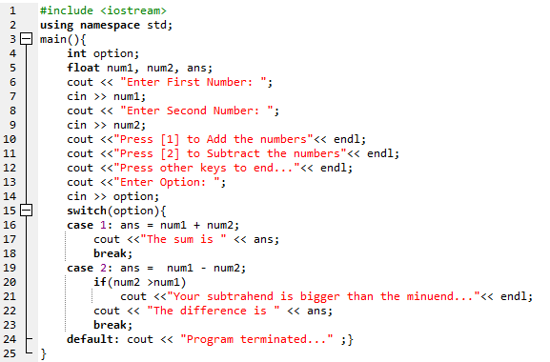
Notes:
#include <iostream>
using namespace std;
main(){
int option;
float num1, num2, ans;
cout << "Enter First Number: ";
cin >> num1;
cout << "Enter Second Number: ";
cin >> num2;
cout <<"Press [1] to Add the numbers"<< endl;
cout <<"Press [2] to Subtract the numbers"<< endl;
cout <<"Press other keys to end..."<< endl;
cout <<"Enter Option: ";
cin >> option;
switch(option){
case 1: ans = num1 + num2;
cout <<"The sum is " << ans;
break;
case 2: ans = num1 - num2;
if(num2 >num1)
cout <<"Your subtrahend is bigger than the minuend..."<< endl;
cout << "The difference is " << ans;
break;
default: cout << "Program terminated..." ;}
}

Slide 68
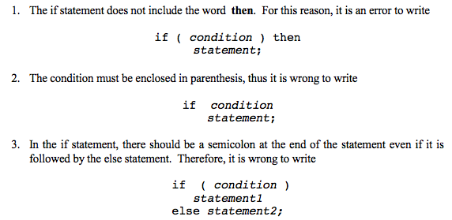
Common Programming Errors

Slide 69
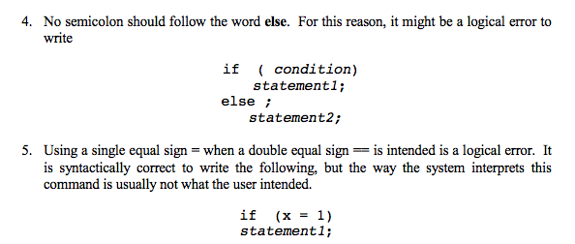
Common Programming Errors

Slide 70
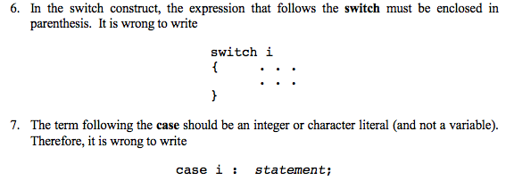
Common Programming Errors

