Slide 2
Switch Structure
It is useful if there are a lot of alternatives to choose from.
However, switch statements can only check equality relationships.

Slide 3
Switch Structure
Switch - Case
- Test variable for multiple values
- Series of case labels and optional default case
switch ( expression ) { case value1: statement1; break;
case value2: statement2; break;
case valueN: statement3; break;
default: statement4;
}

Slide 4
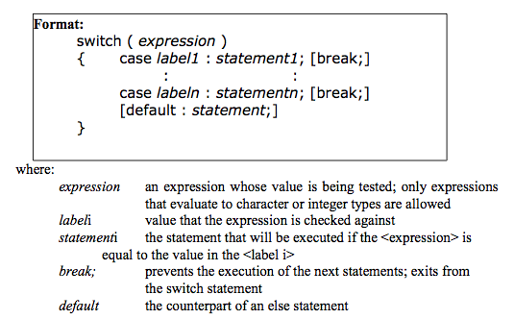
Switch Structure

Slide 5
true
case a
case a action(s)
break
false
true
case b
case b action(s)
break
false
.
.
.
true
case z
case z action(s)
break
false
default action(s)

Slide 6
Switch Structure
switch ( expression ) { case value1: // taken if variable == value1
statements; break; // necessary to exit switch
case value2:
case value3: // taken if variable == value2 or == value3
statements; break;
default: // taken if variable matches no other cases
statements;
}

Slide 7
if-else if-else vs switch-case
if (rank == 11)
cout << "Jack";
else if (rank == 12)
cout << "Queen";
else if (rank == 13;
cout << "King";
else if (rank == 1)
cout << "Ace";
else
cout << rank;
switch (rank){
case 11: cout << "Jack"; break;
case 12:
cout << "Queen"; break;
case 13:
cout << "King"; break;
case 1: cout << "Ace";
break;
default: cout << rank; }

Slide 8
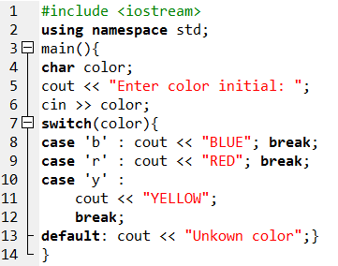
Notes:
#include <iostream>
using namespace std;
main(){
char color;
cout << "Enter color initial: ";
cin >> color;
switch(color){
case 'b' : cout << "BLUE"; break;
case 'r' : cout << "RED"; break;
case 'y' :
cout << "YELLOW";
break;
default: cout << "Unkown color";}
}

Slide 9
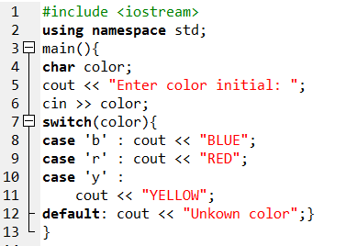
Remove all break;

Slide 10
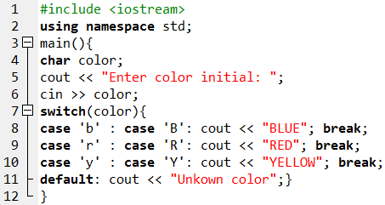
Notes:
#include <iostream>
using namespace std;
main(){
char color;
cout << "Enter color initial: ";
cin >> color;
switch(color){
case 'b' : case 'B': cout << "BLUE"; break;
case 'r' : case 'R': cout << "RED"; break;
case 'y' : case 'Y': cout << "YELLOW"; break;
default: cout << "Unkown color";}
}

Slide 11
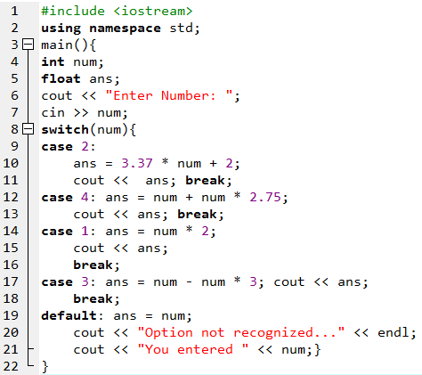
Notes:
#include <iostream>
using namespace std;
main(){
int num;
float ans;
cout << "Enter Number: ";
cin >> num;
switch(num){
case 2:
ans = 3.37 * num + 2;
cout << ans; break;
case 4: ans = num + num * 2.75;
cout << ans; break;
case 1: ans = num * 2;
cout << ans;
break;
case 3: ans = num - num * 3; cout << ans;
break;
default: ans = num;
cout << "Option not recognized..." << endl;
cout << "You entered " << num;}
}

Slide 12
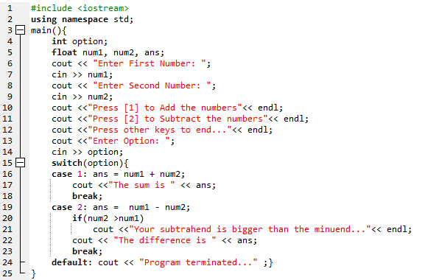
Notes:
#include <iostream>
using namespace std;
main(){
int option;
float num1, num2, ans;
cout << "Enter First Number: ";
cin >> num1;
cout << "Enter Second Number: ";
cin >> num2;
cout <<"Press [1] to Add the numbers"<< endl;
cout <<"Press [2] to Subtract the numbers"<< endl;
cout <<"Press other keys to end..."<< endl;
cout <<"Enter Option: ";
cin >> option;
switch(option){
case 1: ans = num1 + num2;
cout <<"The sum is " << ans;
break;
case 2: ans = num1 - num2;
if(num2 >num1)
cout <<"Your subtrahend is bigger than the minuend..."<< endl;
cout << "The difference is " << ans;
break;
default: cout << "Program terminated..." ;}
}

Slide 13
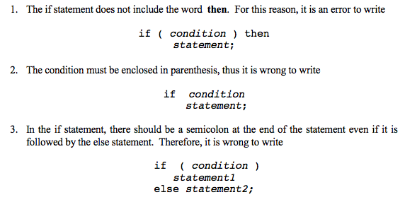
Common Programming Errors

Slide 14
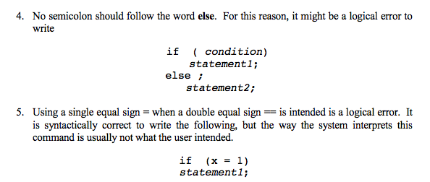
Common Programming Errors

Slide 15
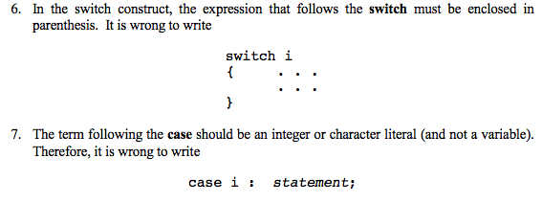
Common Programming Errors

