Slide 1

Introducing the World Wide Web
OBJECTIVES :
Explore the structure of the World Wide Web
Learn the basic principles of Web documents
Create a HTML document
View an HTML file using a Web browser
Use HTML tags for text, headings, paragraphs, and lists
Insert character tags into an HTML document
Insert an inline graphic image into a HTML document
Add special characters to an HTML document
Insert horizontal lines into an HTML document
PRELIM

Slide 2
Introducing the World Wide Web
In order for computers to share resources efficiently, they can be linked together in one of the following structured networks:
  linked within a local area network (LAN)
  linked across a wide area network (WAN)
Networks are very useful, their use led to a “network of networks” called the Internet.
PRELIM

Slide 3
The Internet
The Internet consists of millions of interconnected computers that enable users to communicate and share information.
Many Internet tools required users to master an array of terms, acronyms, and commands before they could navigate the Internet.
The World Wide Web was developed to make the Internet easier to use and give quick access to users.
PRELIM

Slide 4
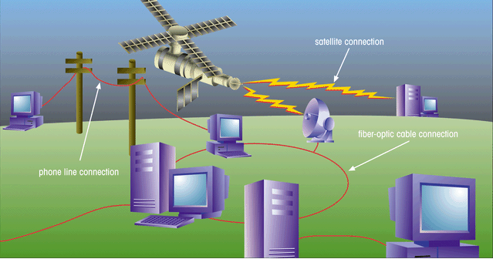
Structure of the Internet
This figure shows the physical structure of the Internet, which uses fiber-optic cables, satellites, phone lines, and other telecommunications media to send data back and forth.
PRELIM

Slide 5
The Development of the
World Wide Web
In 1989, Timothy Berners-Lee and other researchers at the CERN nuclear research facility, laid the foundation of the World Wide Web, or the Web.
  created an information system that would make it easy for researchers to locate and share data
  required minimal training and support
  developed a system of hypertext documents, electronic files that contain elements that you can easily select
PRELIM

Slide 6
Hypertext Documents
Hypertext offers a better way of locating information.
When you read a book, you follow a linear progression, reading one page after another.
With hypertext, you progress through pages in whatever way is best suited to you and your objectives.
Hypertext lets you skip from one topic to another.
PRELIM

Slide 7
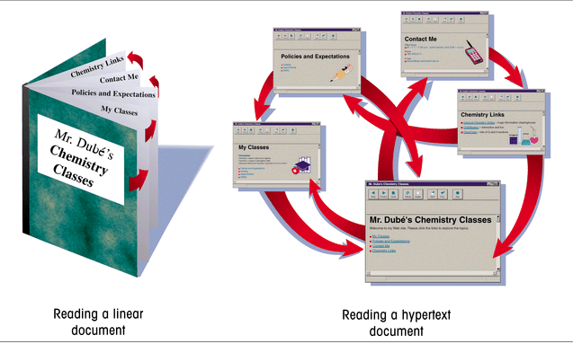
Linear Versus Hypertext Documents
This figure shows how topics can be related in a hypertext fashion,as opposed to a linear fashion.
PRELIM

Slide 8
Hypertext Documents Continued
The key to hypertext is the use of links, which you activate to move from one topic to another.
  a link can open a document on a computer anywhere in the world
Hypertext has become the dominate method of sharing and retrieving information on the Internet, becoming known as the World Wide Web, or the Web.
Documents on the Web are known as Web pages.
PRELIM

Slide 9
Web Pages and Web Browsers
A Web page is stored on a Web server, which makes the page available to users of the Web.
To view a Web page, the user runs a Web browser, a software program that retrieves the page and displays it.
A Web browser can either be text-based, or graphical.
PRELIM

Slide 10
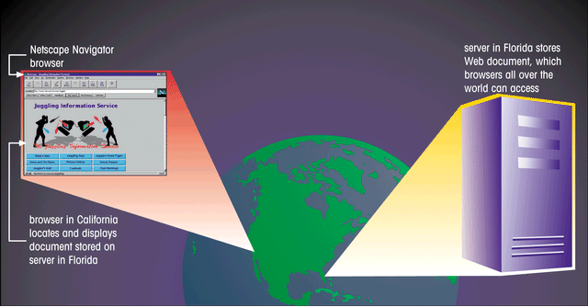
Using a Browser to View a Web Document on a Server
This figure shows to view web pages, the user runs a Web browser,
a software program that retrieves the page and displays it.
PRELIM

Slide 11
Internet Explorer and Netscape
The most common Web browsers available today are:
  Microsoft Internet Explorer
  Netscape Navigator
  Mozilla Firefox
PRELIM

Slide 12

Web Page with Interesting Fonts, Graphics, and Layout
This figure shows a Web page is not only a source of information, it can also be a work of art.
graphic image
links
interesting fonts
The Web designer has a great deal of control over the format of the page.
PRELIM

Slide 13
HTML: The Language of the Web
Web pages are text files, written in a language called Hypertext Markup Language or HTML.
A markup language is a language used to describe the contact and format of documents.
HTML was developed from the Standard Generalized Markup Language (SGML), a language used for large-scale documents.
SGML proved to be cumbersome and difficult, thus HTML was created.
PRELIM

Slide 14
Hypertext Markup Language (HTML)
HTML allows Web authors to create documents that can be displayed across different operating systems.
HTML code is easy to use, that even nonprogrammers can learn to use it.
HTML describes the format of Web pages through the use of tags.
  it’s the job of the Web browser to interpret these tags and render the text accordingly
PRELIM

Slide 15
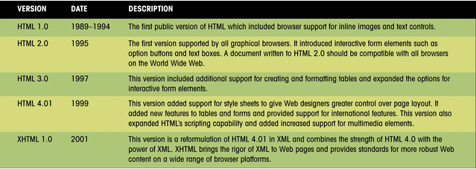
Versions of HTML
This figure presents a history of the various versions of HTML that have been released by the World Wide Web Consortium (W3C).
PRELIM

Slide 16
Hypertext Markup
Language (HTML) Continued
HTML has a set of rules, called syntax.
  syntax are a set of standards or specifications developed by a consortium of Web developers, programmers, and authors called the World Wide Web Consortium (WC3)
HTML extensions have been added to support new features, which have been adopted in subsequent sets of standards released by the W3C.
  these extensions have provided Web page authors with more options
PRELIM

Slide 17
Web Development
Web designers need to determine which browsers and browser versions support their web pages.
In the future, Web development is focusing more on XML (Extensible Markup Language) and XHTML (Extensible HyperText Markup Language) for developing document content.
PRELIM

Slide 18
Tools for Creating HTML Documents
HTML documents are text files, which a text editor such as Windows NotePad can be used to create.
You can also use an HTML converter or an HTML editor.
  an HTML converter like Microsoft Word takes text in one format and converts it to HTML code
  an HTML editor helps you create an HTML file by inserting HTML codes for you as you work
PRELIM

Slide 19
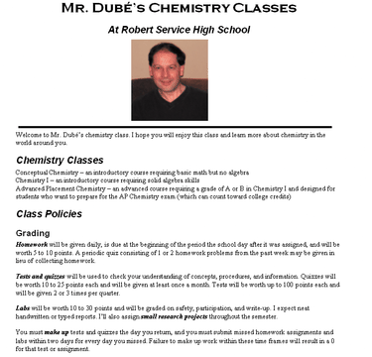
Creating an HTML Document
It’s always a good idea to plan the appearance of your Web page before you start writing code.
heading 1
image
horizontal line
paragraph
list
heading 3
bold and italic text
PRELIM

Slide 20
HTML Syntax
Document content is what the users sees on the page, such as headings and images.
Tags are the HTML codes that control the appearance of the document content.
  tag is the name of the HTML tag
  attributes are properties of the tag
  document content is actual content that appears in the Web page
PRELIM

Slide 21
HTML Tags
Tags can be one-sided or two-sided.
  two-sided tags contain an opening tag <b> that tells the browser to turn on a feature and apply it to the contact that follows, and a closing tag </b> that turns off the feature
  one-sided tags are used to insert noncharacter data into the Web page, such as a graphic image or video clip <tag attribute>
Tags are not case sensitive. The current standard is to display all tags in lowercase letters.
PRELIM

Slide 22
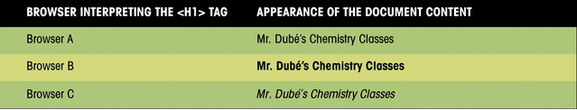
Interpretation of the <H1> tag by Different Browsers
This figure shows how three different browsers might interpret a line of HTML code.
PRELIM

Slide 23
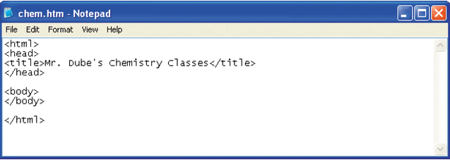
Initial HTML Tags in Notepad
Your text editor may not display the file extension in the title bar. This is okay.
<html> tag indicates that this file is written in HTML
<title> tag contains
the Web page title
Page content will
go between the
<body> tags
<head> tag contains information about the Web page
PRELIM

Slide 24
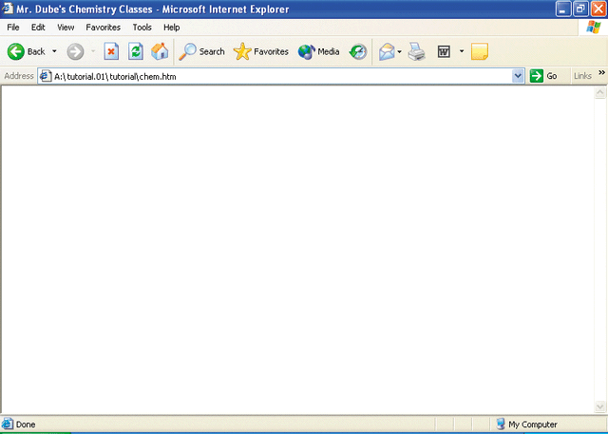
The Initial HTML File in
Internet Explorer
the title you entered between the <title> tags
address box indicates the name and location of the HTML file
You should occasionally view the formatted page with different Web browsers to check compatibility, verify that there are no syntax errors, or other problems.
page content will appear here
PRELIM

Slide 25
Creating Heading Tags
HTML supports six levels of headings, numbered <h1> through <h6>, with <h1> being the largest and most prominent.
Headings are always displayed in a bold font.
PRELIM

Slide 26
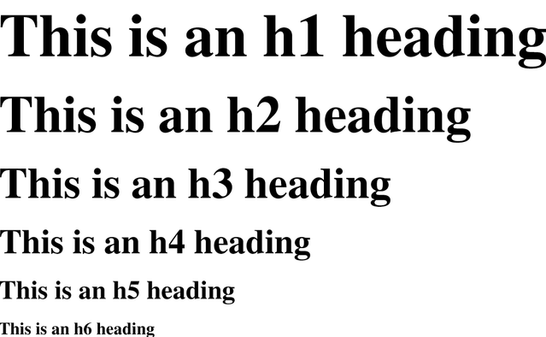
Six Heading Levels
This figure illustrates the general appearance of the six heading styles. Your browser might use slightly different fonts and sizes.
PRELIM

Slide 27
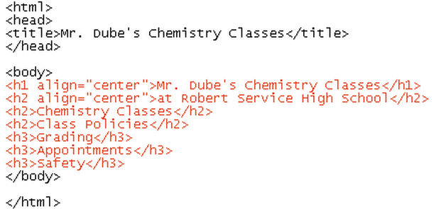
Entering Heading Tags and Text
heading tags
As of HTML 3.2, the heading tag can contain additional attributes, one of which is the alignment attribute.
PRELIM

Slide 28
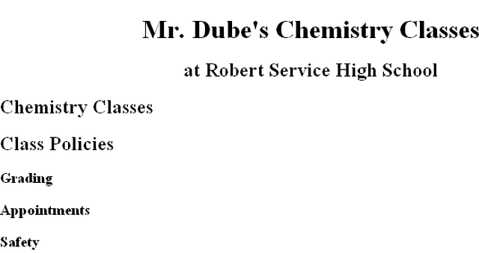
Headings As They Appear in the Browser
<h1>
<h2>
<h3>
PRELIM

Slide 29
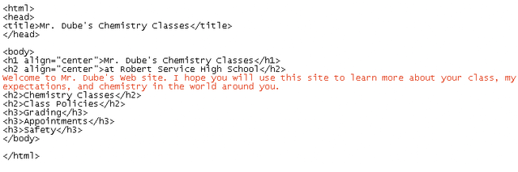
Entering Paragraph Text
If you are using a test editor like NotePad, the text might not wrap to the next line automatically.
Selecting the Word Wrap command within NotePad will allow you to see all the text on your screen.
PRELIM

Slide 30
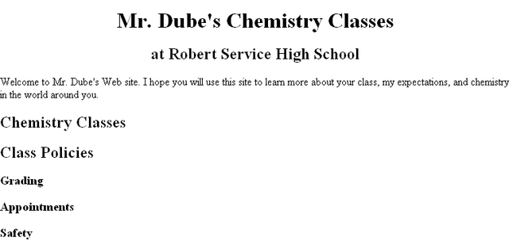
Paragraph Text in the Browser
PRELIM

Slide 31
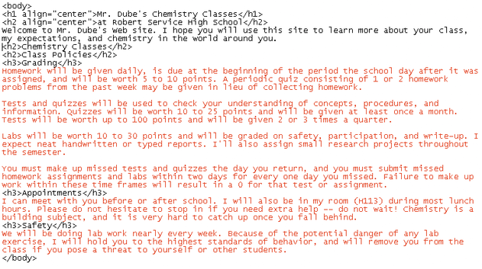
Adding Paragraphs
adding
paragraphs
PRELIM

Slide 32
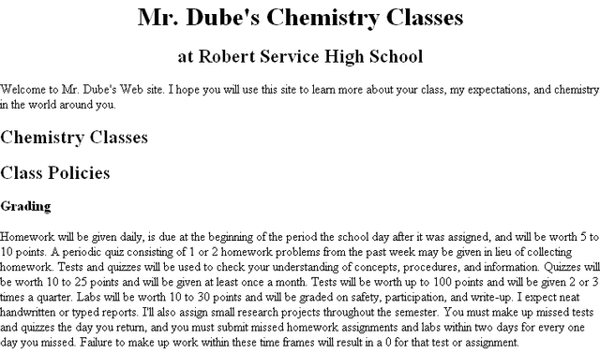
The Paragraphs Displayed by the Browser
Remember: HTML formats text only through the use of tags and ignores such things as extra blank spaces, blank lines, or tabs.
four grading
paragraphs are not
separated
PRELIM

Slide 33
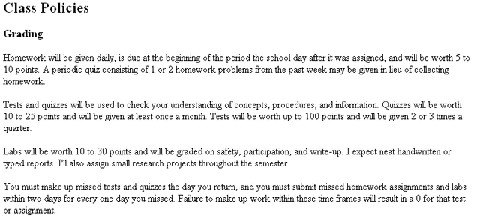
The Grading Text Separated into Paragraphs
To add space between paragraphs, you use the paragraph tag <p>.
text is now separated into four paragraphs
PRELIM

Slide 34
Creating Lists
HTML supports three kinds of lists:
  an ordered list, which is used to display information in a numeric order
  an unordered list, which list items are not listed in a particular order i.e. bullets
  a definition list, which is a list of terms, each followed by a definition line that is typically indented slightly to the right
PRELIM

Slide 35
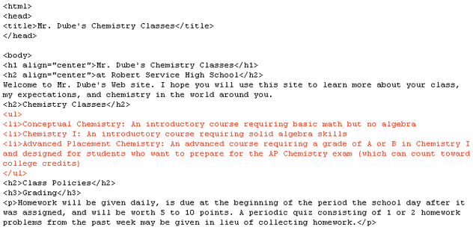
Entering an Unordered List
<ul> unordered
list tag
<li> list item tag
PRELIM

Slide 36
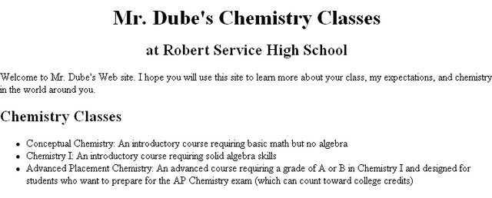
The Unordered List in the Browser
An unordered list is a bulleted list.
unordered
list
PRELIM

Slide 37
Creating Character Tags
HTML also lets you format individual characters.
A tag that you apply to an individual character is called a character tag. There are two types of character tags:
  logical character tag
  physical character tag
PRELIM

Slide 38
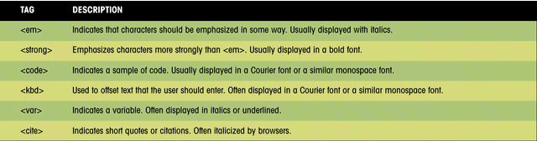
Common Logical Character Tags
This figure lists some common logical character tags.
PRELIM

Slide 39
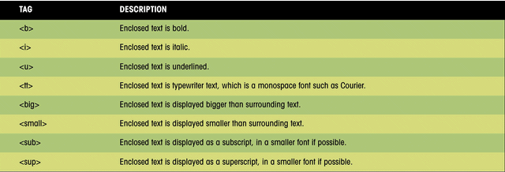
Common Physical Character Tags
This figure shows examples of how these tags can be displayed in a browser.
PRELIM

Slide 40
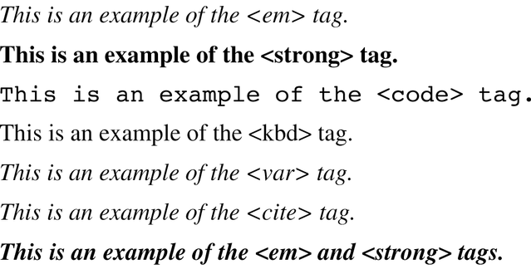
Logical Character Tags as They Appear in the Browser
examples of individual tags
example of combined tags
PRELIM

Slide 41
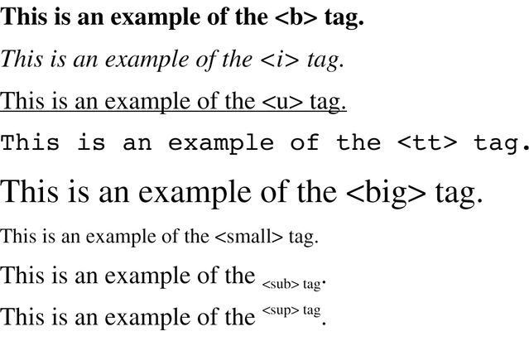
Physical Character Tags as They Appear in the Browser
Underline text can sometimes be confused with hyperlinked text (which is usually underlined), and for that reason, use of the <u> tag is discouraged.
PRELIM

Slide 42
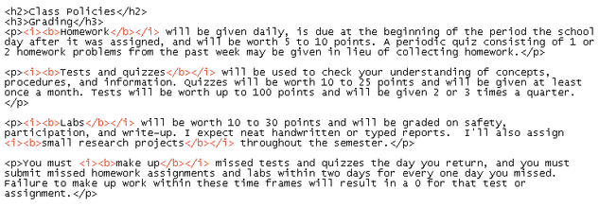
Applying Character Tags
Italic <i> </i>
and bold
<b> </b>
character tags
If you support users with older browsers, you should use a logical tag. Otherwise, use physical tags, which are more common and easier to interpret.
PRELIM

Slide 43
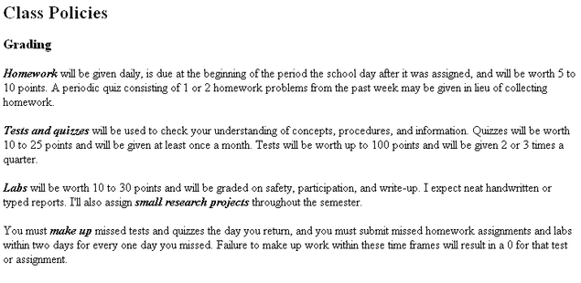
The Effect of the Character Tags in the Browser
text formatted with bold and italic
PRELIM

Slide 44
Inserting a Graphic
Images can be displayed in two ways: as inline images or as external images.
  an inline image displays directly on the Web page and is displayed when the page is accessed by a user
  an inline image can be placed on a separate line in your HTML code, or it can be placed directly within a line of text
  inline images should be in one of two file formats: GIF (Graphics Interchange Format) or JPEG (Joint Photographic Experts Group)
PRELIM

Slide 45
Inserting a Graphic Continued
  an external image is not displayed with the Web page, the browser must have a file viewer, which is a separate program that the browser launches when it encounters an external image file
  external images are represented by an icon that a user clicks to view the image
  external images are not limited to GIF or JPEG formats
PRELIM

Slide 46

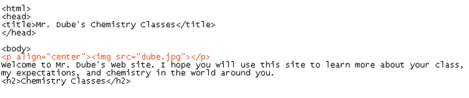
Inserting a Graphic
Image file
dube.jpg
use the <p> tag so you can center the image
PRELIM

Slide 47
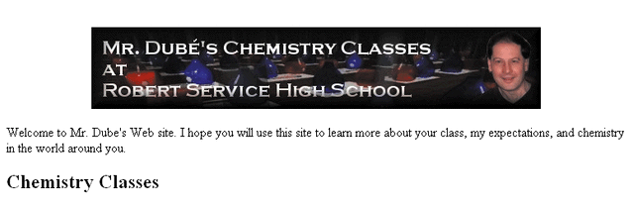
The Image File as it Appears in the Browser
PRELIM

Slide 48
Special Characters
Occasionally you will want to include entities or special characters in your Web page that do not appear on your keyboard. For example:
  registered trademark symbol ®
  copyright symbol ©
HTML supports the use of character symbols that are identified by a code number or name.
PRELIM

Slide 49
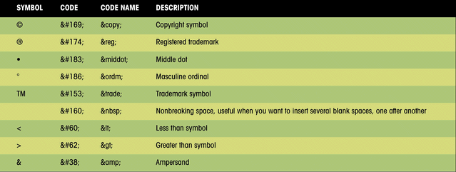
Special Characters and Codes
This figure shows some HTML symbols and the corresponding code numbers or names.
PRELIM

Slide 50
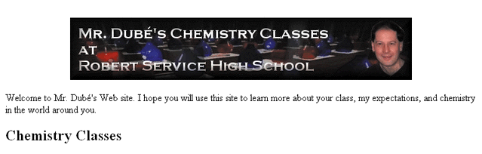
Special Characters in the Browser
This figure shows an example of the code “Welcome to Mr. Dub&#233’s
Web site”, which accented the é in his last name..
accented é added
to last name
PRELIM

Slide 51
Inserting Horizontal Lines
A horizontal line can improve the appearance of a Web page.
The syntax for creating a horizontal line is:
  <hr align=“align” size=“size” width=“width” color=“color” noshade>
PRELIM

Slide 52
Inserting Horizontal Lines
The HTML horizontal syntax includes the following:
  align specifies the horizontal alignment of the line on the page (center, left, or right)
  size specifies the height of the line in pixels or percentage of the screen width
  width indicates the width of the line in pixels or percentage of the screen width
  color indicates the color of the line
  noshade specifies that the browser display a solid line
PRELIM

Slide 53
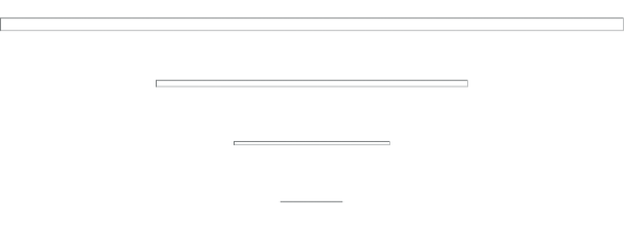
Different Line Styles
size=12
width-100%
<hr align=“center” size=“12” width=“100%”>
<hr align=“center” size=“6” width=“50%”>
size=6
width-50%
<hr align=“center” size=“3” width=“25%”>
size=3
width-25%
size=1
width-10%
<hr align=“center” size=“1” width=“10%”>
You can use line styles to improve the appearance of your Web page.
PRELIM

Slide 54
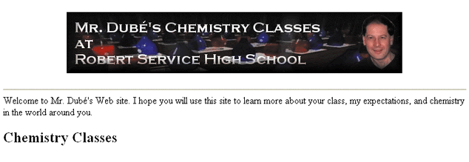
Horizontal Line Added to the Page
horizontal line
PRELIM

Slide 55
Unit 1 Summary
Learned about the history and structure of the World Wide Web.
Introduced the basic principles of Web documents and about the HTML language.
Learned how to create a Web page using basic layout tags.
Learned how to create paragraphs, headings and lists (both ordered and unordered).
Worked with character tags and special characters.
Introduced to working with graphics by creating a horizontal line and an inline graphic image.
PRELIM

