Slide 1




Numpy

Slide 2
What is Numpy?
NumPy is the fundamental package needed for scientific computing with Python.
It contains:
a powerful N-dimensional array object
basic linear algebra functions
basic Fourier transforms
sophisticated random number capabilities
tools for integrating Fortran code
tools for integrating C/C++ code
Page 01

Slide 3
What is Numpy?
Lists ok for storing small amounts of one-dimensional data
>>> a = [1,3,5,7,9]
>>> print(a[2:4])
[5, 7]
>>> b = [[1, 3, 5, 7, 9], [2, 4, 6, 8, 10]]
>>> print(b[0])
[1, 3, 5, 7, 9]
>>> print(b[1][2:4])
[6, 8]
>>> a = [1,3,5,7,9]
>>> b = [3,5,6,7,9]
>>> c = a + b
>>> print c
[1, 3, 5, 7, 9, 3, 5, 6, 7, 9]
But, can’t use directly with arithmetic operators (+, -, *, /, …)
Need efﬁcient arrays with arithmetic and better multidimensional tools
Page 02

Slide 4
Why Numpy?
Size – NumPy data structures take up less space
Performance – Faster than lists
Functionality – SciPy and NumPy have optimized functions such as linear algebra operations built in
Page 03

Slide 5
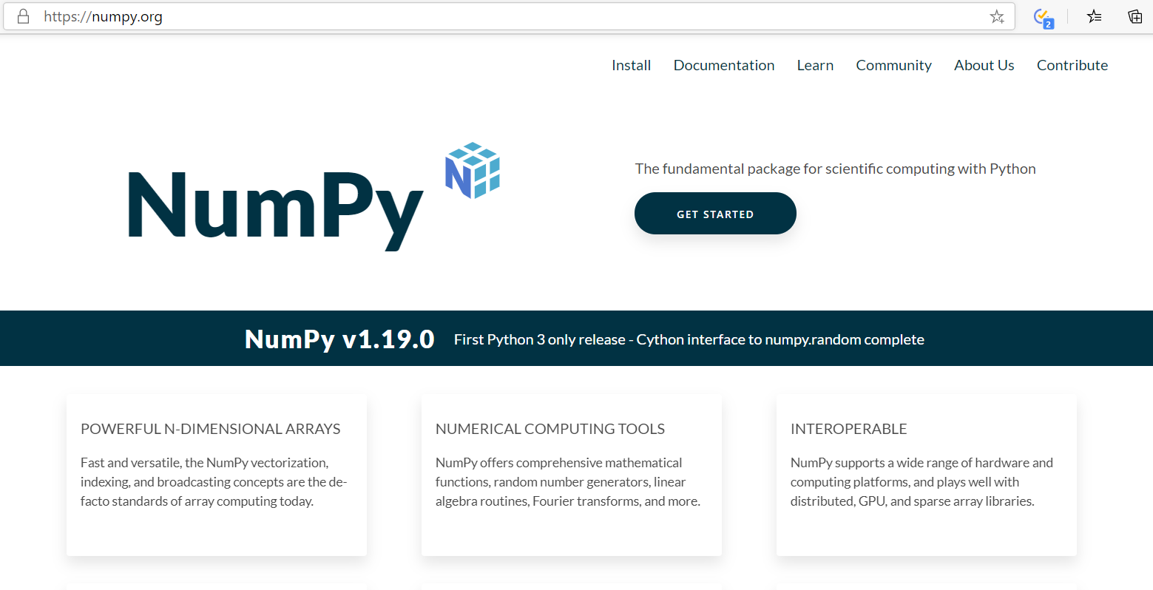
Content
Page 04

Slide 6
Numpy Ecosystem
OpenCV
PySAL
numexpr
astropy
PyTables
statsmodels
BioPython
Scikit-image
Scikit-learn
Numba
Scipy
Pandas
Matplotlib
NumPy
Page 05

Slide 7
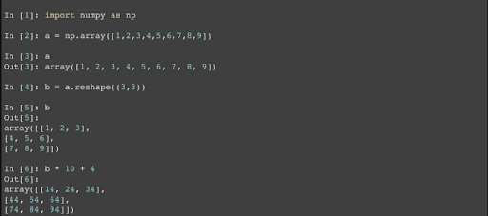
Quick Start
Page 06

Slide 8
Array Shape
One dimensional arrays have a 1-tuple for their shape
1 | 2 | 3 | 4 | 5 | 6 | 7 | 8
Shape: (8,)
Page 07

Slide 9
Array Shape
2 dimensional arrays
1 | 2 | 3 | 4
5 | 6 | 7 | 8
9 | 10 | 11 | 12
Shape: (3, 4)
Page 08

Slide 10
Array Shape
And so on…
1 | 2 | 3 | 4
5 | 6 | 7 | 8
9 | 10 | 11 | 12
1 | 2 | 3 | 4
5 | 6 | 7 | 8
1 | 2 | 3 | 4
5 | 6 | 7 | 8
1 | 2 | 3 | 4
5 | 6 | 7 | 8
Shape: (3, 4, 4)
Page 09

Slide 11

Quiz Session
Page 10

Slide 12
Quiz
What is output from this code :
import numpy as np
a = np.arange(15).reshape(3, 5)
print(a)
Page 11

Slide 13

Terima Kasih!
Indonesia AI | AI for Everyone, AI for Indonesia
contact@aiforindonesia.org

