Slide 1




Matplotlib

Slide 2

What is Matplotlib?
Matplotlib is a comprehensive library for creating static, animated, and interactive visualizations in Python.
Page 01

Slide 3
What is Matplotlib?
It has a module named pyplot that makes things easy for plotting by providing feature to control line styles, font properties, formatting axis, etc
It support a wide variety of graph and plot, such as histogram, bar chart, power spectra, error chart, etc
Page 02

Slide 4

Quiz Session
Page 03

Slide 5
Quiz
What command is used to import the Matplotlib library..?
Page 04

Slide 6
Why Data Visualization is Important
Human brain naturally understand information much easier and faster when in it is visualize properly.
Page 05

Slide 7
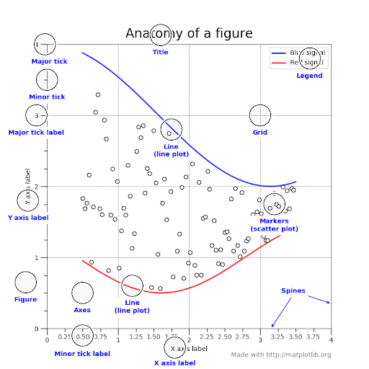
Anatomy of Figure
Page 06

Slide 8
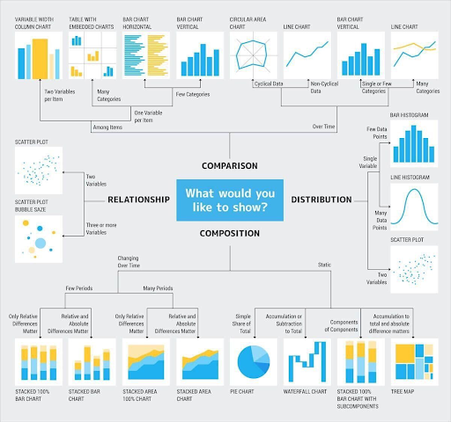
Chart Suggestions
Page 07

Slide 9
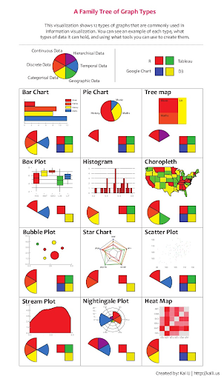
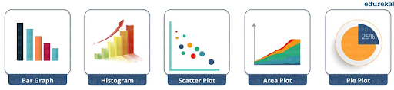
Chart
Page 08

Slide 10
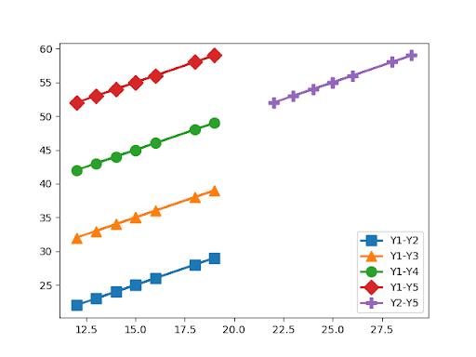
Format Strings
A format string consists of a part for color, marker and line:
fmt = '[marker][line][color]'
Page 09

Slide 11
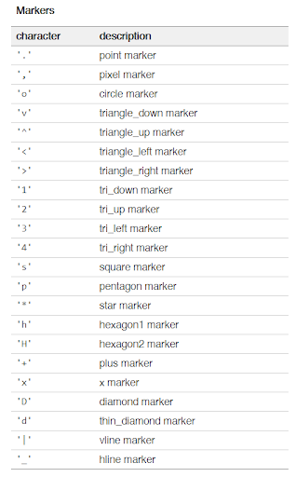
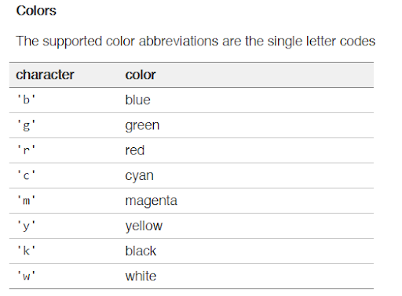
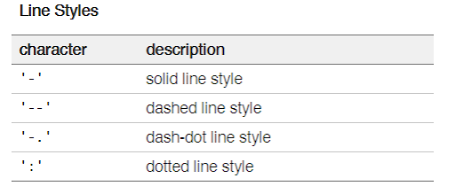
Format Strings
If the color is the only part of the format string, you can additionally use any matplotlib.colors spec, e.g. full names ('green') or hex strings ('#008000').
Page 10

Slide 12
Quiz Session
Page 11

Slide 13
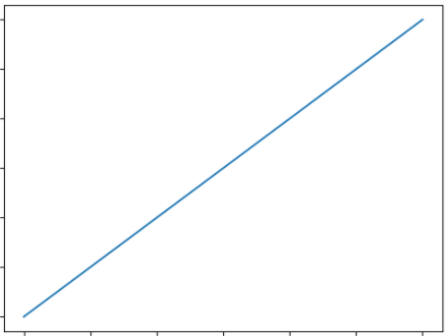
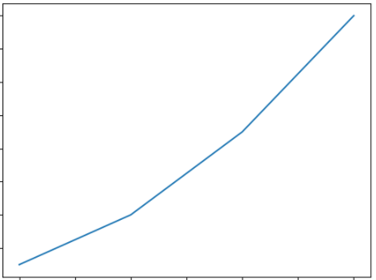
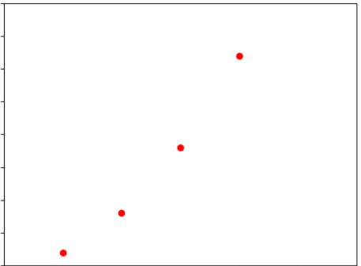
Quiz
What is output graft from this code ?
import matplotlib.pyplot as plt
plt.plot([1, 2, 3, 4])
plt.ylabel('some numbers')
plt.show()
A
B
C
Page 12

Slide 14

Terima Kasih!
Indonesia AI | AI for Everyone, AI for Indonesia
contact@aiforindonesia.org

