Slide 1




Pandas

Slide 2
What is Pandas?
Pandas is a fast, powerful, flexible and easy to use open source data analysis and manipulation tool, built on top of the Python programming language.
Page 01

Slide 3
Key Features
Fast and efficient DataFrame object with default and customized indexing
Tools for loading data into in-memory data objects from different file formats
Data alignment and integrated handling of missing data
Reshaping and pivoting of date sets
Label-based slicing, indexing and subsetting of large data sets
Columns from a data structure can be deleted or inserted
Group by data for aggregation and transformations
High performance merging and joining of data
Page 02

Slide 4
Essential Concept
Series
Series is a one-dimensional array like structure with homogeneous data. For example, the following series is a collection of integers 10, 23, 56, …
Homogeneous data
Size Immutable
Values of Data Mutable
Page 03

Slide 5
Essential Concept
DataFrame
DataFrame is a two-dimensional array with heterogeneous data.
Heterogeneous data
Size Mutable
Data Mutable
Page 04

Slide 6
What We Will Learn?
Data loading
Selecting/Indexing
Filtering
Sorting
Mutating/conditionally adding columns
Groupby/summarize
Page 05

Slide 7

Quiz Session
Page 06

Slide 8
Quiz
What is a correct syntax to create a Pandas Series from a Python list?
pd.getSeries(myseries)
pd.series(myseries)
pd.createSeries(myseries)
Page 07

Slide 9
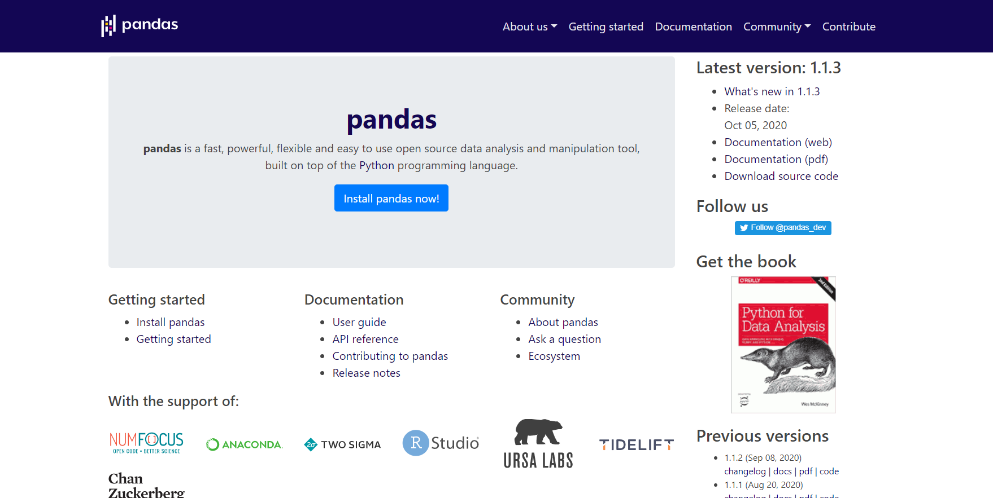
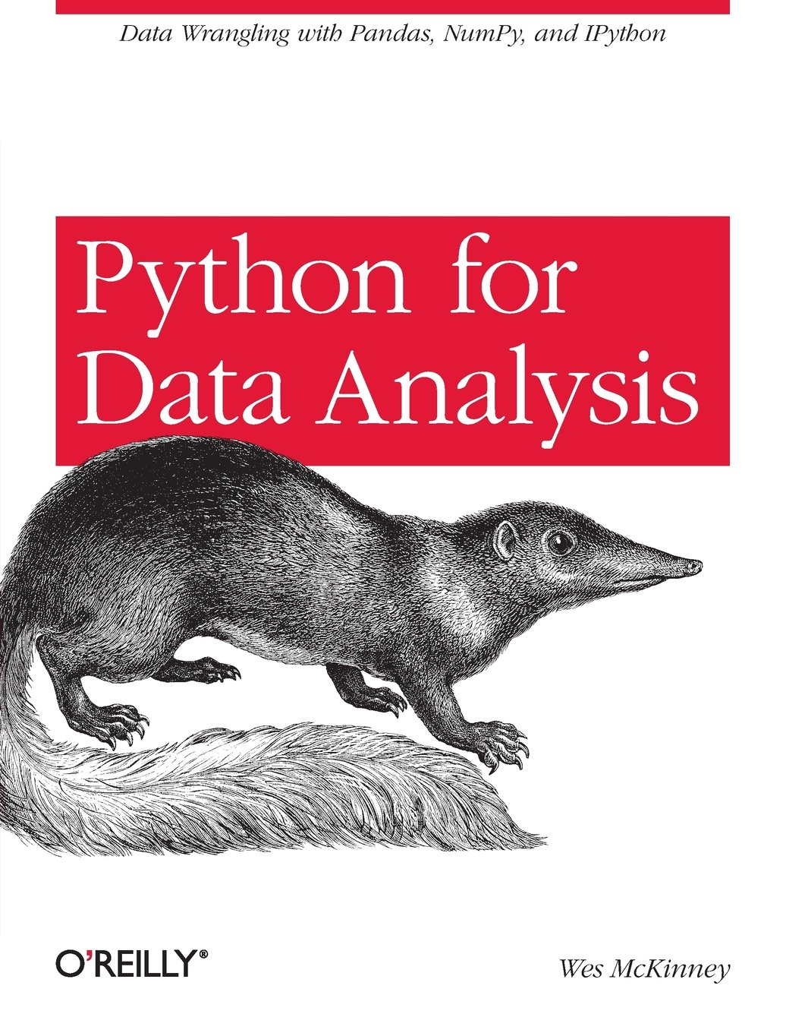
Resources
Python for Data Analysis
(Wes McKinney)
Page 08

Slide 10
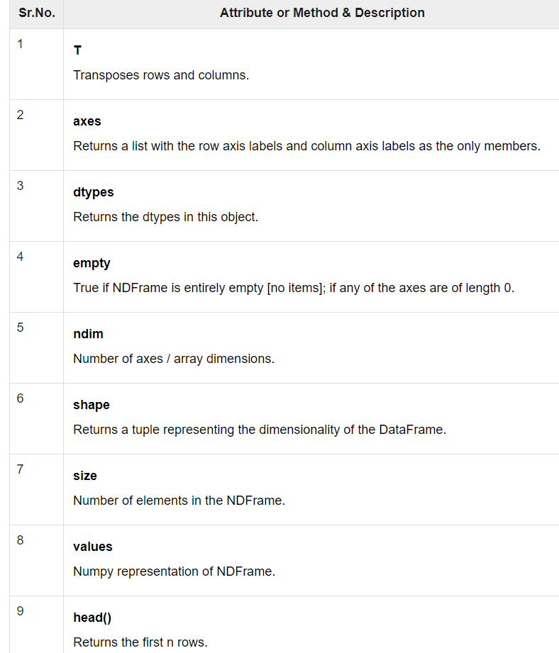
DataFrame - Basic Functionality
Let’s get started!
Page 09

Slide 11
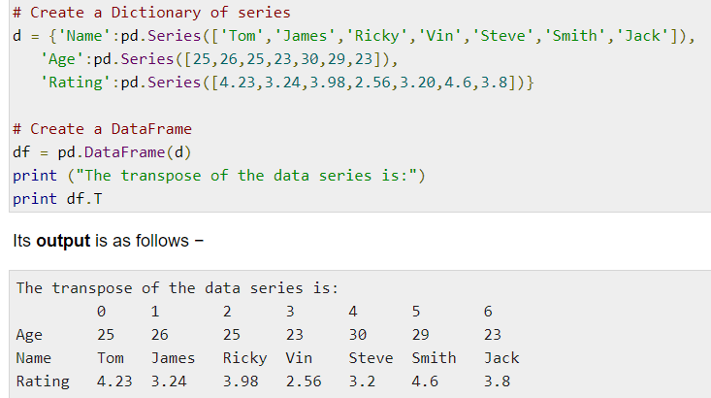
DataFrame - T (Transpose)
Returns the transpose of the DataFrame. The rows and columns will interchange.
Page 10

Slide 12
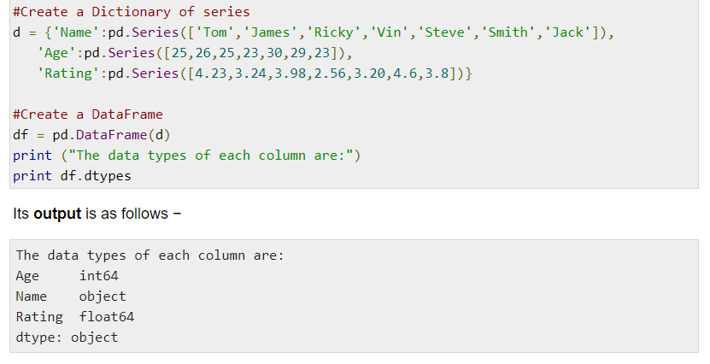
DataFrame - dtypes
Returns the data type of each column.
Page 11

Slide 13
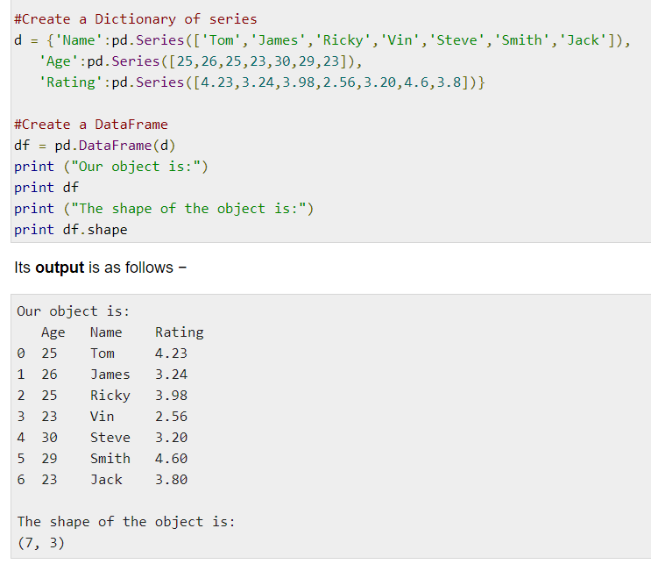
DataFrame - shape
Returns a tuple representing the dimensionality of the DataFrame. Tuple (a,b), where a represents the number of rows and b represents the number of columns.
Page 12

Slide 14
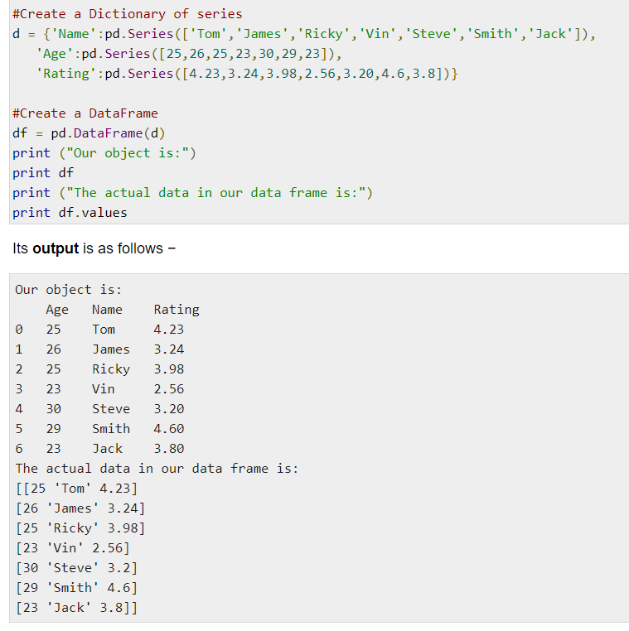
DataFrame - values
Returns the actual data in the DataFrame as an NDarray.
Page 13

Slide 15
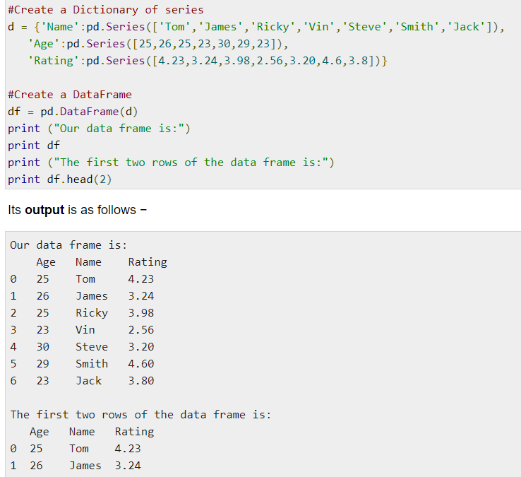
DataFrame - Head & Tail
To view a small sample of a DataFrame object, use the head() and tail() methods. head() returns the first n rows (observe the index values). The default number of elements to display is five, but you may pass a custom number.
Page 14

Slide 16
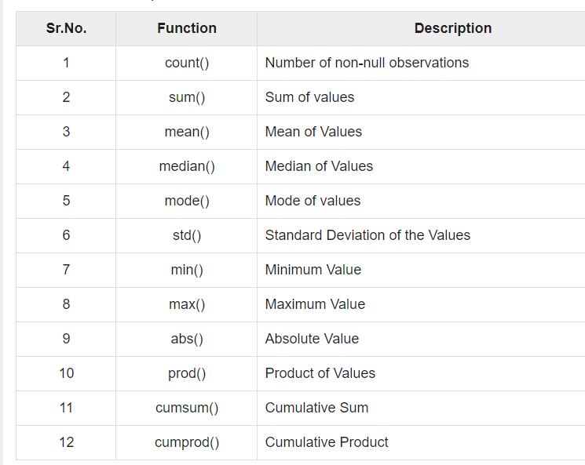
DataFrame - Functions
Page 15

Slide 17
Quiz Session
Page 16

Slide 18
Quiz
What is the output from this code ?
df = pd.DataFrame([[1, 2], [3, 4]], columns=list('AB'), index=['x', 'y'])
df2 = pd.DataFrame([[5, 6], [7, 8]], columns=list('AB'), index=['x', 'y'])
df.append(df2)
Page 17

Slide 19

Terima Kasih!
Indonesia AI | AI for Everyone, AI for Indonesia
contact@aiforindonesia.org

