Slide 1




Github

Slide 2
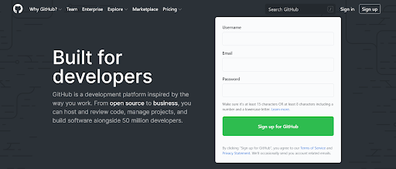
What is Github?
Page 01

Slide 3
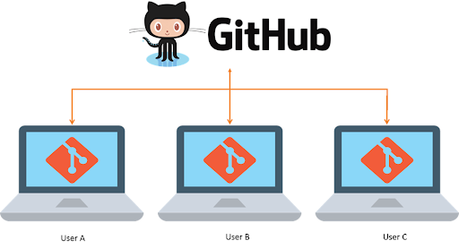
Page 02

Slide 4
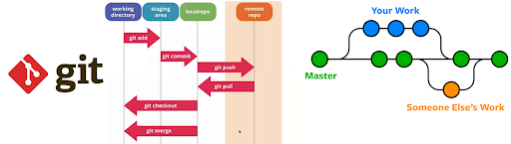
How does Github work?
Page 03

Slide 5
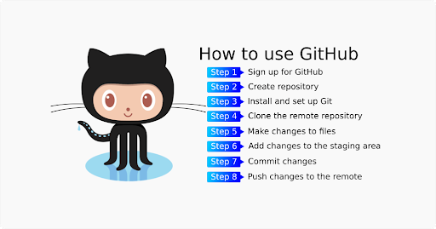
How does Github work?
Page 04

Slide 6
Basic Commands
Git clone
Git branch
Git checkout –b namabranch
Git add . (all) / filename.ipynb
Git commit –m “comment”
Git push origin develop-rowi
Git merge branchtujuan
Git push origin branchtujuan
Page 05

Slide 7

Terima Kasih!
Indonesia AI | AI for Everyone, AI for Indonesia
contact@aiforindonesia.org

