Slide 1
360 pictures for object detection

Slide 2
Index
What has been done
Next Steps
Define scope of the project
Approach
Identification of issues ahead
Task historical approach and Status of the art: two articles
Collecting (some) data
First hands on
Image augmentation
Testing various pretrained NN performances (pytorch)
Adding new layers/ features and apply transfer learning (Image AI )

Slide 3
Define scope of the project
1- STEP: Features identification in 360 pictures
INPUT: rough 360 degree pictures
OUTPUT: pictures where the desired features are identified (eg tables, chairs, people…)
2- STEP: Identify same obj across multiple images
INPUT: images where features have been identified
OUTPUT: for selected feature a yes/no or degree of similarity

Slide 4
Define scope of the project
2- STEP: Identify same obj across multiple images

Slide 5
articles
https://arxiv.org/abs/1708.00919
Learning Spherical Convolution for Fast Features from 360° Imagery
2018
https://arxiv.org/abs/1910.01712 360-Indoor: Towards Learning Real-World Objects in 360° Indoor Equirectangular Images
late 2019

Slide 6
360 pictures
a 360° camera captures the entire viewing sphere surrounding its optical
Hot Applications : virtual reality (VR) and augmented reality (AR) technologies

Slide 7
Established approach: CNN
CNNs are responsible for state-of-the-art results:
image recognition
object detection
image and video segmentation
action detection
Available CNN architectures trained with massive labeled image datasets produce “pre-trained" networks (*)
Notes:
Indeed such networks are widely adopted as off-the-shelf feature extractors for other algorithms and
applications (c.f., VGG [33], ResNet [17], and AlexNet [25] for images; C3D [36] for video).
We will see more about this when we talk about transfer learning

Slide 8
Limits of CNN
the existing CNN filters and the expensive training data that produced them are product of perspective projection to a plane.
powerful CNN features are awkward if not off limits in practice for 360° imagery
Notes:
In contrast, a 360° image is projected onto the unit sphere surrounding the camera’s optical center.
Conclusion: we do not expect a cnn to work well with 360 images as input, it will recognize only non distorted objects on which he was trained upon

Slide 9
Different types of Image Projection
A projection is performed when a panoramic image is mapped onto a flat surface
https://www.cambridgeincolour.com/tutorials/image-projections.htm
Equirectangular, cylindrical, rectilinear, fisheye,… etc.

Slide 10
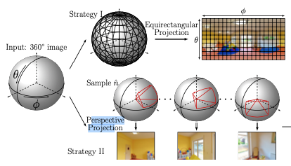
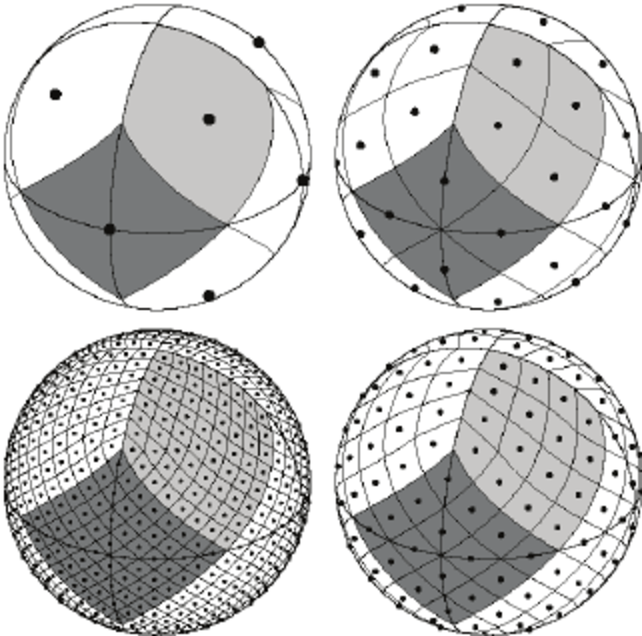
Image projections usually used to parse 360 pics into CNN
Notes:
EQUIRECTANGULAR PROJECTION, the spherical image is projected to a planar one,1 then the CNN is applied to the resulting 2D image [19,26] (see Fig. 1, top).
However, any sphere-to-plane projection introduces distortion, making the resulting convolutions inaccurate.
PERSPECTIVE PROJECTION the 360° image is repeatedly projected to tangent planes around the sphere, each of which is then fed to the CNN
The denser the sampling of tangent planes, the more the solution is accurate.
Problem: high computational cost. Not only does it incur the cost of rendering each planar view, but also it prevents amortization of convolutions: the intermediate representation cannot be shared across perspective images because they are projected to different planes.(no weight sharing!)
Weights sharing in NN https://towardsdatascience.com/understanding-parameter-sharing-or-weights-replication-within-convolutional-neural-networks-cc26db7b645a

Slide 11
Different types of Image Projection
Depending on the type of projection, different distortions occur in the image
Which type of projection does the camera we are using apply ? Should the method be robust with the type of input aka being independent on the camera model used to take the panorama?

Slide 12
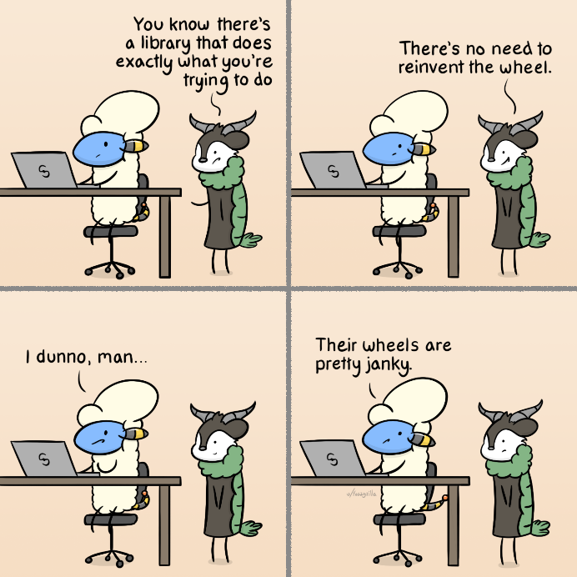
Approach : Transfer Learning
use a neural network trained to solve a particular type of problem and with a few changes → reuse it to solve a related problem

Slide 13
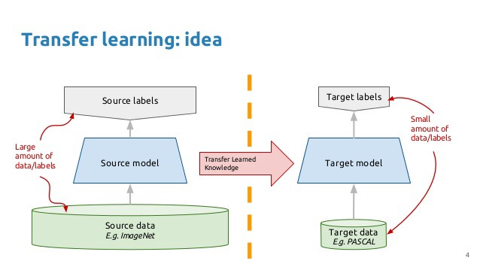
Transfer Learning
Why?
Working with non randomly initialized weights makes the learning process faster and more accurate
Key factors:
-Size of current dataset
-Similarity with original dataset

Slide 14
Transfer Learning
Current dataset size
Train from scratch, just reuse the architecture
Freeze earlier layers that detect simple features, train the rest
big
Train all and only the fully connected layers
Train only last fully connected layer
small
different
Quite similar
Similarity with original dataset

Slide 15
Libraries and tools for transfer learning
Pytorch (https://pytorch.org/docs/stable/torchvision/index.html )
ImageAI→ custom object detection models using the YOLOv3 (requires PASCAL VOC) (https://github.com/OlafenwaMoses/ImageAI/ )
- Neet Computational power to re-train (partially) NN: Google Colab, AWS..???
Notes:
https://towardsdatascience.com/coco-data-format-for-object-detection-a4c5eaf518c5#:~:text=Pascal%20Visual%20Object%20Classes(VOC)&text=Pascal%20VOC%20is%20an%20XML,for%20training%2C%20testing%20and%20validation.
, spare Nvidia graphic card anyone ???

Slide 16
Libraries and tools for transfer learning
Pytorch
Evaluate the pretrained models performance with very different data input (360pic)
Notes:
https://towardsdatascience.com/coco-data-format-for-object-detection-a4c5eaf518c5#:~:text=Pascal%20Visual%20Object%20Classes(VOC)&text=Pascal%20VOC%20is%20an%20XML,for%20training%2C%20testing%20and%20validation.
, spare Nvidia graphic card anyone ???

Slide 17
We need good data!
needs to be representative of reality
Needs to capture variance in prospective, light , background etc
will be noisy
The more the merrier–> more time for training needed

Slide 18
Currently available data
Ca 200 panorama pictures self shot
despite the geoloc on, in the process of exporting the images out of the app these info seem to be lost

Slide 19
Desired data
360-Indoor dataset : 3335 360pic annotated in 37 categories → made request of access to google for research purposes
Image augmentation : pipeline in the making
Notes:
Google dataset: ‘work’ ‘home’ ‘shop’ ‘activity’. In the end, we have 3, 335 images in total. All images are with 960 × 1, 920 resolution

