Slide 1
Oximetry readings
By Marisol Arita

Slide 2
Question:
Do different levels of liquid intake affect oxygen saturation level?
In my study I research whether the oxygen saturation after drinking 16 or more liquid ounces differ from drinking less than 16.

Slide 3
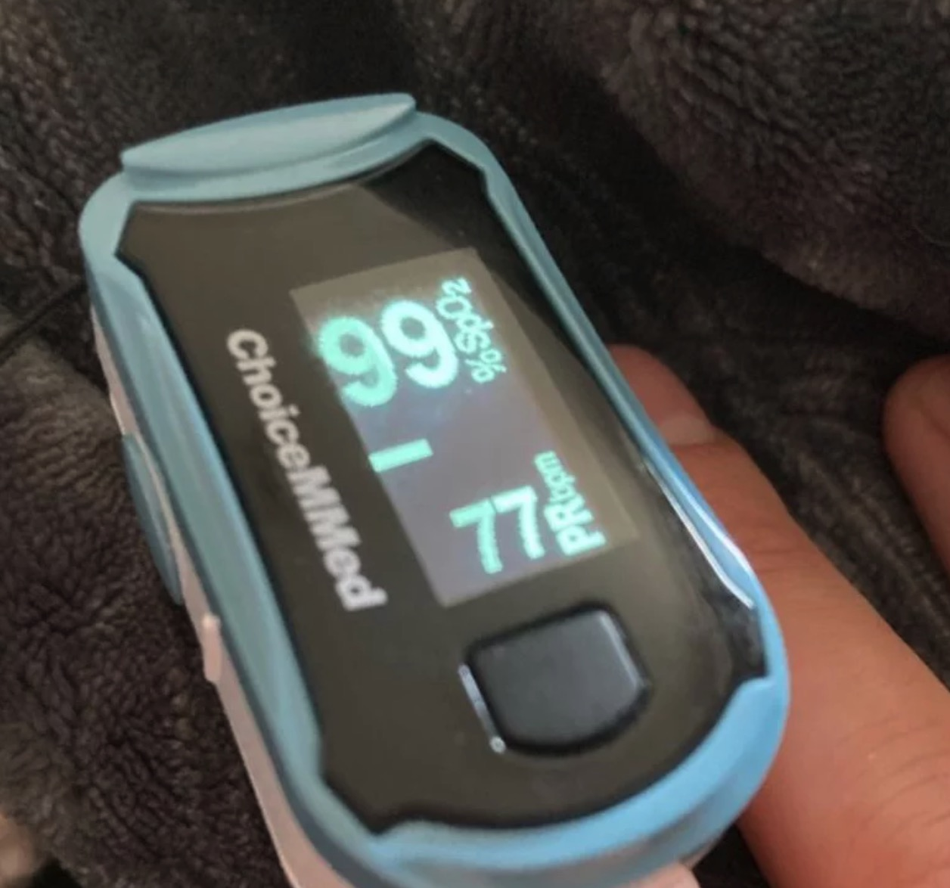
Data
Data collection: Nov. 15 – Nov. 28 2023
Guidelines:
Count only premeasured drinks (bottles, cans)
Did not count liquid within food including soups.
Variables: Split into less than 16 ounces and more than or equal to 16 ounces.
I used an oximetry meter to measure oxygen saturation daily usually at night after a day of drinking and collected inputs on excel sheet.
* Not my finger pictured

Slide 4
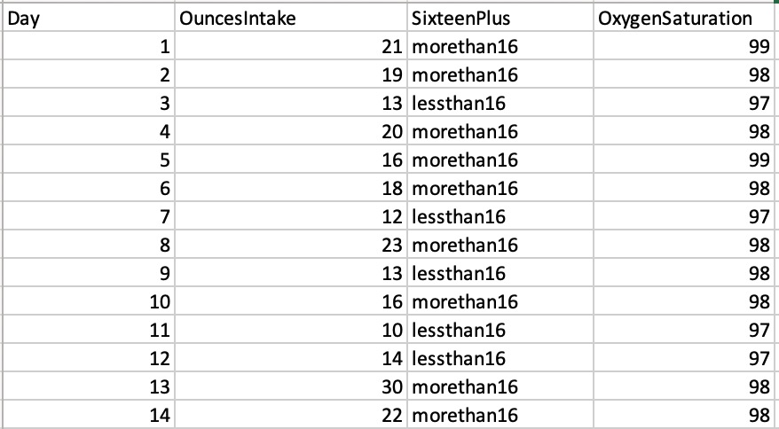
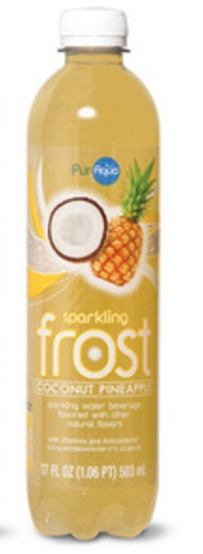
Data
Used 16oz as the basis for measurement as that’s roughly the size of a standard water bottle.

Slide 5
Hypothesis testing
Claim: Test if the data provides evidence that the average oxygen saturation level after drinking less than 16 ounces of liquid is significantly different from that of drinking 16 or more ounces.
Dependent variable: Oxygen saturation
Independent variable: Liquid intake (Below 16 ounces and 16 or above ounces)

Slide 6
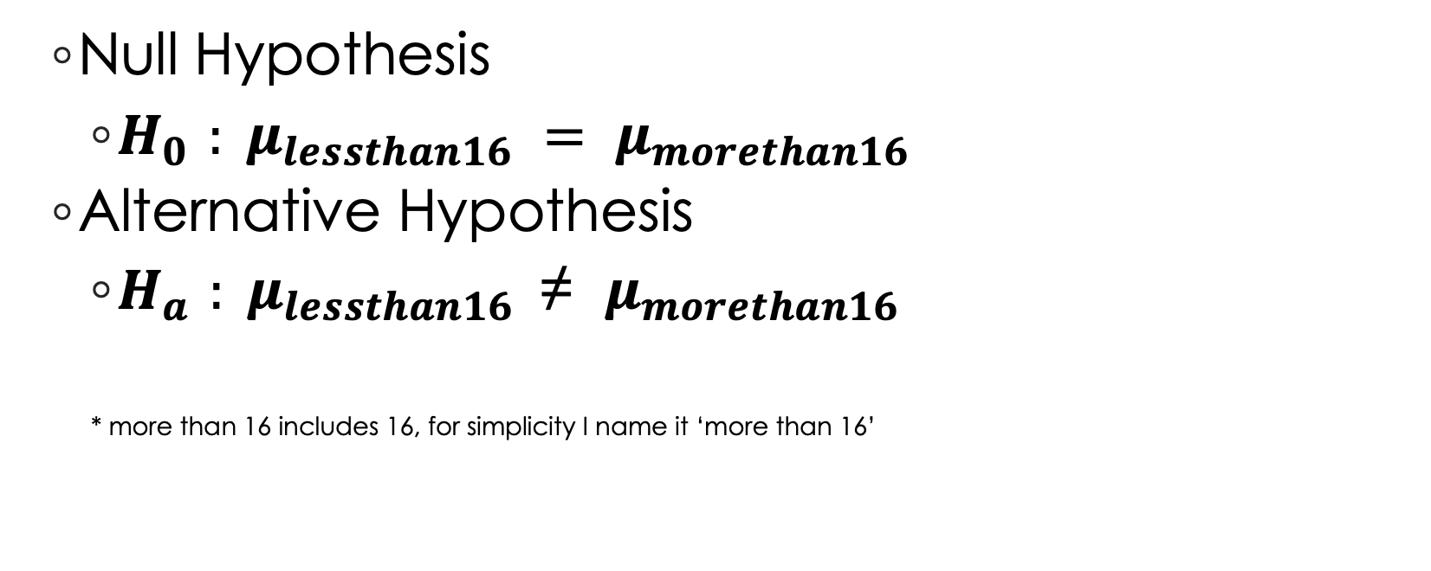
Hypothesis testing
Null Hypothesis
$H_{0 }: μ_{lessthan16} = μ_{morethan16}$
Alternative Hypothesis
$H_{a }: μ_{lessthan16} \text{≠} μ_{morethan16}$
* more than 16 includes 16, for simplicity I name it ‘more than 16’

Slide 7
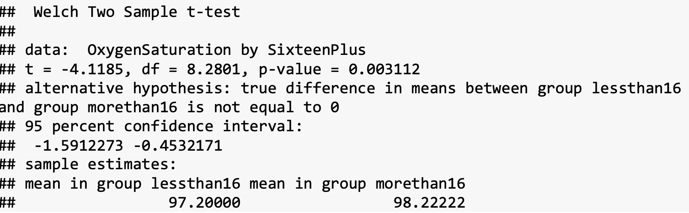
Hypothesis testing
Used two sided t-test
P value = .003112 so therefore with a significance level of .05 I reject the null hypothesis and accept the alternative hypothesis.

Slide 8
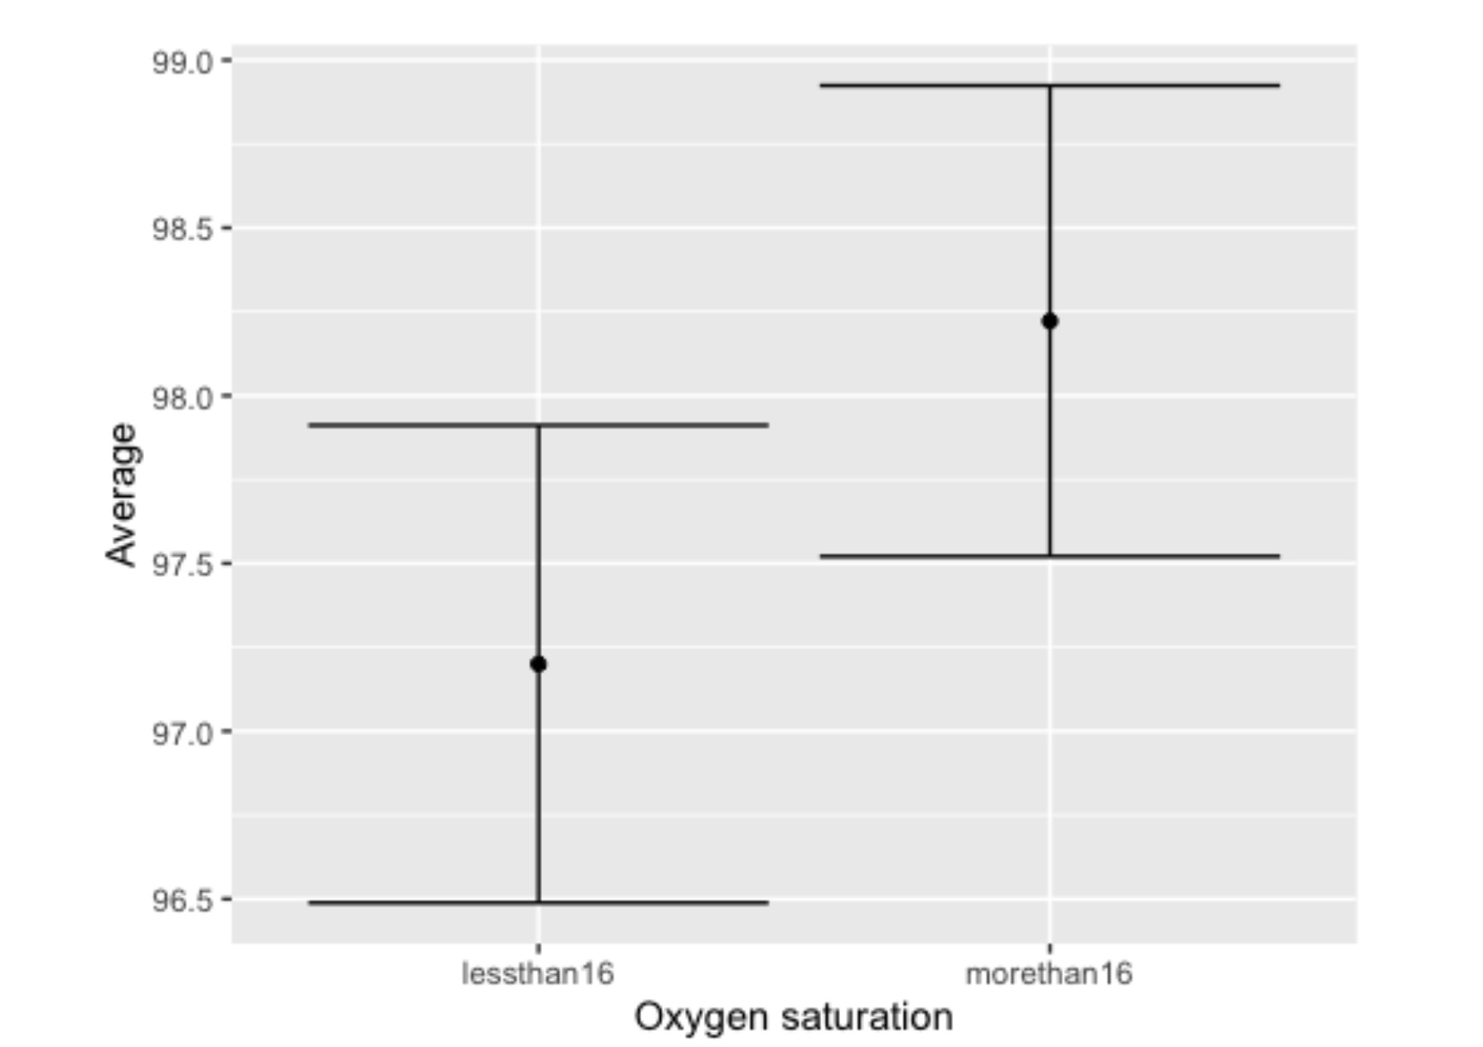
Conclusion
Reject the null hypothesis in favor of the alternative hypothesis. There is evidence to support that the mean oxygen sat. level differs when drinking less than 16 ounces and drinking 16 or more ounces.
The graph shows there is a significant difference in oxygen saturation between drinking less than 16 ounces of liquid and more than 16 as neither mean overlaps in the opposite confidence interval.

