Slide 1
TDS 3751
Lab 04: Web Application with Flask
By: Aristotle Tan
Github: github.com/aritan7/smc_flask

Slide 2
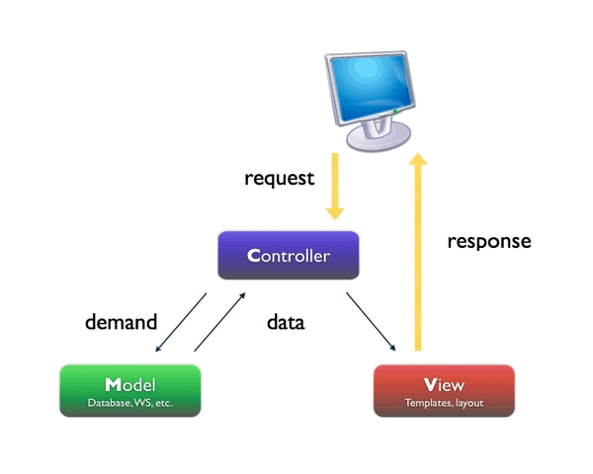

Slide 3
MVC Architecture
Model
Database, Data structure
Data abstraction layer
Not covered
View ✓
How the user engage with the browser
What the user perceives
Controller ✓
Provides the logic to either handle presentation flow in the view or update the model’s data

Slide 4
Why Flask?
Micro-framework
Support templating languages like Jinja2
Simple!
To install:
Pip install flask

Slide 5
Hands-on
1. Hello World
2. Tweet Search
3. Dashboard

Slide 6
#1: hello world
from flask import Flask, render_template, request
# turn this file into an web application
app = Flask(__name__)
# whenever flask see a request for "slash" by some user
@app.route('/')
def index():
return "Hello World"

Slide 7
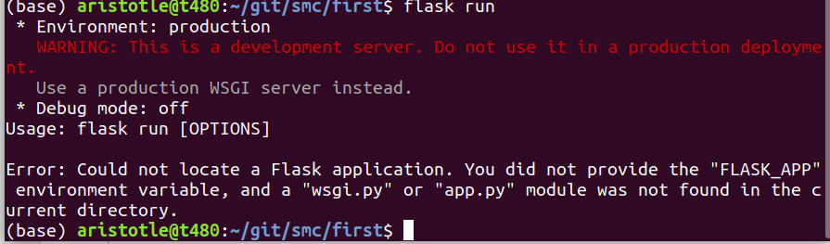
To run
Flask run
Set Environment var:
Windows: set FLASK_APP='application.py'
OSX / Linux: export FLASK_APP='application.py'

Slide 8
#1: Templates
Dynamically construct HTML
Templating Language: Jinja2
Basic template blocks, some basic (limited) logical expression allowed: if-else, for statement
Purpose: for displaying data

Slide 9
#1: hello world (templates)
from flask import Flask, render_template, request
# turn this file into an web application
app = Flask(__name__)
# whenever flask see a request for "slash" by some user
@app.route('/')
def index():
Return render_template('index.html')

Slide 10
#1: index.html (templates)
<html>
<head>hello</head>
<body>
Hello, {{ name }}
</body>
</html>

Slide 11
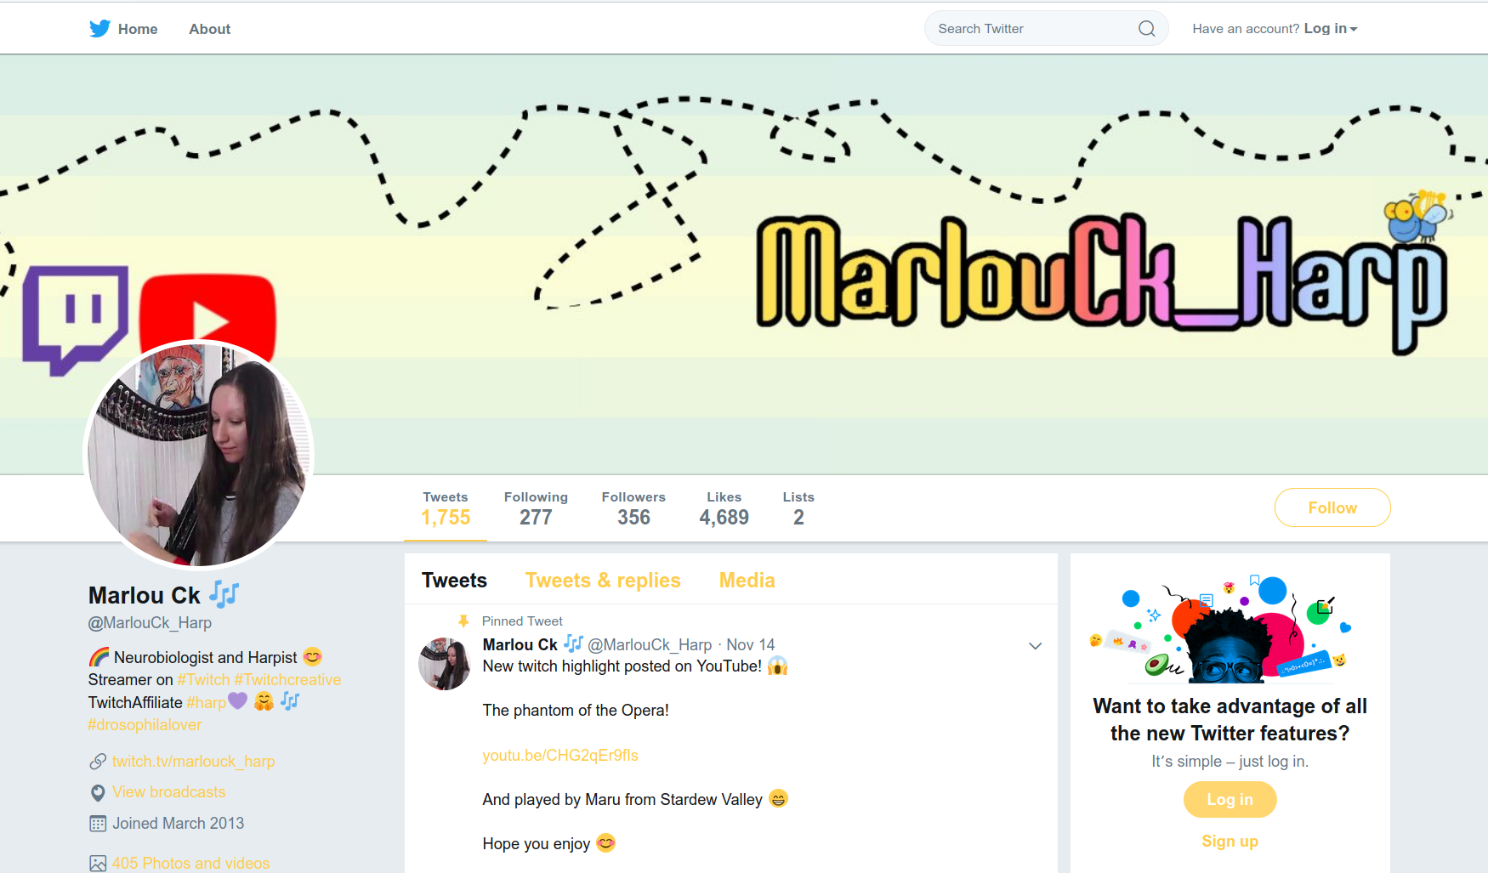
#2: Search Tweets

Slide 12
#2: Search Tweets
Get user query
Retrieve list of tweets from csv.
Retrieve list of csv based on user query.

Slide 13
#2 Search Tweets
Search1 directory
Templates
index.html
Application.py
Tweet_processing.py
Tweets.json

Slide 14
#2 Search Tweets
Search1 Exercise
- Complete tweets_processing.py

Slide 15
#2 Search Tweets
Search4 Exercise
- Submitting form via POST

Slide 16
#2 Search Tweets
Search1 – HTTP_GET via form
Search2 – Templates, extend template, blocks
Search3 – Dynamically generated html, jinja-for
Search4 – HTTP_POST via form
Red: Partial code only

Slide 17
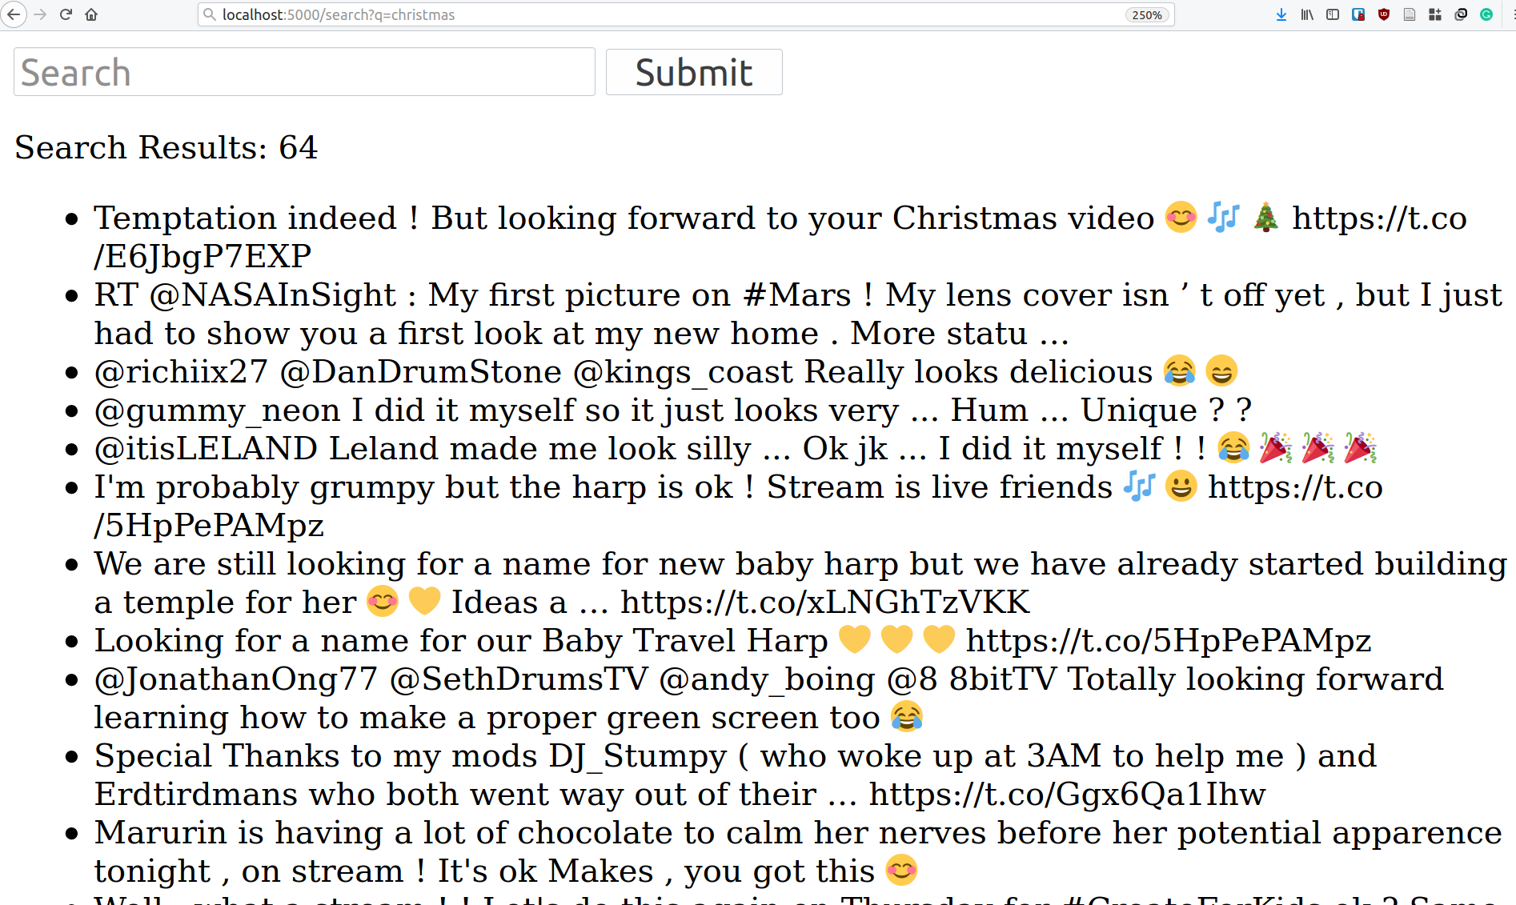
#2: Search Tweets

Slide 18
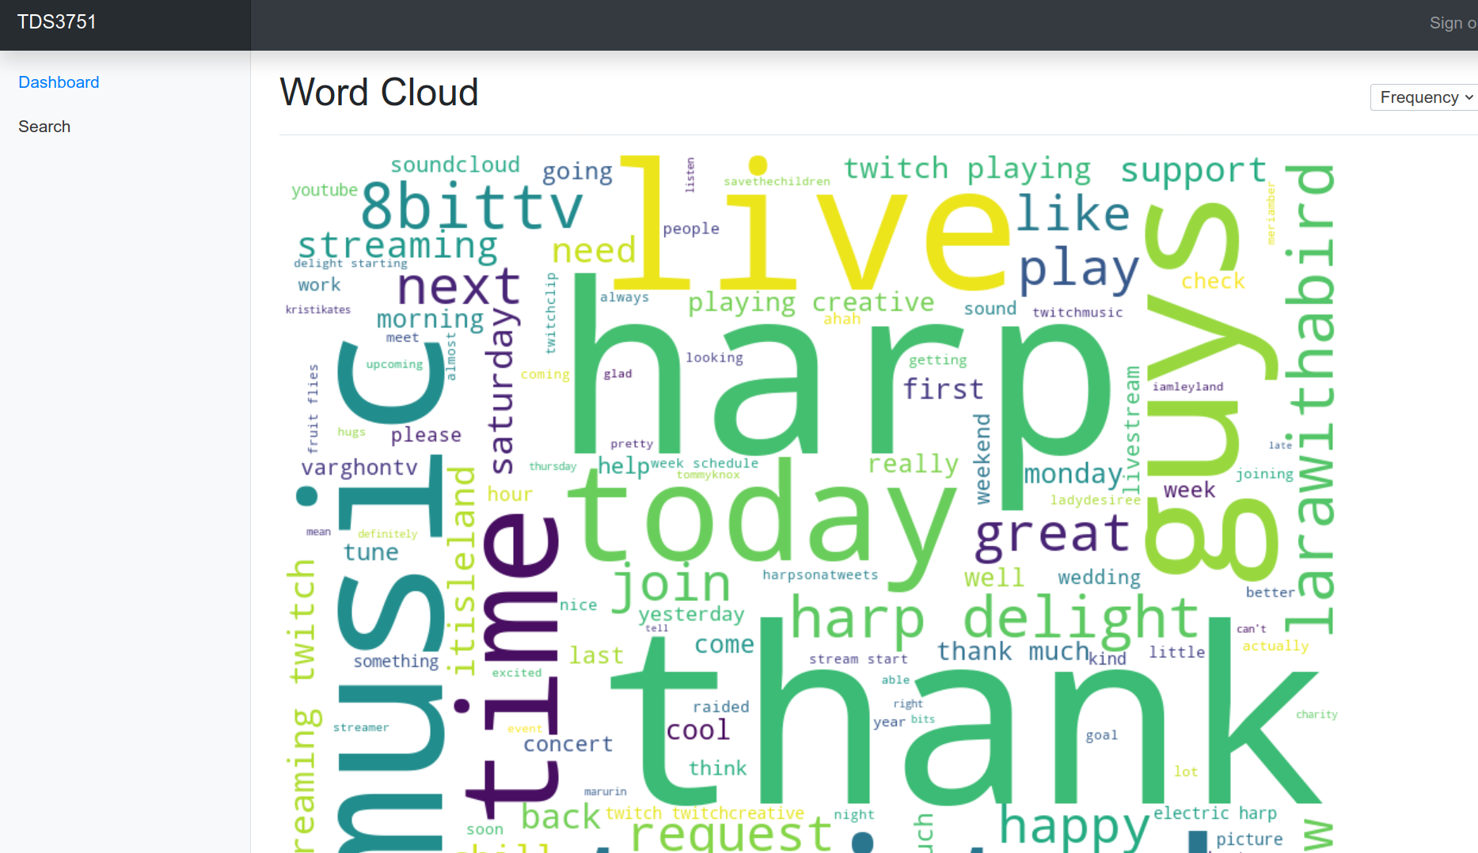
#4: Dashboard
Wordcloud Example

Slide 19
#4: Dashboard
Exercise: Generate word-cloud using Tf-Idf

