Slide 1

Shiny .NET
Allan RitchiE

Slide 2


Allan Ritchie
Microsoft MVP & Former Xamarin MVP
Been doing .NET since it started
Lots of OSS and Xamarin stuff
ACR User Dialogs
BluetoothLE RX Plugin for Xamarin
Geofencing Plugin for Xamarin
Twitter: @allanritchie911
GitHub:artichie

Slide 3
What We’ll Cover
What Is Shiny
What Does Shiny Solve?
General Architecture
The Modules
Periodic Jobs, BLE, Locations, Notifications, & More
Open Q&A

Slide 4
What Is Shiny?
A cross platform foundation to build background and device centric services on
Provides a way to write modular and testable code while supporting needed infrastructure like logging, storage, and dependency injection out of the box. Think Prism for services!
Shiny is designed for Android, iOS, and UWP on the .NET platform

Slide 5
What Does Shiny Solve?
I saw every app suffer when it came to backgrounding with device features like GPS, Geofencing, and background jobs in general
Even when backgrounding was done “right”, it was hard to do it cross platform and even harder to bring your services to it
You always needed additional infrastructure to support cross platform – persistent storage, jobs/alarms, permissions, etc – Shiny brings all of this!
Xamarin Essentials is great, but it doesn’t lend itself to testability for us old school enterprise devs
The APIs for things like Push & BLE were always complex or junk like Bluetooth on Android
Android changes how it does backgrounding with almost every module or major release. We deserve better!

Slide 6
General Architecture
It has a startup/app file just like Xamarin Forms
& ASP.NET Core – Why Another Startup File???
Logging Built-In from the start based on Microsoft.Extensions.Logging
Dependency Injection (Microsoft.Extensions.DependencyInjection) through and through to support testing & spread of your services to the background
Reactive Extensions (RX) at the Core – No .NET Events
For the background, we use delegate interfaces. This enables us to have a testable, modular unit that supports DI

Slide 7
The Modules
Periodic Background Jobs
Background GPS & Geofencing
Motion Activity Recognition
Local Notifications
Scheduled
User interfactions
Customizable from every aspect
Push Notifications
switch between native, firebase, or azure notifications hubs with 1 line of code
Bluetooth LE, Beacons, & MORE!

Slide 8
Core
This is where all the magic happens
Brings together logging, service injection, and the “Essentials”
Yes: there is overlap with Essentials due to the rest of Shiny needing things like
Power Info
Connectivity
Permissions
Settings/Secure Storage – This has a cool twist though – bind objects to a storage mechanism!
Periodic Background Jobs!

Slide 9
Locations
GPS, Geofencing, & Motion Activity Recognition
The Android provider is intelligent to switch between providers with and without Google Play Services for both GPS and Geofencing
Motion Activity Recognition – provides the last known movement you were doing “driving, running, etc”
Why is it here? Ask Android why they thought the API should live here ☺
2.0 – We now use foreground services to enable true real time GPS while your app is backgrounded
iOS just works – It’s why I don’t talk about it much in this slide ☺

Slide 10
Bluetooth LE
Android is BAD – an async API that is anything but async – FEAR the GATT 133 error – until Shiny
Fully RX because BLE is the perfect protocol for it!
If you use the library right, you can literally connect and move data in around in only a couple of lines of code
2.0 Introduces
Managed Scans – Deals with all the “cruft” of scanning for unique devices, while observing their RSSI, and when removing them from your list if they aren’t “heard” from in a specified period of time
Managed Peripheral – Never have to worry about finding and resubscribing to characteristics across reconnections

Slide 11
(i)Beacons
The only fully C# beacon client that I know of
Does full beacon monitoring (background) even on Android
2.0 introduces managed ranged scans to deal with your app “hearing” and “not hearing for while” listings

Slide 12
HTTP Transfers (Shiny.Net.Http)
Background Uploads & Downloads
Support for resuming transfers
Track Metrics in the foreground like
% complete
Time Remaining
Speed in bytes per second

Slide 13
Notifications
Supports all the standard notification stuff
Scheduling
Sounds
Actions – reply with buttons, text entry, etc
What does notifications have to do with the background?
It became clear that I needed to constantly communicate things happening in the background, so Shiny needed this
Doing notifications on Android (again), required a lot of infrastructure to support scheduling (storage, jobs, etc)
I needed a shared mechanism for Push Notifications

Slide 14
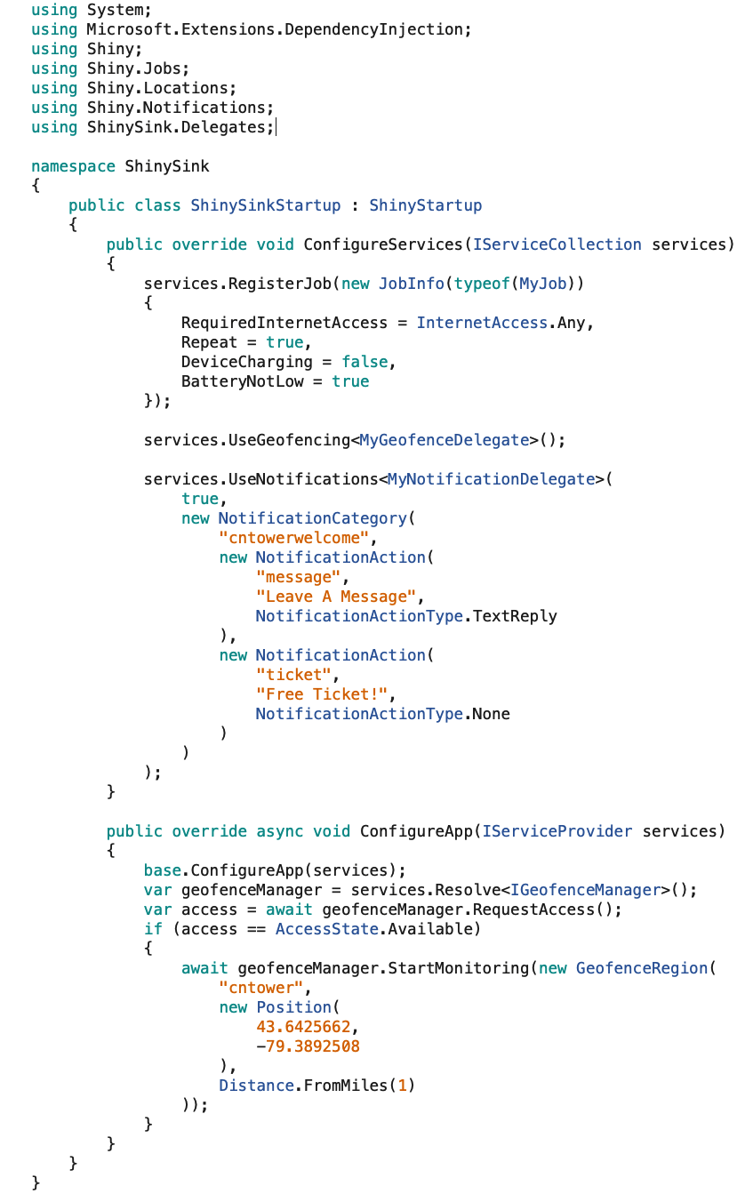
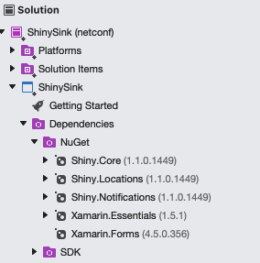
Setup

Slide 15
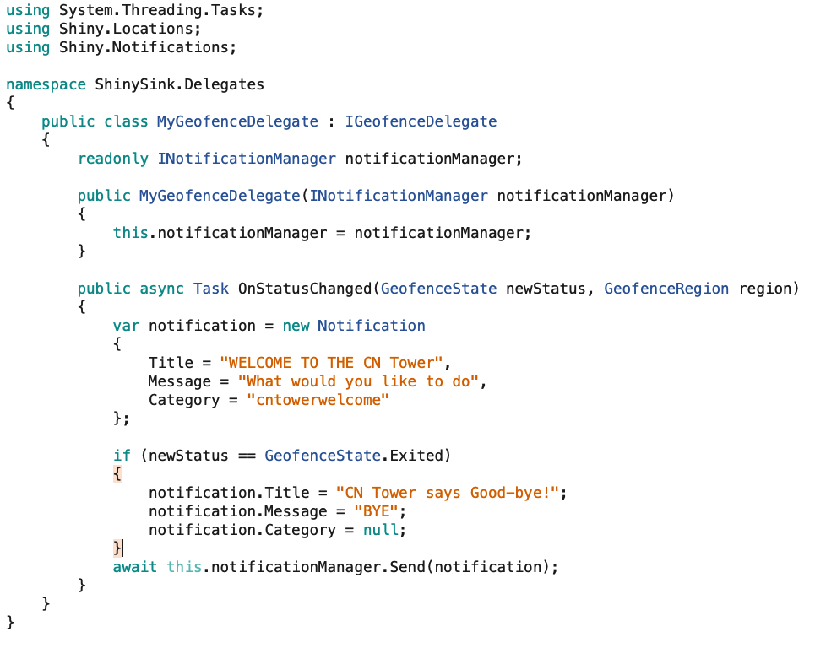
Geofences

Slide 16
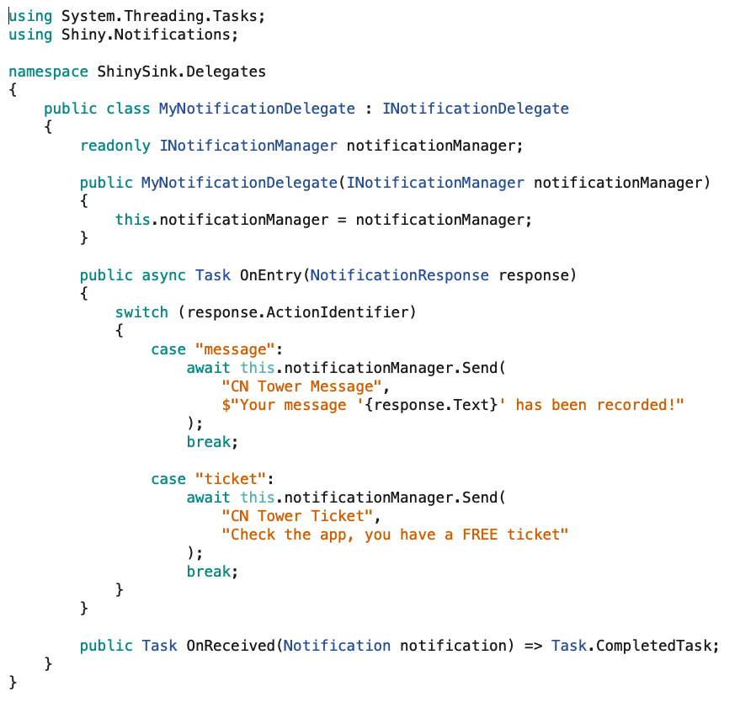
Notifications

Slide 17
Notification Actions

Slide 18
Shiny.Push
Push Providers come and go overnight
Google has changed its mechanism too many times
AppCenter came and went
All of the countless service providers that have fallen over the years
Push works the same on every platform since it is an OS level thing!
What if we could change between providers with a single line of code?
And Support tags on the providers that do this?
Current Support for Native, Firebase Messaging (on Android & iOS), and Azure Notifications Hubs
Support for AWS and OneSignal coming

Slide 19
The Other Modules
Shiny – This is new to 2.0 and generates ALL of the boilerplate code via .NET source generators that you have to do in your iOS & Android projects
Shiny.Logging.AppCenter – The logging provider for AppCenter on Microsoft.Extensions.Logging
Shiny.Logging.Firebase – The logging provider for Firebase Analytics on Microsoft.Extensions.Logging
Shiny.NFC – Near Field Communication
Shiny.Sensors – Sensors with RX
Shiny.SpeechRecognition – Local speech to text translation

Slide 20
Roadmap
Integration with MAUI and Microsoft Extensions Hosting model
WASM via Blazor, Uno, Other?
Windows?? Project Reunion??
App Services – bringing modules together to produce real world solutions
Trip Tracker – GPS + Motion Activity – track runs, drives, etc
GeoDispatching – Push + GPS – enable your employees in the field to respond to alerts
OBD Communications – BLE at its best to talk to a dongle hooked up to your vehicle

Slide 21
Open Forums – Questions?
https://github.com/shinyorg/shiny
Samples: https://github.com/shinyorg/shiny/tree/dev/samples
https://github.com/aritchie
https://allancritchie.net
https://www.nuget.org/profiles/ShinyLib
Twitter: @allanritchie911
GitHub: aritchie

