Slide 1

Shiny for Xamarin
Allan RitchiE

Slide 2

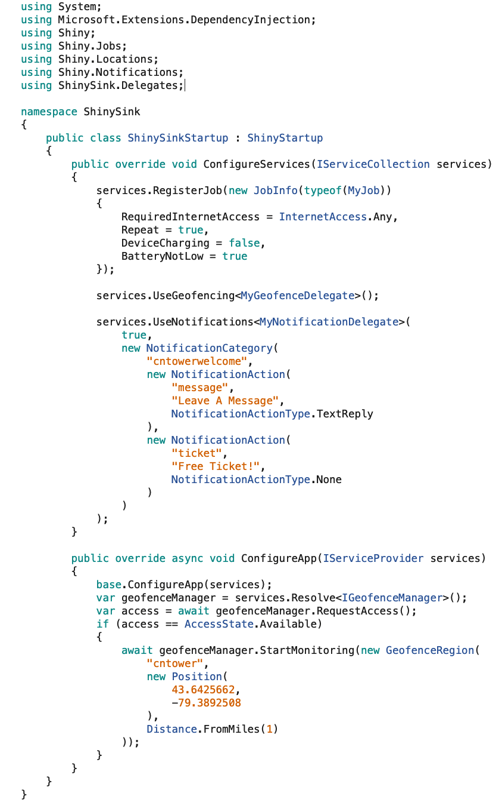
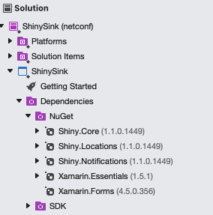
Setup

Slide 3
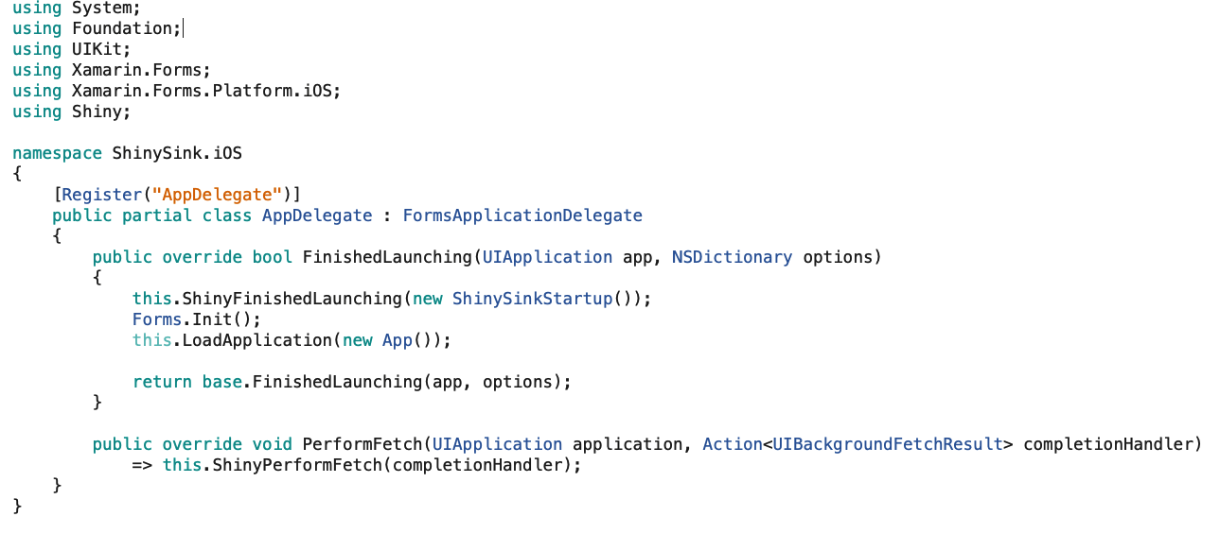
Boilerplate iOS

Slide 4
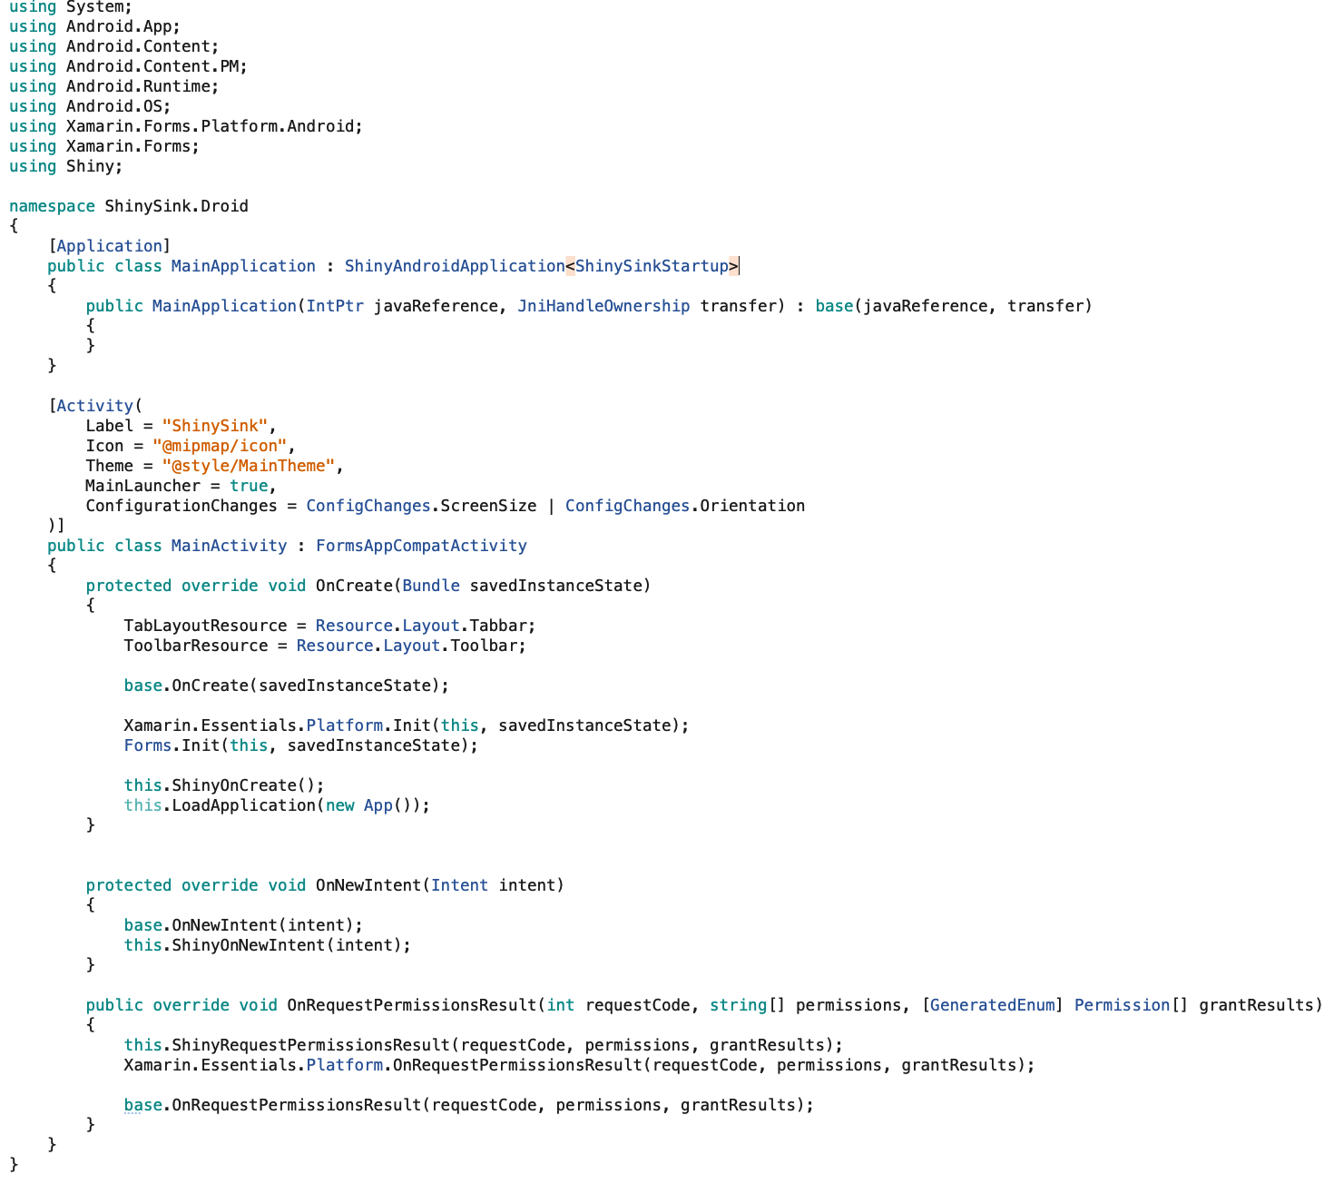
Boilerplate - Android

Slide 5
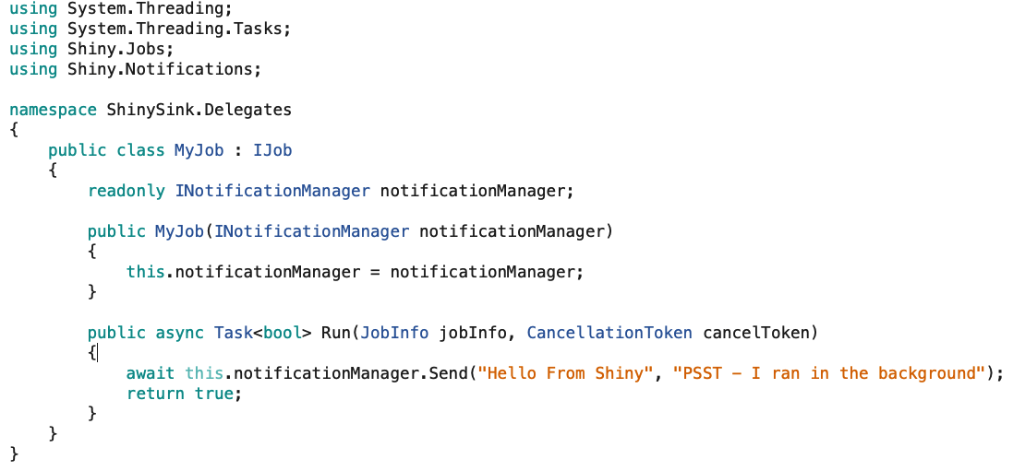
Background Jobs

Slide 6
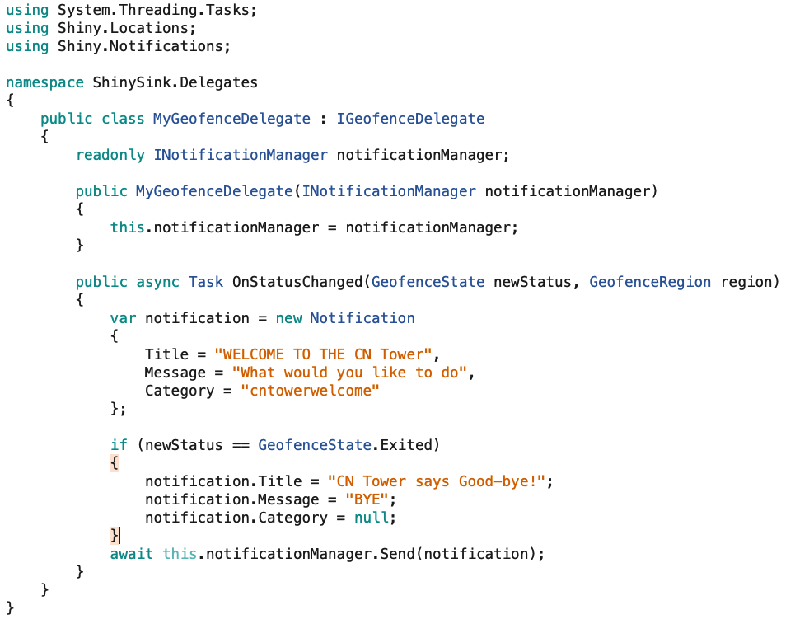
Geofences

Slide 7
Geofences

Slide 8
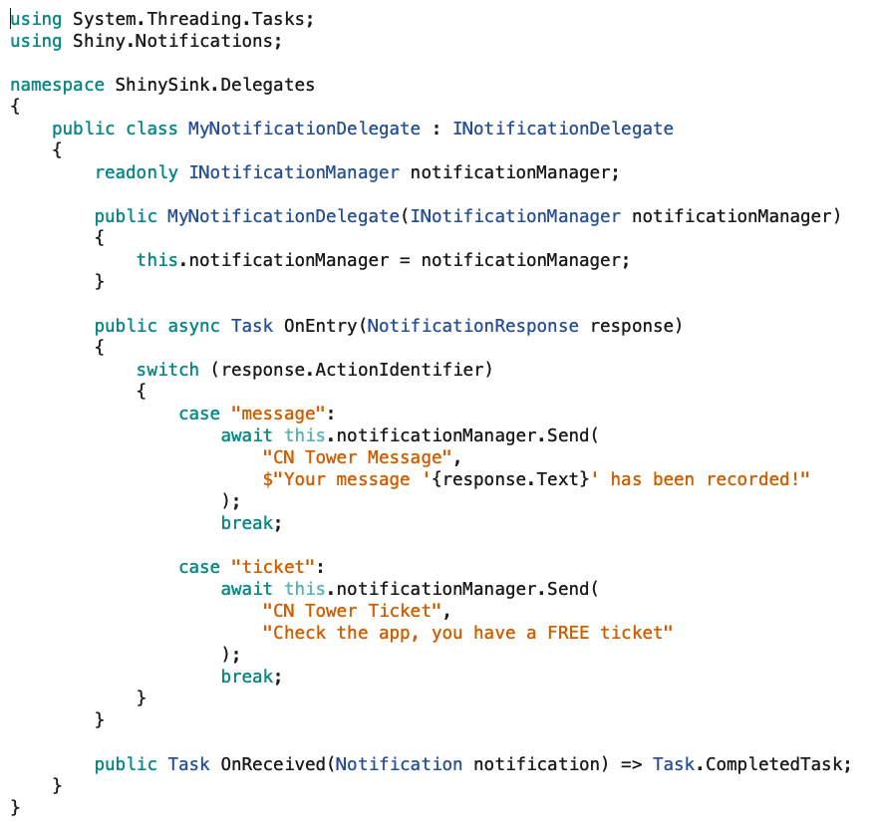
Notifications

Slide 9
Thanks for Watching
https://github.com/shinyorg
https://github.com/aritchie
https://allancritchie.net
https://www.nuget.org/profiles/ShinyLib
Twitter: @allanritchie911

