Slide 1

Getting Started with Shiny
Allan RitchiE

Slide 2


Allan Ritchie
Microsoft MVP & Former Xamarin MVP
Been doing .NET since it started
Lots of OSS
Twitter: @allanritchie911
GitHub:artichie

Slide 3
What Does Shiny Solve?
I saw every app suffer when it came to backgrounding with device features like GPS, Geofencing, and background jobs in general
Even when backgrounding was done “right”, it was hard to do it cross platform and even harder to bring your services to it
Xamarin Essentials is great, but it doesn’t lend itself to testability for us old school enterprise devs
The APIs for things like Push & BLE were always complex or junk like Bluetooth on Android. I wanted Prism, but for services !

Slide 4
What Does Shiny Offer?
Periodic Background Jobs
Background GPS & Geofencing
Motion Activity Recognition
Local Notifications
Scheduled
User interfactions
Customizable from every aspect
Push Notifications
switch between native, firebase, or azure notifications hubs with 1 line of code
Bluetooth LE, Beacons, & NFC

Slide 5
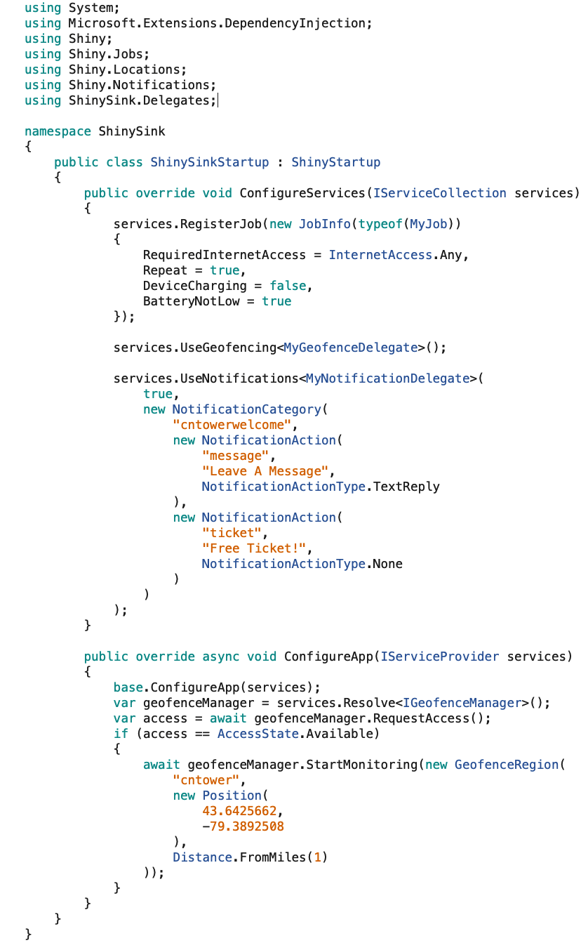
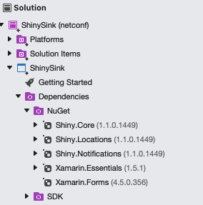
Setup

Slide 6
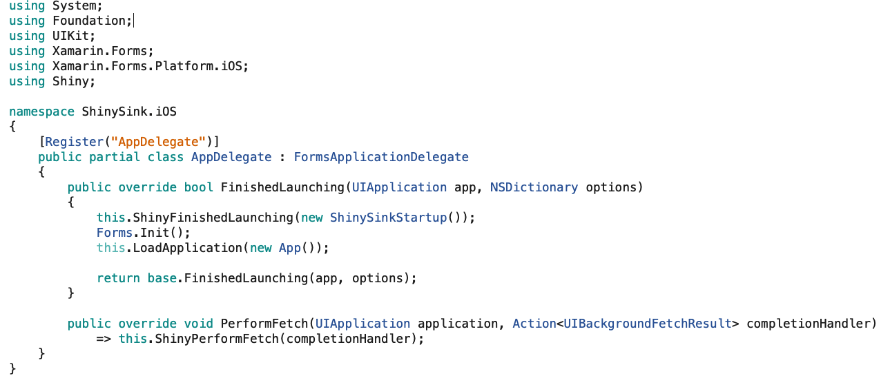
Boilerplate iOS

Slide 7
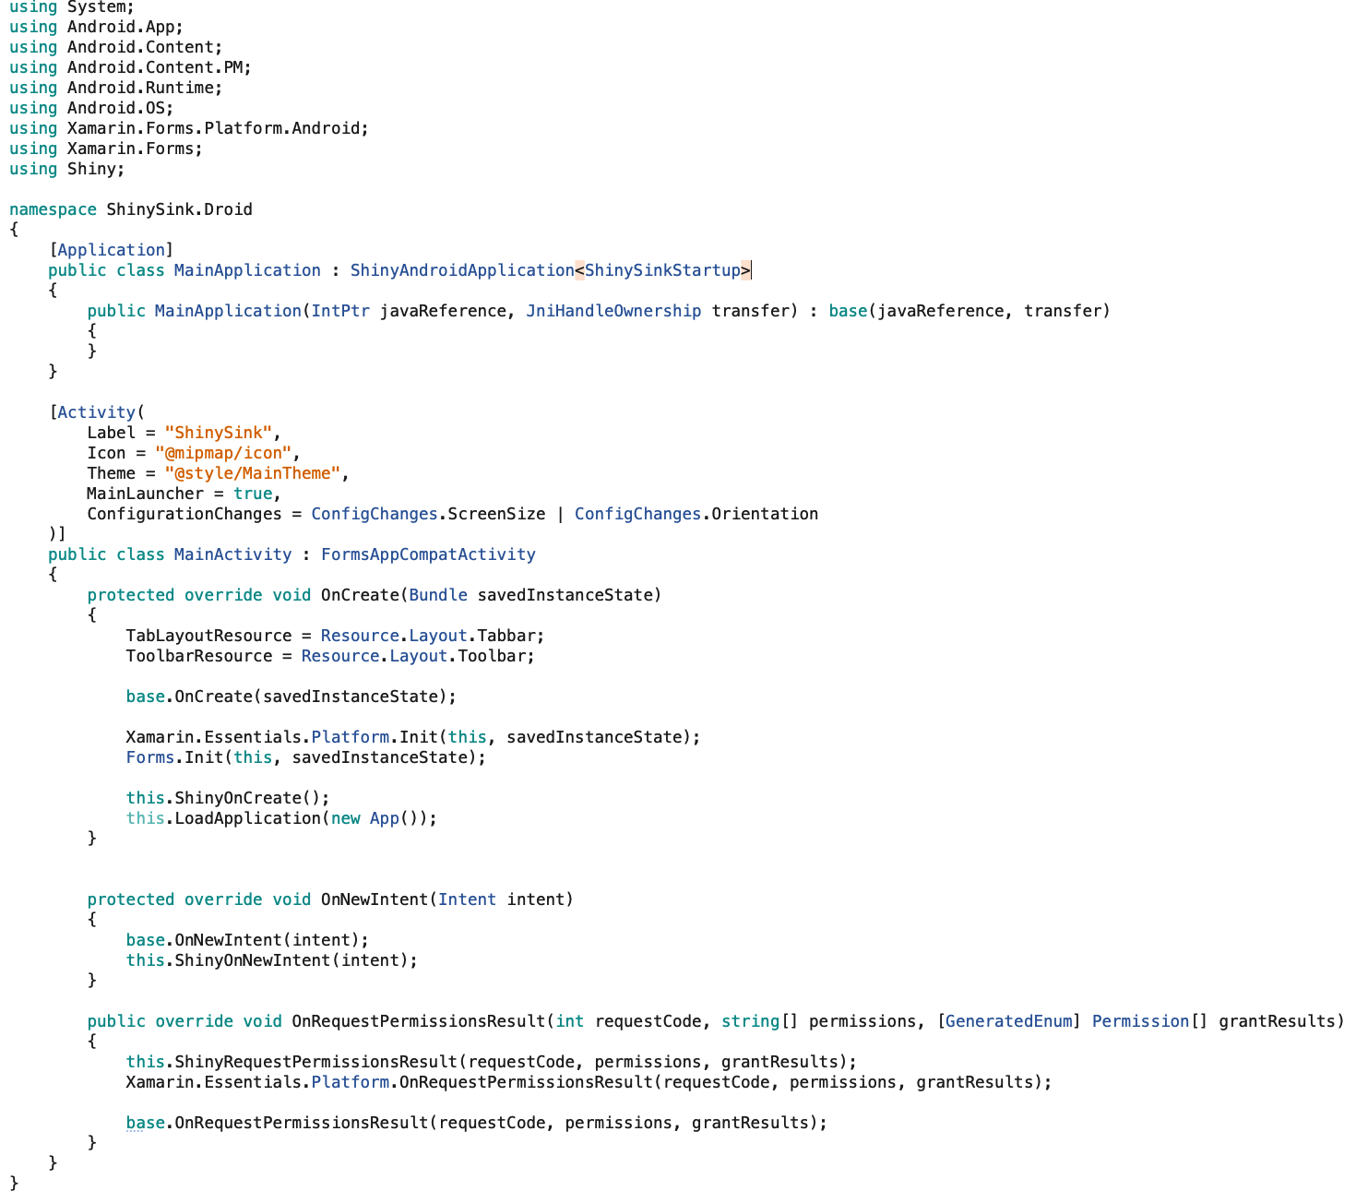
Boilerplate - Android

Slide 8
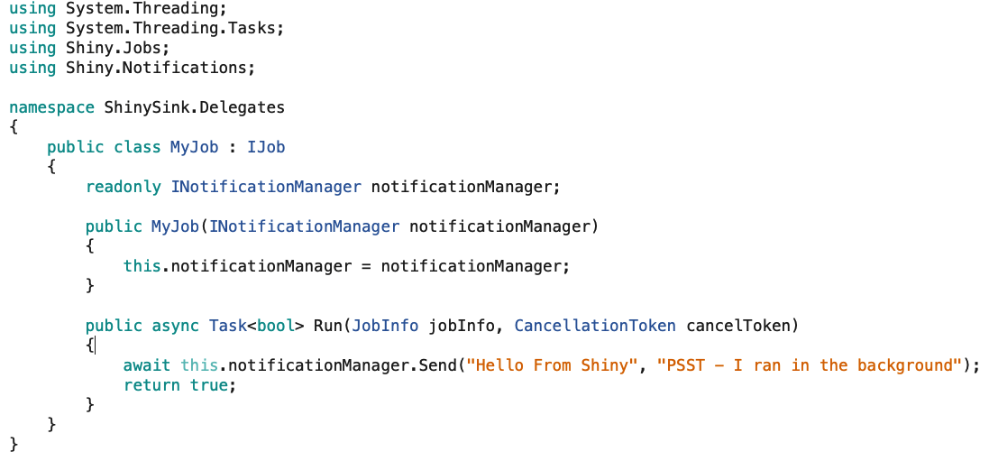
Background Jobs

Slide 9
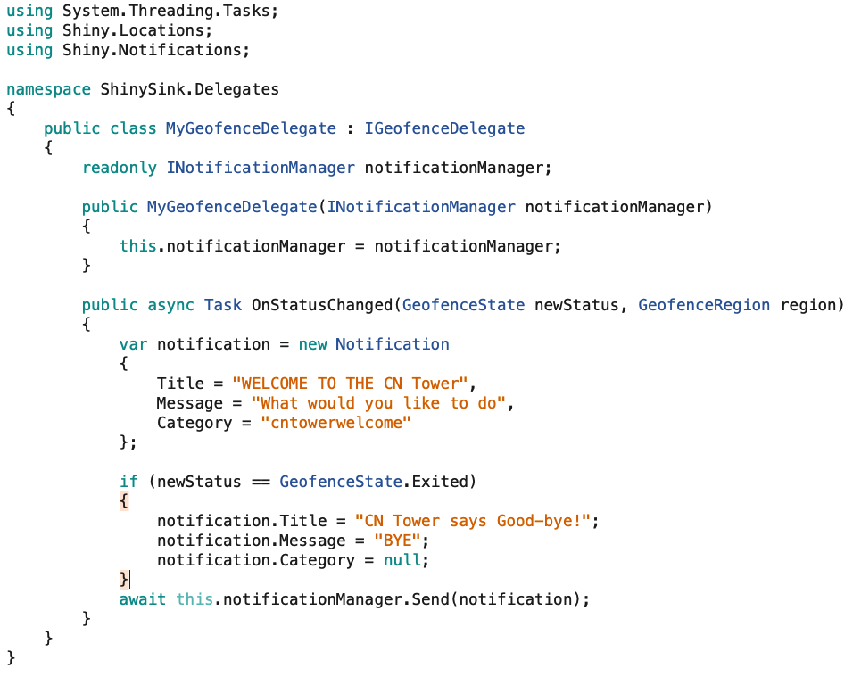
Geofences

Slide 10
Geofences

Slide 11
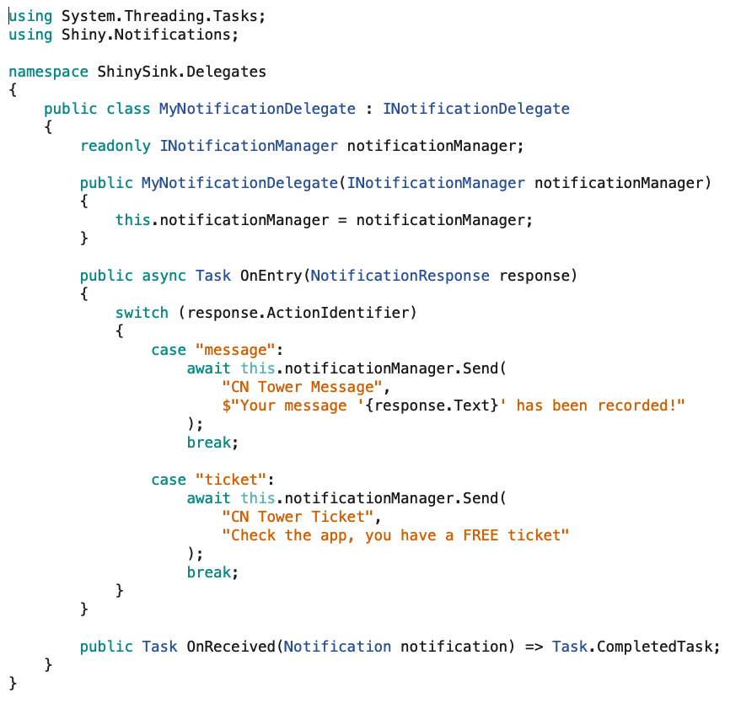
Notifications

Slide 12
What’s Next
Web Assembly
Code Gen Everywhere
No More Boilerplate
Don’t like DI? ShinyJobs.Schedule(); will be built via code gen
Easy BluetoothLE – Think SignalR style
App Services
Media Sync
Location Sync
Trip Tracking
Under Consideration
Tizen, macOS, Linux, & Meadow
Improved Hosting model based on Microsoft.Extensions.Hosting
VPN
Printing

Slide 13
Thanks for Watching
https://github.com/shinyorg
https://github.com/aritchie
https://allancritchie.net
https://www.nuget.org/profiles/ShinyLib
Twitter: @allanritchie911

