Slide 1
Portfolio Valuation Results
Prepared by Aritra and Jacob’s team - Quantitative Finance

Slide 2
Methodology Overview
1. Historical repayment percentages were calculated for each vintage.
2. Expected repayment percentages were computed based on historical averages.
3. Forecasted cash flows were calculated by multiplying origination amounts by expected repayment percentages.
4. Present value of forecasted cash flows was derived using a 5% annual discount rate, converted to monthly.
5. Portfolio value was compared with the client's estimate.

Slide 3
The estimated portfolio value based on the forecasted cash flows is CHF 289,695,195.26, which is significantly higher than the client's estimate of CHF 84,993,122.67. Here are the key results:
Estimated Portfolio Value: CHF 289,695,195.26
Absolute Difference: CHF 204,702,072.59
Relative Difference: 240.85%
Is the Difference Acceptable?: No, the difference exceeds the acceptable threshold of CHF 500,000.

Slide 4
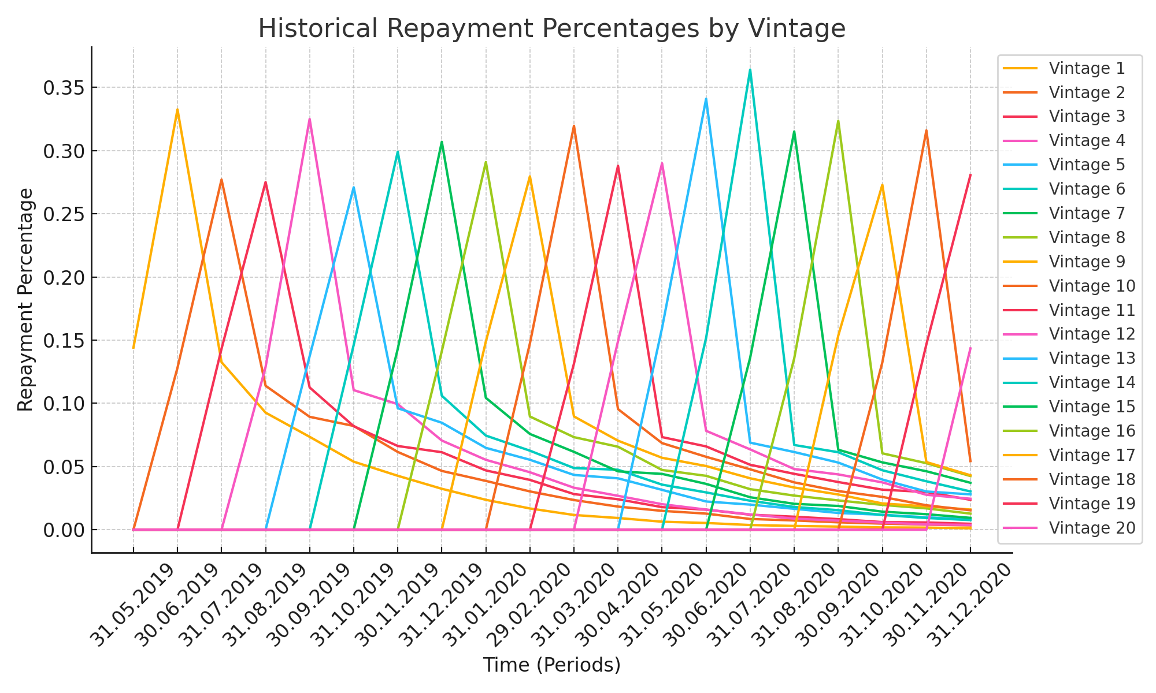
Historical Repayment Percentages by Vintage

