Slide 1

Heart Disease Prediction Model
NAME-ARITRA HALDER
Framingham Heart Study Dataset | Logistic Regression Analysis

Slide 2

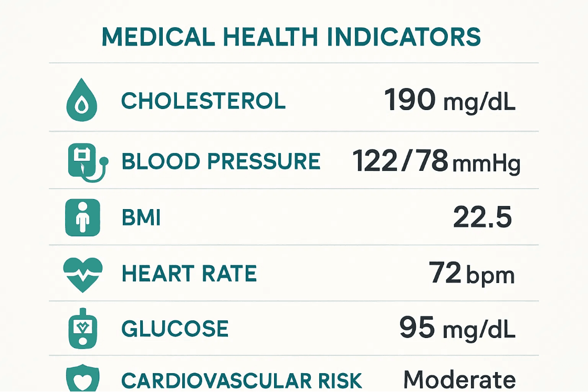
Key Predictors: Understanding Cardiovascular Risk Factors
Demographics
Lifestyle Factors
▸
Age
▸
Current Smoker Status
▸
Sex (Male/Female)
▸
Cigarettes per Day
Cardiovascular Metrics
Health Indicators
▸
Total Cholesterol
▸
Body Mass Index (BMI)
▸
Systolic Blood Pressure
▸
Blood Glucose Level
▸
Diastolic Blood Pressure
▸
Diabetes Status
▸
Heart Rate
▸
Hypertension Status
▸
BP Medication Use
▸
Prevalent Stroke
Data Processing: After removing incomplete records, 3,656 complete patient records were used for model training and evaluation.

Slide 3

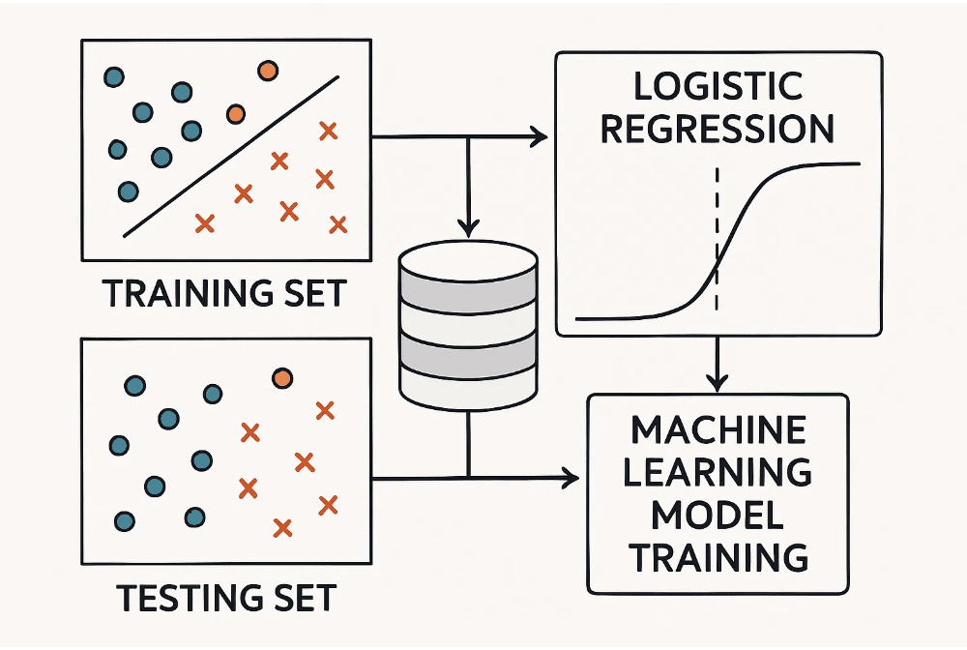
Model Selection & Training: Logistic Regression Framework
Why Logistic Regression?
Logistic Regression
is ideal for binary classification:
▸
Interpretable probability estimates for CHD risk
▸
Clear feature importance through coefficients
▸
Performs well with medical/clinical data
▸
Produces calibrated probability predictions
Training Methodology
Data systematically split for robust evaluation:
▸
80% Training:
2,924 records
▸
20% Testing:
732 records
▸
All 15 features used as inputs
▸
TenYearCHD as target variable
Technical Note: Convergence warning noted during training, suggesting potential for optimization through feature scaling or increased iterations.

Slide 4

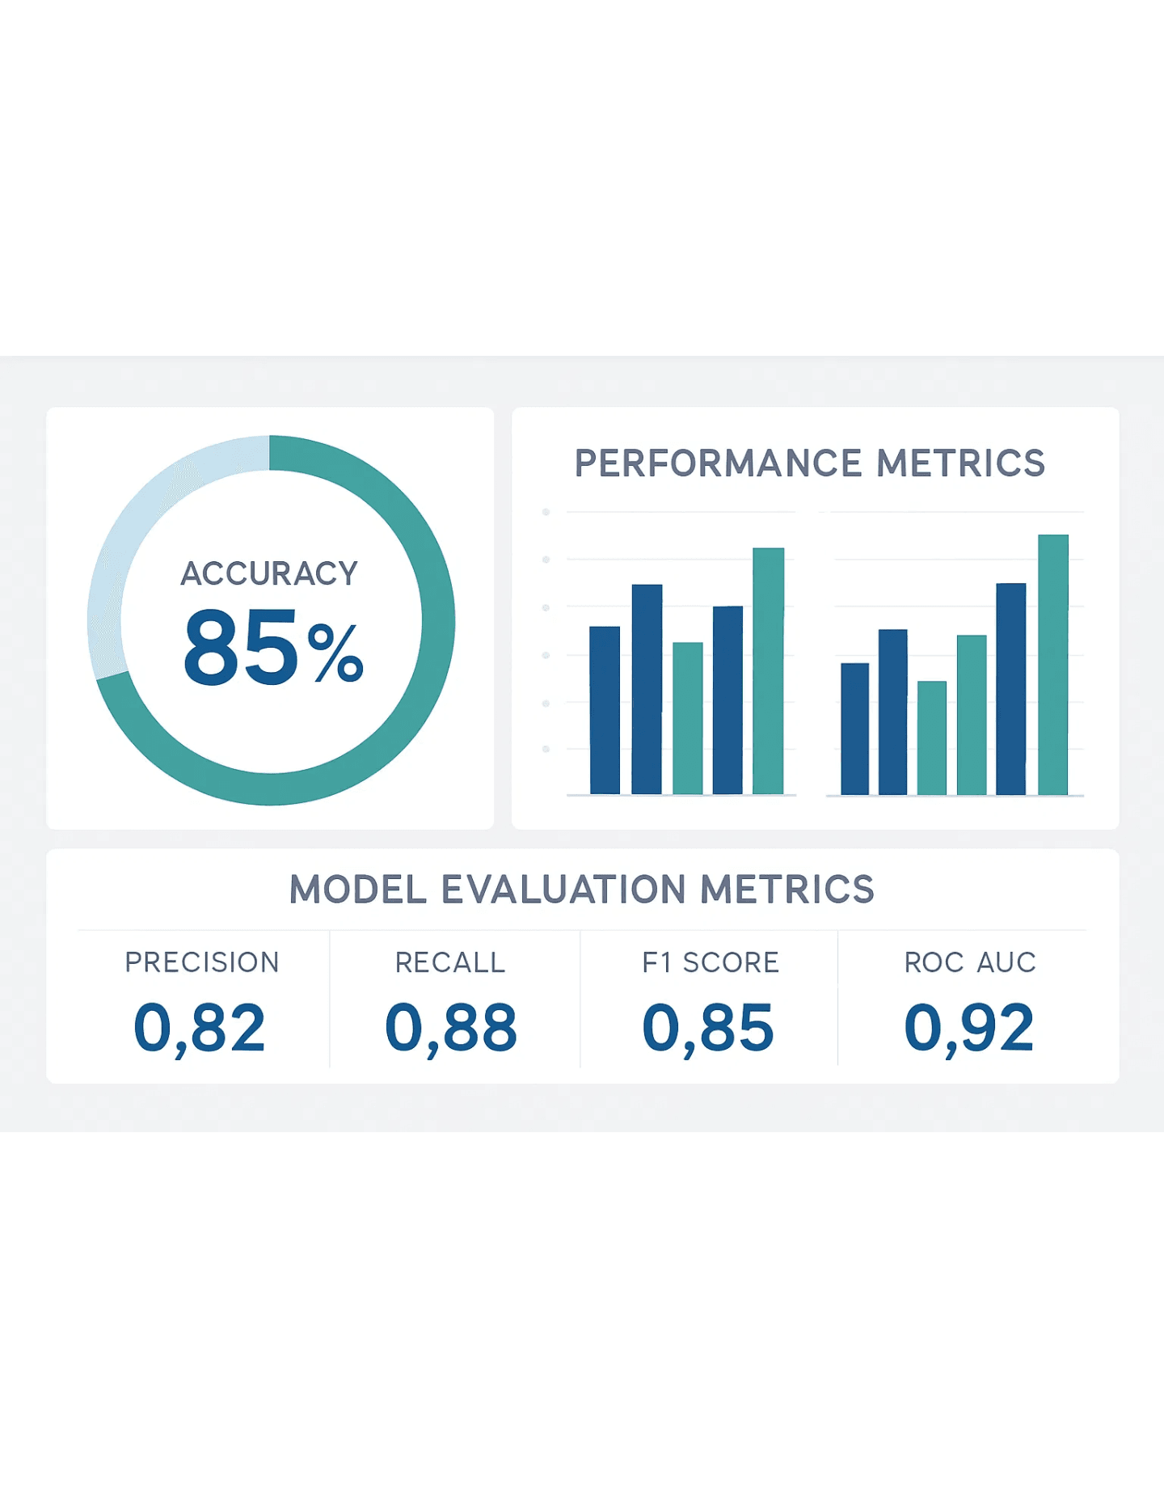
Model Performance: 85% Accuracy with Critical Caveats
Training Accuracy
85.06%
Testing Accuracy
85.07%
Critical Caveat: The Imbalance Problem
While the model achieves 85% accuracy on unseen data, this metric is highly misleading due to severe class imbalance in the dataset.
Only approximately 15% of the population in the Framingham dataset has coronary heart disease (CHD). This means the model can achieve 85% accuracy simply by predicting "No CHD" for almost everyone.
Implication: High accuracy alone is not a reliable indicator of model quality for imbalanced datasets. We must examine precision, recall, and other metrics to assess the model's true ability to identify high-risk patients.

Slide 5

Deep Analysis: Precision, Recall, and the Imbalance Problem
Confusion Matrix (Test Set)
Performance Metrics (Class: CHD)
Predicted: No CHD
Predicted: CHD
Precision
Recall (Sensitivity)
Actual: No CHD
14.29%
2.02%
True Negatives
False Positives
622
12
Of all predicted CHD cases, only 14.29% were correct
Model caught only 2.02% of actual CHD cases
Actual: CHD
False Negatives
True Positives
97
2
Specificity
F1 Score
98.10%
0.034
Model correctly identifies 98.10% of non-CHD cases
Harmonic mean of precision and recall
Critical Finding
The model exhibits extreme bias toward the majority class (No CHD). With a recall of only 2.02%, the model fails to identify 97.98% of high-risk patients. This makes the model unsuitable for clinical use, as missing actual CHD cases could have severe health consequences.

Slide 6

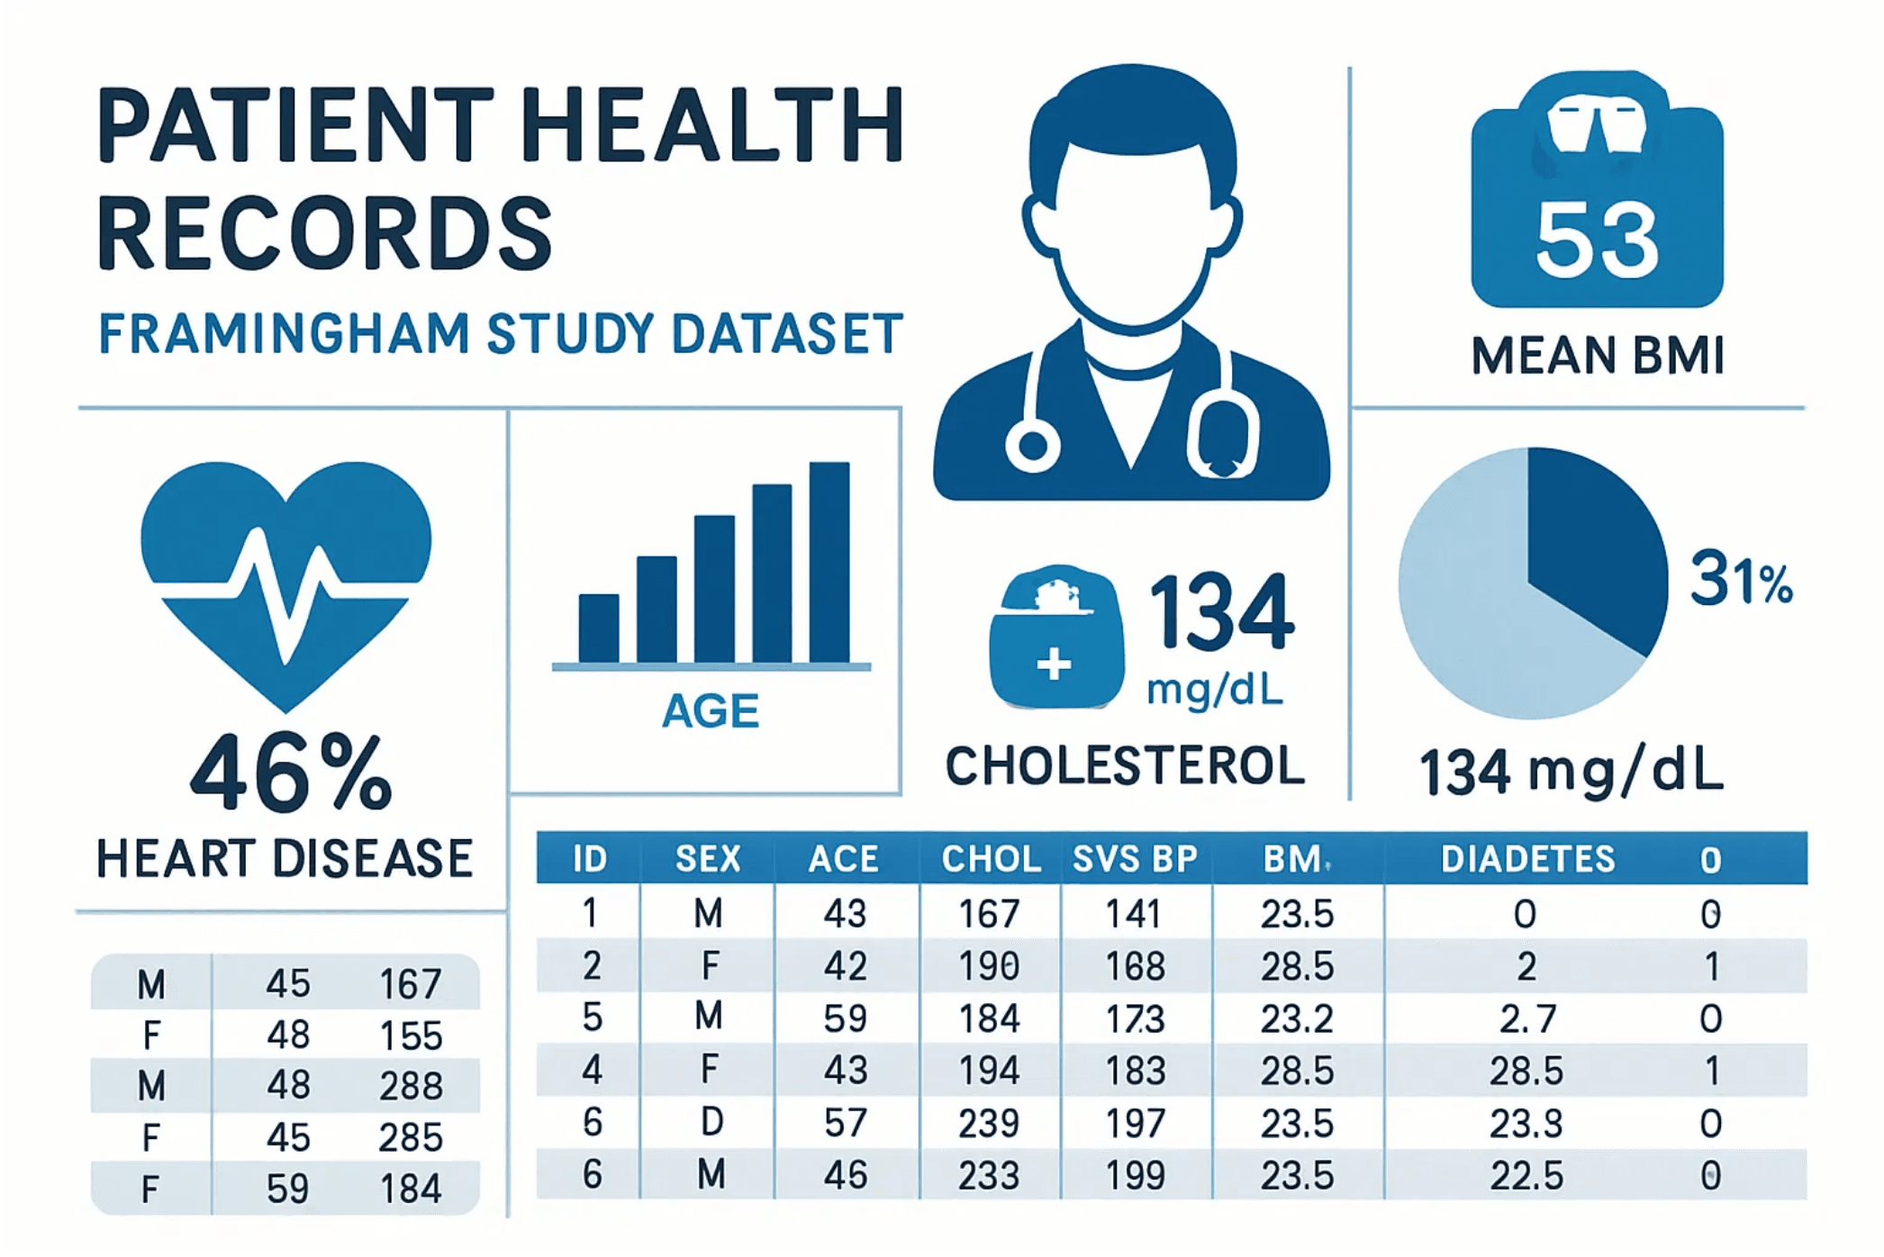
Conclusions: Critical Findings on Model Performance
Key Findings
Overall Accuracy
85.07%
High accuracy achieved on test set, but misleading due to class imbalance in the dataset
Critical Issue: Recall
2.02%
Model identifies only 2% of actual CHD cases, missing 98% of high-risk patients
Clinical Viability Assessment
The current model is unsuitable for clinical use. While it achieves high accuracy, the extremely low recall means it fails to identify almost all patients at actual risk of CHD, making it potentially dangerous in a healthcare setting.
→ See next slide for recommended improvements

Slide 7

Future Recommendations: Pathways to Clinical Viability
1. Address Data Imbalance
2. Feature Engineering
SMOTE & Class Weighting
Scaling & Normalization
Implement Synthetic Minority Over-sampling Technique (SMOTE) or apply class weights to penalize misclassification of the minority class (CHD cases)
Standardize or normalize features to improve model convergence and enhance the algorithm's ability to learn meaningful patterns
3. Explore Advanced Models
4. Hyperparameter Tuning
Random Forest & Gradient Boosting
Grid Search & Cross-Validation
Test more robust algorithms that may better capture complex relationships and handle class imbalance more effectively
Systematically optimize model parameters and use cross-validation to ensure robust performance across different data subsets
Implementation Priority
Recommendations 1 and 2 should be prioritized first, as addressing class imbalance and improving feature preprocessing are foundational steps that will likely yield the most significant improvements in model recall and clinical viability.

