Slide 1

Unified Simulation Environment
UNCLASSIFIED // NOT APPROVED FOR PUBLIC RELEASE
21 May 2020
UNCLASSIFIED // NOT APPROVED FOR PUBLIC RELEASE
Notes:
1
1

Slide 2
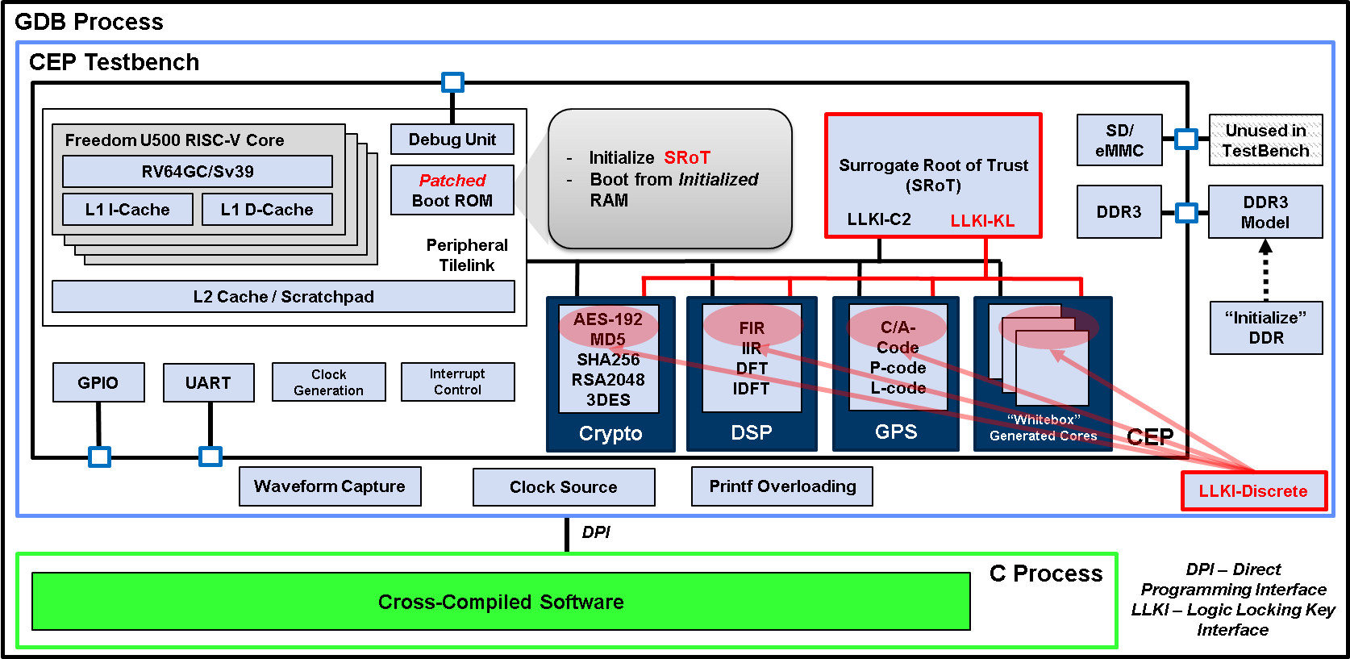
Architecture
Support unified simulation environments:
1. Behavioral mode (BFM/fast)
2. BARE Metal (RISC-V RTL/slow)
3. Linux (HW card/super fast)
4. Individual Unit level test benches. One per HW assist core. Supports 2 modes:
Clock Cycle accurate.
TileLink Transaction level accurate
CEP with LLKI
C2 – Command and Control, KL- Key Load, LLC – Logic Locked Core, TSS – Technique Specific Shim

Slide 3
BFM Mode
Each RISC-V core is replaced with a behavioral model that only support TileLink transactions.
Test is running on native machine with hooks to control the BFM model to execute TL transactions (via Direct Programing Interface).
Test also support capture mode (TL transaction level or cycle-by-cycle) to a header file for playback in BARE Metal mode and unit level (e.i aes_playback.h)
<core>_playback.h
(transaction accurate)
<core>_stimulus.txt
(cycle accurate)
RISC-V
BFM Model
If enable
titleLink Bus
C_module wrapper
C/C++ Test

Slide 4
BARE Metal Mode
RISC-V is actual RTL code
Test is wrapped inside RISC-V wrapper and cross compiled to ELF executable file to be loaded into DDR3 memory (via backdoor).
<core>_playback.h, captured from BFM mode, is executed by actual RISC-V transaction-by-transaction.
RISC-V wrapper
playback.cc
<core>_playback.h
titleLink Bus

Slide 5
Linux Mode
. FPGA is synthesize, place/route to obtain mcs file and loaded onto VC707 eval card.
Linux OS is built with cep_diag application (which includes all simulation tests) as diagnostic
Linux OS
cep_diag.cc
VC707 Eval Card
test1
. . .
testN
titleLink Bus

Slide 6
Playback File Format
Below is one example of the <core>_playback.h file format to be used in BARE Metal or Unit-Level testbench.
// Write to : <physicalAdr> <writeData>
#define WRITE__CMD 1
// Read and compare: <physicalAdr> <Data2Compare>
#define RDnCMP_CMD 2
// Read and spin until match : <physicalAdr> <Data2Match> <mask> <timeout>
#define RDSPIN_CMD 3
// dft command sequences to playback
uint64_t dft_playback[] = {
WRITE__CMD, 0x70050010, 0x0001000000000000 // 1
, WRITE__CMD, 0x70050008, 0x0000000000000000 // 2
<...>
, WRITE__CMD, 0x70050000, 0x0000000000000000 // 130
, RDSPIN_CMD, 0x70050000, 0x0000000000000004, 0xffffffffffffffff, 0x00000064 // 131
<...>
, RDnCMP_CMD, 0x70060020, 0x7c9280d37ccc8118 // 3898
, WRITE__CMD, 0x70060018, 0x000000000000001f // 3899
, RDnCMP_CMD, 0x70060020, 0x7cf0815a7d1181a5 // 3900
};
#define dft_size (sizeof(dft_playback)/sizeof(uint64_t))
#define dft_totalCommands 3900
#endif

Slide 7
LLKI Supports??
TileLink CrossBar
SRoT
TLSlave
RISC-V
TLMaster
Logic unlocking path
TLMaster
Core TileLik Wrapper (Chisel)
LLKI-PP
LLKI-Discrete
Logic Locked Core
(Verilog or Netlist)
Core TileLik Wrapper (Chisel)
LLKI-PP
LLKI-Discrete
Logic Locked Core
(Verilog or Netlist)
Core RegisterSet
Interface
(Chisel)
Core TileLink Wrapper (Chisel)
LLKI-Reg
LLKI-Discrete
Logic Locked Core
(Verilog or Netlist)
Core RegisterSet
Interface
(Chisel)
Core Specific
Discrete IOs
Core RegisterSet
Interface
(Chisel)
Core Specific
Discrete IOs
Logic path
Core Specific
Discrete IOs

Slide 8
Unit Testbench with LLKI Supports
Modified TL wrapper extracted from VCShell.v (to add LLKI’s)
LLKI-PP (Chisel)
Core with LLKI_IF
LLKI-PP
BFM
SRoT
BFM
LLKI-TL
BFM
LLKI-Discrete
BFM
LLKI-Discrete
Bus
Core
LLKI-Discrete
IF
TL-bus
Core register Interface Set
Core
(RTL)
Cycle-by-cycle
Playback
Core specific
Bus
TLplayback.sv
TL-core peripheral bus
<core>_playback.h
<core>_stimulus.txt
BFM Blocks
HW
Blocks
Purple blocks: used in cycle-accurate testbench
Green blocks: used in transaction-accurate testbench

