Slide 1
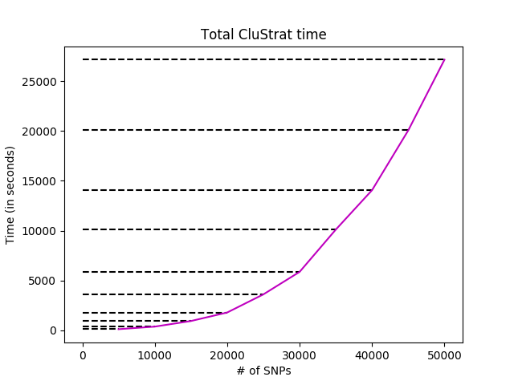
Proportion 1 (5 5 90)

Slide 2
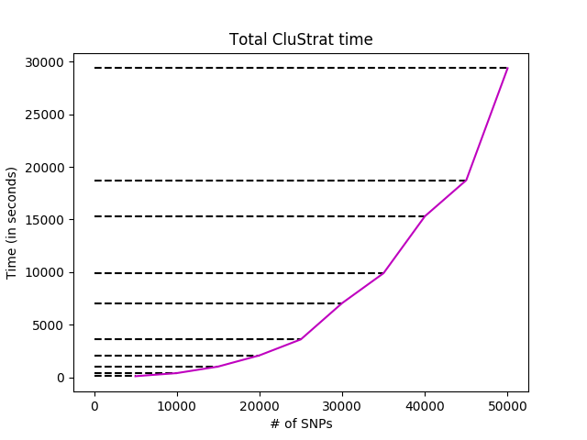
Proportion 2 (10 0 90)

Slide 3
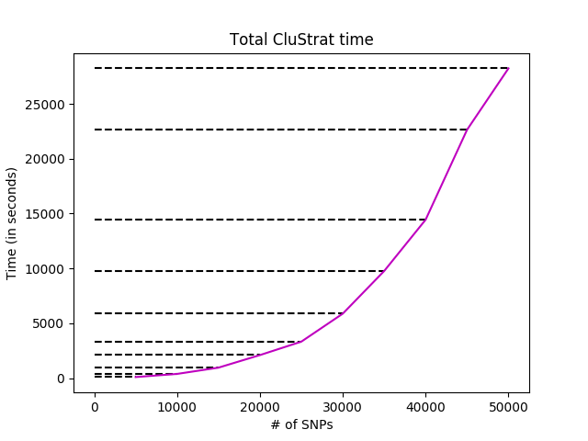
Proportion 3 (10 20 70)

Slide 4
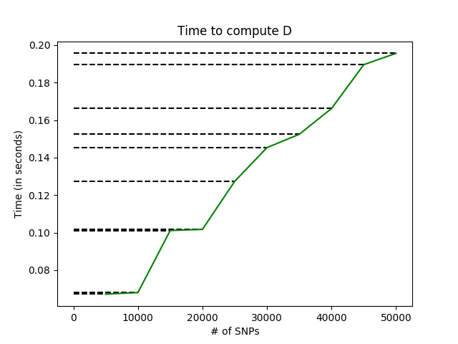
Proportion 1 (5 5 90)

Slide 5
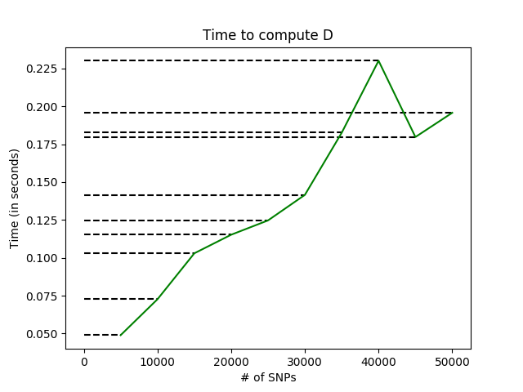
Proportion 2 (10 0 90)

Slide 6
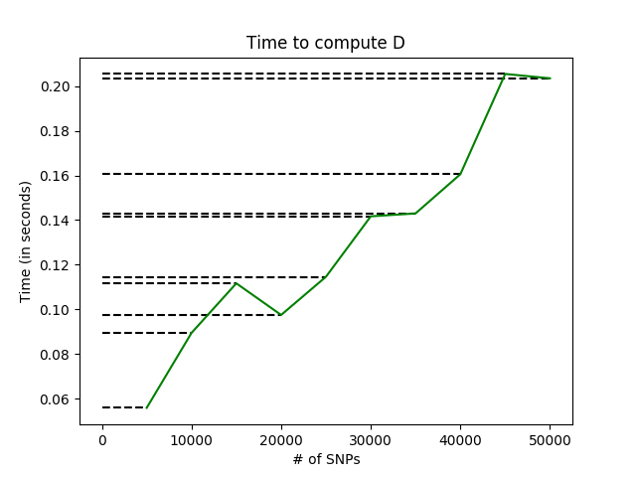
Proportion 3 (10 20 70)

Slide 7
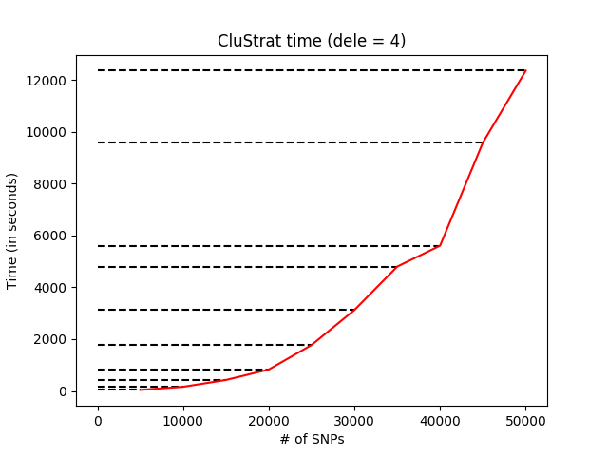
Proportion 1 (5 5 90)

Slide 8

Proportion 2 (10 0 90)

Slide 9
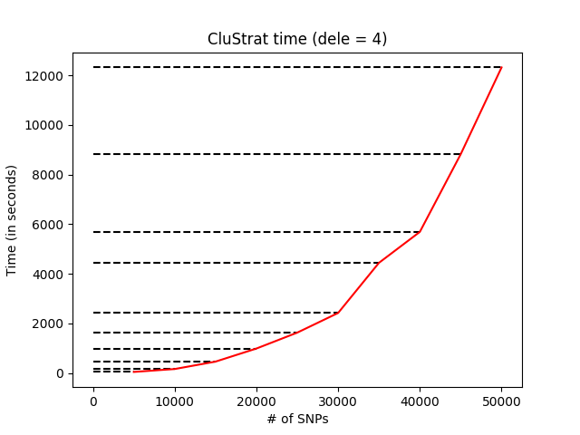
Proportion 3 (10 20 70)

Slide 10
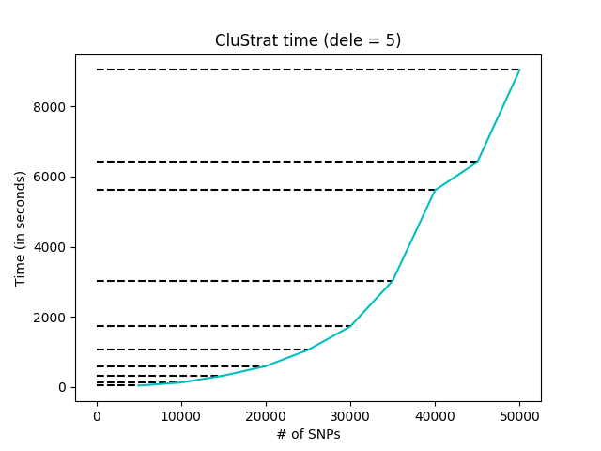
Proportion 1 (5 5 90)

Slide 11
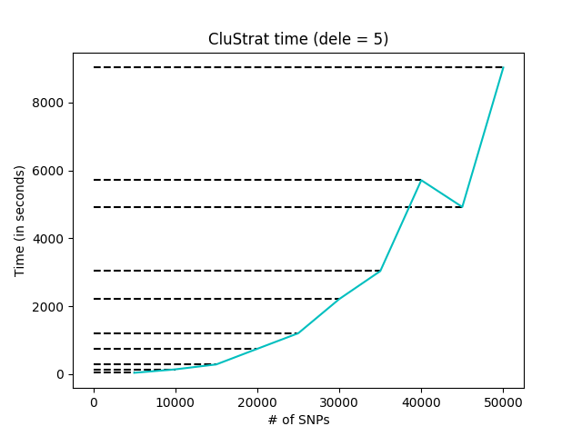
Proportion 2 (10 0 90)

Slide 12
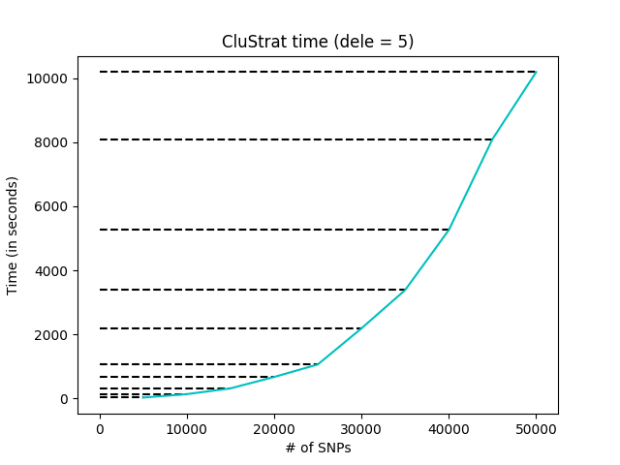
Proportion 3 (10 20 70)

Slide 13
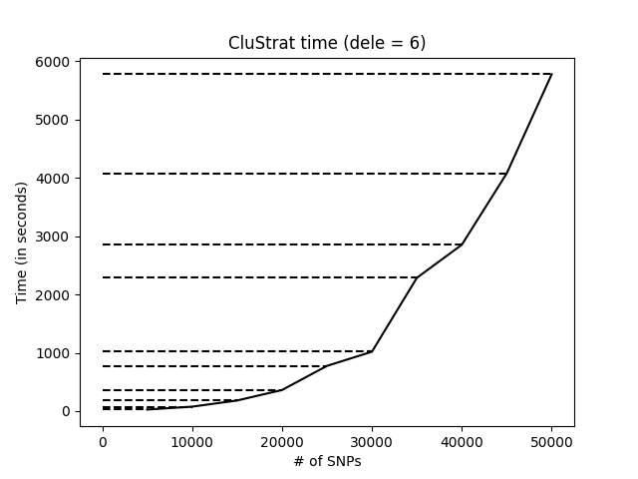
Proportion 1 (5 5 90)

Slide 14
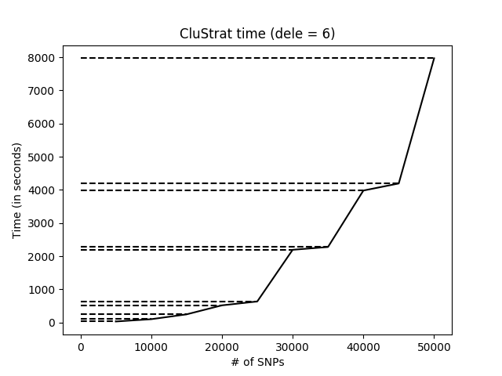
Proportion 2 (10 0 90)

Slide 15
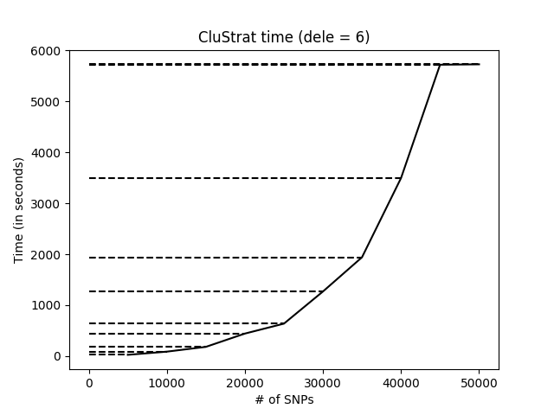
Proportion 3 (10 20 70)

