Slide 1
Secure Authentication Using Blockchain Tech
Nikhil Ahuja
Aritra Chatterjee
10th May 2018

Slide 2
Business Problem
Security is of utmost importance in all our products for keeping customer trust, keeping that in
mind, we have come up with an idea that encompasses usage of blockchain in implementation of
user authentication to 3rd party apps.
In OAuth use cases, the identity provider stores all user related information. The user tells the
IP what information to share with 3rd parties using a confirmation UI. In our case, the IP does not
store the user data, it is secure on the user’s phone. An important aspect is if a hacker
tries to maliciously alter the user hashed data, the blockchain will query other nodes on the
network whether this update is authentic. Hence such attacks are averted.
CA does have IAM solutions in place, but it currently does not have this implementation. The
value add is the user data stored on such products can be more secure and this will let us up our
NPS score of the customer experience.

Slide 3



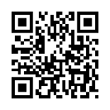




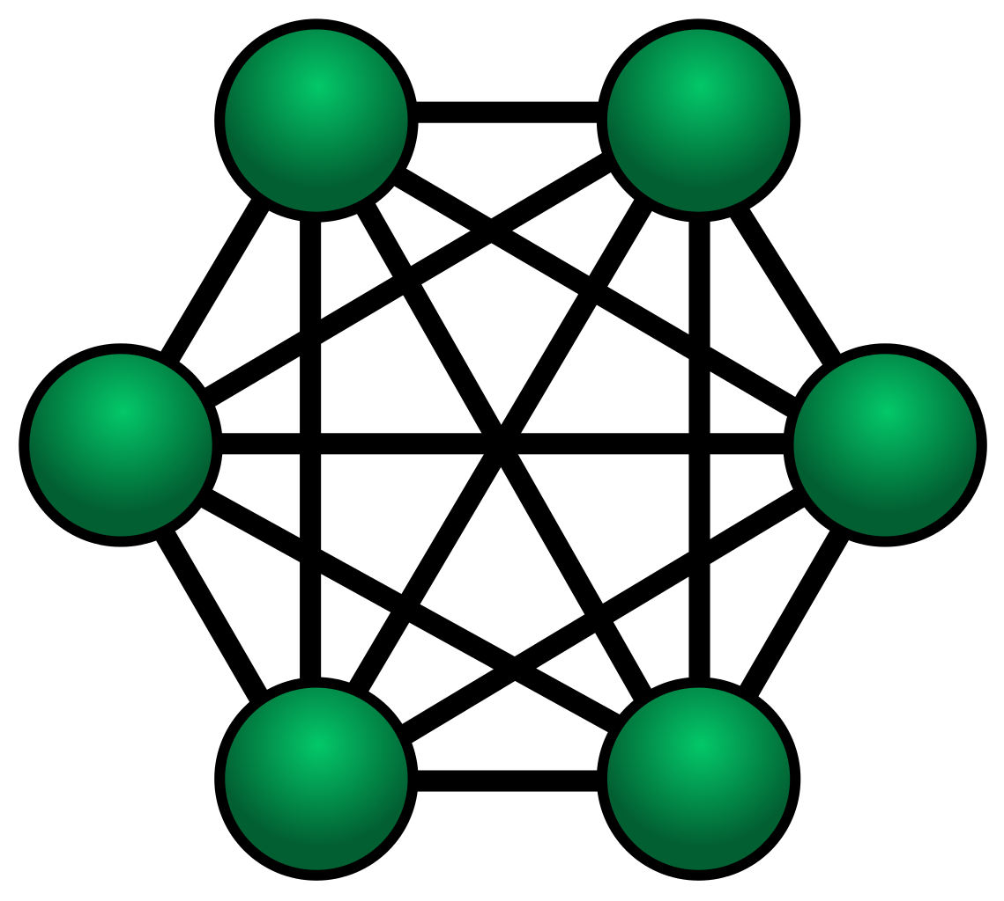


5
User app sends the email and txId to the service endpoint
Endpoint to accept email and txnid
The app on the mobile device
will store user personal data such as
email aadhaar number and so on
QRCode scanned by the app
1
3
Third party application which needs access to User personal information for authorization
Registration: User id and server public key sent back
4
App from QRCode contacts blockchain to find out what info to send back
6
Registration: Email and Public key of user sent to blockchain
3rd Party hashes the user info and sends it to Blockchain server for verification. It verifies the and sends the result.
SHA256 hash generated by 3rd party app
Stored SHA256 hash returned
By Blockchain
Application Layer
Both the hashes should match
To provide user access
Node 1
Node 2
2
Identity Server sends the QRCode to the 3rd party app
Registration: Identity Servers
In P2P mode
In blockchain. The personal user info will not be stored here, only hashed data will be stored
Blockchain
Node 6
Node 3
Blockchain will not allow the replace to happen as the change has to be agreed upon by other blockchain nodes
Intruder who wants to replace users stored SHA
Node 5
Node 4
The 3rd party service provider is registered with the Blockchain with appid
This Photo by Unknown Author is licensed under CC BY-SA

Slide 4
What is done so far?
Creation of the android app which will store the user data (email).
Creation of a sample blockchain implementation which will serve as user registry. Block authenticity verification logic.
Creation of the application layer which also has QRCode implementation which exposes RESTful endpoints for interaction with the android app and 3rd Party apps. It is also responsible for pushing data into the blockchain.
A sample Spring Boot 3rd party app
QR Code generation, decoding and encoding logic in Application Layer and Android App
Implementation of JWT tokens for authentication.
Connecting the Blockchain to the Application Layer

Slide 5
What more needs to be done?
Switching to production ready blockchain implementation such as bitcoin or ethereum or any other lightweight implementation. A blockchain expert to help us achieve this would be helpful
Switching the sample 3rd party service implementation to an actual service which customers will use.
Incorporating the AL + Blockchain into an existing CA SaaS or OnPrem product. An expert on that particular product to help us integrate the same will be of great help
A market survey of existing or new customers who might be interested in such a solution.
Making the integration actionable insights driven with some form of Blockchain analytics monitoring solution.
Integration of product metrics to any Performance Monitoring solution that CA provides.
Making certain parts of the implementation open source for more collaboration on the blockchain.

Slide 6

Questions?

Slide 7
Nikhil Ahuja
Senior Software Engineer
Nikhil.Ahuja@ca.com

