Slide 1




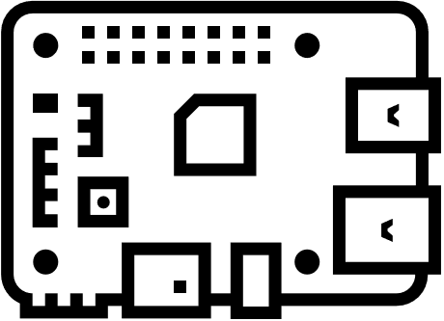



Server
Application level payload
IO second factor
Network
Frames
Input forward
Host
Input
IOHub
Overlay
IO signals

