Slide 1
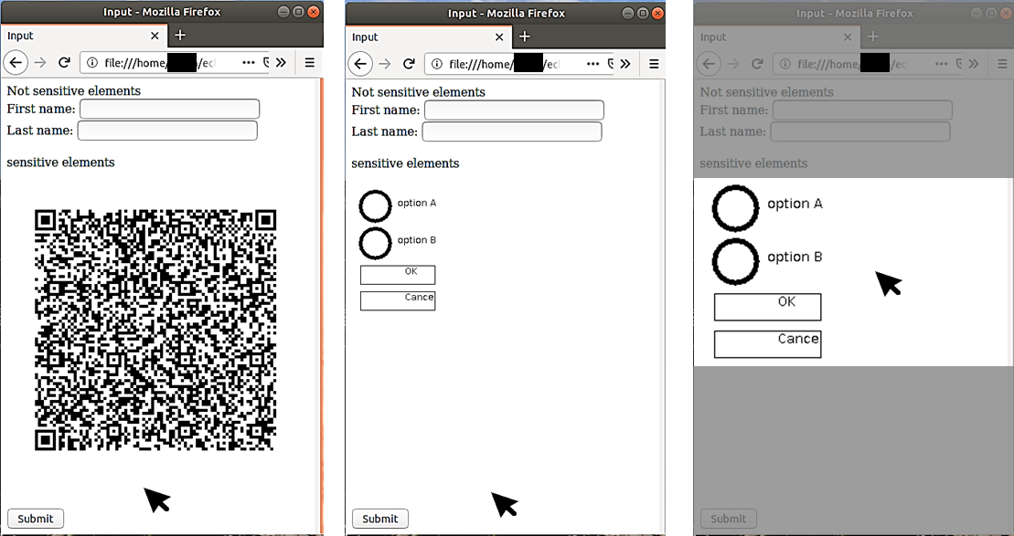
a
b
c
Attacker’s view
User’s view on the monitor
Focusing user’s attention

