Slide 1
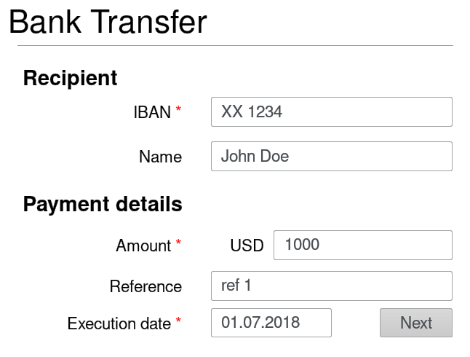







Web form on client’s browser
Client’s HTTTPs payload
POST / HTTP/1.1
Content-Type: form-data
form-name=Bank Transfer &
IBAN=XX 1444 &
Name=John Doe &
Amount=1000 USD
5
Matches data
1
Inputs
data
A
3
Submits data
over HTTPS
B
B
A
User
Remote server +
INTEGRISCREEN
component
INTEGRISCREEN TLS payload
2
form-name
{ value=Bank Transfer }
Input:
[{ key = IBAN
value = XX 1234
} , (…) ]
Supervises & OCR-s
client’s screen
A
B
Sends data over TLS
Smartphone
application
4

