Slide 1

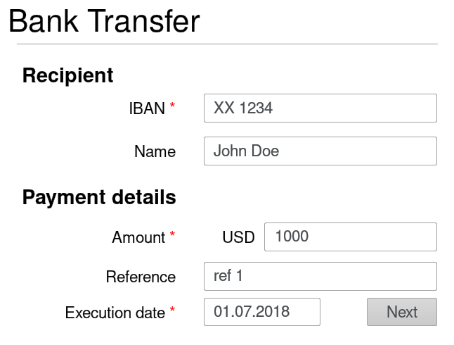






1
Inputs
data
Remote server
+
INTEGRISCREEN
component
User
Web form on client’s browser
Client’s HTTTPs payload
POST / HTTP/1.1
Content-Type: form-data
form-name=Bank Transfer &
IBAN=XX 1444 &
Name=John Doe &
Amount=1000 USD
5
Matches data
A
3
A
Submits data
over HTTPS
B
B
INTEGRISCREEN TLS payload
2
form-name
{ value=Bank Transfer }
Input:
[{ key = IBAN
value = XX 1234
} , (…) ]
Supervises & OCR-s
client’s screen
A
Phone app
B
Sends data over TLS
4

