Slide 1
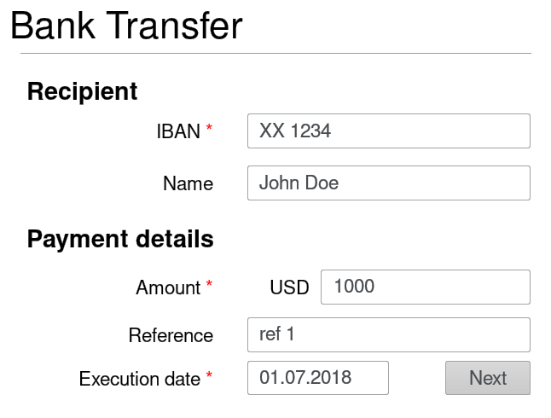
“form_id": "Bank Transfer",
“UI": [{"id": "IBAN_label", "type": "label",
“X": 10,“Y": 25, “W": 30, “H": 8},
{"id": "IBAN_value", "type": "input",
“X": 42, “Y": 25, “W": 50, “H": 8}, (...) ]
1
Form id
2
IBAN label
IBAN text box
3
Corresponding UI Specification

