Slide 1

PIE: A Platform-wide TEE
Moritz Schneider*, Aritra Dhar*, Ivan Puddu, Kari Kostiainen, Srdjan Capkun
ETH Zurich
*equally contributing authors

Slide 2




Traditional CPU-centric Model
Memory
USB
PCI
TB
SATA
Security Monitor (SM)
Processor

Slide 3
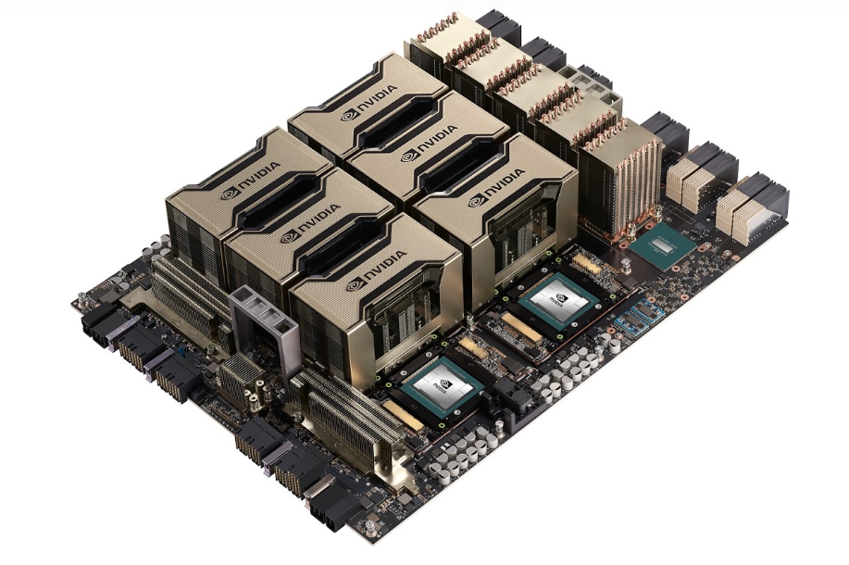
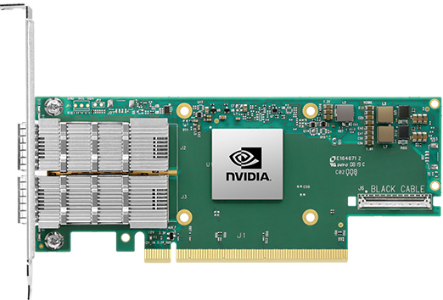
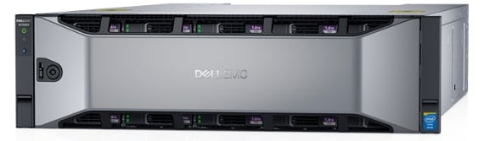
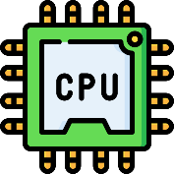

Motivation: Disaggregated computing
Central executioner $→$ coordinator
Images are from nVidia, Dell, Mellanox official websites

Slide 4










Challenges
Secure communication
Remote attestation
Runtime attacks

Slide 5
Challenges
Secure communication
Remote attestation
Runtime attacks

Slide 6
Challenges
Secure communication
Remote attestation
Runtime attacks

Slide 7
Challenges
Secure communication
Remote attestation
Runtime attacks

Slide 8
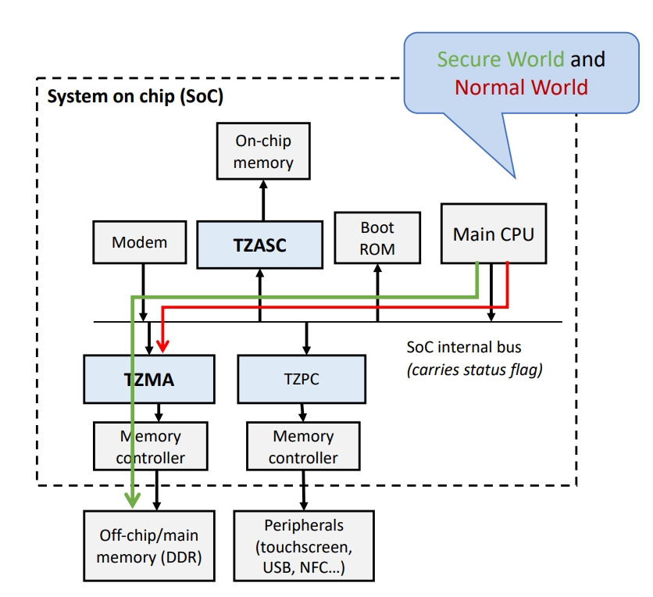
Can Existing TEEs Solve this Problem?
Can Existing TEEs Solve this Problem?
Secure world & non-secure world
App
App
Enclave
App
App
Enclave
U-mode
OS
Peripheral
OS
RT
S-mode
CPU
Peripheral
S-ROT
Security Monitor
M-mode
ARM TrustZone
Intel SGX
RISC-V KeyStone

Slide 9
What About TEE-based Solutions?
SGX IO
Needs trusted hypervisor
Static HW TCB
Sanctuary
User-space enclaves in ARM TZ
Peripherals are not protected + static HW TCB
CURE
Static HW TCB in RISC-V
Expensive disk-based context switch
Graviton
Not generalizable to non-GPU
Assumes static devices

Slide 10
Challenges revisited
Secure communication
Remote attestation
Runtime attacks

Slide 11

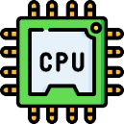

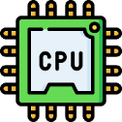




Challenges revisited
TCB
Secure communication
Remote attestation
Runtime attacks
Least privilege

Slide 12
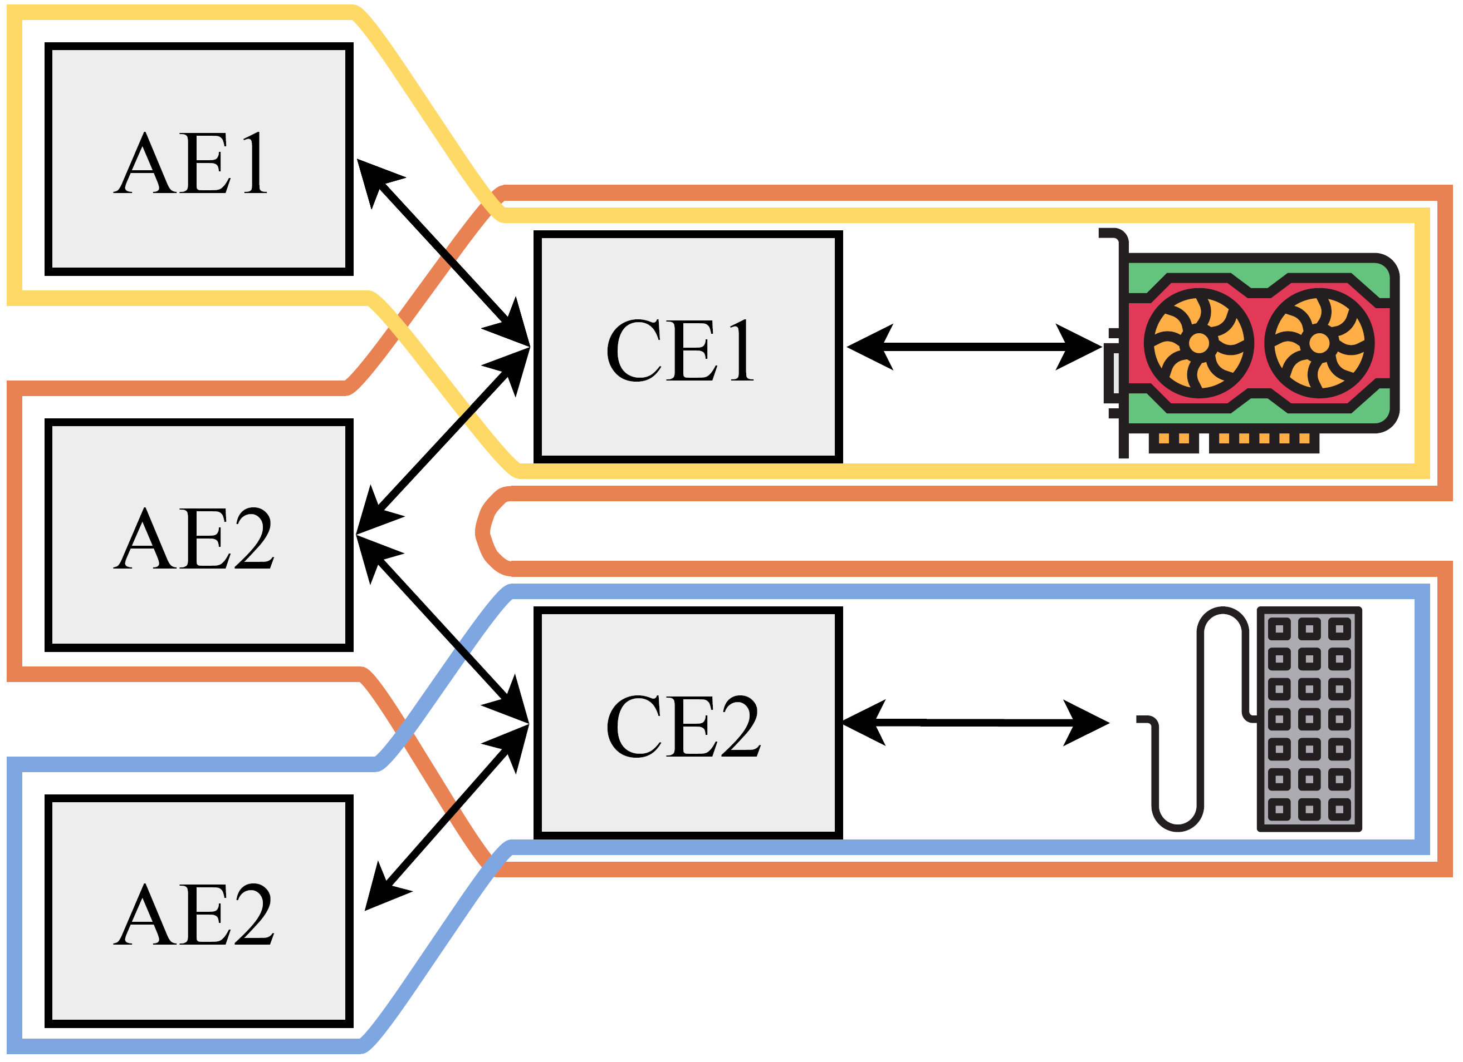



PIE
Platform-wide enclave
Three types of enclave
Application enclave
Controller enclave
Multi app isolation
Policy enforcement
Firmware enclave
Multi-tenancy
Communication over shared memory
Enclave: EPC + shared buffer
Firmware enclave
Controller enclave
Application enclave
0x00
0x0FF

Slide 13
Secure Communication
App
App
Enclave
SM
RT+E
OS
Shared
OS
RT
Pmp0
000
SM
Pmp1
000
Pmp2
111
Pmp2
111

Slide 14
Secure Communication
RISC-V PMP
App
App
Enclave
SM
RT+E
OS
Shared
OS
RT
Pmp0
000
SM
Pmp1
000
Pmp2
111
Pmp2
111

Slide 15
Secure Communication
RISC-V PMP
App
App
Enclave
SM
RT+E
OS
Shared
OS
RT
Pmp0
000
SM
Pmp1
111
Pmp2
000
Pmp2
111

Slide 16
Secure Communication
RISC-V PMP
App
App
Enclave
SM
RT+E
OS
Shared
OS
RT
Pmp0
000
SM
Pmp1
111
Pmp2
000
Pmp2
111

Slide 17
Secure Communication
RISC-V PMP
App
App
Enclave
SM
RT+E
OS
Shared
OS
RT
Pmp0
000
SM
Pmp1
111
Pmp2
000
Pmp2
111

Slide 18
Secure Communication
RISC-V PMP
Use PMP entries for shared buffers
App
App
Enclave
SM
RT+E
OS
Shared
OS
RT
Pmp0
000
SM
Pmp1
000
Pmp2
111
Pmp2
111

Slide 19

Platform-awareness
Additional enclaves states
Based on moving ownership
Connect $E_{2}$: $M_{\left\{E_{1}\right\}}→M_{\{E_{1}, E_{2}\}}$
Device tree by the zero-stage bootloader
Disconnect $E_{2}$: $M_{\left\{E_{1}, E_{2}\right\}}→M_{\{E_{1}\}}$
Two types of disconnect
Synchronous
Asynchronous
Zeros out all the internal states

Slide 20




Platform-wide Attestation
Firmware
Controller enclave
Application enclave
Remote verifier
Attach
Deploy
Establish shared memory
Challenge
Firmware report
Connect
Establish shared memory
Includes connection parameters
AE report +
CE list
Remote attestation
CE + firmware report
Secret
provision
Shared memory comm
Shared memory comm

Slide 21
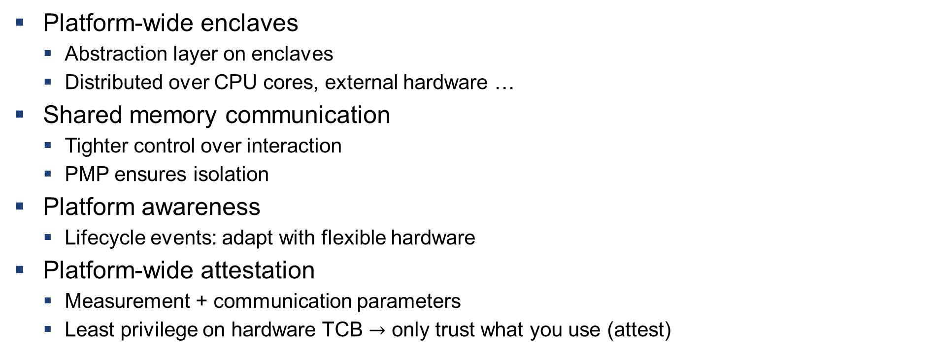
Summary of the properties
Platform-wide enclaves
Abstraction layer on enclaves
Distributed over CPU cores, external hardware …
Shared memory communication
Tighter control over interaction
PMP ensures isolation
Platform awareness
Lifecycle events: adapt with flexible hardware
Platform-wide attestation
Measurement + communication parameters
Least privilege on hardware TCB $→$ only trust what you use (attest)

Slide 22
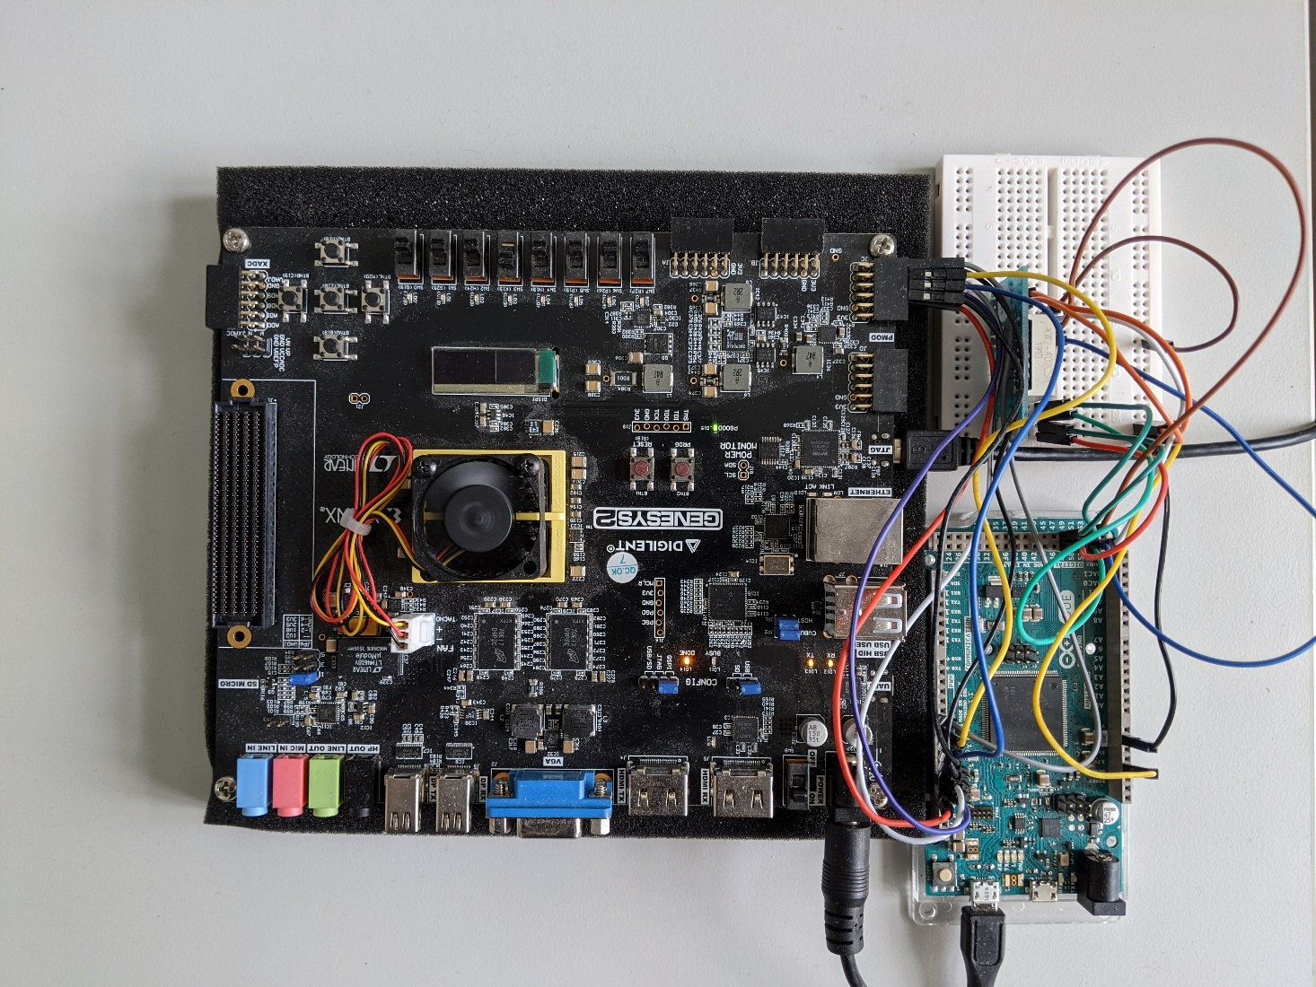
Prototype: simple IO peripherals
Peripheral emulation
FPGA running application class RISC-V core with PMP
PMOD peripheral

Slide 23
Prototype: Accelerator
Multi-tenant isolation
4096-core RISC-V* accelerator based on Snitch**
Addition of PMP
Small increase in the core size
750 MHz with 0 PMP
666 MHz with 4 PMP
* Florian Zaruba, Fabian Schuiki, and Luca Benini. 2020. A 4096-core RISC-VChiplet Architecture for Ultra-efficient Floating-point Computing. In2020 IEEEHot Chips 32 Symposium (HCS). IEEE Computer Society, 1–24.
** F. Zaruba, F. Schuiki, T. Hoefler, and L. Benini. 2020.Snitch: A tinyPseudo Dual-Issue Processor for Area and Energy Efficient Executionof Floating-Point Intensive Workloads.IEEE Trans. Comput.(2020)

Slide 24
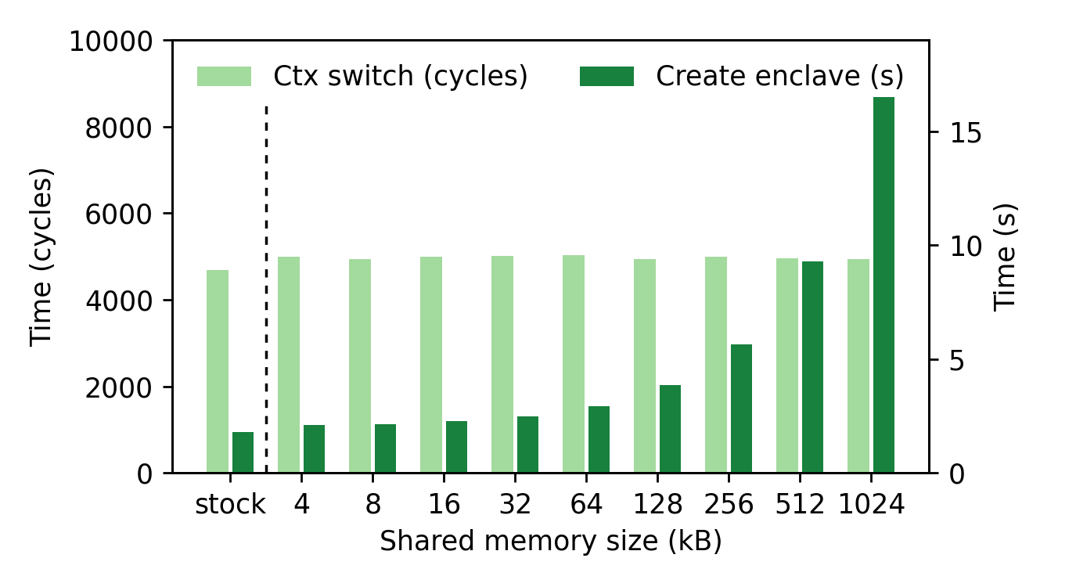
Context switch performance

Slide 25
Thank you!
https://arxiv.org/abs/2010.10416

