Slide 1

PIE: A Platform-wide TEE
Moritz Schneider*, Aritra Dhar*, Ivan Puddu, Kari Kostiainen, Srdjan Capkun
ETH Zurich
*equally contributing authors

Slide 2




Traditional CPU-centric Model
Memory
USB
PCI
TB
SATA
Security Monitor (SM)
Processor

Slide 3
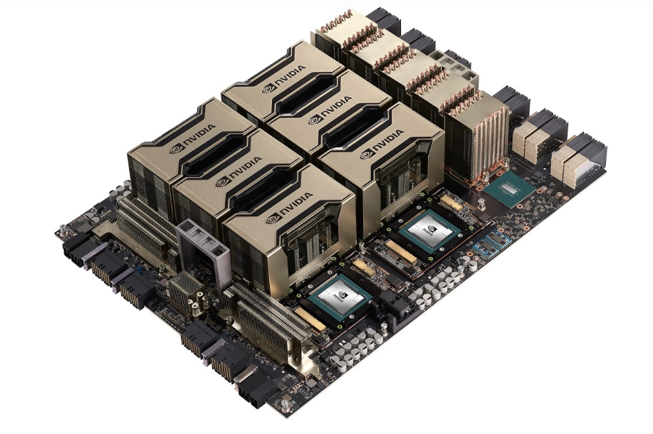
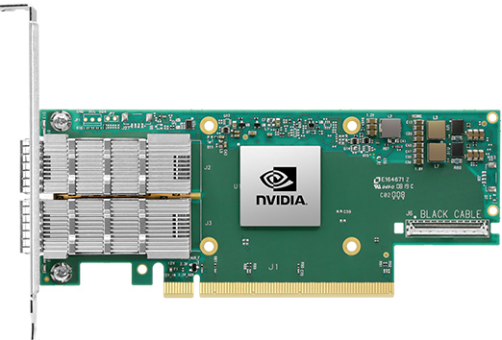
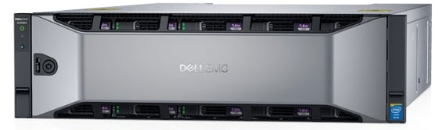
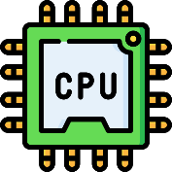

Motivation: Disaggregated computing
Central executioner $→$ coordinator
Images are from nVidia, Dell, Mellanox official websites

Slide 4










Challenges
Secure communication
Remote attestation
Runtime attacks

Slide 5
Challenges
Secure communication
Remote attestation
Runtime attacks

Slide 6
Challenges
Secure communication
Remote attestation
Runtime attacks

Slide 7
Challenges
Secure communication
Remote attestation
Runtime attacks

Slide 8
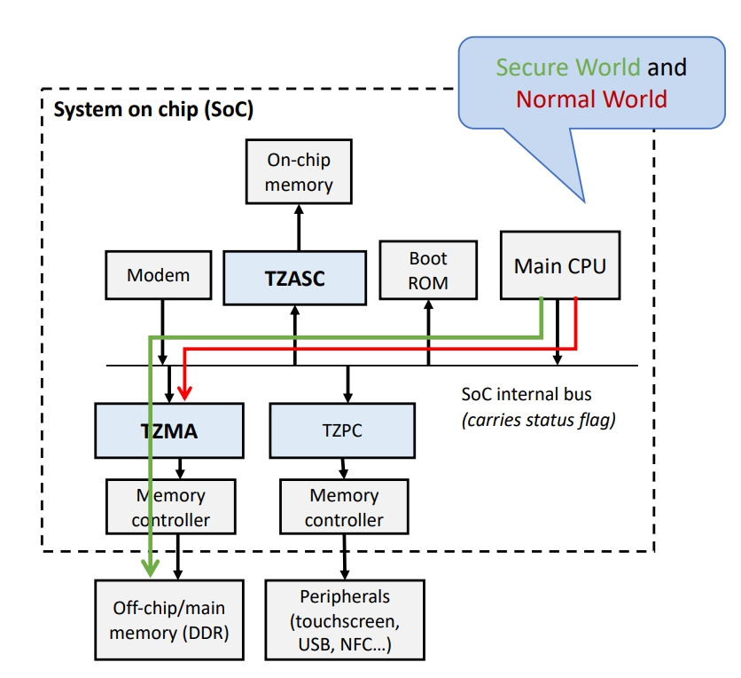
Can Existing TEEs Solve this Problem?
Can Existing TEEs Solve this Problem?
Secure world & non-secure world
App
App
Enclave
App
App
Enclave
U-mode
OS
Peripheral
OS
RT
S-mode
CPU
Peripheral
S-ROT
Security Monitor
M-mode
ARM TrustZone
Intel SGX
RISC-V KeyStone

Slide 9
What About TEE-based Solutions?
SGX IO
Needs trusted hypervisor
Static HW TCB
Sanctuary
User-space enclaves in ARM TZ
Peripherals are not protected + static HW TCB
CURE
Static HW TCB in RISC-V
Expensive disk-based context switch
Graviton
Not generalizable to non-GPU
Assumes static devices

Slide 10
Challenges Revisited
Secure communication
Remote attestation
Runtime attacks

Slide 11

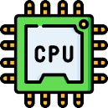

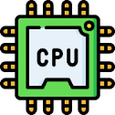




Challenges Revisited
TCB
Secure communication
Remote attestation
Runtime attacks
Least privilege

Slide 12
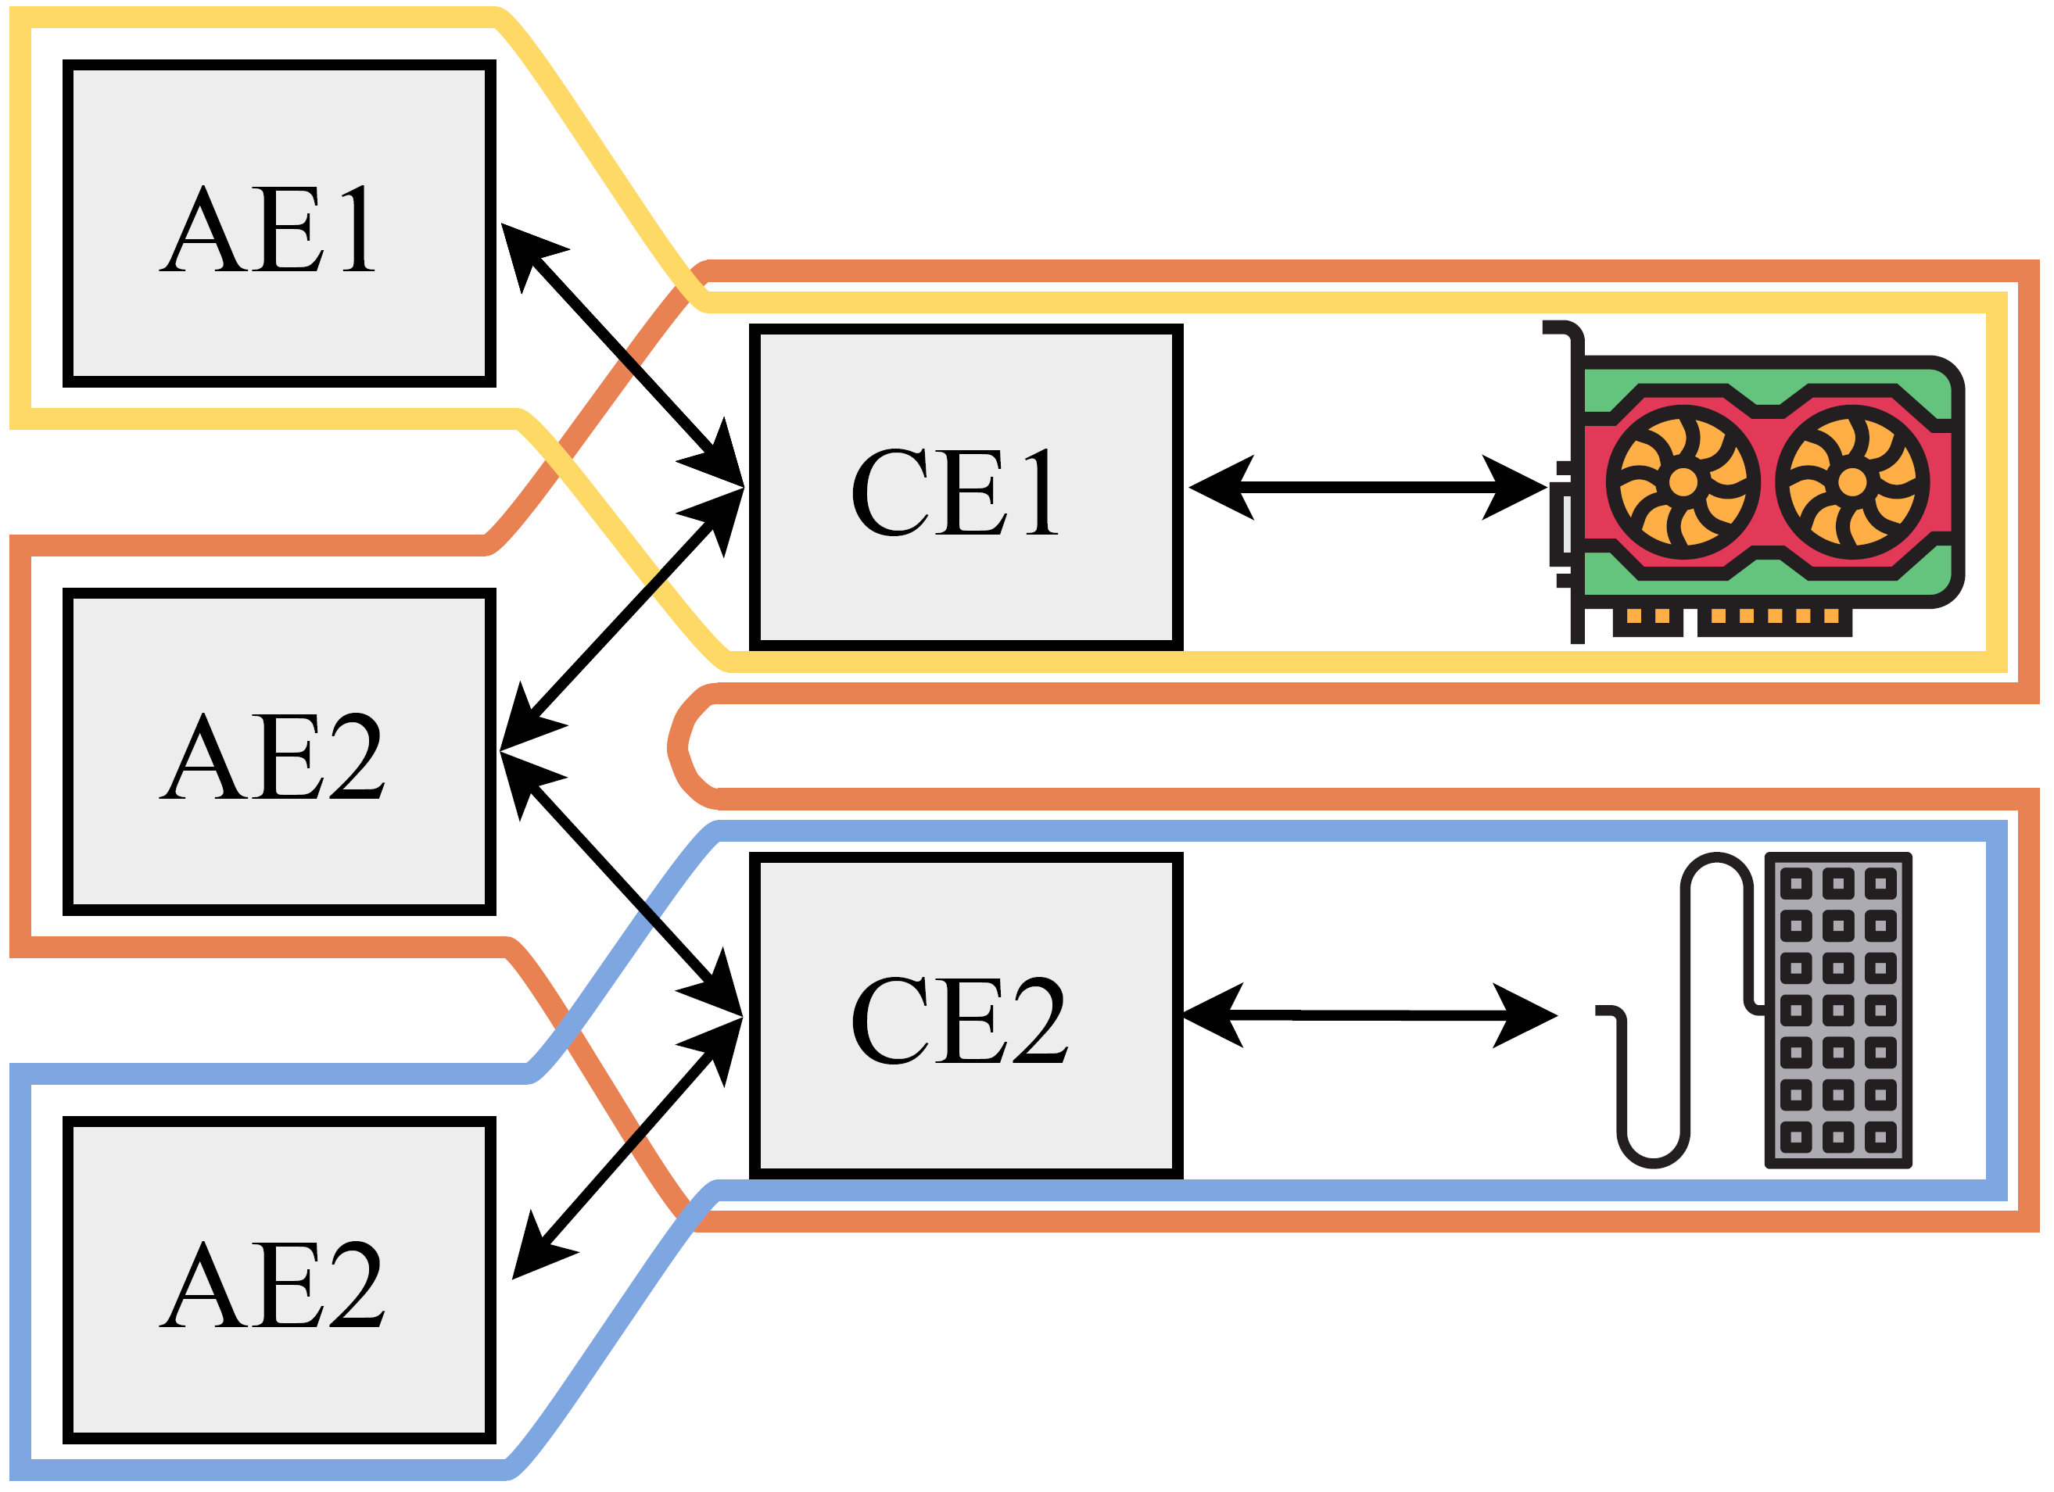



PIE: Platform Isolation Environment
Platform-wide enclave
Three types of enclave
Application enclave
Controller enclave
Multi app isolation
Policy enforcement
Firmware enclave
Multi-tenancy
Communication over shared memory
Enclave: EPC + shared buffer
Firmware enclave
Controller enclave
Application enclave
0x00
0x0FF

Slide 13
Secure Communication
App
App
Enclave
SM
RT+E
OS
Shared
OS
RT
Pmp0
000
SM
Pmp1
000
Pmp2
111
Pmp2
111

Slide 14
Secure Communication
RISC-V PMP
App
App
Enclave
SM
RT+E
OS
Shared
OS
RT
Pmp0
000
SM
Pmp1
000
Pmp2
111
Pmp2
111

Slide 15
Secure Communication
RISC-V PMP
App
App
Enclave
SM
RT+E
OS
Shared
OS
RT
Pmp0
000
SM
Pmp1
111
Pmp2
000
Pmp2
111

Slide 16
Secure Communication
RISC-V PMP
App
App
Enclave
SM
RT+E
OS
Shared
OS
RT
Pmp0
000
SM
Pmp1
111
Pmp2
000
Pmp2
111

Slide 17
Secure Communication
RISC-V PMP
App
App
Enclave
SM
RT+E
OS
Shared
OS
RT
Pmp0
000
SM
Pmp1
111
Pmp2
000
Pmp2
111

Slide 18
Secure Communication
RISC-V PMP
Use PMP entries for shared buffers
App
App
Enclave
SM
RT+E
OS
Shared
OS
RT
Pmp0
000
SM
Pmp1
000
Pmp2
111
Pmp2
111

Slide 19

Platform-awareness
Additional enclaves states
Based on moving ownership
Connect $E_{2}$: $M_{\left\{E_{1}\right\}}→M_{\{E_{1}, E_{2}\}}$
Device tree by the zero-stage bootloader
Disconnect $E_{2}$: $M_{\left\{E_{1}, E_{2}\right\}}→M_{\{E_{1}\}}$
Two types of disconnect
Synchronous
Asynchronous
Zeros out all the internal states

Slide 20




Platform-wide Attestation
Firmware
Controller enclave
Application enclave
Remote verifier
Attach
Deploy
Establish shared memory
Challenge
Firmware report
Connect
Establish shared memory
Includes connection parameters
AE report +
CE list
Remote attestation
CE + firmware report
Secret
provision
Shared memory comm
Shared memory comm

Slide 21
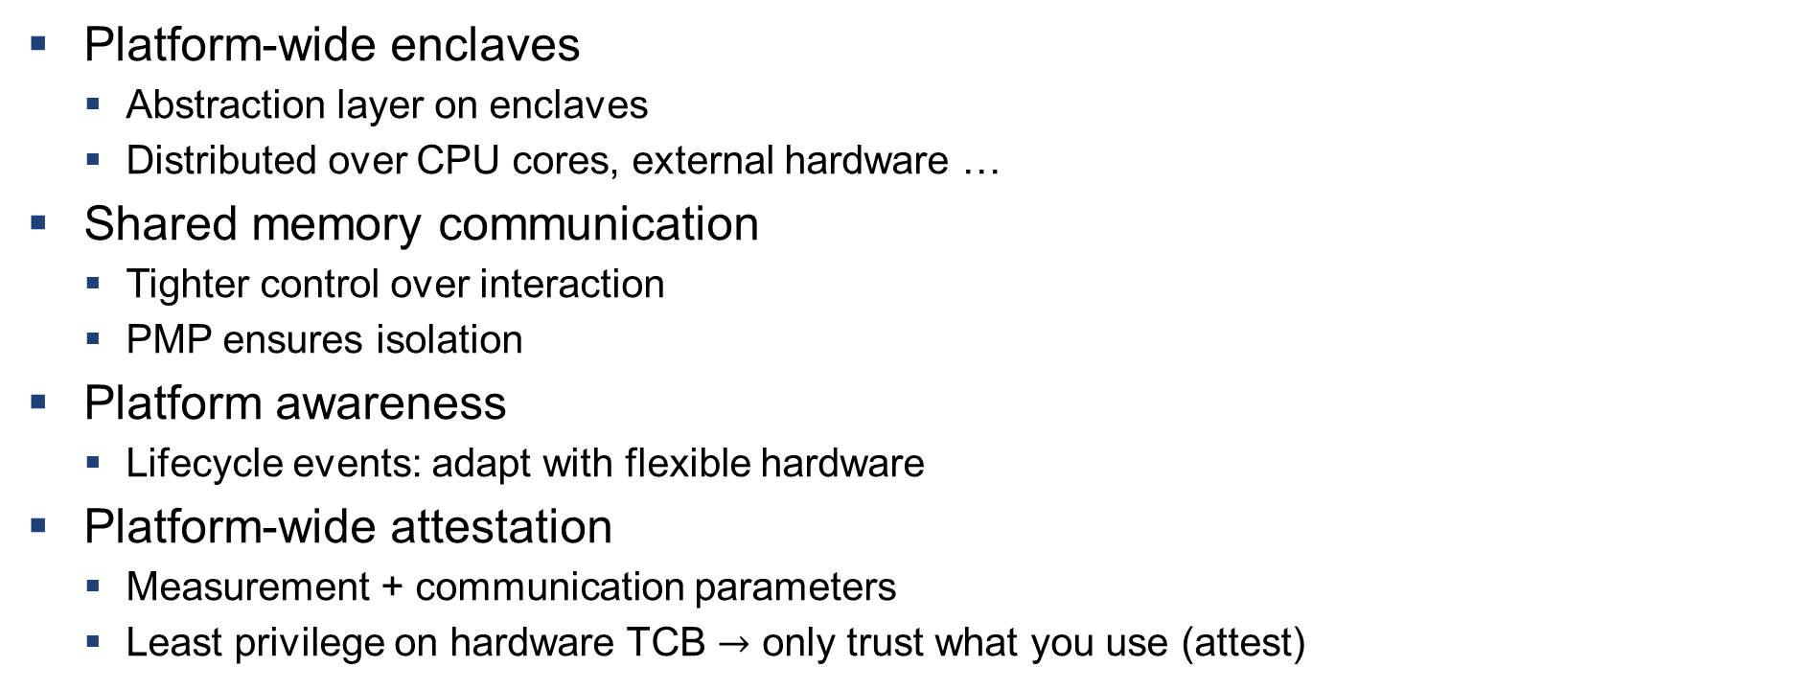
Summary of the properties
Platform-wide enclaves
Abstraction layer on enclaves
Distributed over CPU cores, external hardware …
Shared memory communication
Tighter control over interaction
PMP ensures isolation
Platform awareness
Lifecycle events: adapt with flexible hardware
Platform-wide attestation
Measurement + communication parameters
Least privilege on hardware TCB $→$ only trust what you use (attest)

Slide 22
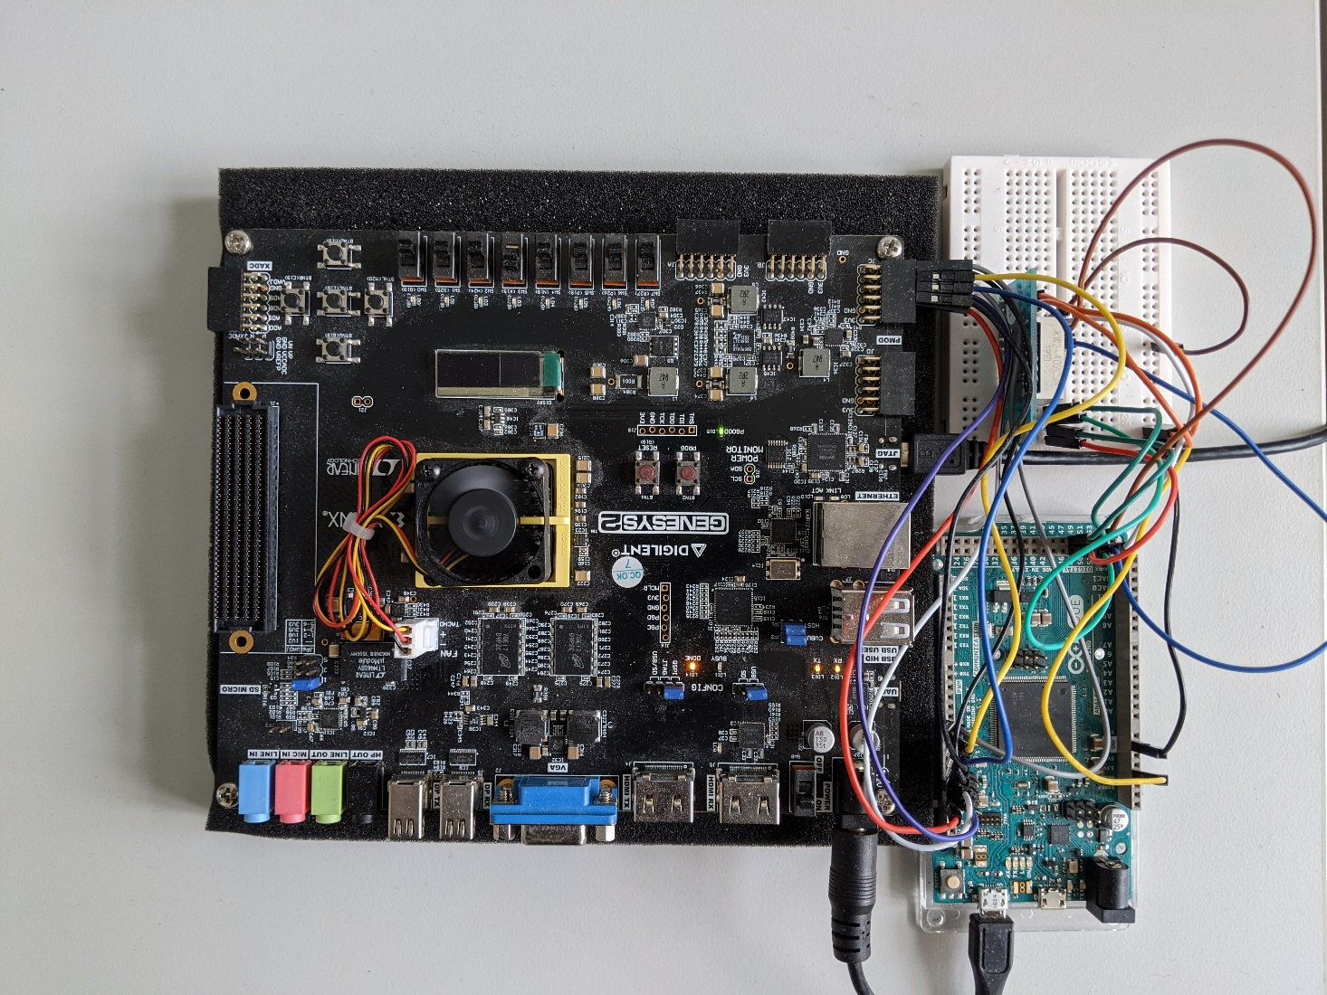
Prototype: simple IO peripherals
Peripheral emulation
FPGA running application class RISC-V core with PMP
PMOD peripheral

Slide 23
Prototype: Accelerator
Multi-tenant isolation
4096-core RISC-V* accelerator based on Snitch**
Addition of PMP
Small increase in the core size
750 MHz with 0 PMP
666 MHz with 4 PMP
* Florian Zaruba, Fabian Schuiki, and Luca Benini. 2020. A 4096-core RISC-VChiplet Architecture for Ultra-efficient Floating-point Computing. In2020 IEEEHot Chips 32 Symposium (HCS). IEEE Computer Society, 1–24.
** F. Zaruba, F. Schuiki, T. Hoefler, and L. Benini. 2020.Snitch: A tinyPseudo Dual-Issue Processor for Area and Energy Efficient Executionof Floating-Point Intensive Workloads.IEEE Trans. Comput.(2020)

Slide 24
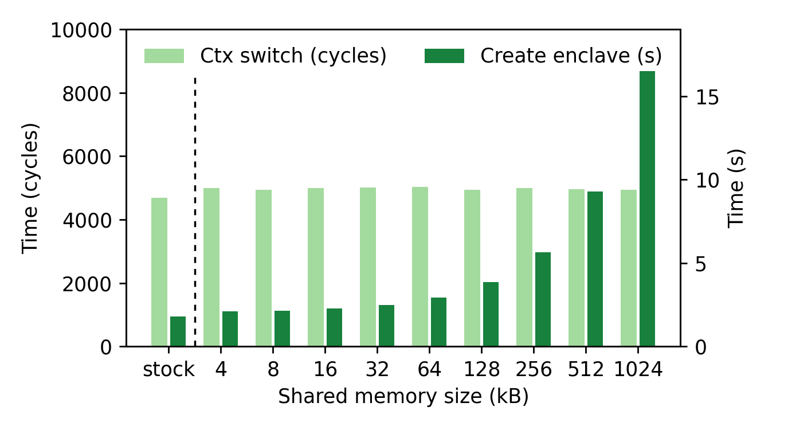
Context switch + create enclave performance

Slide 25
Thank you!
https://arxiv.org/abs/2010.10416

