Slide 1
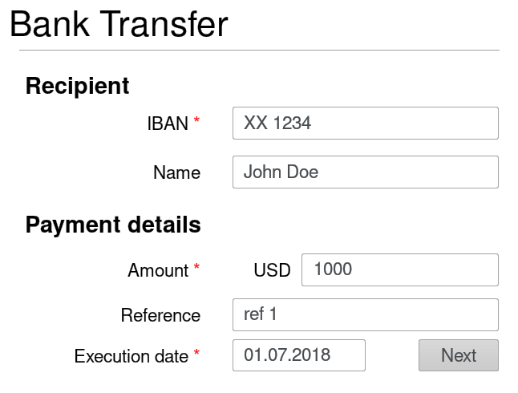
Web form in client’s browser
1
2
Client’s HTTPS payload
INTEGRISCREEN TLS payload
POST / HTTP/1.1
Content-Type: form-data
form-name=Bank Transfer &
IBAN=XX 1234 &
Name=John Doe &
(…)
Execution date=01.07.2018
form-name
{
value=Bank Transfer
}
Input:
[{
key = IBAN
value = XX 1234
}
, (…) ]
1
1
2
2

