Slide 1







8
Matches data
Opens site
2
Loads site
1
3
Input
5
Submits data
User
Host system
Web server
4
Captures laptop screen
7
Sends data
6
OCR
Smartphone

Slide 2
1
Heading
2
Text label 1
Text field 1
Text label 2
Text field 2
Text label n
Text field n
3
4
Submit
5

Slide 3
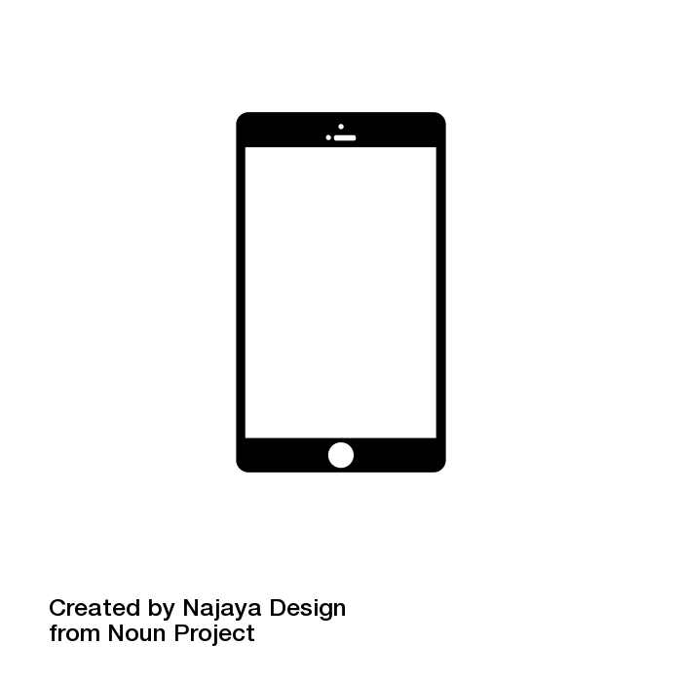
1
Heading
2
Text label 1
Data 1
5
Text label 2
Data 2
Text label n
Data n
3
4
Submit
6

Slide 4
Application level payload
IntegriScreen trace
POST / HTTP/1.1
Content-Type: form-data
form_name=form_1 &
key_1=value_1 &
key_2=value_2 &
…
key_n=value_n
form_name
{
value=form_1
}
Input
{
key_name = key_1
value_name=value_1
}

Slide 5
Form_1
key_1
value_1
key_2
value_2
key_n
value_n
Submit
Application level payload
IntegriScreen trace
POST / HTTP/1.1
Content-Type: form-data
form_name=form_1 &
key_1=value_1 &
key_2=value_2 &
…
key_n=value_n
form_name
{
value=form_1
}
Input
{
key_name = key_1
value_name=value_1
}

Slide 6
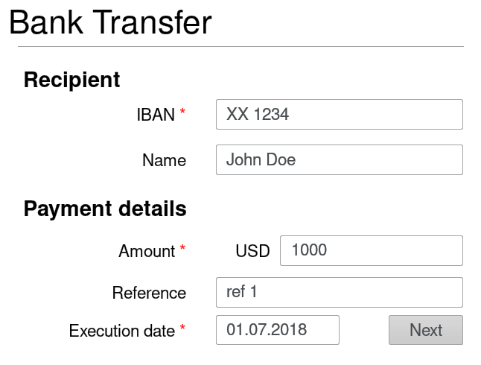
1
2
Browser
Client’s HTTPS payload
INTEGRISCREEN TLS payload
POST / HTTP/1.1
Content-Type: form-data
form-name=Bank Transfer &
IBAN=XX 1234 &
Name=John Doe &
…
Execution date=01.07.2018
form-name
{
value=Bank Transfer
}
Input:
[{
key = IBAN
value = XX 1234
}
, (…) ]
1
1
2
2

Slide 7
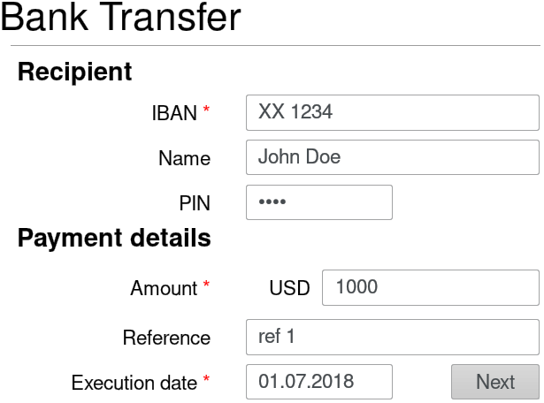
Browser
1
Input manipulation
2
UI manipulation
POST / HTTP/1.1
Content-Type: form-data
form-name=Bank Transfer &
IBAN=XX 9999 &
Account Name=John Doe &
…
Execution date=01.07.2018
Browser HTTPS payload
Modified webpage
Notes:
Running example with manipulation

