Slide 1
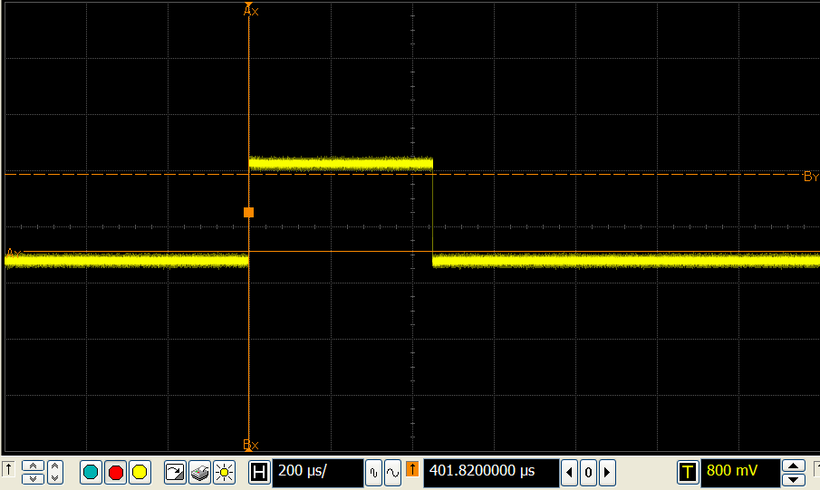
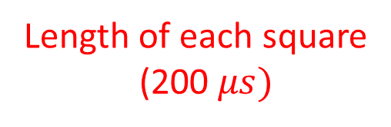
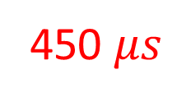
450 $μs$
Sending a challenge
[low-high]
Receiving a response
[high-low]
Trigger voltage to record a event
Length of each square
(200 $μs)$

