Slide 1
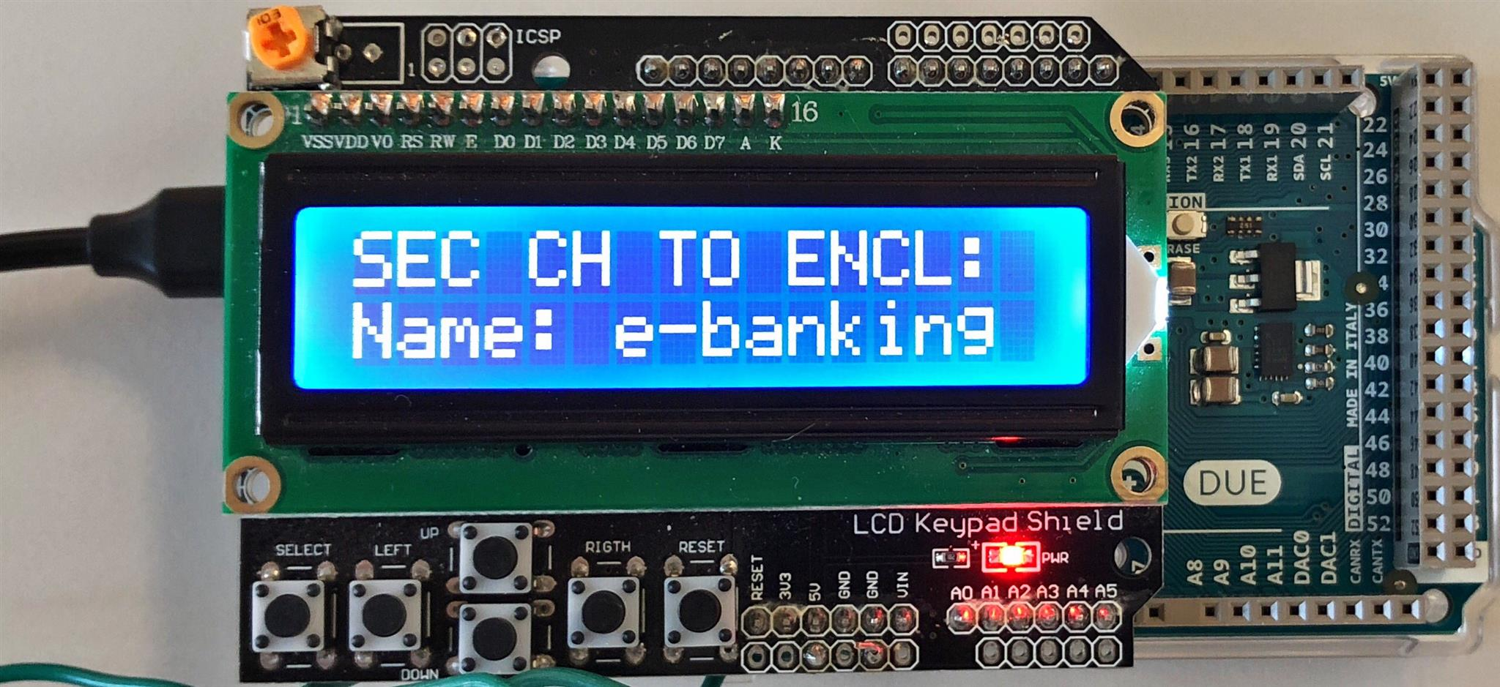
Arduino LCD-keypad shield for debugging
Arduino Due for prototyping
To target platform
Proximity verification
Application Enclave identity

Slide 2
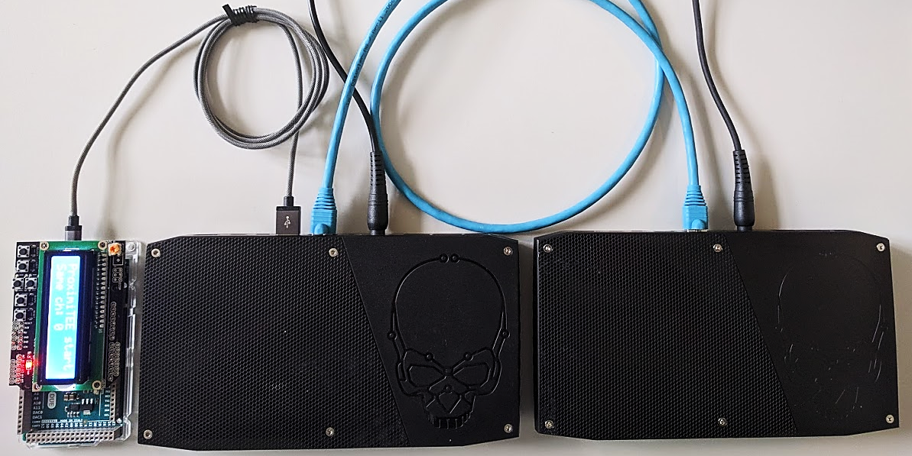
ProximiKey
USB 3.0 interface
1m Ethernet cable
Target platform
Attacker’s platform

